Slide 1
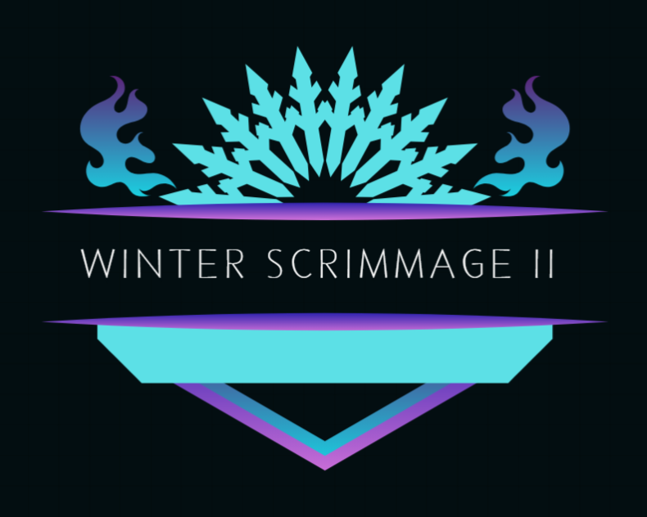
Presented by:
Edna Lynn

Slide 2

Python
Why?
The selection was established mainly on influence from friends and patients that are software engineers. I did do research myself and I was intrigued with my findings especially simplified syntax and ongoing growth usage for web and software development.
What did I build with it?
I produced a renovated version from my personal project from Computer Programming I. An extra credit opportunity submission.

Slide 3
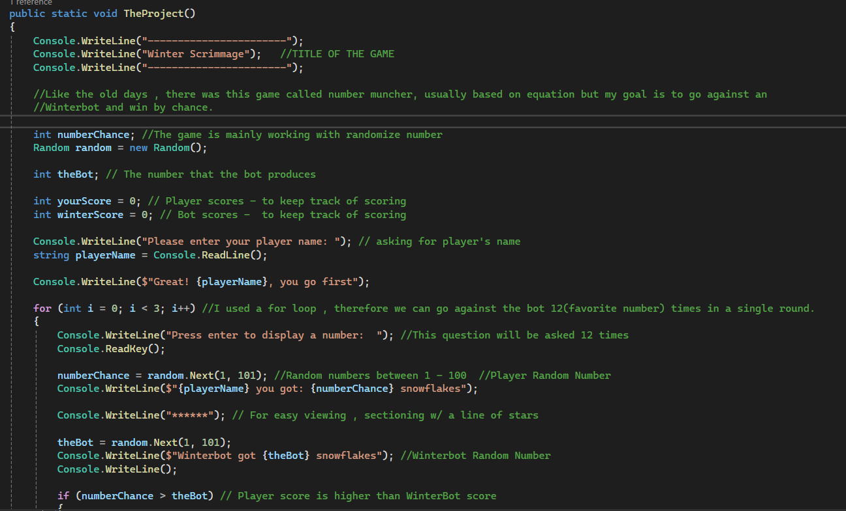
Demo :
CUE VIDEO *

Slide 4
The Project:
❄️WINTER SCRIMMAGE II ❄️
Game of chance – No skills required. ❄️
Player vs Bot ❄️
❄️The game function predominately runs on randomized integers.
Player & Bot roll snowflakes and a random number is generated.
❄️The chosen random number will then be displayed by square like figures. I score system is then tracked for the x number of times a player wins per round, same goes for the robot.
❄️For the sake of presentation, The player and bot will go against each other in 5 rounds, but this can be easily modified to any desire amount.

Slide 5
❄️Producing this game, I ran into little fussy details. I'm not sure if its because of the IDE i am using but it's very particular when it comes to spacing, aligning, and lower-case usage. If my alignment was off, the display of my code dipict itself in this odd placement. It took me awhile to figure why the arrangement was being placed the way it is and it was the simplest fix but also, i mainly played around parts of my coding that had the word print.
❄️Another difficulty I ran into was score upkeep for both player and bot. In C#, ++ is used as a behavior of increase by 1 but in Python its " +=1 " (thank you stackoverflow), although my syntax was correct, there was a code I added into the program that restarted the score count. Which was input() . This was added after my "if" conditional statement in highlights of the score. I thought placing the input() would register what was being spawned but it generally restarted the count. After playing with the code endless of times, I realized that the score is working but it's restarting, and by chance I removed the input() and my score was finally accumulating. My problem solving take on this was to only observe the section dedicated to the score since this was where the bad execution falls into.
❄️The last troublesome I ran into was the build of the square. I learned that python has an object called unicode. Basically, these can be characters that can be printed. I coded print unicode of angles and lines to construct the square. I also was able to find a snowflake which was so fitting for this final. After, playing with the square for over 2 hours, i couldn't figure out reasoning as to why the addition of the snowflake in the middle, the line couldnt line itself correctly. I tried multiple times to perfect this. However, I shaped a depiction that's not too perfect but it works.

Slide 6
Give honest opinions about the languages and things you learn.
I learn that when you learn one programming language it can be a little easier to grasp an understanding for other languages. I played this code game dedicated to Swift on my ipad and I see a lot of similarities. With Python, it's the same story. There's are different syntax that each language posesses but for the most part the function plays are in the same vicinity. It's entertaining to learn a new language because it expands the knowledge you know and exposes you to new information.

Slide 7
It's entertaining to learn a new language because it expands the knowledge you know and exposes you to new information.
“
”

Slide 8
Present:

Slide 9
THANK YOU

