Slide 1
Forecasting Bike Rental Demand
Hourly demand prediction with tree-based machine learning (XGBoost)
PROJECT
UE24CS352A Machine Learning Mini-Project
Final Review & Demonstration
Problem No. 87
TEAM
M B Divyadharshini (PES2UG24CS252)
Naija Arun Hodigere (PES2UG24CS296)

Slide 2

1. Problem Statement
What are we trying to solve?
Goal
Why tree models?
Predict the number of bikes rented in a given hour for the Capital Bikeshare system in Washington D.C.
Inputs: date, hour, calendar information and weather. Output: hourly rental count.
Why it matters: too few bikes lose customers, too many raise storage and relocation costs.
Demand depends non-linearly on hour, temperature and calendar effects.
Research question
Which features drive demand, and how much better are ensembles than a linear baseline?
2 / 9

Slide 3
2. Dataset
Kaggle Bike Sharing Demand (Capital Bikeshare, Washington D.C.)
10,886 training rows
6,493 test rows (no labels)
17 engineered features
1.24 target skewness
Preprocessing
What the EDA showed
Parse dates; drop invalid timestamps and duplicates
Build hour, weekday, rush-hour and weekend flags
Temperature bucket; casual and registered excluded (they sum to count)
Train on log(1 + count)
Peaks at about 8 am and 5-6 pm (commuting)
Hour matters far more than weekday
Season 3 highest, season 1 lowest
Warmer weather raises rentals, humidity lowers them
3 / 9

Slide 4
3. Approach
From raw records to a deployed forecast
01 Data
02 Features
03 Split
train.csv, 2011-2012
17 calendar and weather features
Chronological 80 / 20
04 Models
05 Select
06 Deploy
Ridge, RF, GB, XGBoost, LightGBM
Tune, keep best on validation
Saved model + Streamlit app
Why chronological validation?
Demand is time-dependent, so a random split would leak the future. We train on the first 8,708 rows and validate on the last 2,178.
4 / 9

Slide 5
4. Model & Implementation
Code structure and training setup
Final model
Training
Code structure
Features (16 after dropping day)
XGBoost regressor
500 trees, depth 6
Learning rate 0.05
Subsample 0.85
Seed 42
Predicts log(1 + count)
Metric: RMSLE (plus RMSE, R2)
Tuning: randomized search, 3 time-ordered folds
Final fit on all labelled data
scikit-learn 1.6.1, XGBoost 3.4.1
preprocessing/ loader + features
modeling/ split, metrics, predict
notebooks/ Colab training
scripts/ EDA, quick retrain
app/ Streamlit demo
5 / 9

Slide 6
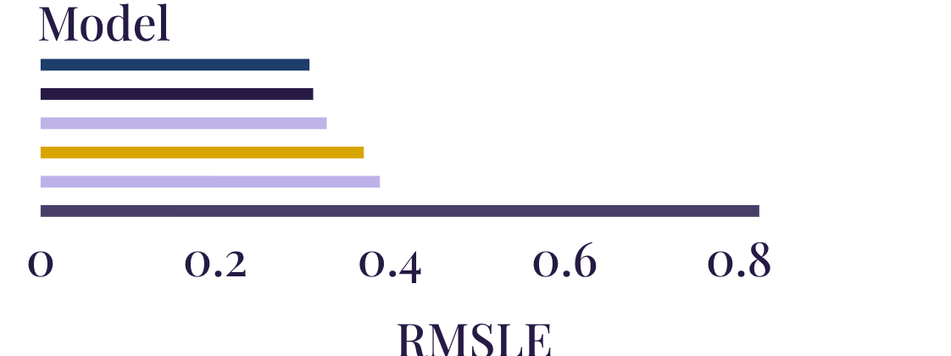
5. Results: Model Comparison
Chronological validation set (lower RMSLE is better)
Model | RMSLE | RMSE | R2
XGBoost (final) | 0.3079 | 60.51 | 0.9227
LightGBM | 0.3121 | 61.62 | 0.9198
XGBoost (tuned) | 0.3276 | 71.29 | 0.8927
Random Forest | 0.3701 | 80.46 | 0.8633
Gradient Boosting | 0.3885 | 95.11 | 0.8090
Ridge (baseline) | 0.8230 | 177.20 | 0.3369
Observation Tree-based models beat the linear baseline by a wide margin. Tuning did not help: the tuned XGBoost scored worse, so the untuned model was kept.
6 / 9

Slide 7
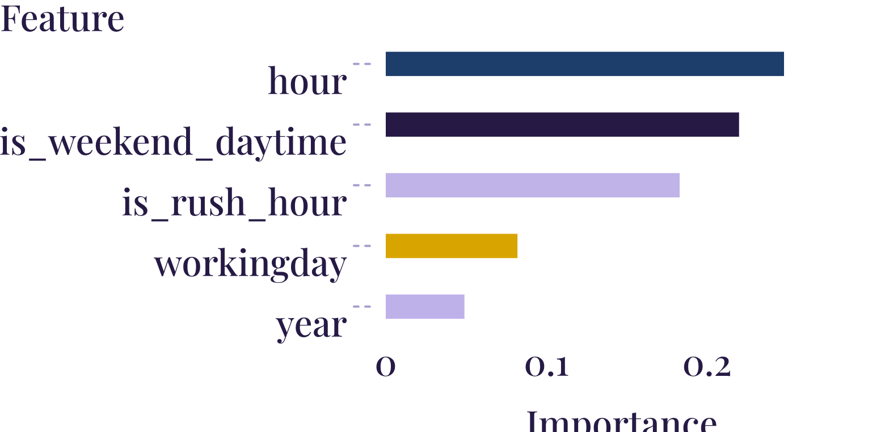
6. What Drives Demand
Feature importance and error analysis
Top 5 features (final XGBoost)
Interpretation
The engineered rush-hour and weekend-daytime flags rank right behind the hour itself. R2 = 0.92 on validation.
Limitations
Under-predicts above about 600 rentals
Largest errors at rush hours
Only 2011-2012 data; test labels not public
Why not compare with Kaggle scores? Our validation split is the final evaluation.
7 / 9

Slide 8
7. Live Demonstration
What we will show during the review
1
Open the Streamlit app
Show the interface and the input controls.
2
Choose date and weather
Pick a 2012 date, hour, temperature, humidity, wind and weather.
3
Forecast rentals
Press the button to run the saved XGBoost model.
4
Compare scenarios
Summer 8 am vs 3 am, and a clear day vs a rainy winter day.
5
Demo command streamlit run app/streamlit_app.py
8 / 9

Slide 9
8. Conclusion & Future Work
What we learned
Conclusion
Future improvements
XGBoost with calendar-aware features reached RMSLE 0.308 and R2 0.92 on a chronological validation set.
A log target, time-ordered validation and a leakage guard gave an honest estimate.
The Streamlit app makes the model easy to demonstrate.
Lag and rolling-demand features
Weather interaction features
Ensemble of XGBoost and LightGBM
More years of data
Reference: Du, He & Zhechev, "Forecasting Bike Rental Demand", Stanford CS229 Project, 2014.
9 / 9

