Slide 1
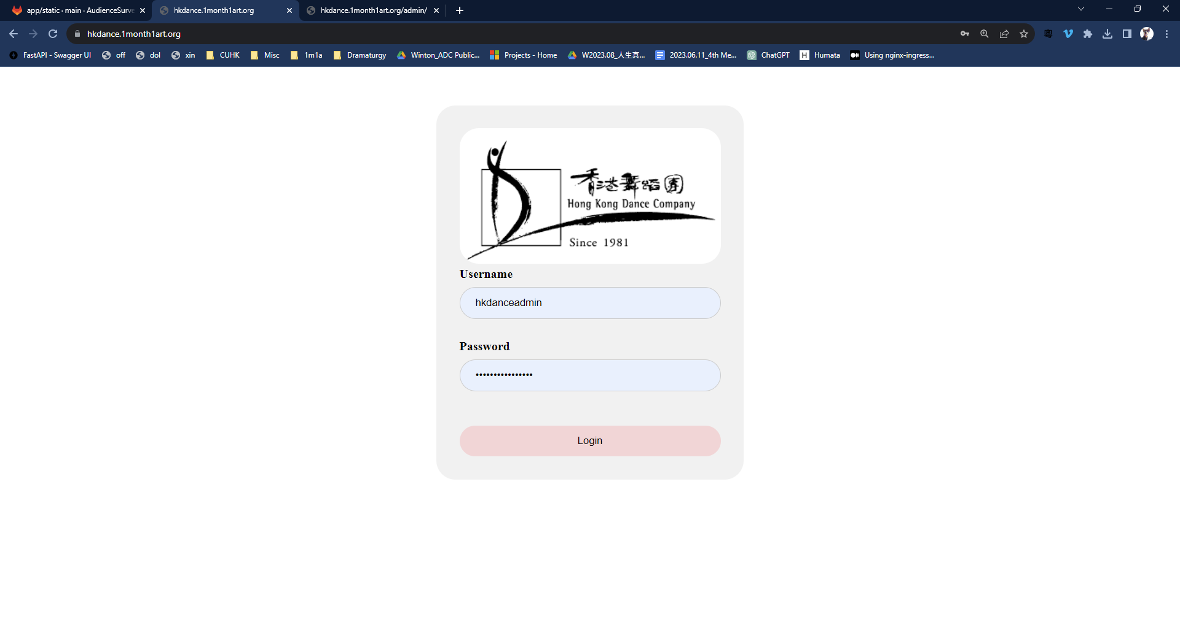
To enter the admin page, use
Login: hkdanceadmin
Password: HKDANCEAdmin1234
Using the admin page, you can create other logins for different users having different access to different survey results
There is currently a user login
Login: hkdance
Password: hkdance2023
to view survey results

Slide 2
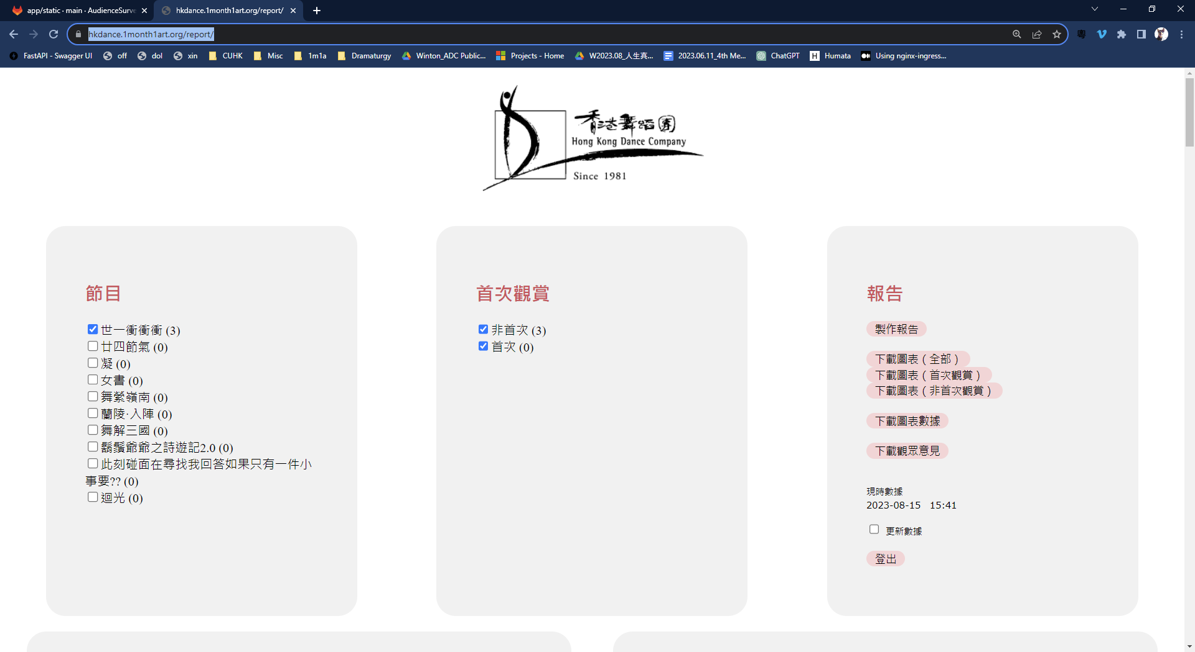
To select survey results for the different programmes
To show data of audience being their first time or not to attend HKDance performances
To download Powerpoint slides of the survey results summary
To generate survey summary online
To download open-ended comments in a Word file
To download Excel data of the survey results summary
To retrieve the most recent survey data

Slide 3
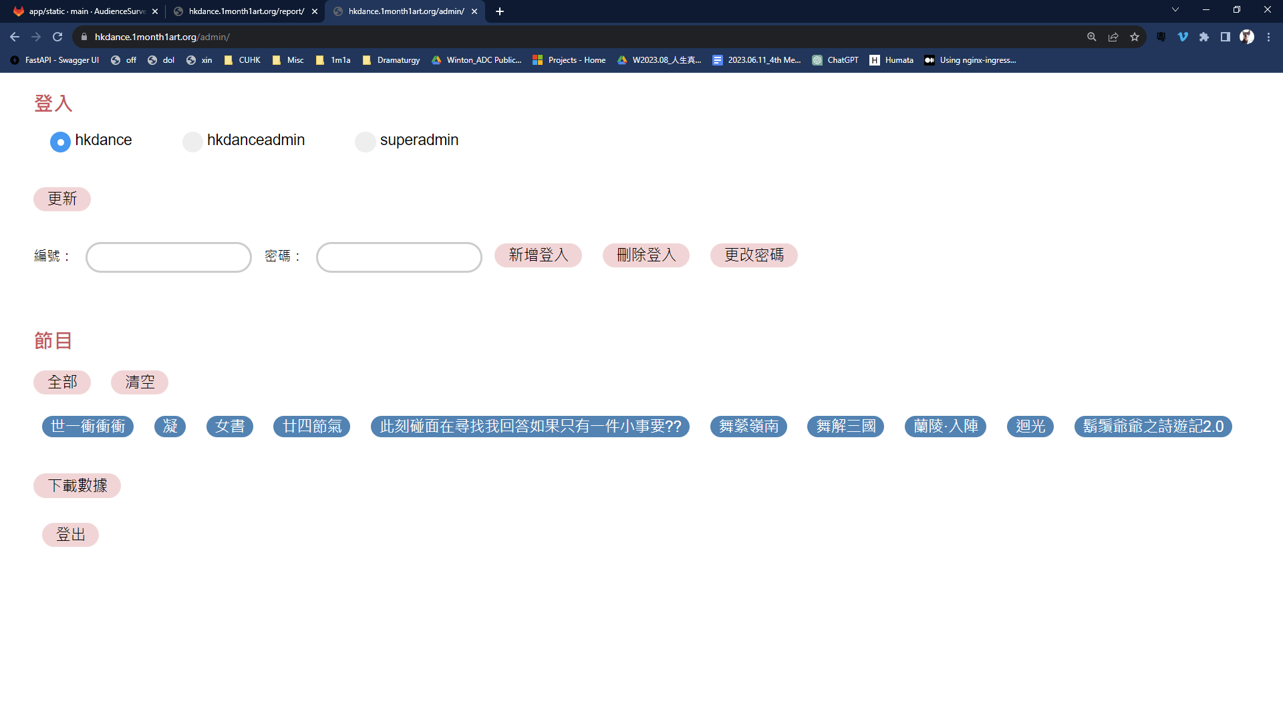
To create a new login
Select the performance survey results to which this login has this login has access
Download the survey raw data in Excel

