Slide 1

JUMP THAILAND HACKATHON 2026 · PROJECT CASE STUDY
FutureMe AI
STUDY ROUTE
TVET ROUTE
From “I think” to “I tried.”
ช่วยให้นักเรียนเข้าใจตัวเอง ก่อนตัดสินใจอนาคต
ME NOW
A decision-support prototype for Thai secondary and vocational students.
RESEARCH-INFORMED · NOT VALIDATED GUIDANCE
23,257
993
923
SKILL TRIAL
หลักสูตรจริง
สถาบัน
อาชีพ
ปวช. · ปวส. · ปริญญาตรี
ทั่วประเทศ
โปรไฟล์ความสนใจที่วัดมา
NEXT EVIDENCE
Explore the next step—not one final answer.
Research synthesis · Product strategy · UX · AI architecture · Validation
Several hypotheses. One reversible next step.

Slide 2

PROBLEM
02
Students decide before they have evidence
Thai education has visible forks; the day-to-day reality behind each route is harder to test.
Decisions arrive before experience.
CONSEQUENTIAL CHOICE POINTS
General upper secondary
Vocational ปวช.
Other / local options
ม.3
FutureMe’s design hypothesis
Students need a safe way to test a direction before committing time, prerequisites and money.
TCAS / university
Work / training
Continue vocational
ม.6
Criteria vary by school, campus, programme and admission year.
PRIMARY USER RESEARCH: NOT YET RUN
FutureMe AI · Project case study · August 2026
Sources: Thai curriculum, VEC catalogue, TCAS70; FutureMe source audit (24 Jul 2026)

Slide 3
EVIDENCE
03
The cost is mismatch—and a moving target
The evidence supports earlier exploration, not a promise of one perfect match.
56%
27%
39%
work outside their field of study
work below their skill or qualification level
of core skills expected to change by 2030
TDRI CONTEXT
SAME POPULATION
WEF EMPLOYER SURVEY
Design implication: help students test, compare and revise—before a direction becomes expensive to change.
Caution: the TDRI public page describes a broadly highly educated group and does not expose its denominator or method. These figures are problem context, not a FutureMe performance baseline.
FutureMe AI · Project case study · August 2026
Sources: TDRI (2025); WEF Future of Jobs (2025); scopes differ and are not combined causally

Slide 4
CURRENT GAP
04
Information exists. Interpretation is fragmented.
The gap is not another list—it is a visible chain from self-knowledge to action.
SEARCH
TEST
RESULT
AFTER
School plans TCAS pages Career sites
Static interest questionnaire
Generic career or faculty list
Still unsure what to try
→
→
→
What is missing
WHAT I SAID
→
WHAT I TRIED
→
WHY THIS ROUTE
→
WHAT TO DO NEXT
Admission criteria expire. Career-to-programme links are many-to-many. A trustworthy product must show scope, date and source.
FutureMe AI · Project case study · August 2026
Sources: FutureMe Data/RAG_DATA_SPEC; curriculum and source-audit files

Slide 5
IDEA
05
The idea evolved from matching to learning
Each research input changed a product decision.
1
→
2
→
3
→
4
→
5
PROBLEM
THEORY
CONTEXT
ACTION
PRODUCT
Study–work mismatch is not one-to-one
RIASEC gives a six-part interest language
Socratic + STAR surface lived evidence
A mini mission tests self-report
Top 5 programmes + a 30-day experiment
FutureMe is an evidence loop, not a career oracle.
Conversation frameworks guide prompts; they do not validate the questionnaire.
FutureMe AI · Project case study · August 2026
Sources: FutureMe research summaries; Holland RIASEC; interview framework files

Slide 6
RESEARCH FOUNDATION
06
Research shaped the model—and what we rejected
Only constructs that change the product’s output earn a place in the assessment.
R
Hands-on
INCLUDED
RIASEC interest vector
A starting hypothesis for exploration
C
I
Organise
RIASEC
Investigate
Socratic prompts + STAR
Conversation scaffolds—not psychometrics
DESIGN INPUT
one vector six interests
DEFERRED
Work values
Route catalogue lacks value profiles
E
A
Lead
Create
S
REJECTED
MBTI-type matching · learning styles
Unstable types / weak evidence
Help
The 41-item instrument is research-informed—but has never been validated.
FutureMe AI · Project case study · August 2026
Sources: Holland (1997); O*NET Interest Profiler Manual; FutureMe methodology

Slide 7
DESIGN PRINCIPLES
07
Five product rules follow directly from the evidence
Research is useful only when it changes what the product does.
01
Interests still move in adolescence
→
Offer hypotheses—not a verdict; keep routes reversible
02
Self-report is only one signal
→
Add a scenario mission that can agree or disagree
03
AI recommendations can become opaque
→
Rules decide; show evidence, unknowns and contradictions
04
Admissions and labour data expire
→
Carry source, scope, last-checked date and freshness
05
The users are minors
→
Guest-first, browser-local; consent before saving or sharing
Private by default · Evidence before confidence · One useful next action
FutureMe AI · Project case study · August 2026
Sources: Source audit, RAG data spec, interview research, privacy design

Slide 8
SOLUTION
08
FutureMe turns reflection into a low-stakes experiment
The experience accumulates evidence instead of manufacturing certainty.
1
→
2
→
3
→
4
→
5
REFLECT
TRY
EXPLORE
COMPARE
ACT
41-item profile: interest + confidence
One scenario mission
Top 5 real programmes
Evidence · trade-offs unknowns · sources
A reversible 30-day plan
EVIDENCE — NOT CERTAINTY
A learner can revise answers, override the mission, compare routes or stop.
FutureMe AI · Project case study · August 2026
Source: implemented FutureMe guest journey

Slide 9
USER JOURNEY
09
Each step gives the learner control
The output at every stage is provisional, inspectable and editable.
1
2
3
4
5
What activities draw me?
Does action agree?
What is feasible now?
Why these options?
What can I test next?
Provisional RIASEC vector
Mission can corroborate or contradict
Cost · location · timing filters
Reasons · evidence · unknowns · sources
30-day reversible experiment
CONTROL LOOP · change answers · choose another mission · compare again · keep, park or drop a route
FutureMe AI · Project case study · August 2026
Source: implemented UX flow and session behavior

Slide 10
AI ARCHITECTURE
10
AI supports the conversation—not the decision
Current capabilities and future architecture are deliberately separated.
TODAY · IMPLEMENTED
FUTURE · PLANNED
Learner input
Adaptive Thai conversation
Structured profile extraction
Rule engine
→
→
↓
↓
Deterministic TypeScript rules
↓
Audited RAG retrieval
→
Evidence-grounded explanation
→
Interactive roadmap
Top 5 programmes
Optional LLM: reword reasons only Off by default · no learner answers
Rules decide. Retrieval grounds. AI explains.
FutureMe AI · Project case study · August 2026
Sources: current code + planned RAG architecture; Qdrant/AIS/NDLP are not implemented

Slide 11
RECOMMENDATION LOGIC
11
Every number is measured, derived, or declared missing
Same answers, same programmes. No model touches the ranking.
41 items + context
→
RIASEC vector
→
Kelley shrinkage
→
Core fit cos + efficacy
→
Context capped +15
→
Top 5 programmes
INTEREST VECTORS ARE MEASURED, NOT ASSIGNED
A programme’s six-dimension profile is the mean of the O*NET occupations in its official ISCED-F field — 923 occupations, measured. The twelve hand-written vectors it replaced had the wrong dominant dimension in four of nine comparable fields.
ACADEMIC FIT AND CONTEXT STAY APART
Final = CoreFit + 15 × ContextFit. Distance, cost and intake reorder programmes of similar fit; they cannot lift a poor fit above a strong one, because 15 points is smaller than any gap that matters.
“3” = 0
FLAT
NULL
TRACE
an unsure answer is not evidence
profile → no ranking (Holland)
tuition unknown → link, not a guess
every figure opens to its source
FutureMe AI · Project case study · August 2026
Source: lib/recommend · the Python reference in 01_Research/Recommendation_Engine is pinned to it by test

Slide 12
DATA
12
23,257 real programmes, and the gaps named out loud
Every figure traces to a government register. Nothing on a card is an estimate.
23,257
993
923
15,586
หลักสูตรจริง
สถาบัน
อาชีพ O*NET
มีผลการมีงานทำ
ปวช. 16,908 · ปวส. · ป.ตรี 6,349
840 วิทยาลัยอาชีวะ · 153 มหาวิทยาลัย
RIASEC วัดจริง · 269 สาย
สอศ. 2566 · แสดงฐานเสมอ
SOURCES · ALL GOVERNMENT REGISTERS
แผนการรับนักศึกษา (data.go.th) · หลักสูตรและรหัส ISCED-F (อว.) · ต้นทุนต่อหัวรายหลักสูตร (อว.)
นักเรียนอาชีวะรายวิทยาลัยรายสาขา (สอศ. 2568) · ภาวะการมีงานทำ (สอศ. 2566) · ระยะทางถนนจริง OSRM 77 จังหวัด
O*NET 29.1 Interests (US DOL, CC BY 4.0) · ทะเบียนที่ตั้งสถานศึกษา อว. และ สอศ.
WHAT WE DO NOT HAVE — AND DO NOT ESTIMATE
ค่าเทอมจริง
รอบ TCAS · คะแนน
ทุนการศึกษา
ไม่มีชุดข้อมูลเปิด → ลิงก์ประกาศของสถาบัน
mytcas ไม่มี API → ยังตอบไม่ได้ บอกตรง ๆ
ไม่มีทะเบียนกลาง
FutureMe AI · Project case study · August 2026
A blank field is a finding. Filling it with an average would be the failure this project keeps arguing against.

Slide 13
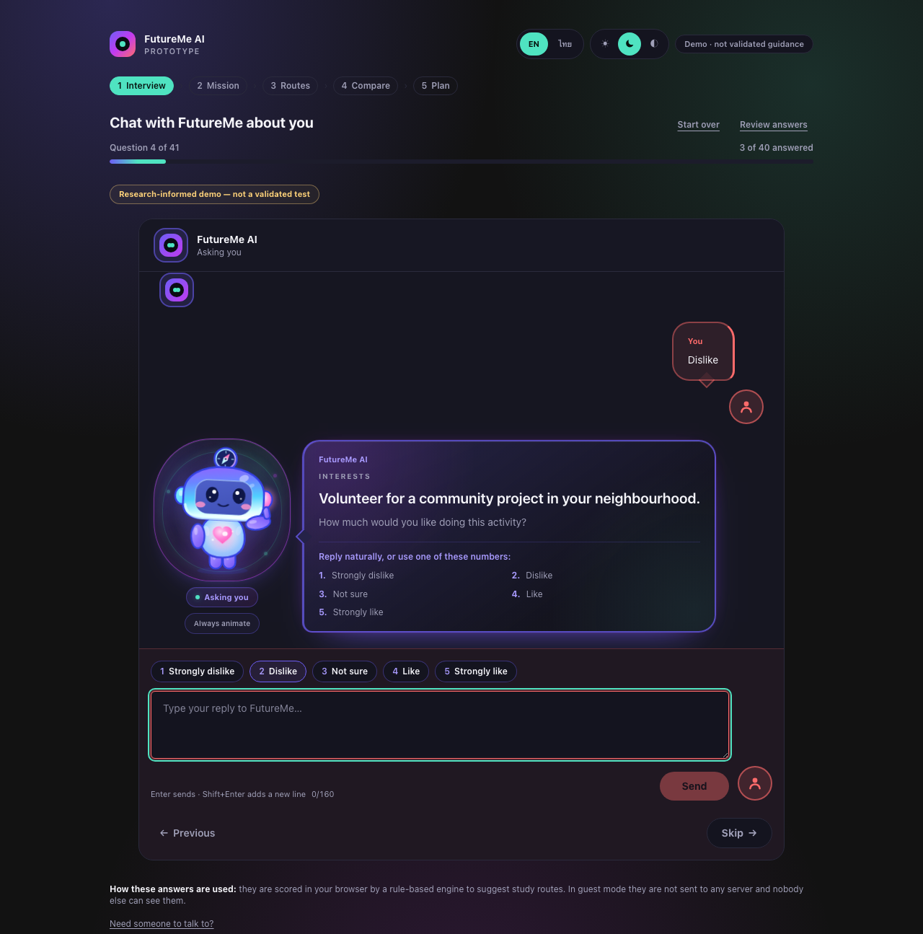
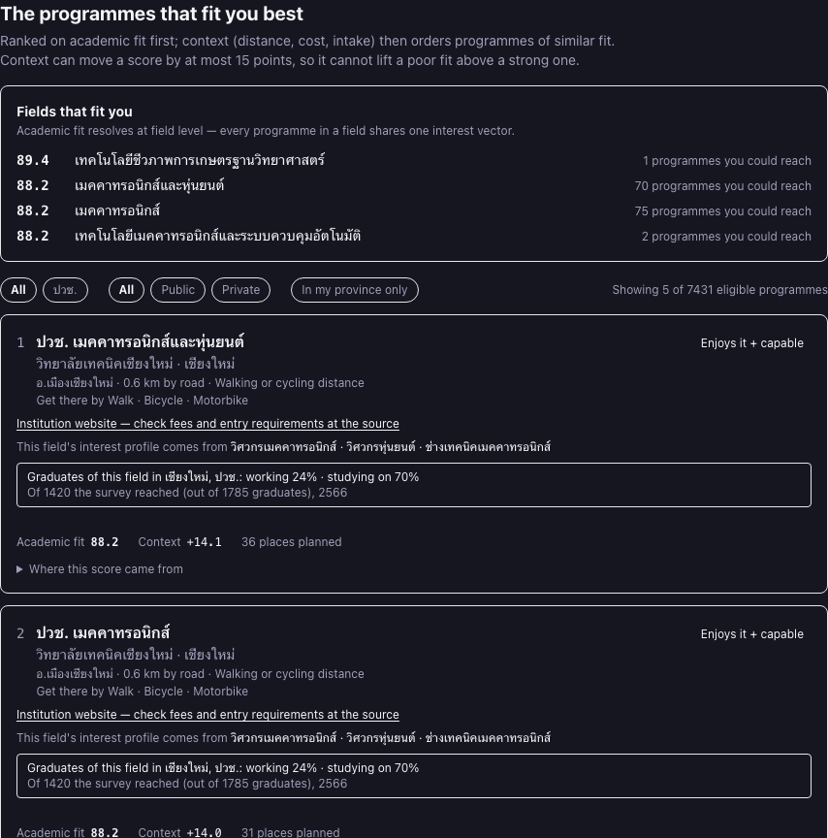
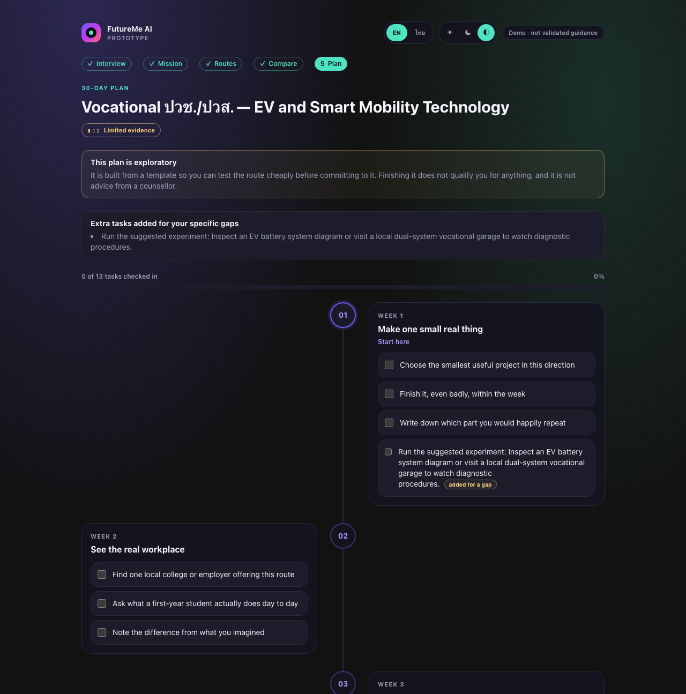
PROTOTYPE
13
A complete prototype already runs end to end
These are screenshots from the implemented app—not concept mockups.
1 · ASSESS
3 · EXPLORE
5 · ACT
One item at a time
Several hypotheses
30-day experiment
TH / EN + THEMES
3 MISSIONS
23,257 PROGRAMMES
BROWSER-LOCAL
559 TESTS
993 INSTITUTIONS
Programmes and distances come from government registers. The interest instrument itself is still unvalidated.
FutureMe AI · Project case study · August 2026
Screenshots captured 12 Aug 2026 from the production build · 559 unit tests, lint and build passing

Slide 14
VALUE PROPOSITION
14
The difference is what happens after the score
FutureMe changes a result into a testable next step.
TRADITIONAL CAREER TEST
FUTUREME EVIDENCE LOOP
Questionnaire
1
→
2
→
3
→
4
→
5
↓
Reflect
Try
Explain
Compare
Act
Score / type
provisional signal
independent evidence
reasons + unknowns
constraints + trade-offs
30-day experiment
↓
new evidence updates the next exploration
Career list
↓
✓
✓
✓
✓
✓
Stops
Refuses to guess
Shows disagreement
No manufactured winner
Sources + freshness
Vocational routes are first-class
FutureMe AI · Project case study · August 2026
Source: product design and implemented behavior

Slide 15
VALIDATION
15
Validation is the next product—not a footnote
The analysis pipeline is verified. The instrument is not.
PIPELINE VERIFIED ≠ INSTRUMENT VALIDATED
PROPOSED SUCCESS MEASURES
ASSESSMENT
Reliability · item quality · construct structure
0
Ethics gate
Approval · parent consent · student assent · PDPA
1
Cognitive debrief
n ≈ 30–40 · meaning and translation
ROUTES
Relevance · counsellor agreement · diversity
2
Pilot
target n = 250 · minimum 200
EXPERIENCE
Completion · comprehension · route exploration
3
Measurement
α + ω · item-total · “not sure” rate
4
Structure
RIASEC circular-order randomisation test
LONG-TERM
Can the student still explain and defend the choice?
5
Revise + re-pilot
then invariance and outcome studies
No reliability, norms or validity results exist yet.
FutureMe AI · Project case study · August 2026
Sources: FutureMe validation plan + pre-registered pilot protocol (30 Jul 2026)

Slide 16
ROADMAP
16
From runnable demo to trusted decision support
Every phase has a gate; partnerships stay exploratory until something is signed.
1
2
3
4
5
Foundation
Runnable prototype
Validation
School pilot
Ecosystem
DONE
DONE
NOW · NEXT
PLANNED
EXPLORATORY
Phase 3: adapt Thai translation · validate instrument + missions · licensed route data · bias + safety audit
SELECTED REFERENCES
Career test → AI career discovery companion
• [1] TDRI — การพัฒนาทุนมนุษย์ไทย (2025)
• [2] NSO — Social Indicators 2025, p.185
• [3] NESDC — ภาวะสังคมไทย Q2/2568
• [4] OECD — PIAAC 2023 mismatch evidence
• [5] WEF — Future of Jobs 2025
• [6] Holland (1997) + O*NET Interest Profiler Manual
• [7] FutureMe Source Audit, Methodology & Pilot Protocol
ช่วยให้เด็กเข้าใจตัวเอง ทดลองทางเลือก และตัดสินใจด้วยเหตุผลที่อธิบายได้
FutureMe AI · Project case study · August 2026
Full source registry: 01_Research/Data/REFERENCES.md

