Slide 1
DEPARTMENT OF COMPUTER SCIENCE, COCIS MAKERERE UNIVERSITY SUPERVISOR: GGALIWANGO MARVIN
Knowledge-Distilled Large Acoustic Models for Emotion-Conditioned Music Generation in Resource-Constrained Settings
Group CODE: ML-X-X / DL-X-X
Keywords: Acoustic Emotion Modeling, Valence–Arousal Framework, Diffusion-Based Music Generation, Knowledge Distillation, Music Information Retrieval, Emotion-Aware Recommendation Systems
Team Members: Name, Student Number, Registration Number, Student Email, University Affiliation
Ssentongo Joshua, 2400701345, 24/U/1345, ssentongo.joshua@students.mak.ac.ug ,Makerere University
Wamani Joshua, Student Number, Registration Number, Student Email , University Affiliation
Aita Prince Joshua, Student Number, Registration Number, Student Email , University Affiliation

Slide 2
CONTENTS OF PRESENTATION
Introduction
Related work
Problem Statement (focus on the computational problem)
Research Questions and Objectives
Research Contributions
Methodology / System Architecture
Dataset Description ( if you are doing Machine Learning, AI, Data Science, Quantum Computing, Deep Learning) otherwise ignore
Results (Experimental / Simulation)
Conclusions
Anticipated Limitations and counteraction plan
References
Acknowledgment (if any)

Slide 3
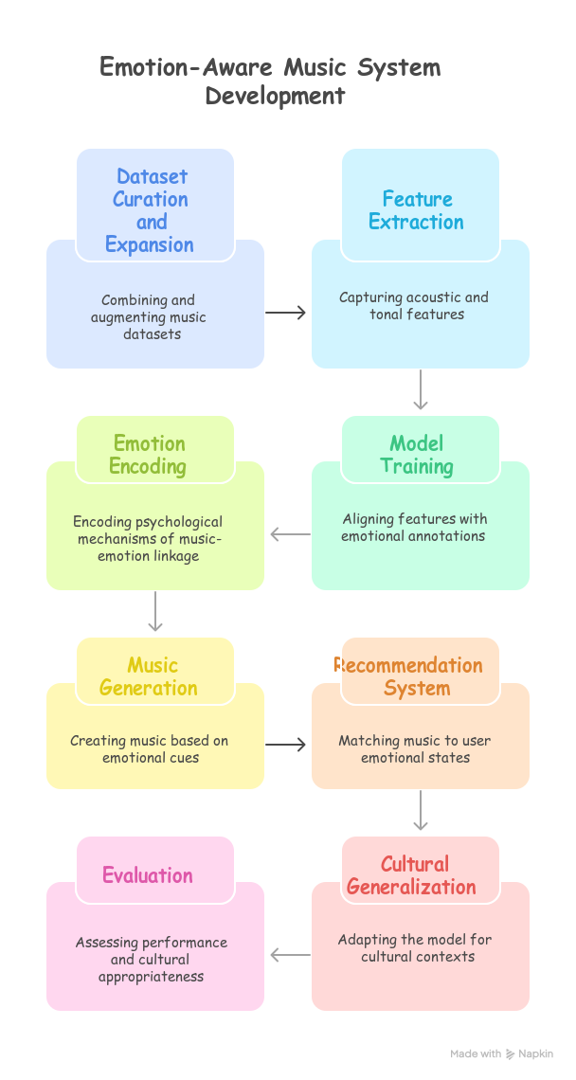
BACKGROUND AND INTRODUCTION
Developing an Emotion-Aware Music System for Uganda
Emotionally Relevant Music System
Limited Emotion- Aware Music
Recommendations lack emotional and cultural relevance.
Personalized music enhances emotional well-being in Uganda.

Slide 4
RELATED WORKS/ RECENT TRENDS/ LITERATURE REVEIW
Then the model is trained in a self-supervised manner, learning to generate music from these objective attribute vectors. This stage does not require emotion-labeled data. This means the can then be trained on massive unlabeled music datasets using attributes extracted directly from the audio. this works well for ugandan songs that have no VA annotations. In other words, EmoGen avoids directly mapping subjective emotion labels to music.
EmoGen also employs a data-driven method. It trains a Random Forest classifier on an emotion annotated dataset to select the top attributes with the highest feature importance. This approach significantly outperform both manual and random attribute selection for emotion control accuracy and music quality.
Our proposed Large Acoustic Model aligns with recent work on large-scale self-supervised training for music understanding. The MERT (Music undERstanding model with large-scale self-supervised Training) is relevant since it learns general purpose music representations without human annotated labels
MERT is pre-trained and employs a multi-task paradigm with teacher models to provide pseudo-labels for the masked audio segments.
The EmoGen System is another which uses two stages to generate bias free emotional music. It first uses a small emotion annotated data set to find a set of objective musical attribute values that represent the general emotion for each VA quadrant.

Slide 5
PROBLEM STATEMENTS
Domain Application problem
Music Enthusiasts relate with songs on an emotional level. However, current music generation and recommendation systems fail to address emotional and cultural needs due to :
Limited Emotional Understanding: Existing systems rely on genre or artists rather than learning mappings between musical features and emotions
Cultural Bias and Generalization: Global models trained on Western datasets fail to capture cultural differences in music emotion relationships e.g. in underrepresented regions like Uganda
Sparse Emotion Annotated Data: There is limited emotion labeled music datasets, especially for non-Western music which restricts training effectiveness and cultural adaptability
Computational Problem
State of the art acoustic models are compute hungry and hence don’t deploy in resource constrained settings such as mobile devices in developing regions.
Processing latency in such models is high which prevent real time generation and recommendation of emotion based music.
Adapting these models to local cultural contexts requires extensive retraining which is compute expensive.

Slide 6
RESEARCH QUESTIONS AND OBJECTIVES
Mention the specific objectives for the audience (at most 4)
Specific objective clarifies what you have solved or searched for
Also it directs your results
Write the objectives in the following way
To determine the number of slides
To model the ppt slide
To evaluate the work with others

Slide 7
RESEARCH CONTRIBUTIONS & OUTPUTS
Mention the Contributions for the audience (extracted from the objectives)
Specific contributions clarifies what you have solved or searched for
Also it directs your results
Write the contribution in the following way
We developed ……
We build the first…
We deployed novel… etc

Slide 8
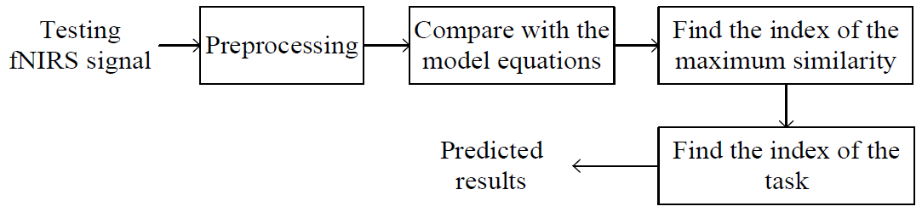
METHODOLOGY & SYSTEM ARCHTECTURE
A block diagram or flow-diagram can help to share your methodology without using hundred words

Slide 9
DATASET DESCRIPTION AND EXPLORATORY DATA ANALYSIS
Dataset description
EDA Results, Graphs and insights go here

Slide 10
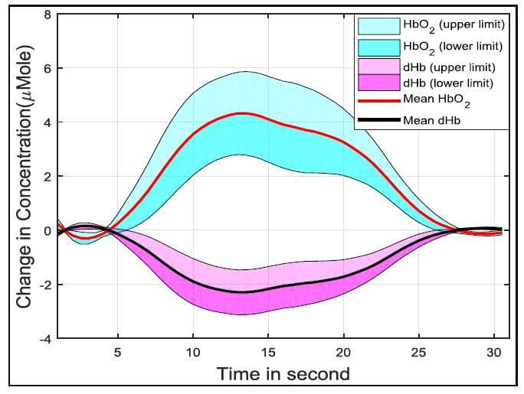
OUTPUT RESULTS AND DISCUSSIONS
To show results use figures, tables, graphs with clear axis, legend, and scaling

Slide 11
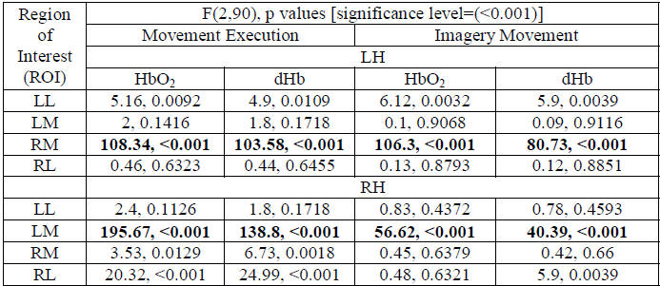
RESULTS AND DISCUSSIONS – CONT’D
To present table, you may highlight the significant results. Also you may use image format of the table, it helps not to change the fonts

Slide 12
EXPECTED RESULTS AND DISCUSSIONS – CONT’D
To present table, you may highlight the significant results. Also you may use image format of the table, it helps not to change the fonts

Slide 13
EXPECTED RESULTS AND DISCUSSIONS – CONT’D
To present table, you may highlight the significant results. Also you may use image format of the table, it helps not to change the fonts

Slide 14
EXPLAINABLE AI RESULTS AND DISCUSSIONS – CONT’D
To present table, you may highlight the significant results. Also you may use image format of the table, it helps not to change the fonts

Slide 15
EXPLAINABLE AI RESULTS AND DISCUSSIONS – CONT’D
To present table, you may highlight the significant results. Also you may use image format of the table, it helps not to change the fonts

Slide 16
MODEL SELECTION AND DEPLOYMENT
Model Selected For Deployment ( with technical and Scientific Justification)
Deployment Pipeline and System Architecture
Visualize and explain your pipeline
Add some screenshots of the Interfaces

Slide 17
DEMONSTRATION OF THE DEVELOPED PRODUCT
Demonstrate and Explain your Product
Explain the IP assets and

Slide 18
CONCLUSIONS AND LIMITATIONS
Conclusions
Point out your concluding remarks with significant outcomes and conditions
Also mention the limitations of your work
Make it simple and brief
Limitations
Write the Limitations of your research
Every Limitation should have a possible practical suggestion on how to address it
Make it simple and brief

Slide 19
NEXT STEPS
Write the future works and direction of future works
You should also give some recommendation for further work on the topic
Make it simple and brief

Slide 20
ACKNOWLEDGEMENTS
It is an often accepted manner to acknowledge the authority, organization, person, or others who directly or indirectly helps to conduct this research work

