Slide 1
Sentio AI
By Aita Joshua Prince

Slide 2
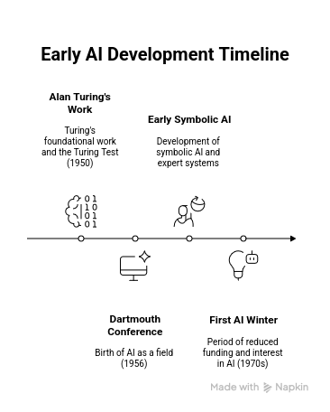
Artificial Intelligence and it history
The Dawn of Artificial Intelligence (1950s-1970s)
Content:
Alan Turing's foundational work and the Turing Test (1950)
Dartmouth Conference (1956) - Birth of AI as a field
Early symbolic AI and expert systems
First AI winter (1970s) due to computational limitations

Slide 3
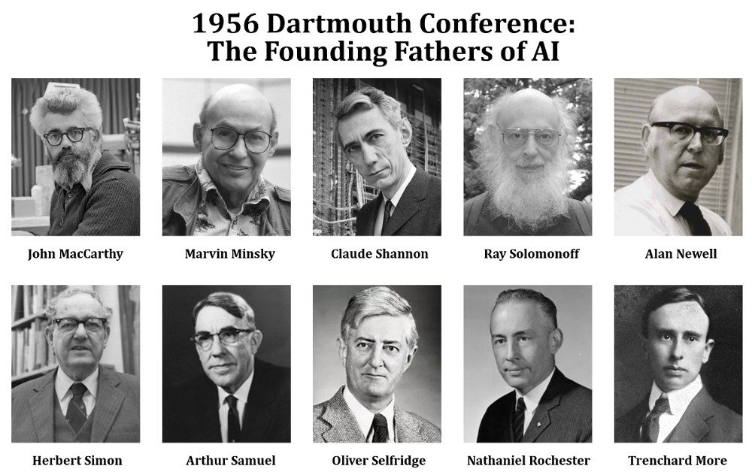

Slide 4
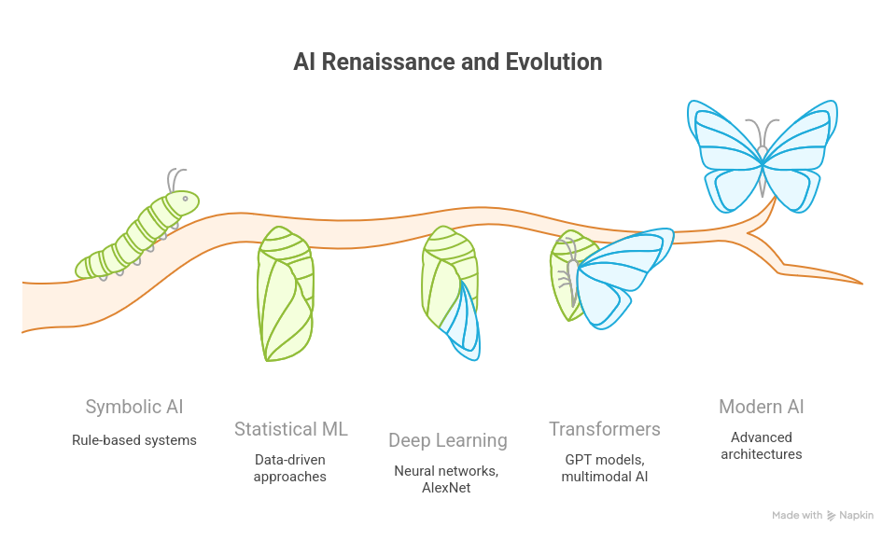

Slide 5
Sentio Project in AI Historical Context
Historical Context: Our emotion-based music generation represents AI's evolution from symbolic rule-based systems to deep understanding of human experience
Gardner's Intelligence: Primarily leverages musical intelligence while integrating logical-mathematical (pattern recognition) and intrapersonal (emotional understanding)
Philosophy: Addresses the Hard Problem of Consciousness - can AI truly understand and generate emotional experiences?

Slide 6
Problem Solving in AI
Problem space representation: Initial state, goal state, state space
Operators and actions: How states transform
State space explosion and combinatorial complexity
Abstraction and hierarchical problem decomposition
Knowledge representation for problem domains
The Frame Problem: What changes and what doesn't?

Slide 7
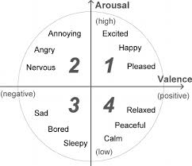
Initial State: Silent audio buffer or user emotional specification (valence=-0.3, arousal=0.7)
Goal State: Generated music clip that evokes target emotional response
Operators: Neural network transformations, audio processing operations, feature manipulations
State Space: High-dimensional audio feature space mapped to emotional coordinates
Data Mining Connection: Classification problems reframed as state-space search through feature space
Intelligence Type: Logical-mathematical (formal problem structure) + Musical (domain knowledge)
Philosophy: Frame Problem - how do we know which audio features are relevant to emotion?

Slide 8
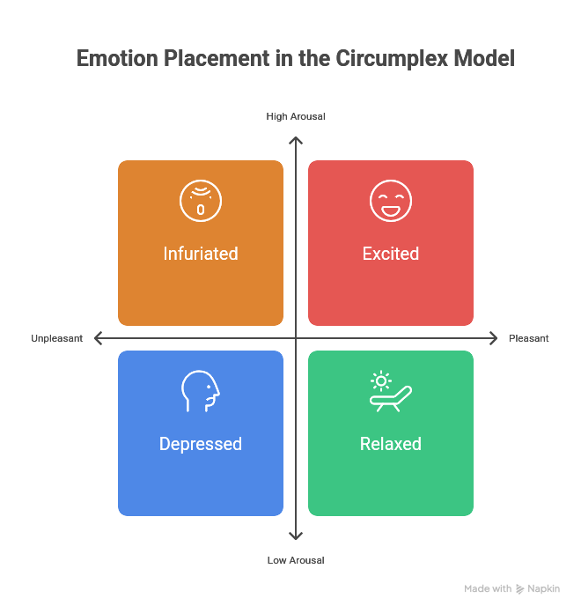

Slide 9
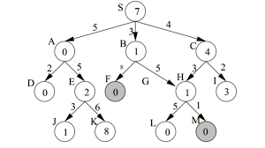
Problem Solving by Search
Uninformed Search Strategies
Depth-First Search: Memory efficient, not optimal
Breadth-First Search: Optimal for unit costs, memory intensive
Uniform Cost Search: Optimal for any step costs
Iterative Deepening: Best of both worlds
Informed Search with Heuristics
Heuristic functions: Admissible vs. consistent heuristics
A* algorithm: Optimal with admissible heuristics
Greedy search: Fast but not optimal
Local search methods: Hill climbing and variations

Slide 10
Search Applications in Sentio
Optimizing Musical Emotional Expression Through Search
Search Space: Audio parameter space (tempo, key, timbral features) to achieve target emotional coordinates
Heuristic Function: Distance between generated music's predicted emotions and target emotions
Finding optimal audio synthesis parameters that minimize emotional distance while maintaining musical coherence
Data Mining Connection: Clustering reduces search complexity by grouping similar emotional states
Intelligence Type: Spatial intelligence (navigating complex parameter spaces)
Philosophy: Is the search tree itself a "simulation" of possible musical realities?
Is it practical:NO

Slide 11
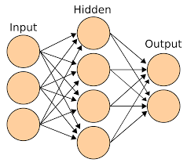
Knowledge Representation and Reasoning
Propositional and predicate logic
Semantic networks and concept hierarchies
Frames and slots for structured knowledge
Ontologies and knowledge graphs
Symbolic VS Connectionist

Slide 12
Knowledge Representation in Sentio
Symbolic Rules: "IF valence > 0.5 AND arousal > 0.6 THEN use major keys with fast tempo"
Neural Embeddings: Continuous representations of musical features in emotional space
Hybrid Approach: Rule-based constraints combined with learned feature representations
Question: Can all musical emotional knowledge be captured symbolically, or do we need sub-symbolic representations?

Slide 13
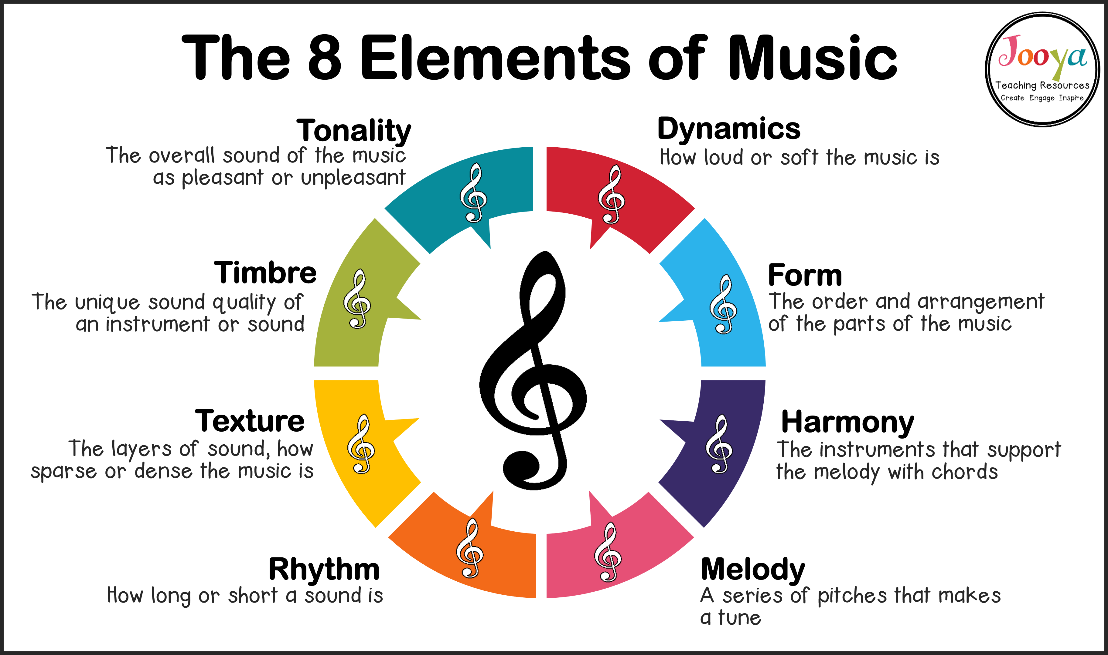

Slide 14
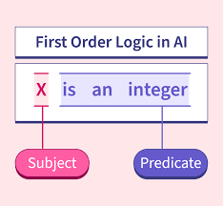
First Order Logic
Predicates, functions, and quantifiers
Variables, constants, and terms
Well-formed formulas and logical connectives
( ( p ∧ q ) ∧ r )

Slide 15
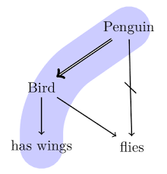
FOL Limitations and Extensions
Closed-world assumption limitations
Frame problem in dynamic domains
Uncertainty and probabilistic extensions
Non-monotonic reasoning

Slide 16
FOL Applications in Sentio's Musical Rules
Musical Rules: "∀song (InMinorKey(song) ∧ SlowTempo(song) → TendsToward(song, sadness))"
Emotional Inference: Using logical rules to derive emotional properties from musical features
Limitations: Subjective emotional responses cannot be fully captured by logical rules
Data Mining Connection: Association rules converted to FOL for formal reasoning
Intelligence Type: Logical-mathematical (formal reasoning) + Musical (domain-specific rules)
Philosophy: Limits of formalization - can all musical emotional knowledge be logically expressed?

Slide 17
Inference in First Order Logic
Automated Reasoning Through Resolution
Converting to Clause Normal Form (CNF)
Resolution rule and unification algorithm
Proof by contradiction methodology
Completeness and decidability issues

Slide 18
Inference Challenges in Sentio's Music Domain
Logical Reasoning for Musical Emotional Intelligence
Forward Chaining: Audio features → intermediate musical concepts → emotional classifications
Backward Chaining: Target emotion → required musical properties → synthesis parameters
Challenges: Musical context, cultural variations, personal preferences break logical assumptions
Hybrid Approach: Logic for explainable rules, neural networks for complex pattern recognition
Data Mining Connection: Rule discovery from music datasets, logical validation of patterns
Intelligence Type: Logical-mathematical (inference mechanisms) + Musical (domain reasoning)
Philosophy: Computational limits of emotional reasoning - can machines truly "understand" music?

Slide 19
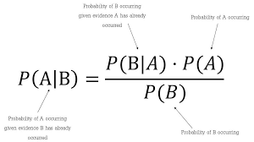
Reasoning Under Uncertainty
Probabilistic Models and Bayes' Theorem
Probability theory fundamentals
Bayes' theorem and conditional probability
Prior and posterior distributions
Bayesian updating and evidence accumulation

Slide 20
Uncertainty in Sentio's Emotional Modeling
Uncertainty Sources: Subjective emotional responses, cultural differences, contextual factors, measurement noise
Bayesian Modeling: P(Emotion|Musical_Features) with continuous updates as new data arrives
Fuzzy Emotions: Gradual transitions between emotional states rather than discrete categories
VAE models for learning probabilistic mappings between music and emotion
Probabilistic clustering for discovering latent emotional patterns
Intelligence Type: Mathematical (probability) + Intrapersonal (understanding emotional uncertainty)

Slide 21
Planning
States, actions, and goals representation
Preconditions and effects of actions
STRIPS assumption and world modeling
Plan generation and execution

Slide 22
Planning Applications in Sentio Music Synthesis
TStrategic Music Generation Through AI Planning
Project Integration:
Musical Planning: Goal = target emotional trajectory, Actions = musical transformations (tempo changes, key modulations, instrumental additions)
Hierarchical Composition: High-level emotional arc → section planning → phrase generation → note-level synthesis
Constraints: Musical theory rules, emotional consistency, temporal coherence
Dynamic Planning: Adapting composition based on real-time emotional feedback
Learning effective action sequences from successful emotional music pieces
Intelligence Type: Musical (compositional knowledge) + Logical-mathematical (planning algorithms)

Slide 23
Supervised vs Unsupervised learning
Supervised learning uses labeled data, where the training examples are paired with the correct outputs or "labels."
Unsupervised learning uses unlabeled data, where the algorithm must find patterns, structures, or relationships within the data on its own without any guidance

Slide 24
Sentio Ai
Supervised learning
DEAM (Database for Emotional Analysis of Music)
Convolutional Neural Network → Recurrent Neural Networks
Transformers
Bayesian Networks and Hidden Markov Models (HMMs)

