Slide 1
GameBox
05/01/2018
He Zhu | CEO, GameBox Inc.
hzhu1@andrew.cmu.edu
Anirudh Kanjani | CTO, GameBox Inc.
akanjani @andrew.cmu.edu

Slide 2
Product Overview
There are so many games being developed these days that it is hard to keep up with them and some games that do not become popular go unnoticed.
We create an application that takes the steam dataset and then provide game information and create an ordered list of recommendations based on the categories specified by the user.

Slide 3
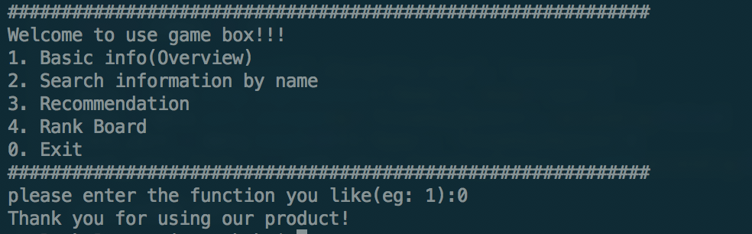
Product Features
Basic Information(Overview)
Different point of view
Search game information
Recommendation for user
Rank board
Figure1. the Main User Interface

Slide 4
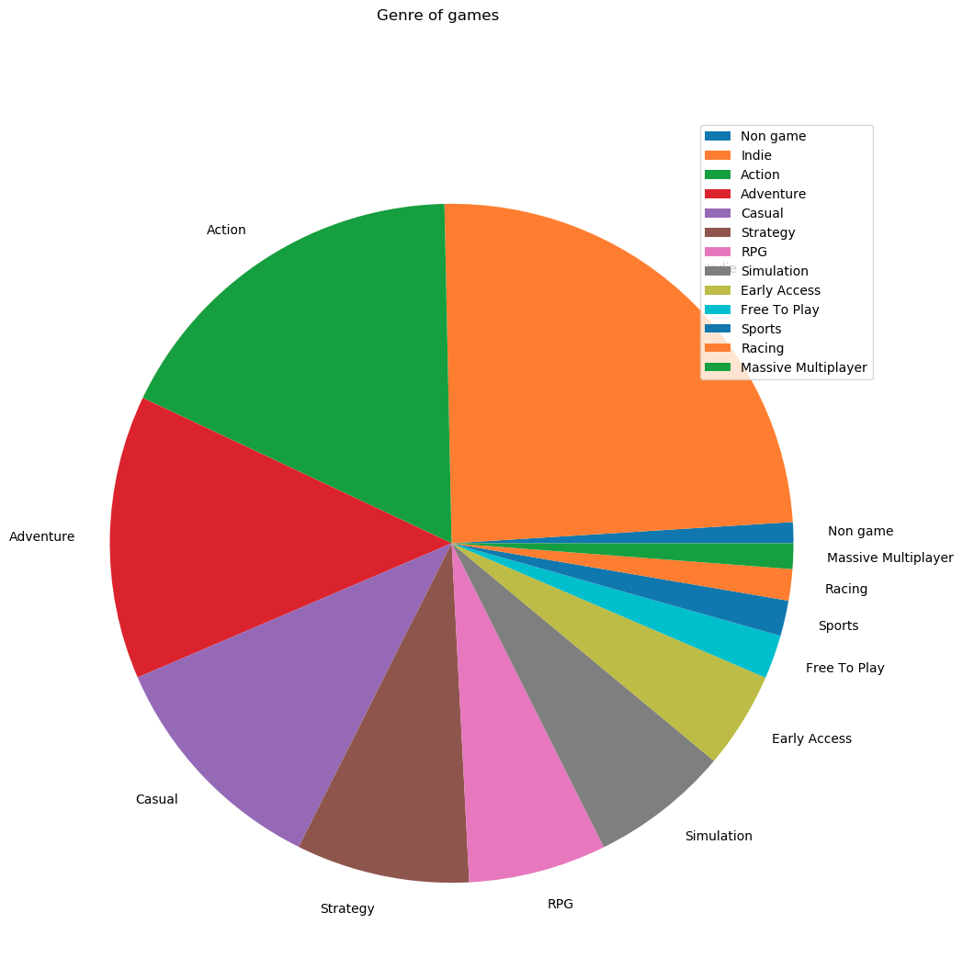
Feature 1 - Basic Information
Description
Give basic overview of the whole dataset by showing bar charts in statistics like comparisons of different types games
Screenshot
types games
Figure2. Pie Chart of Genre of Games

Slide 5
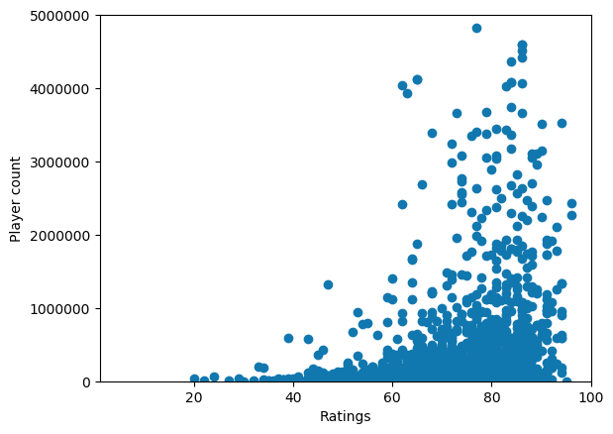
Feature 2 - Different point of view
Description
Provide useful information in multiple different perspectives like scatter plot, histogram, and pie chart
Screenshot
Figure3. Scatter Chart in Game Ratings

Slide 6
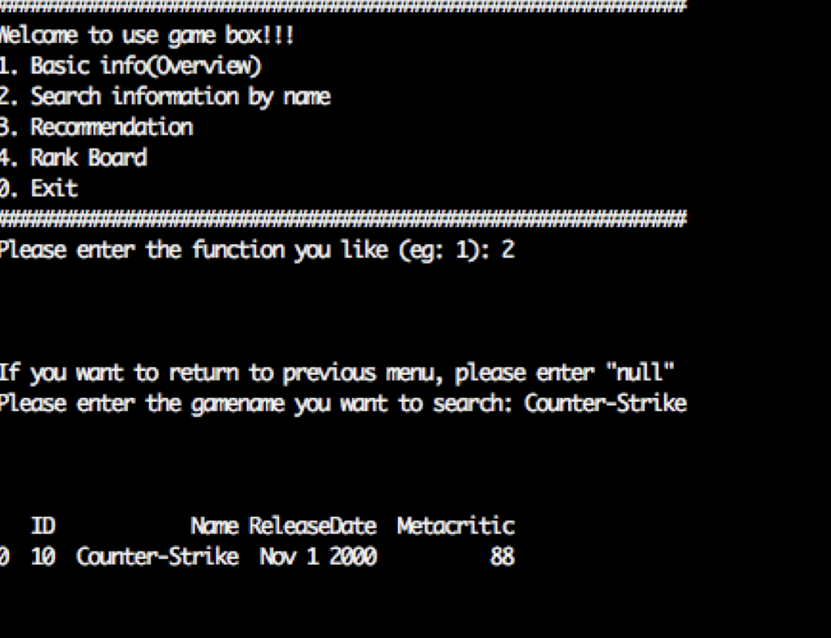
Feature 3 - Search information by name
Description
After users enter the name, our system will return the overall description of this specific game
Screenshot
Figure4. Search information Example

Slide 7
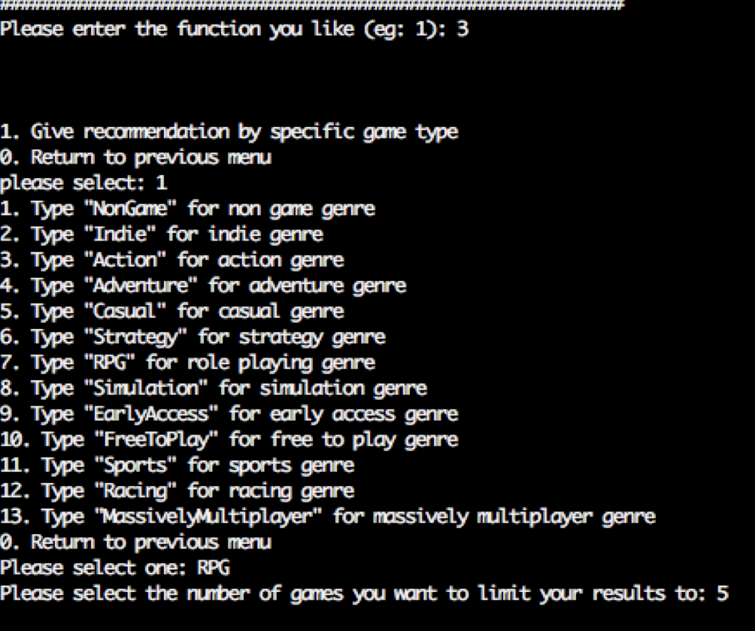
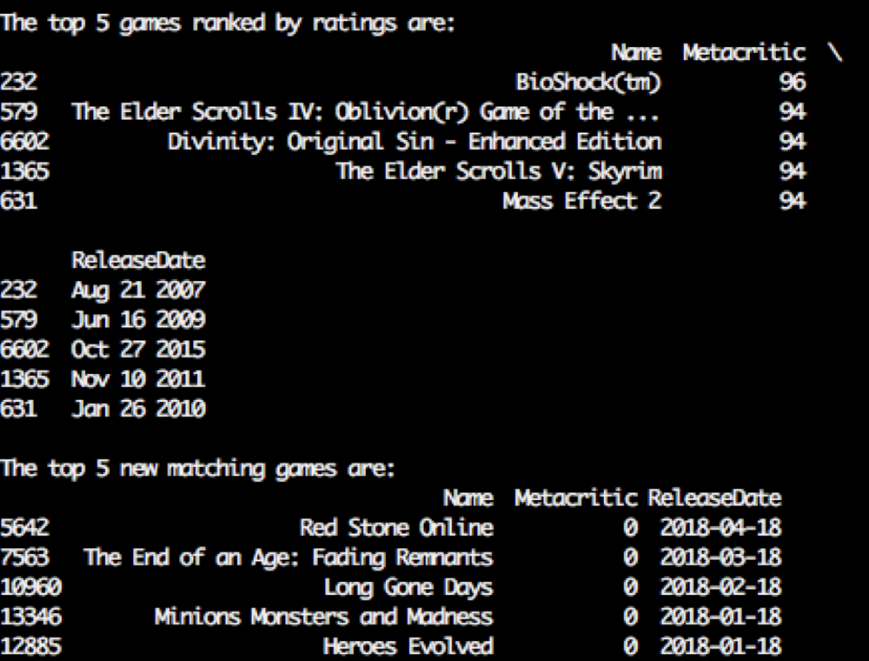
Feature 4 - Recommendation
Description
Our product will give the recommended games for user according to input conditions from user
Screenshot
Figure5. Example of Recommendation for User Preference

Slide 8
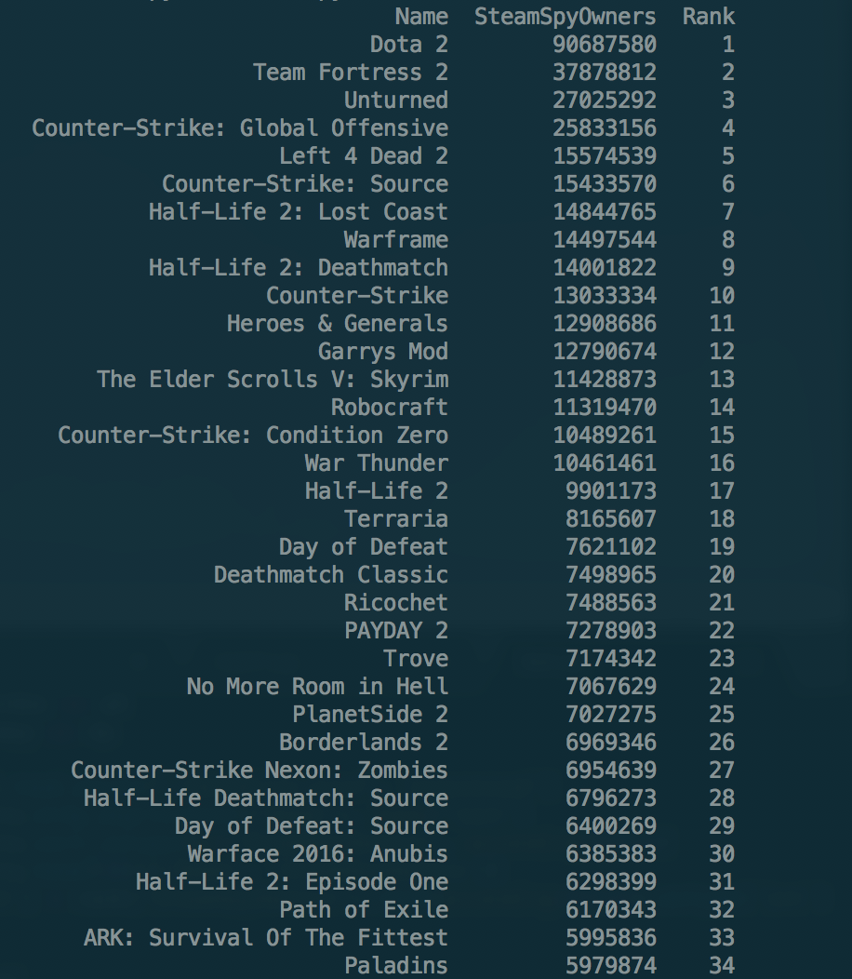
Feature 5 - Rank Board
Description
We release the latest popular ranks(top sells, top new popularity, top players...) by evaluating the trends of all games.
Screenshot
Figure6. Rank Board in Top Sells

Slide 9
Deliverables
Git URL
https://github.com/wipebugs/GameBox
Code, File Resources
Project Board URL
https://github.com/wipebugs/GameBox/projects/1
Whole specific processes

Slide 10
Additional Enhancements
Process real-time streaming data
Increase update frequency like once a day
Process big data
Use popular computation framework: Spark, Kafka and Samza
Flexible adoption
Provide more precise and wider recommendation by applying machine learning or deep learning algorithms

Slide 11
Lessons Learned
Found the value of the surrounding data
Ability to control the process of project
Tried different data sources and selected the best one.
Learned how to ETL data with useful Python Library
Dealt with pandas DataFrame to get ideal result
Debugged our code in effective ways

