Slide 1

Drawing with Turtle
September 5, 2024
Students will be able to:
Navigate the Wipple Playground
Move the Turtle to draw a shape
Use the repeat command to make a spirograph
Today’s plan:
Warm up: Spirograph
Guided practice: Setting up Wipple
Turn and talk: The repeat command
Partner activity: Spirograph

Slide 2

Warm up: Spirograph
Work with your table to draw a shape using the spirograph.
Discuss: How often does the shape repeat?
Brainstorm instructions so another table can draw your shape.
Exchange instructions with the table on your left. Were your instructions effective? How could you make your instructions easier to understand?
Spirograph image: Pixabay, CC0 1.0

Slide 3

Guided practice: Setting up Wipple
You can make a computer draw your spirograph using the same instructions!
Work with a partner
Open your computers and go to wipple.org
Click the button

Slide 4

Guided practice: Setting up Wipple
Continue as Guest

Slide 5
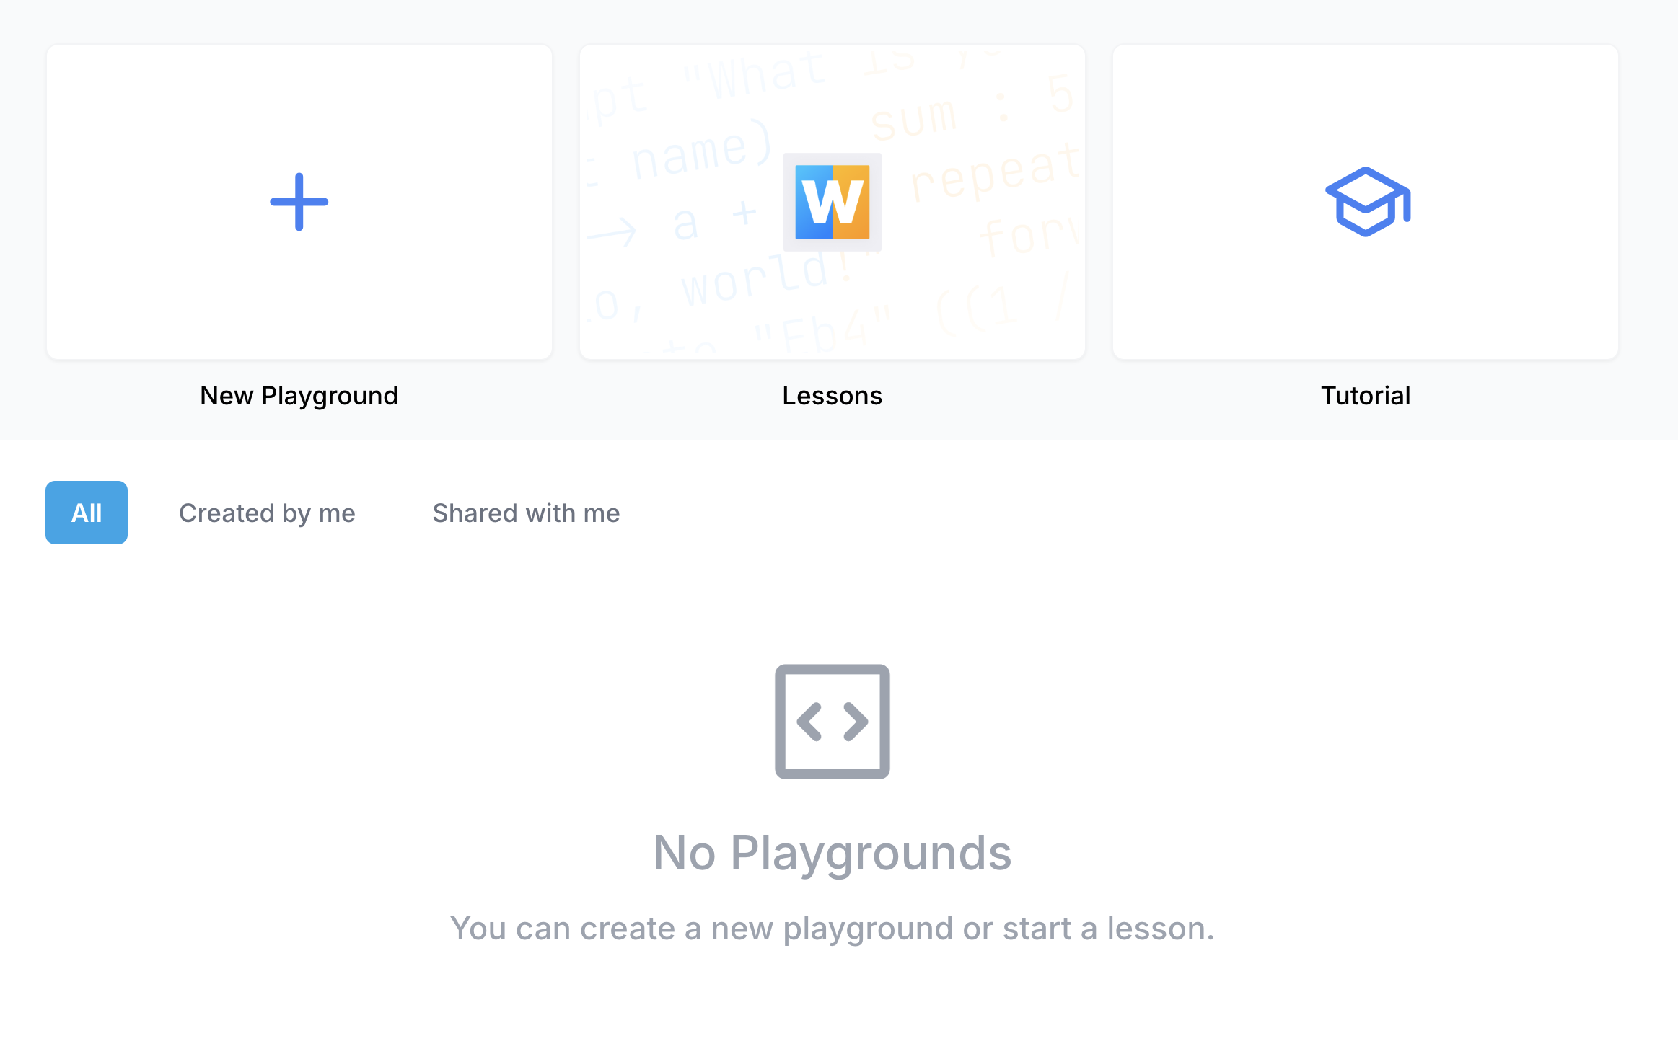
Guided practice: Setting up Wipple
New Playground

Slide 6
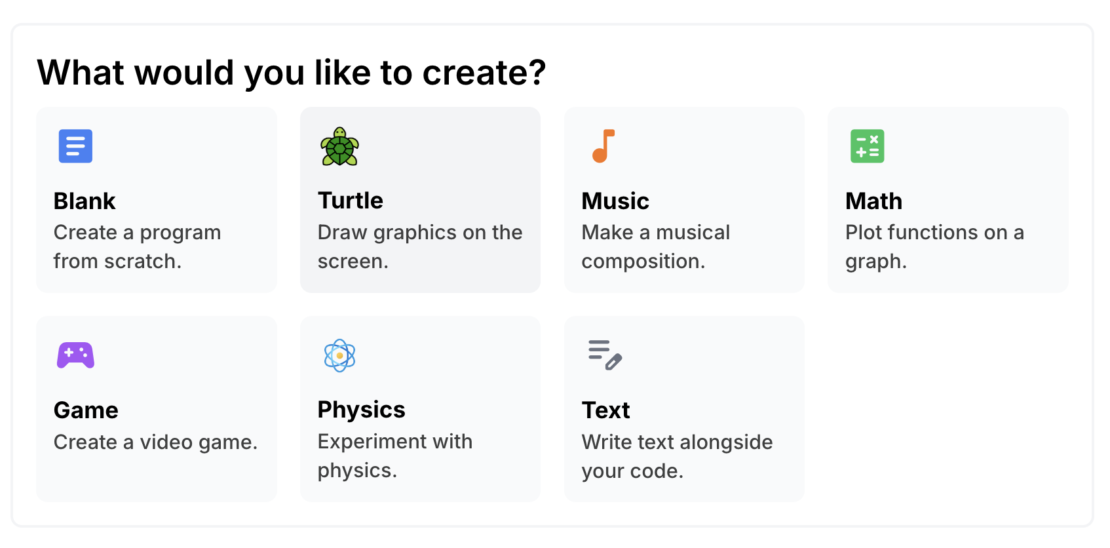
Guided practice: Setting up Wipple
Turtle

Slide 7
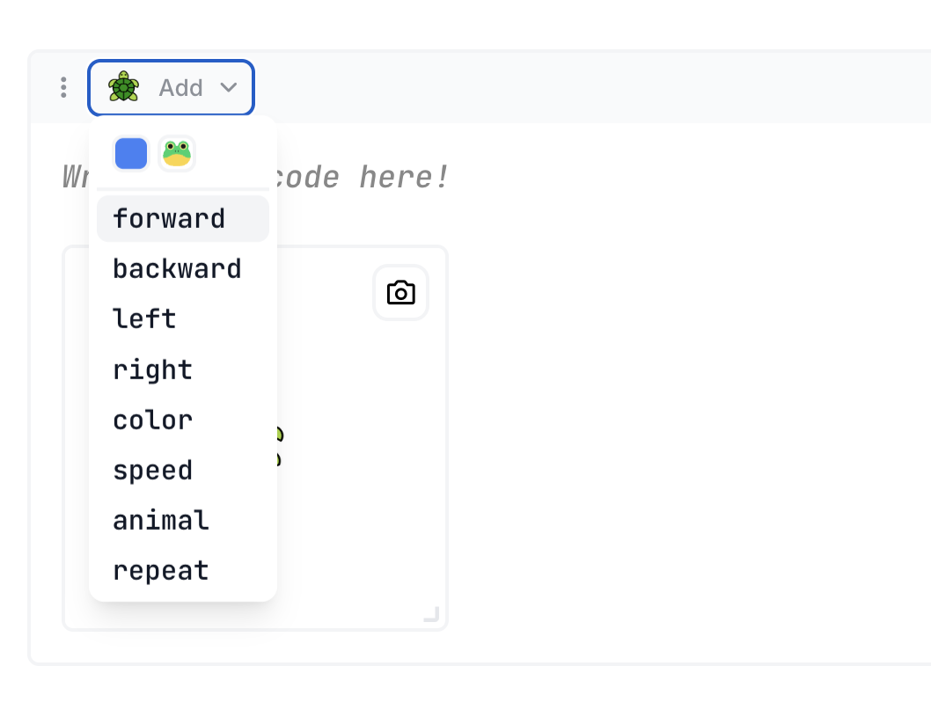
Guided practice: Setting up Wipple
Click and drag

Slide 8
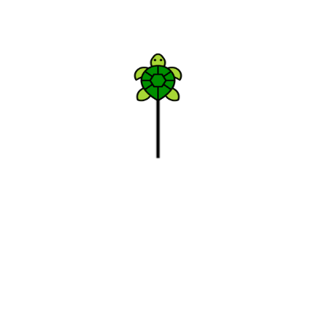
Guided practice: Setting up Wipple
Click “Start coding now”
Click “Continue as Guest”
Click “New Playground”
Click “Turtle”
Click ”Add” and drag forward into code box

Slide 9
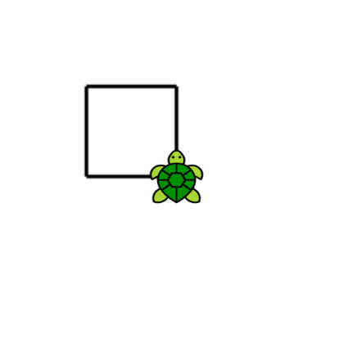
Guided practice: Setting up Wipple
Try all the commands:
forward
backward
left
right
Can you make a square?

Slide 10
Turn and talk: The repeat command
Read your instructions for drawing a square. How many instructions do you have? How could you use fewer instructions?
Listen for: repeat, times, again

Slide 11

The repeat command
{ means begin, } means end

Slide 12


Partner activity: Spirograph
Use the commands you learned today and repeat to draw a spirograph!
Work with your partner
Click to save a photo when you’re done
Tip: Drag speed into your code to make the turtle go faster

Slide 13
Exit ticket (on your own)
Upload your photo
How many times did you repeat to draw your spirograph?
Could you draw your spirograph without repeat? Why or why not?

