Slide 1
Introduction
East Ham book store
Introduction
East Ham book store is a store which is located in East London and has 5 employees. The project manager has indicated to us that there is a plan in place to make sure that there are 5 stores open by the end of the year. They have also expressed their intention to invest in online presence in order to get some of their market share back and to branch out to more people than the current local residents.
The employees at East ham book store are NOT IT savvy and have therefore provided us with the ability to use our own expertise and experience to develop this website for them. They will require us to maintain and update the site for them and to provide training to the team.

Slide 2
Business Functionality
A team from Wipro has been invited to speak to the owner of the book store called “ East Ham books”. The owner has made it clear that they would like to make an online presence in order to compete with other companies who have taken their market share by providing customers with an online option of purchasing books. In a digital world people want to be able to order products easily online and the owner of East ham books is prepared to cater for this need.

Slide 3
Use Cases
User/customer | Emplloyee/business owner
Login/Register | Generate Sales Report
Forgotten Password | Add product
Search engine. | Edit product
View product | Delete product
Add to basket
Choose delivery method
Pay for product

Slide 4
Process Flow
Login
Register
Guest
Password Reset
Payment
View Product
Collection
Delivery
Add Product
Edit Product
Delete Product
Sales Report
Edit website content such as “ about us”

Slide 5
Functional requirements
The website must have a language option:
- English(default)
- French
- Spanish
The website must have the option to login/register.
The website must allow users to recover forgotten passwords via an email link sent to their registered email.
The website must have a search option.
The user should be able to see the following details about a book: Name, Author, Image, Description,
Date Published, Genre, Price.

Slide 6
Functional Requirements
The user should be able to pay for products online
The basket should perform a calculation which adds the product prices together and
then also adds 20% VAT
The user should be able to have an option to have the product delivered to them in any
location of the world.
A user has logged in should have the ability to store products in “basket” for later
purchases.
The system will generate a report of monthly sales.
Must have security to secure customer payments.

Slide 7
Functional requirements continued
The employees should be able to see a full list of products which are available to customers.
The employees should be able to add a product which are available to customers.
The employees should be able to edit products which they have added.
The employees should be able to delete products which they have added.
The employees should be able to see sales information from the website based on month:
  Total Sales
  Total amount of each book sold
  Date sold
  Revenue
Must have error message if customer misses fields in registration process.
Customers must have ability to store payment details.
Customers must be able to edit their data via profile on the system. E.g. Address, name and email.

Slide 8
Non-functional requirements
The process of logging in shouldn’t take longer than 5 seconds.
Available languages should be English(default), Spanish and French.
The password reset link should arrive in the users email account no longer than 1 minute after requested.
Username must contain valid email address
The user of the website should be able to navigate around the website within 2 seconds of clicking a link.
The headers should stand out in bold text.
Content should be populated by employees.
The content should be in size 12 font.
Once using the search function, the user should see a list of relevant products appear with an option to see description.
Password must be case sensitive and contain special characters.
A payment confirmation should be sent to the users email account.
The link should arrive in the users email account in no longer than a minute.
Must be able to integrate with an online payment system

Slide 9
Non-Functional Requirements
The currency should be in pound sterling when viewing products and paying.
All 5 employees must have access to the system and different roles.
- 3 normal users
- 2 “super” users.
Must be available 24/7
Must be able to handle 100 customers simultaneously.
System updates every month.
Must be compatible with web browsers- Firefox, Chrome, Internet explorer and safari.

Slide 10
Non-functional requirements
The website must provide a drop down list for the user to select a convenient physical store location.
The website should store the products selected by a user indefinitely
  There should be no limit on the amount of books stored in a basket.
The products should be categorised by “genre”.
  There should be no duplicates
Date published should be formatted into a date field.
  After clicking “save” the product should be updates on the front end within a minute.
The employees should have to confirm deletion via a pop up message.
  The product should disappear from the front end within a minute.
  Report is generated and available to see on the 1st day every month for previous month.
  The website must be able to process 100 transactions at once.
  The website must be able to function with 1000 users at once.

Slide 11
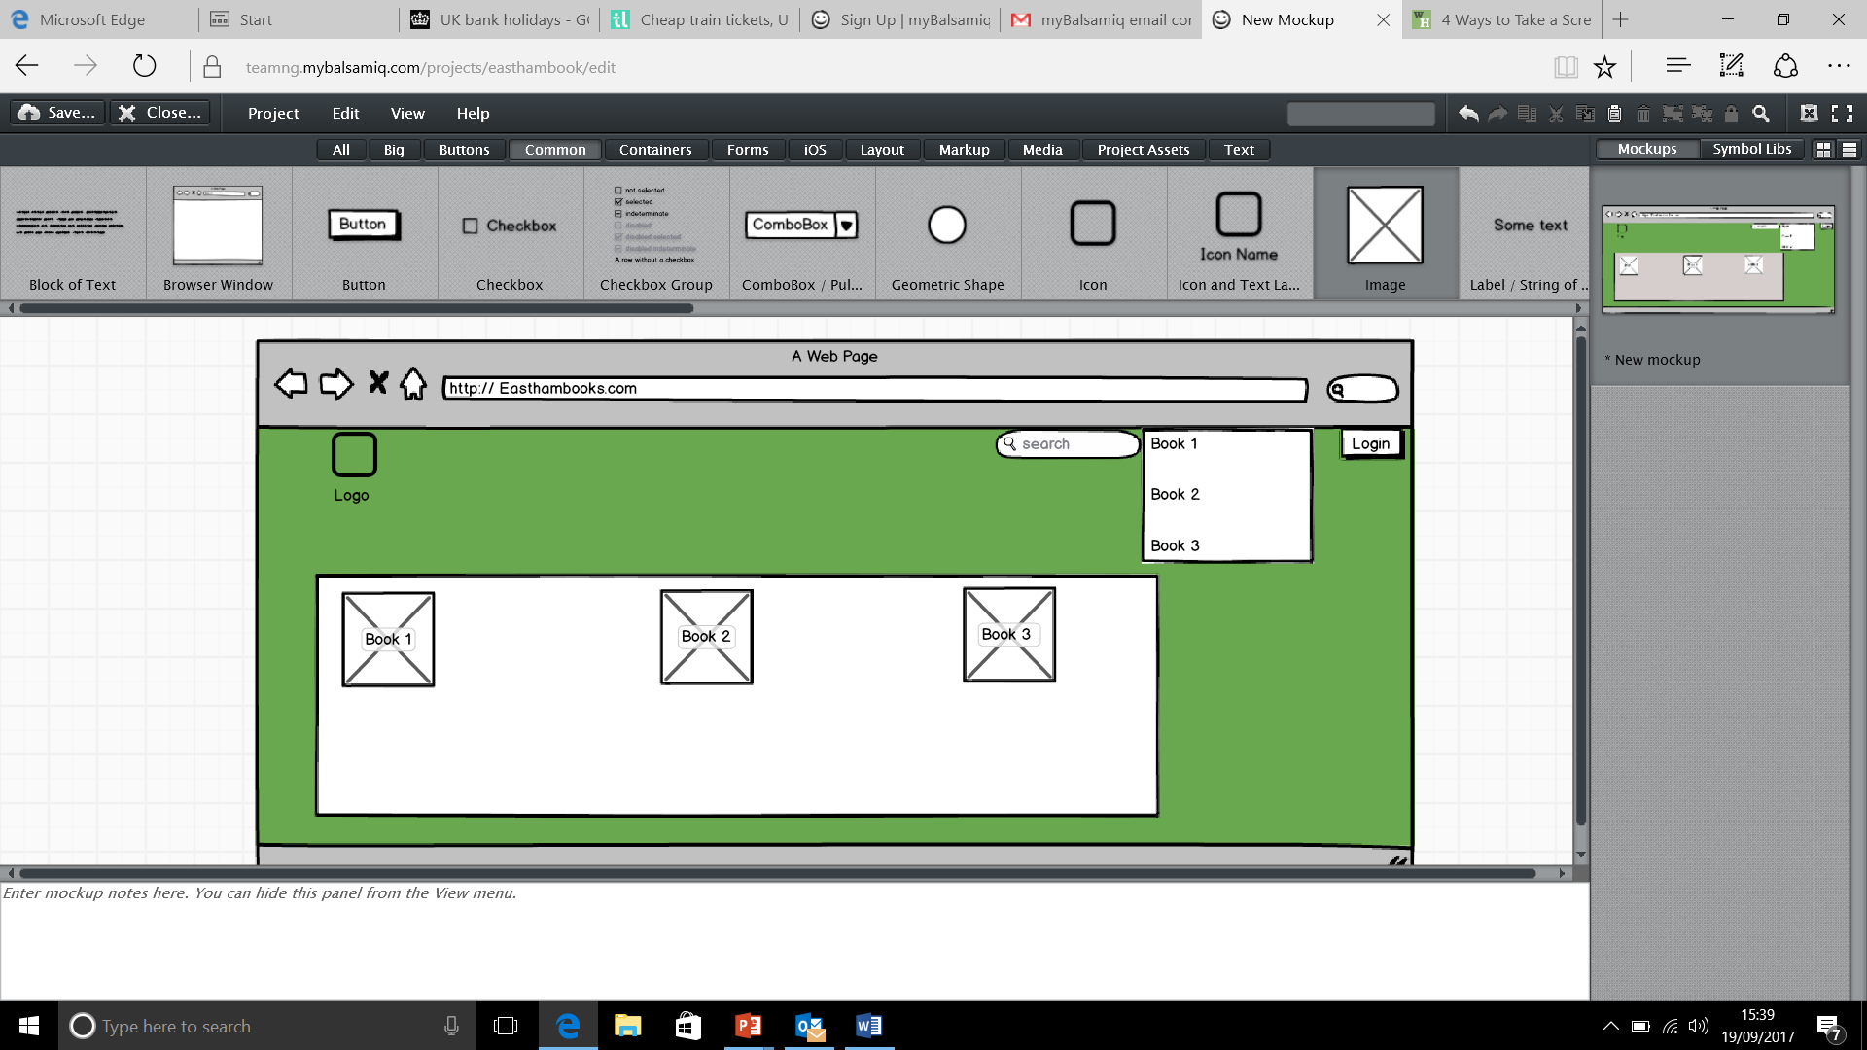
Mock ups

