Slide 1
Stepper Motors

Slide 2
Reminders!
The Final Project!
New Rubric
Parts taken home/parts over break

Slide 3
Some thoughts on reports

Slide 4
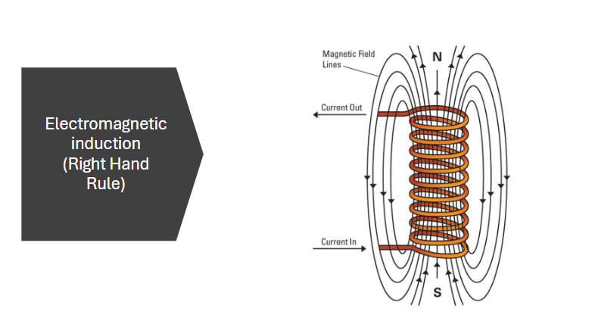

Slide 5
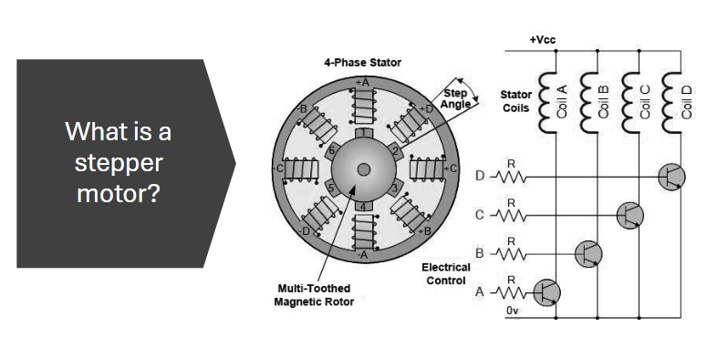

Slide 6
Forming Groups!!
Work with somebody you have NEVER worked with before (in the lab)
Make sure at least 1 of you have a USB Port!!

Slide 7
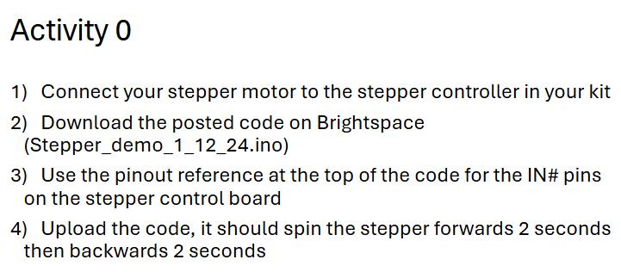

Slide 8
Activity 1
Wire either 1 joystick axis or a potentiometer to your Arduino
Using this input, program your stepper motor to go forwards and backwards with controllable speed
Hint: look up documentation for the map() function in Arduino

Slide 9
Activity 2
This is a DIY activity, with your newfound knowledge, make something cool!
There are plenty of sensors/outputs on the parts table, talk to TAs if you are looking for something specific
Only requirement is you must impress Ian or Jack!

Slide 10
Write-up (due Thursday 3-20 at 10AM!)
Write a report regarding Activity 2 following the guidelines used for Design Challenge 1!!!!!!

