Slide 1
Lab 1: KVL & KCL!!

Slide 2
Icebreaker!
Last night I was in bed trying to sleep and get over my cold
TOASTING BREAD IN A DIRTY AIRFRYER!!!
My housemates set off the fire alarm at 1AM
What did they do to set off the alarm?

Slide 3
Office Hours!!!!
Office hours will be held during the IEEE club general meeting timeslot which is.....
Tuesdays from 5PM --> 6PM
They can also be scheduled with TAs outside of this time, shoot us an email and we can schedule something that work for you!!!

Slide 4
Safety Trainings!!!
Has everybody signed the safety training sheet?

Slide 5
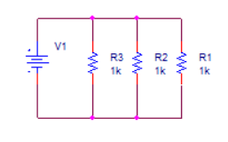
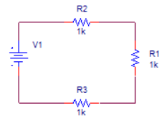
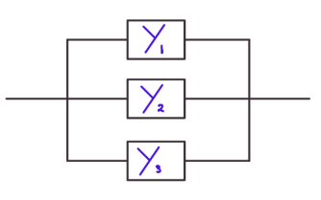
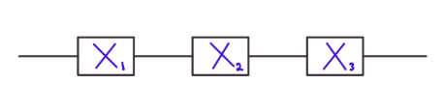
Parallel Vs. Series
Parallel Series

Slide 6
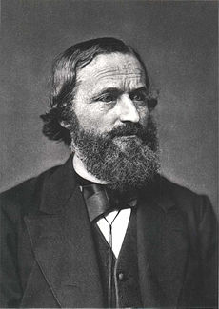
Gustav Kirchhoff
Was a German physicist that made huge contributions to the study of electrical circuits and spectroscopy, along with other branches of physics. His circuit laws are very useful to Electrical Engineering and were originally presented as his doctoral dissertation in 1845.
Source: https://en.wikipedia.org/wiki/Gustav_Kirchhoff https://www.britannica.com/biography/Gustav-Robert-Kirchhoff

Slide 7
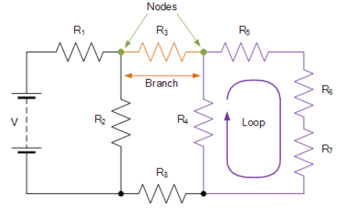
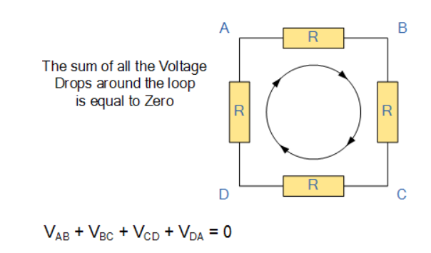
Kirchhoff’s Voltage Law (KVL)
The sum of all voltages within a closed loop must be equal to zero. The voltage change across a resistor is a voltage drop. The convention for labeling voltage drop can be seen in the equation below where VAB is equal to the voltage drop across the resistor circled in red.
Source: https://www.electronics-tutorials.ws/dccircuits/dcp_4.html

Slide 8
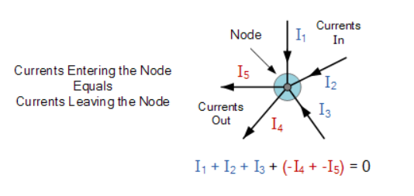
Kirchhoff’s Current Law (KCL)
The total current entering a node is equal to the total current exiting a node.
I_{(entering)} - I_{(exiting)} = 0
Source: https://www.electronics-tutorials.ws/dccircuits/dcp_4.html

Slide 9
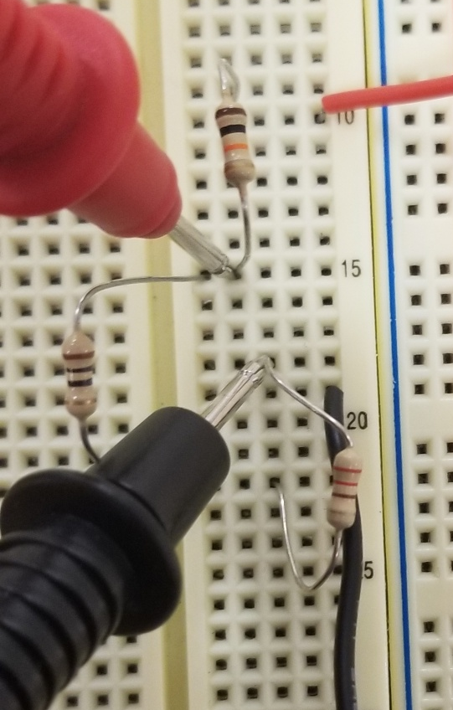
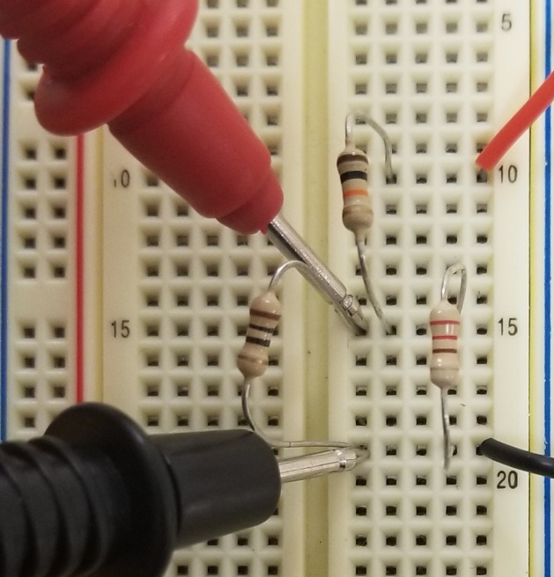
Measuring Current and voltage refresher
Voltage
DMM probes in parallel with component(s) of interest
DMM probes in series with branch of interest
Current

Slide 10
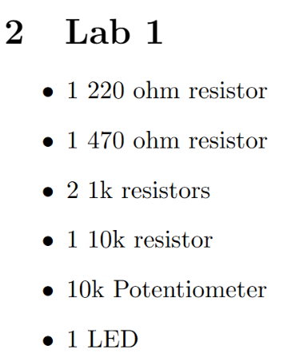
Grab components!!

Slide 11
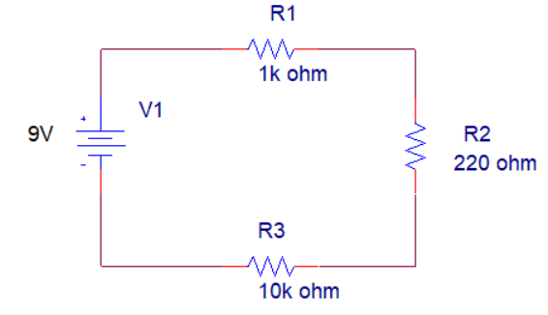
Activity 1: Voltage Divider Circuit
To demonstrate KVL measure and record the voltage drop across each resistor and show that the sum of all voltages in loop are zero.
Hint: When adding the voltages up the signs can be tricky so it should fallow this equation
9V – (VR1 + VR2 + VR3)=0
Notes:
1K Brown Black red gold 10k= brown black orange gold 220=red red brown gold 470= yellow violet brown gold

Slide 12
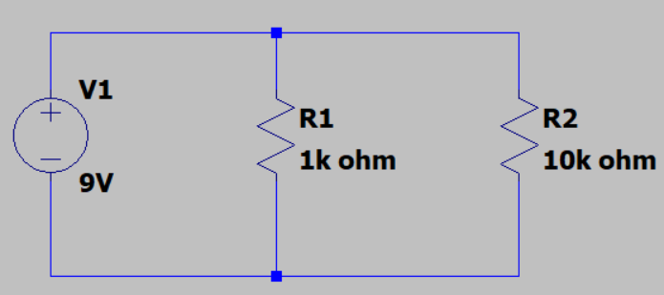
Activity 2: Current divider circuit
This is one node
Measure incoming (entering) current in your circuit, write it down
Measure the current through each of the resistors (exiting currents) and add them up. This should equal your measured current in Step 1!!!
Have a TA verify your results
entering
exiting
Created by Jack McTasney, EE-1100 Spring 2024 & 2025 TA

Slide 13
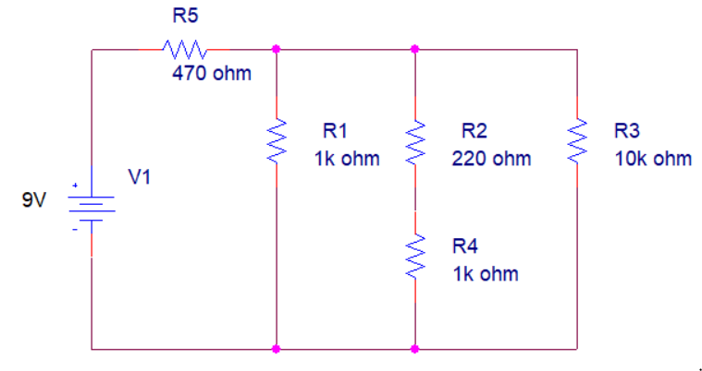
Activity 3: Combined
This circuit has both resistors in series and parallel. Measure and record the current though each branch and the voltage drop across each resistor in the circuit.

Slide 14
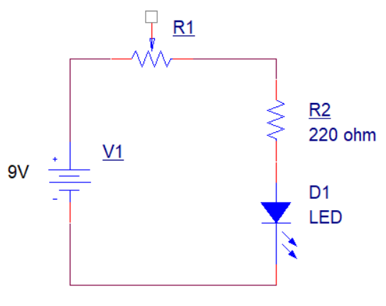
Activity 4: KVL and potentiometers
R1 is a potentiometer and can be used to vary resistance. After building the circuit see what happens to the LED when the potentiometer is turned. Then for two different positions of the potentiometer knob do the following:
Use DMM to measure the resistance of the potentiometer.
Measure the voltage drop across R1, R2, and the LED. Confirm that these values make sense based off KVL
3) Measure the current though the loop (the current is the same everywhere in this circuit).

