Slide 1
Intro to Arduino

Slide 2
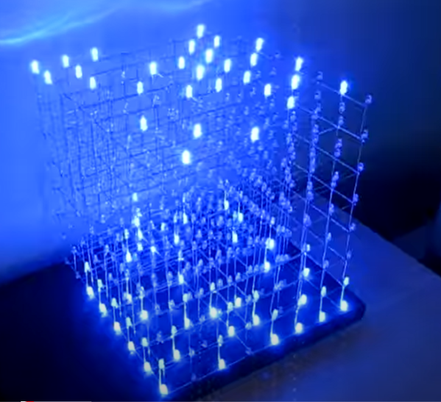
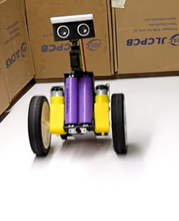
What is Arduino?
Arduino is an open source proto-typing platform that is an easy to code and implement in to designs. The microcontroller at the core of the Arduino Uno board is a ATmega328. Arduino can be used in many applications to interact with buttons, LEDs, Bluetooth, GPS units, cameras, motors ect.
https://www.youtube.com/watch?v=6mXM-oGggrM
https://www.youtube.com/watch?v=BjzaKMvR8s0
https://www.youtube.com/watch?v=T5Aq7cRc-mU
Notes:
https://www.youtube.com/watch?v=6mXM-oGggrM

Slide 3
What is a microcontroller
A microcontroller is a small computer-like IC chip. A microcontroller contains one or more processor cores (CPU) along with some memory and programmable inputs and outputs. Microcontrollers are designed for embedded applications.
Source: https://en.wikipedia.org/wiki/Microcontroller

Slide 4
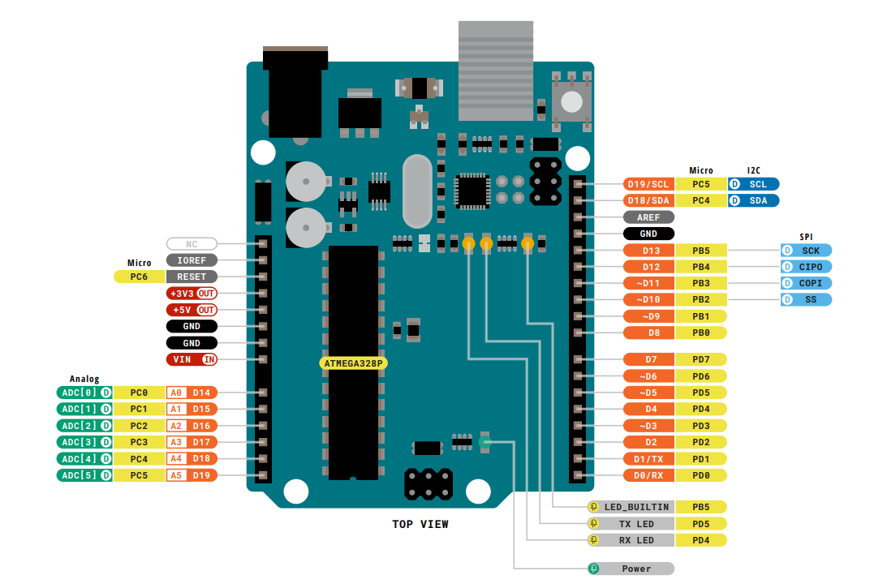
The Arduino Uno
This is a pinout (map of the pins) for the Arduino Uno!
Notice the pins labeled A and the ones labeled D, there's a reason for this!
Source: https://docs.arduino.cc/hardware/uno-rev3/, Jack McTasney EE-1100 TA Spring 2025

Slide 5
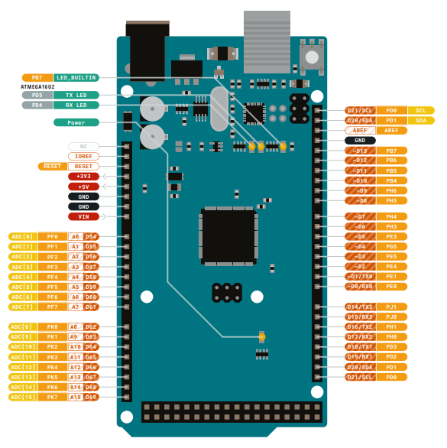
The Arduino Mega
This is a pinout (map of the pins) for the Arduino Mega!
Similar to the Uno, but with a ton more pins!
Source: https://docs.arduino.cc/hardware/mega-2560/, Jack McTasney EE-1100 TA Spring 2025

Slide 6
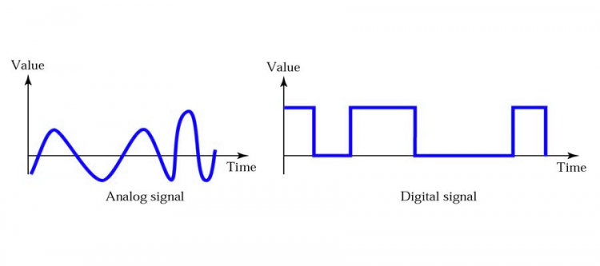
Digital vs. Analog
Analog information is a time varying signal of electric pulses of varying amplitude. Digital information is in binary format (zero: off or one: on) where each bit is representative of two distinct amplitudes.
The ATmega328 controllers used for the Arduino contain an onboard 6 channel (8 channels on the Mini and Nano, 16 on the Mega) analog-to-digital (A/D) converter. The converter has 10 bit resolution, returning integers from 0 to 1023.
Sources: https://www.diffen.com/difference/Analog_vs_Digital https://coeleveld.com/arduino-analog-vs-digital/, Arduino, EE-1100 2024 TA Jack McTasney

Slide 7
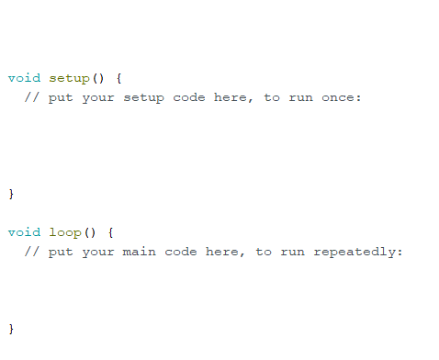
Parts of an Arduino Program
#include, #define, Declare any global variables (pin numbers)
Setup and other stuff you need to happen once (ex. motor settings, turn on radio, set pins to input or output)
Must be included in every Arduino program
Stuff you need to happen OVER and OVER and OVER again (infinite loop).
Source: Deborah Sigel

Slide 8
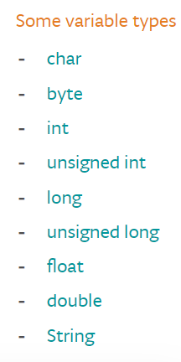
Variables
Declaring Variables
Before they are used, all variables have to be declared. Declaring a variable means defining its type, and optionally, setting an initial value (initializing the variable). Variables do not have to be initialized (assigned a value) when they are declared, but it is often useful.
Example:
int inputVariable1;
int inputVariable2 = 0;
int sensorPin = A0; // Example of defining sensorPin as an analog pin
int ledPin = 13; // Example of defining ledPin as a digital pin
Float sensorValue; // Example of initializing sensorValue as a float (this variable is just initializing a variable that will be set equal to a value later in the program)
Source: Arduino, EE-1100 2024 TA Jack McTasney

Slide 9
Void Setup() {
// this section is for setting up pins for inputs and outputs. Initializing things such as the serial monitor and over all setting up the program
pinMode(A0, INPUT); // sets analog pin 0 to input
pinMode(ForcePin, OUTPUT); // sets a predefined pin using the variable name ForcePin as an output
Serial.begin(9600); // initializes the serial monitor (where output is displayed)
}
Source: Arduino

Slide 10
Void loop() {
// this section is for the main bulk of the program it will step through the code in the order in is written and then once in reaches the bottom of the void loop it restarts at the beginning
// This example is for the blink program you will run later
digitalWrite(LED_BUILTIN, HIGH); // turn the LED on (HIGH is the voltage level)
delay(1000); // wait for a second
digitalWrite(LED_BUILTIN, LOW); // turn the LED off by making the voltage LOW
delay(1000); // wait for a second
}
Source: Arduino

Slide 11
Commonly used functions and other basics
analogRead() The function used to read the analog value of a pin
digitalRead() The function used to read whether a pin is LOW or HIGH
analogWrite() The function used to set a pin to a specific analog value
digitalWrite() The function used to set a pin to HIGH or LOW
pinMode() The function used to set up a pin as an INPUT or OUTPUT
delay() The function used as a time delay the input is in ms
Serial.begin(9600); The line of code used to initialize the serial monitor
Serial.println () The function used to print to the serial monitor
In general :
Capitals matter when calling functions and variables
There needs to be a semicolon after every line (exception is when calling a structure such as a for loop or if statement)
Sources: https://www.arduino.cc/reference/en/, Jack McTasney EE-1100 TA 2024

Slide 12
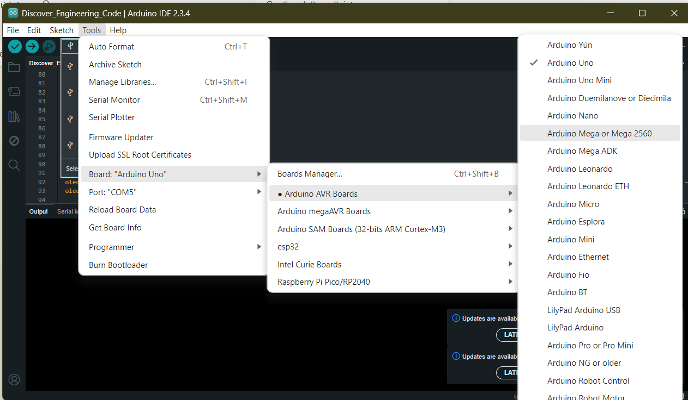
Setting up Arduino Mega or UNO?
Source: Arduino IDE, Jack McTasney Spring 2025 TA

Slide 13
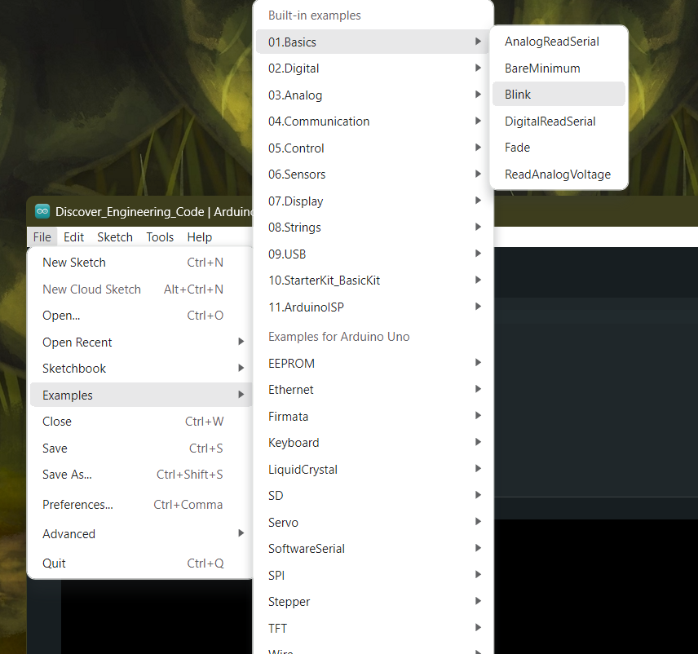
Activity 1: Blink
Run the example program “Blink” from Arduino. There is no external circuit this program uses the built in LED that is wired to digital pin 13.
This will verify your board works, let a TA know if the built in LED is not blinking!
Source: Arduino IDE, Jack McTasney Spring 2025 TA

Slide 14
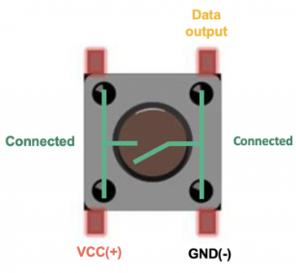
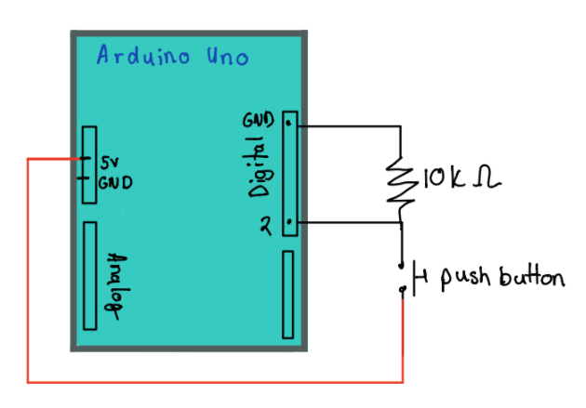
Activity 2: Reading a digital input
Write a program and build a circuit that reads a button press [as a digital input] and displays the state of the button to the serial monitor. Use the push button from the kit. Hint: Use digitalRead ();
Optional Activity:
Modify Activity 2 so that when the button is pushed an LED’s blinks in a patterns of your choice. Hint: Use an if statement

Slide 15
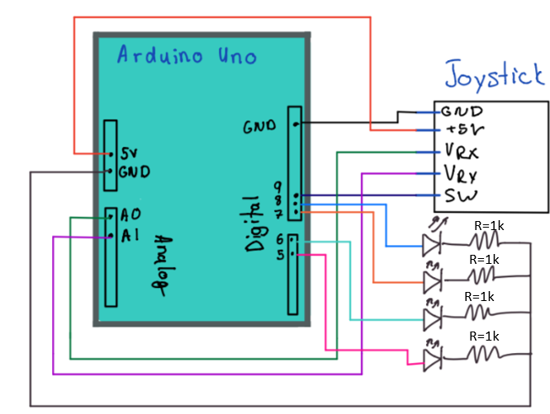
Activity 3: Reading an analog input AND doing something with it
Now, we will combine reading an analog signal with creating an output. This is a CRUCIAL application of embedded systems
A joystick has 2 potentiometers, each on their own axis, commonly referred to as X and Y. Each axis is read by the Arduino through the wiper pin as a value from 0-->1023 (10-bit precision).
By reading both joystick inputs, you will convert the 2 0 -> 1023 values into outputs that turn on the 4 LEDs in the respective range of the joystick
When the switch is pressed, all LEDs should turn on, at neutral all LEDs should be off
Source: EE-1100 2024 TAs Jack McTasney

Slide 16
Write-up (due Thursday 3-6 at 10AM!)
Write a report regarding Activity 3 following the guidelines used for Design Challenge 1!!!!!!

