Slide 1
Displays

Slide 2
Reminders!
The Final Project!
Office Hours (Makeups)!!!
What are the 3P's

Slide 3
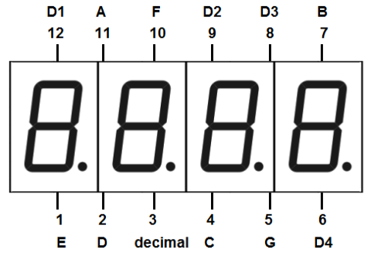
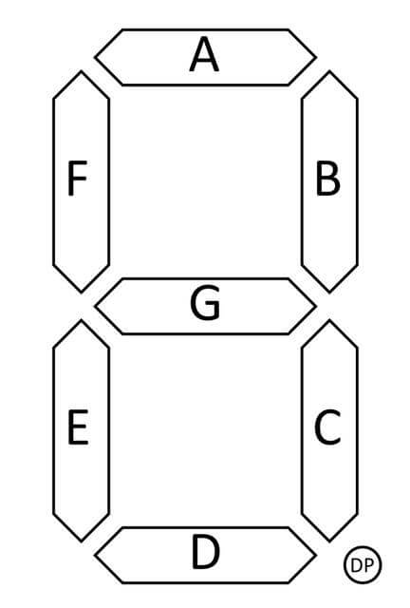
4x7 Segment Display

Slide 4
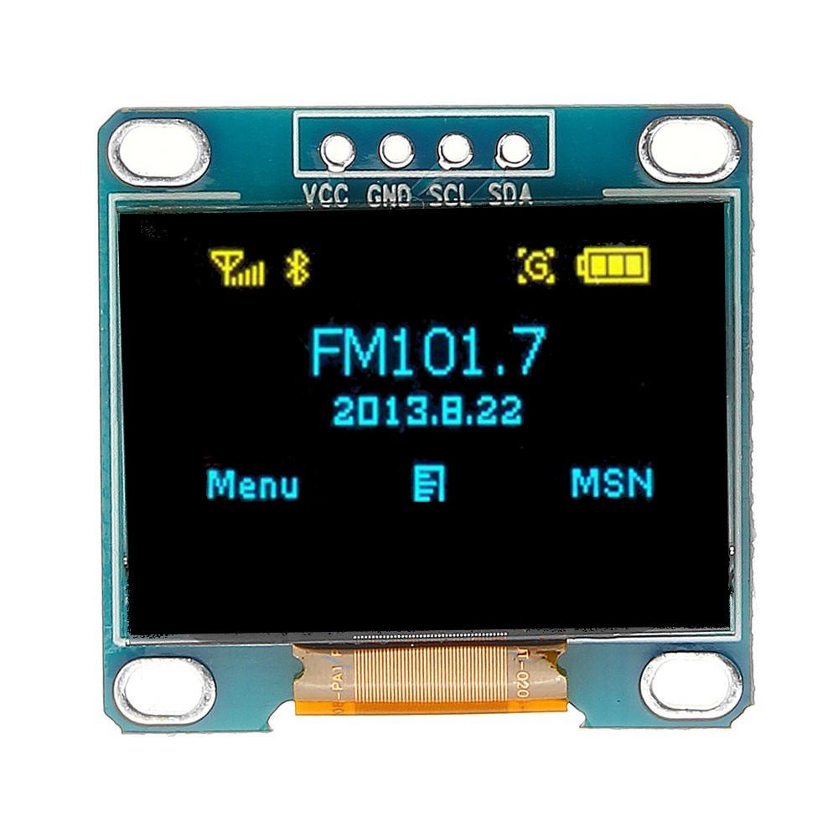
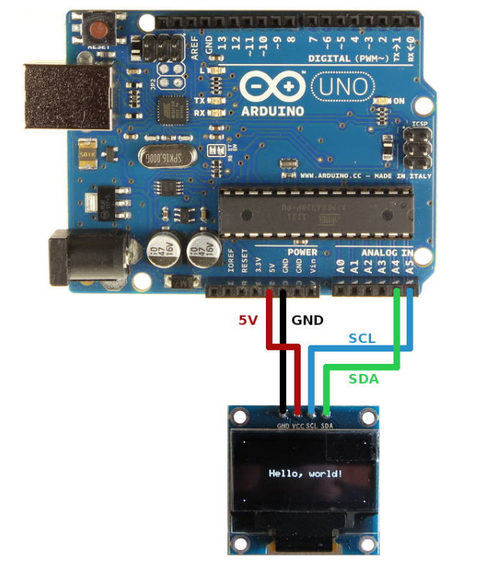
The i2c 128x64 OLED Display

Slide 5
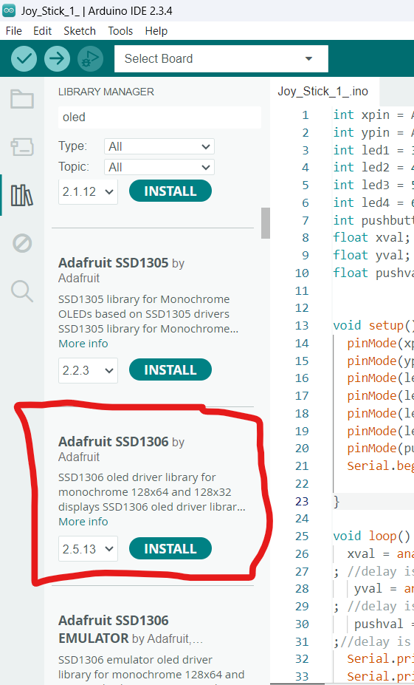
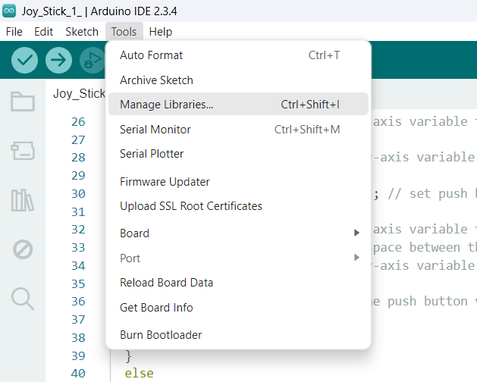
Downloading Library

Slide 6
Forming Groups!!
Work with somebody you have NEVER worked with before (in the lab)
Make sure at least 1 of you have a USB Port!!

Slide 7
This lab is a little different!
You get to choose, either use an OLED or a 4x7 segment display!

Slide 8
Activity 0
Upload the appropriate demo code to your board and wire as indicated in the sketch
If the circuit works as described, your components are working properly!

Slide 9
Activity 1.1 (OLED)
You will design your own motor control GUI (Graphical User Interface)
Must dictate how to make the stepper motor spin forwards/backwards on the display, along with adjustable speed

Slide 10
Activity 1.2 (4x7 Segment Display)
Make the 4x7 segment display show the 10-bit value of an analog input of your choice
This task will require some numeric manipulation, think how you are going to display each individual digit!

Slide 11
Write-up (due Thursday 3-27 at 10AM!)
Write a report regarding Activity 1.1 OR 1.2 following the rubric (REMEMBER THE 3Ps)!!!!!!

