Slide 1
Integrated Circuits and 555 Timers

Slide 2
Office Hours: IEEE General Meeting Hours
Tuesdays: 5:00 – 6:00
By Appointment
Location: Votey 334

Slide 3
Funky Fresh Reminders!
LEDs are directional components!!! (it matters how they are hooked up for them to work properly)
Watch your voltage on the power supply, the knobs are VERY sensitive
Try to use different color wires when your components are close together, this makes debugging your circuit easier!

Slide 4
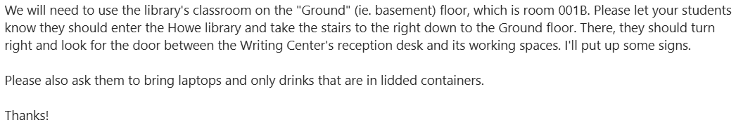
Field Trip next Tuesday

Slide 5
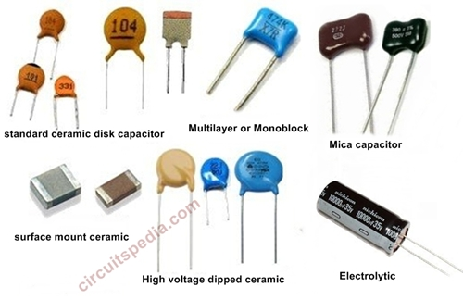
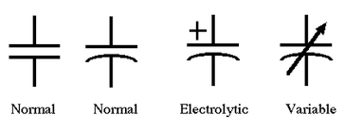
Capacitors
A capacitor is a device that stores electrical energy in an electric field. They are comprised of two conductors separated by a dielectric.
Various circuit schematic symbols
Source: circuitspedia.com https://electronicspost.com/what-is-a-capacitor-what-are-the-different-types-of-capacitors/

Slide 6
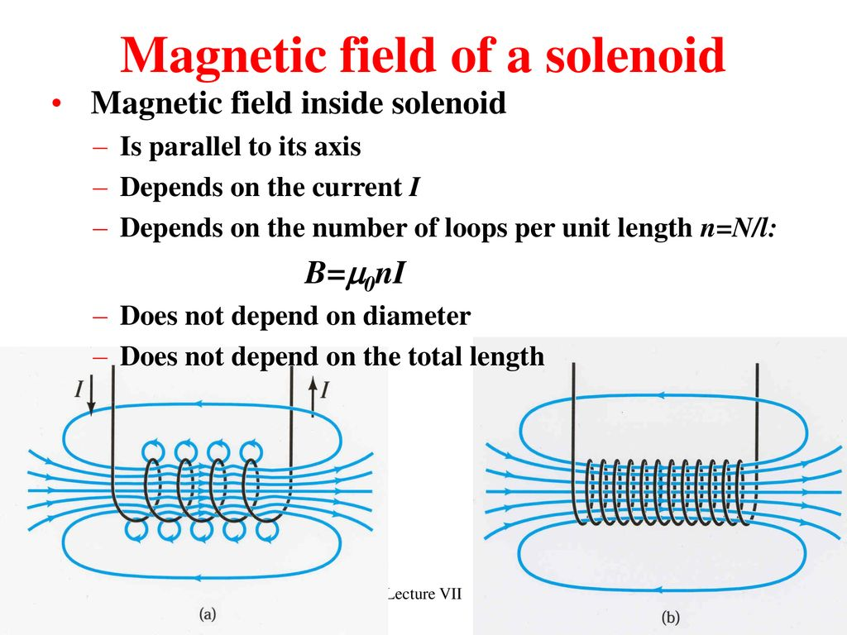
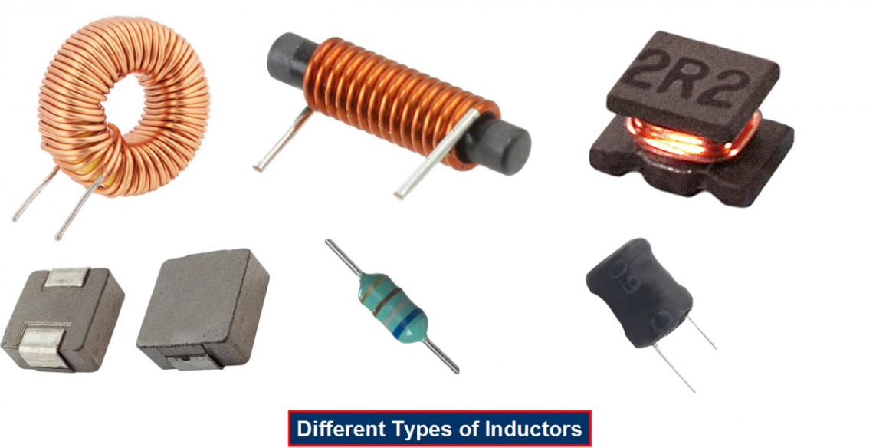
Inductors
Stores electrical energy in the form of a magnetic field

Slide 7
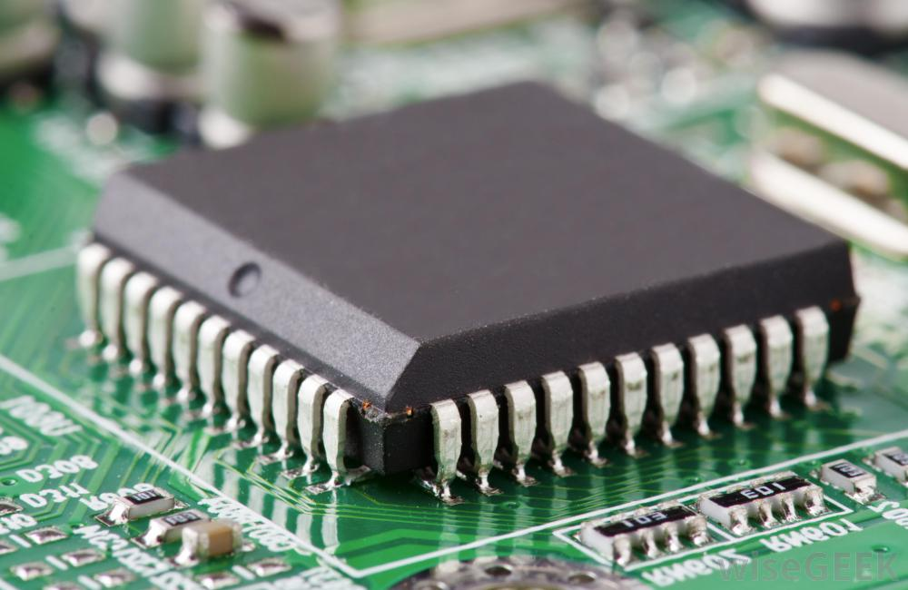
Integrated circuit (IC)
An integrated circuit or IC is an electronic circuit formed on a small piece of semiconducting material, performing the same function as a larger circuit made from discrete components.
Sources: Autodesk, Oxford Dictionary

Slide 8
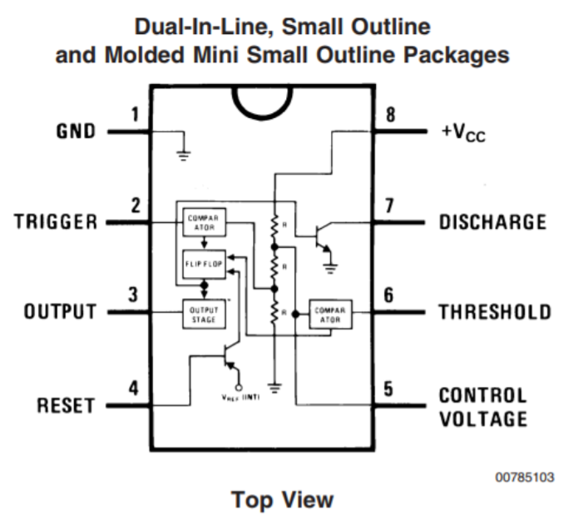
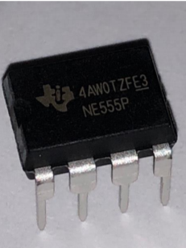
555 Timer
The 555 timer is a common IC used to created specific timed pulses. The IC can be operated in monostable mode, bistable mode or astable mode.
Sources: Texas Instruments datasheet and Khang Tran

Slide 9
555 Timer Datasheet Demo

Slide 10
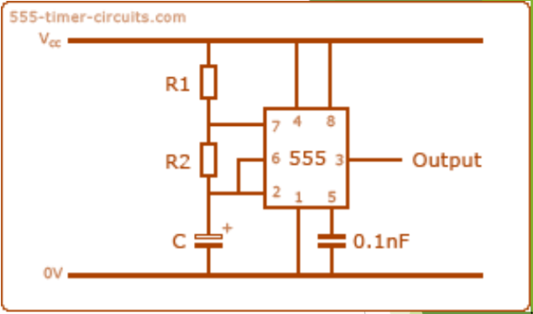
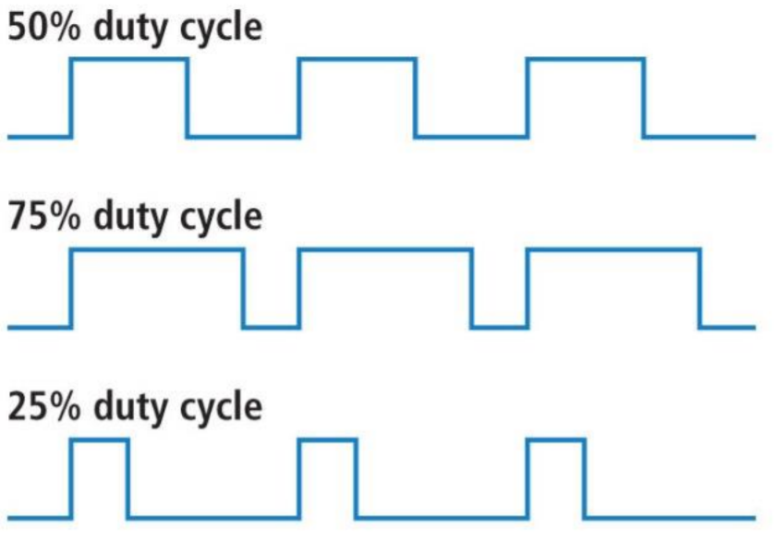
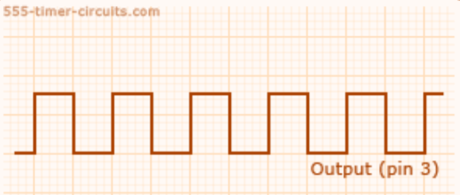
Astable mode
Astable or free running means that the timer will have an output unless you remove the power from the 555 timer. The output is a pulse train with a specific duty cycle which is specified by the “on” time.
Duty Cycle = R2 / (R1 + 2R2)
Sources: http://www.555-timer-circuits.com/operating-modes.html , Jameco Data Sheet /and National Semiconductor

Slide 11
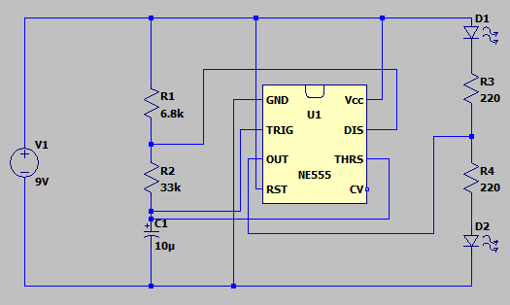
"Railroad Crossing Lights"
Review the Astable mode slide, put a potentiometer in the circuit that would vary the duty cycle of the output!
Hint: look at R1 and R2
Sources: LTSpice, Jack McTasney Spring 2025 TA

Slide 12
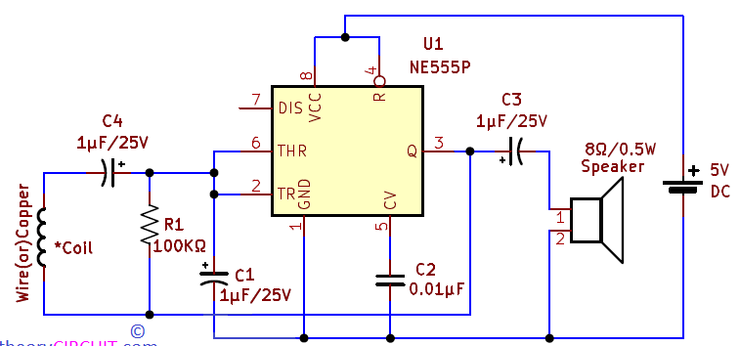
Ian's Super Awesome Magnet Detector

