Slide 1
SECURE
WEB
APPLICATION
DEVELOPMENT
USING THIS ONE WEIRD TRICK
ELDAR MARCUSSEN
@Wireghoul
RUXCON 2016

Slide 3
AGENDA
Simple concept
Does not require attacker knowledge
No owasp top 10
No sqlmap, burp, etc
Language “agnostic”
Knowing how to code = secure code

Slide 4
BACKGROUND
Variable taint tracking
Hungarian (Apps) notation
Making wrong code look wrong

Slide 5
RULES
Assign and taint user input
Untaint using whitelist or context safe
Operate on untainted variables

Slide 6
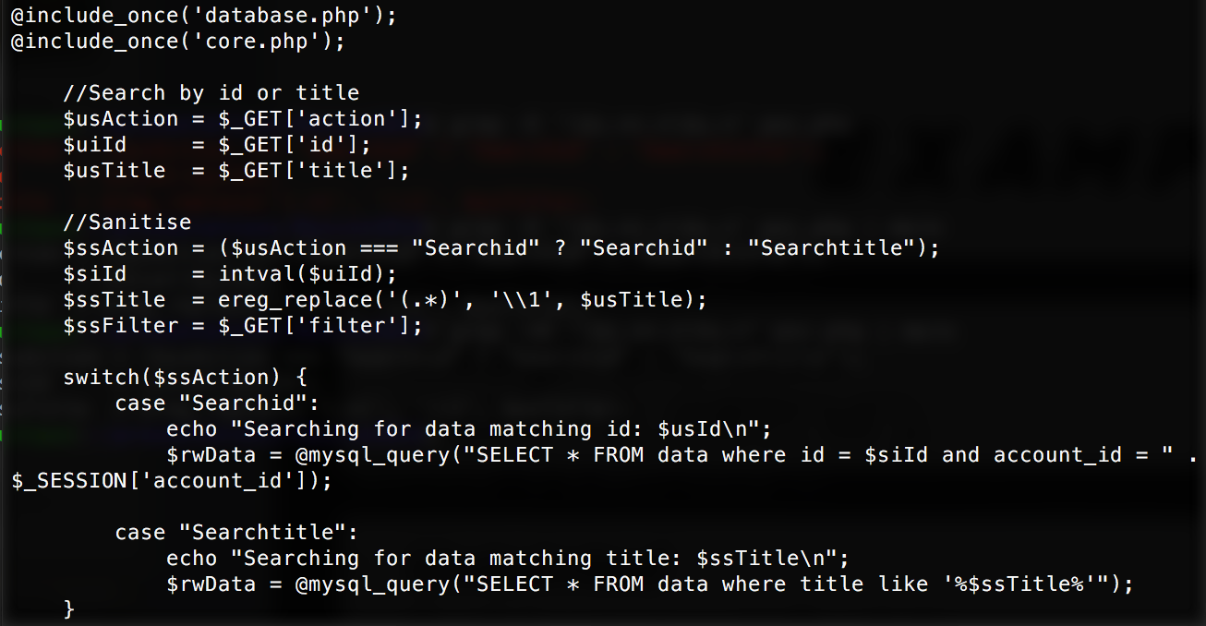
EXAMPLE
Assign and taint $uiId = $_GET[‘id’];
Untainted $siId = intval($uiId);
Operate on untainted $ur_data = @mysql_query("SELECT * FROM data where id = $siId and account_id = " . $_SESSION['account_id']);

Slide 7
AUDITING

Slide 8
AUDITING
Identify taint gaps grep -nE '\$_[GPRCES]' poc.php | grep -v '\$u.*= *\$_'

Slide 9
AUDITING
grep -nE '\$_[GPRCES]' poc.php | grep -v '\$u.*= *\$_'

Slide 10
AUDITING
Identify taint gaps grep -nE '\$_[GPRCES]' poc.php | grep -v '\$u.*= *\$_'
Check untainting grep -nE '\$s.*=.*\$u.*' poc.php

Slide 11
AUDITING
grep -nE '\$s.*=.*\$u.*' poc.php

Slide 12
AUDITING
Identify taint gaps grep -nE '\$_[GPRCES]' poc.php | grep -v '\$u.*= *\$_'
Check untainting grep -nE '\$s.*=.*\$u.*' poc.php
Tainted operations grep -n '\$u' poc.php | grep -v '\$s.*\=.*\$u' | grep -Ev '\$u[[:alnum:]_]+ *= *\S_[GPRCES]'

Slide 13
AUDITING
grep -n '\$u' poc.php | grep -v '\$s.*\=.*\$u' | grep -Ev '\$u[[:alnum:]_]+ *= *\S_[GPRCES]'

Slide 14
FIXED

Slide 15
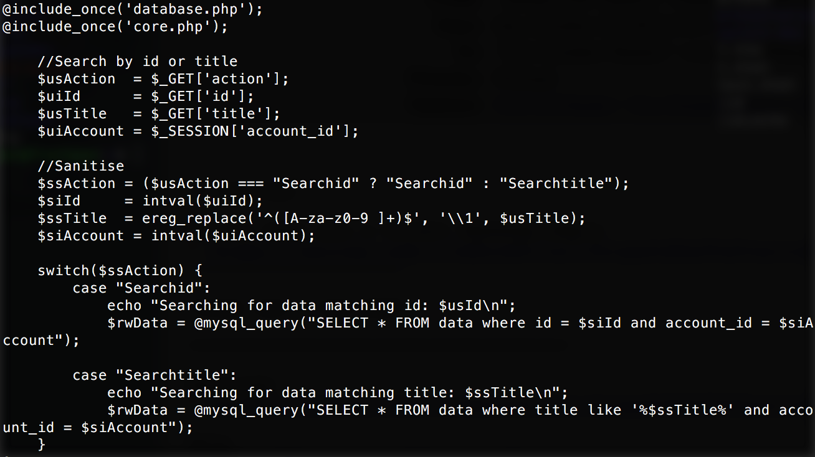
FIXED

Slide 16
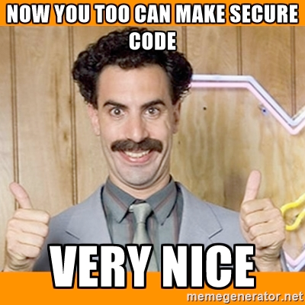
CONCLUSION

Slide 17

THANK YOU

