Slide 1
Operators and Expressions
Arithmetic operators
Expressions
Operator precedence
Notes:
Ok, in the previous section you learned about datatypes of python and you’ve learned in detail about the numeric data types, now in this section you will be learning about operators
Python has a lot of operators
But in this section I will cover arithemetic operators like addition, subtraction, multiplication division and so on
And we will be learning how to frame the expressions
Using variables as operands and the operators framed as expressions
Learning how to write expressions is very important because you have to take care of the precedence of operators which is basically the order in which you should write the operators, so focus on this topic, im going to cover everything in detail and try to practice whatever you see here, ok lets start

Slide 2
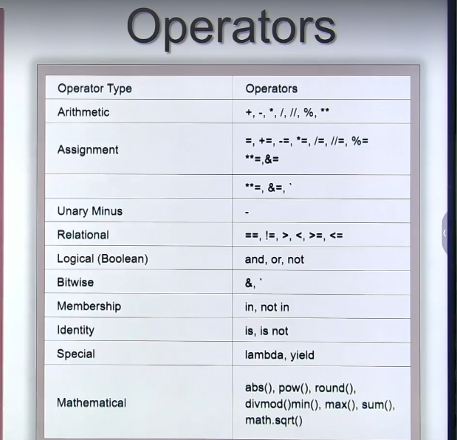
Operators
Notes:
The topic is operators, so first of all we’ll take a look at all the operators available in python
So here you can see the table listing all of them
If you see the operators, they are the arithemetic, assignment, unary minus, relational, logical, bitwise and so on, so as you can see python has a lot of them, so maybe we’ll be using a lot of these operators, so we should get well aquainted with a lot of them, but we’ll do this slowly, so the first thing we’re going to look at are arithemetic operators
So what are these? Addition, subtraction multiplication and so on

Slide 3
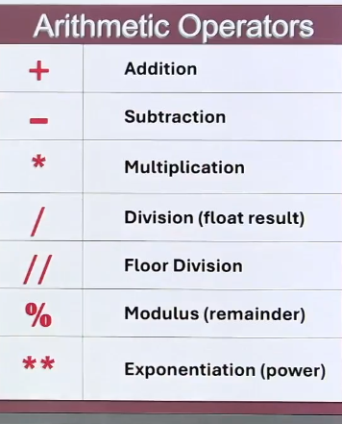
Notes:
Ok, lets take another look at arithemetic operators, so heres the list, as you can see these are simple things you’ve already learned like addition subtraction etc, but in addition to that you have floor division, modulus, exponential operators you may not have heard before and thats why we have to learn in detail about arithemetic operators
Alright we will learn about them one by one, lets look at addition first

Slide 4
Arithmetic Operators
Addition
a = 10
b = 15
c = a+b
operator
operand
operand
Notes:
So first of all I’ll take two variables, I’ll take a to be 10 and b can be assigned 15, as you can see c assign a plus b is an expression for adding two numbers, so the result is stored in c from the addition of a and b
The assign operator does not mean equal to, store the result in c
Now lets learn a little about the expression
You’re looking at an expression for the first time, so lets look at it, so the a and b are called operands and c is also an operand, the addition is called an operator so any results returned by operands and operators is called an expression, so we’ve written an expression for adding two numbers
Anyway when I perform add what happens?

Slide 5
Arithmetic Operators
Addition
a = 10
b = 15
c = a+b
c
25
Notes:
This is what happens, this is what looks like in memory 10 plus 15 is 25, so ive shown you how it looks in memory
Thats it
Addition is a very simple thing so it was the perfect example to show the rest of the things using it such as operands, operators and what an expression is
Now lets go to the next operator, that is subtraction

Slide 6
Arithmetic Operators
Subtraction
a = 20
b = 15
c = a – b
5 = 20 - 15
Notes:
Again I’ll take two variables here
Variable a as 20 and b as 15
Now lets write an expression for subtracting using the subtraction method
So if I write c assign a minus b
Then this is 20 – 15, so the result will be what?
5
This is whats stored in c
How does this look in memory?
You already know this, one more thing

Slide 7
Arithmetic Operators
Subtraction
a = 20
b = 15
c = b – a
-5 = 15 - 20
Notes:
If I change a minus b to b minus a, whats going to happen?
You get 15 – 20 so the result will be negative 5, yes obviously you’ll get the result as negative, so this was about the subtraction operator
Now lets go to the next operator that is multiplication

Slide 8
Arithmetic Operators
Multiplication
a = 4
b = 7
c = a * b
28 = 4 * 7
Notes:
If I have two variables 4 and 7
And if I write an expression c assign a times b
That is 4 times 7, the result in c is 28
So this multiplication has the same behaviour as the normal mathamatical multiplication behavior, so this is pretty simple to understand, now lets take the next operator, lets skip division and go to floor division

Slide 9
Arithmetic Operators
Floor division and Modulus
a = 14
b = 4
4 ) 14 ( 3
-12
2
Notes:
And I’ll pick up another operator along with it modulus
So we’ll learn floor division and modulus together, they are often related
So we’ve taken two variables here a as 14 and b as 4, so we’re going to see what the two slashes mean, first we’ll do mathematical division, so how we divide in mathematics normally, we’ll do the same thing, so 14 divide by 4, 4 3s are 12, so 12 is subtracted and the value remaining is 2, so when 14 is divided by 4, it splits into 3 parts and the remainder’s what? 2, no lets divide it further

Slide 10
Arithmetic Operators
Floor division and Modulus
a = 14
b = 4
4 ) 14 ( 3.5
-12
20
- 20
0
Notes:
I’ll put a single point here with a 5, this is 20 and this becomes 0, so I completely divided 14
But no, we don’t want the division beyond the decimal point, let us go back

Slide 11
Arithmetic Operators
Floor division and Modulus
a = 14
b = 4
4 ) 14 ( 3 quotient
-12
2
remainder
Notes:
Now we’re back, so we’re left with just 3 and just 2 again, we’ll stop here, we’ll not take the decimal points, this is what the floor division does, the 3 is called the quotient and then 2 is called the remainder, so quotient and remainder, when you’re not dividing it completely, you’ll get some remainder, so the remainder may be 0 or more, so lets see how to get this 3 in python, so to just get the three without the decimal point, we have to use the floor division

Slide 12
Arithmetic Operators
Floor division and Modulus
3 14 // 4
4 ) 14 ( 3 quotient
-12
2
Notes:
So 14 floor division 4 returns the value 3, so actually its not giving the decimal value so we also call it integer division
Yes, this is integer division
If you want to divide it completely, then you’ll get a floating value 3.5 we’re not taking the point 5 only 3, so this is why this is called floor value truncated value, so integer division or floor division, now what about the remainder, if you want the remainder in this division, then in python you can use the mod operator
So what do we write?

Slide 13
Arithmetic Operators
Floor division and Modulus
3 14 // 4
2 14 % 4
4 ) 14 ( 3 quotient
-12
2
Notes:
14 mod 4 gives you the remainder which is 2
Thats it
So this is a special operator given in python for integer or floor division that is double slash
Now usually in all programming languages there will be only one division operator, the floor division, when it gives you the integer value only, but for python it looks like a double slash
Ok, so we’ve seen floor division where the result is 3 and the other line we saw mod
Ok lets go to the next operator

Slide 14
Arithmetic Operators
Float division
3.5 14 / 4
3 14 // 4
2 14 % 4
4 ) 14 ( 3.5 quotient
-12
20
- 20
0
Notes:
Now we’ll look at the float division, this will give you the result with a decimal
So as you can see we’re dividing futher from 3 we have to put in a decimal point so just like in the previous slide we’re putting in a point 5 so that there is no more remainder so the quotiant becomes 3.5, its 3.5
How do you get this quotient?, by using the single forward slash operator, so if you see at the top, 14 divided by 4, it the expression returns a 3.5, this is float division
Thats it, so you can see the 3 operators are related to one another, this is float division, and as you can see the floor division just gives you a whole number 3 and the mod gives you a remainder which is 2
Thats it, ok, now lets look at the exponential operator

Slide 15
Arithmetic Operators
Exponentiation ( Power )
2⁵ ⁼ 2 * 2 * 2 * 2 * 2 = 32
2⁵ ⁼ 2 ** 5
32 2 **5
Notes:
This is the power operator, now what does this mean? Lets look at it
If in mathematics I write 2 to the power of 5 what does this mean? This means 2 multiplied by 5 so 2 into 2 into 2 into 2 into 2
So 2 4, 8, 16, 32, this is in mathematics
Now if I want to write this in python? You have to write down double star, so yes, multiplication means a single star, power means double star
So 2 double star 5 returns 32
Thats it
So we’ve now learnt about the power operator
Thats all about the arithemetic operators
Addition, subtraction multiplication were very simple, division was a little bit different, and the exponent is a new type of operator available in python not in other programming languages, now lets try these quickly in our python editor
For this I’ll take our values a=14 and b =4

Slide 16
Expressions
Notes:
Alright, lets look at expressions
So you’v already learned about arithemetic operators
And you’ve seen how they work, the working of the operators
Now using these operators we can write different formulas or we can compute the results of various formulas
That means we’ll be writing expressions
So lets learn about expressions in details
There are a few important things you must know about these thigns
This topic is very important, so lets look at whats going to be present in this lecture

Slide 17
Expressions
What are expressions?
Precedence of Operators
Associativity of Operators
Importance of Parenthesis
Notes:
So first of all ill explain to you what it means by expressions, so what are they
Then we’ll look at precedence of operators
This is a new thing
Yes
Then associativity of operators
Then we’ll see whats the importance of paranthesis
What are these
We will see that one by one
And we have to understand all these things
Let us start with what are expressions

Slide 18
Expressions
What are expressions?
x = a + b * c
operands
operators
Notes:
Let's consider an example of an expression. Here is one form: X = A + B * C. This is an expression. Expressions are written using operators, as you know. The operators here are addition, multiplication, and assignment. A, B, C, and X are all operands. So, expressions are constructed using operators and operands. When you compute them, you get a result. Let us see how these expressions are computed. We will take an example expression to illustrate.

Slide 19
Expressions
What are expressions?
x = 4 + 3 + 5
Notes:
Let us take an example expression. The expression is X = 4 + 3 + 5.
So, how is this computed?

Slide 20
Expressions
What are expressions?
x = 4 + 3 + 5
7
12
Notes:
First, four and three are added, and the result is seven. Then, that seven is added to five, so the final result is 12. This is how the expression is executed.
We are interested in understanding how an expression is executed. We have already defined what an expression is, and now we are learning how it is evaluated.
Let us consider another example.

Slide 21
Expressions
What are expressions?
x = 2+ 3 * 5
5
25
Notes:
For that c x assign two plus three multiplied by five.
So how this is executed?
What is the result.
See first two plus three is added and the result is five.
Then this multiplication is done.
So five multiplied by this five gives 25.

Slide 22
Expressions
What are expressions?
x = 2+ 3 * 5
5
25
X
WRONG
Notes:
No, this is wrong.
If you know basics of mathematics also, this is wrong.
Why?
First multiplication is done.
Why its precedence is higher.

Slide 23
Expressions
What are expressions?
x = 2+ 3 * 5
15
17
Notes:
So let us go back and clear it and start once again.
So first multiplication is done three into five.
That is 15.
Then that is added with this two.
So the result is 17.
Yes this is the right answer.
So it means that the operators have the precedence and priority.
Based on that, they will get executed.
Yes.
So now let us see.

Slide 24
PRECEDENCE OF OPERATORS
Notes:
So for that, I will show you the table of all the operators here in Python.

Slide 25
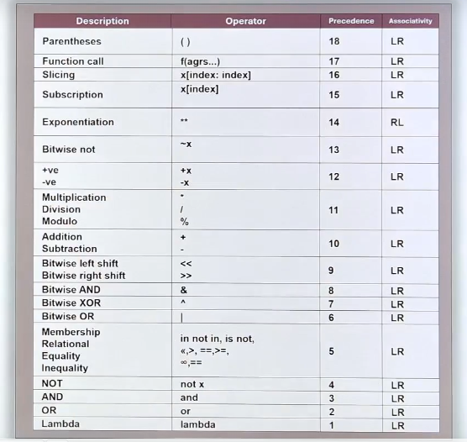
Notes:
Now you can see that these are the names of the operators.
Description is given.
And these are the symbols of operators.
And here the precedences are given.
And here the associativity are written okay.
Names are okay.
Operators.
We are not familiar with all of them.
Slowly we are going to learn.
Now precedence.
If you see every operator is having its importance or priority.
Or you can say that is precedence.
So if you see it's starting from bottom one, two, three, four, five, six, so on and up to 18.
So the least important operator is this one or least precedence.
Is this one.

Slide 26
Notes:
The highest precedence?
Is this one parenthesis?
And what is that?
Associativity.
Let us look at it.
LR.
LR, RL is there.
One of them is RL and LR, LR.
Yeah.
That is associativity.
LR means left to right and RL means right to left.
What is that?
Associativity.
We will learn that in this lecture only.
So we will learn what is precedence.
What is associativity?
Then also we will see what is the importance of parenthesis.
Now from all these operators will pick up those that are related to arithmetic operators.

Slide 27
Notes:
So I will select what addition subtraction multiplication division and exponent.
And also I will pick up parenthesis.
Let us put all these together here.
So these are the operators parenthesis.

Slide 28
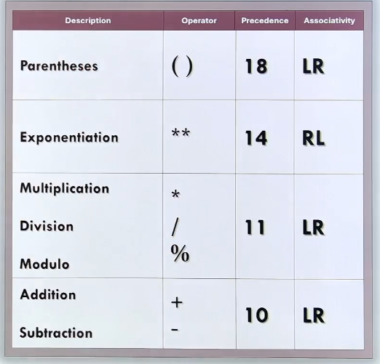
Notes:
Ok these are the operators
Parenthesis, the symbol and the precedence is 18 with an associativity of left to right
Exponent double star with a precedence of 14 RL, which is different
Multiplication, division, modulo, all of them have the same precedence which is 11 and associativity is left to right
Addition and subtraction they have equal precedence

Slide 29
Expressions
Precedence of operators
X = 2 + 3 * 5
15
Notes:
Alright, lets put the table to the side
We’ll use it to understand what is precedence operator and what is associativity
So for an explanation I’ll show you the expression here
So this is the same epxression we did initially incorrectly and then correctly after that
So lets see which operators are present here in the expression
Addition and multiplication
Precedence of addition is 10
Multiplication is 11
So 11 has a higher precedence
So first 3 * 5 gets exectuted
So whats the result of it?
15, so one operation is over, now the next operator is addition

Slide 30
Expressions
Precedence of operators
X = 2 + 3 * 5
15
17
Notes:
So this has the next precedence, which is 10, so now 2 is added to 15 and the result is 17
Thats how the oeprators are executed based on the precedence
This is present in mathematics also
We call this bodmass
And here we just present a precedence table, so you can workout which operators get executed first
So this is an important point
So anyway the simplest thing is that multiplication, division and modula have a higher precedence than addition and subtraction, above that is exponentiation and then parenthesis

Slide 31
Expressions
Precedence and Associativity
X = 5 + 2 * 3 – 8 / 2
6 4
Notes:
Ok, now lets talk about precedence and associativity together
Lets talk about these two things together
Now for this lets look at the given expression
X assign 5 + 2 * 3 – 8 / 2
So there are 4 operators
Addition multiplication subtraction and division
Out of them multiplication and division have the higher precedence afther these we got addition and subtraction, because 11 is greater than 10 right?
So 2 * 3 and 8 / 2 get executed first, but if they have the same precedence..which of the two gets executed first?
Which one?
Then we follow associativity, which is left to right, so first the multiplication will be done, then the division
Thats what happens, if the operators have the same precedence then they are executed based on their associativity, which in this case is left to right, so now you know what associativity is, so we have 6 and 4

Slide 32
Expressions
Precedence and Associativity
X = 5 + 6 – 4
11
Notes:
So lets simplify the expression
Now lets perform the addition and subtraction to get the final result, as we can see their precedence is 10
So now we will follow the left to right associativity again since they have equal precedence, so we work out 5 + 6 is 11 first

Slide 33
Expressions
Precedence and Associativity
X = 5 + 6 – 4
11
7
Notes:
After which we subtract the 4 which gives 7
Thats it
So now I’ve explained associativity and presedence together
Now lets see something about associativity, as you can see exponentiation, it has right to left

Slide 34

Expressions
Associativity of Operators
X = 2 ** 3 ** 2
2
(3)²
( 2³ )^{2 x}
Notes:
Ok lets learn about associativity of an operator
Lets take x assign 2 to the power of 3 to the power of 2, this is the expression we’ve written in python
So how is this expression represented mathematically? The expression to the left is wrong
It means 2 to the power of something and that something is 3 to the power of 2, so the 3 to the power of 2 is evaluated first
This is because the assosiativety is right to left

Slide 35
Expressions
Associativity of Operators
X = 2 ** 3 ** 2
9
Notes:
Look at the slide, so 3 to the power of 2 gets executed first it becomes 9 then the 9 becomes the power of 2

Slide 36
Expressions
Associativity of Operators
X = 2 ** 3 ** 2
9
512
Notes:
So this is what the operation looks like
So the answer is 512
So you can see both the operators are the same, that is exponent operators, but whats the associativity? Right to left
So this is a very important concept for you to understand left to right and right to left associativity, ok thats it ive explained about all the operators
This means for writing an expression I should be very careful
Right?
I should know what the precedence is and what the associativity...right?
If I do this wrong, then the results will also be wrong
Yes
Writing a proper expression is the responsibility of the programmer

Slide 37
Expressions
Associativity of Operators
X = 2 ** 3 ** 2
9
512
Notes:
Actually there is an easy solution to this
What’s that?
You can use paranthesis

Slide 38
Expressions
Importance of Parentheses
Notes:
Now lets learn the importance of parantheses
So who’se precedence is the highest amongst all the operators?

Slide 39
Expressions
Importance of Parentheses
X = 5 + 2 * 6 – 4 / 2
5 12 2
Notes:
its the round brackets right? 18
And its associativity is left to right?
So heres an expression I’ve taken, lets examine it
We’ve got addition, multiplication, subtraction and division
Now how does this get executed, this is based on precedence
So first we’d do multiplication and division
12 and 2
After this addition and subtraction are done
So 5 – 12 + 2
This is based on the precedence
But suppose we want this to be executed differently
Not in this order
How will we do this?, so I want 5 + 2 first

Slide 40
Expressions
Importance of Parentheses
X = ( 5 + 2 ) * 6 – 4 / 2
Notes:
So we put it in brackets, then I want 6 – 4 in brackets

Slide 41
Expressions
Importance of Parentheses
X = ( 5 + 2 ) * ( 6 – 4 ) / 2
7 = 7 * 2 / 2
Notes:
So we put it in brackets aswell
So first I want the addition to be done and then subtraction and after this multiplication and division
You’ve changed the order of precedence of operators
Execution will be done based off of the parenthesis
Whatever is done inside the paranthesis that’ll be done first
So whats the result?
So 5 + 2 is 7 and 6 – 4 is 2
After this multiplication and division are done so the final result is 7
So thats how parenthesis can change the order and associativity of the operator using this you can write down your desired expression

Slide 42
Expressions
Importance of Parentheses
X = ( 5 + 2 ) * ( 6 – 4 ) / 2
X = ( ( ( 5 + 2) * ( 6 – 4) ) / 2 )
Notes:
Ok heres an example in red
Hows this going to get executed?
5+2 then 6 -4 then these two will get multiplied then that will get divided by 2
Thats it
This is basically what paranthesis do
Ok, now I’ve explained to you what is meant by an expression, precedence associativity and paranthesis
You’ve learned about arithemetic operators and how to write their expressions
Ok next up we’re going to learn how to write a complete program

Slide 43
Program using Expressions
How to write a program?
Notes:
Alright now we’re going to look at programs using expressions
In the previous seciton we saw various arithemetic operators,
Now using those operators we can write expressions
In the form of a complete program and execute it in the editor

Slide 44
Program using Expressions
How to write a program?
Program to find Area of a Rectangle
Breadth
length
Notes:
Ok we’re going to find the area of a rectangle
We’re going to write a complete program for this
So let me first explain what a rectangle is then how to go about finding its area, so once you know its formula you can write the program
Observe the yellow rectangle its a 4 sided object, opossite sides are equal we call two sides length and the other two are breadth

Slide 45
Program using Expressions
How to write a program?
Program to find Area of a Rectangle
5
Breadth
15
length
length
Area = length * breadth
Notes:
Lets assume the length is 15 units
So how do we calculate the entire area
So the region occupied by the rectangle
For this, there is a formula
Area is length multiplied by breadth, this will give you the entire area
Thats it
So this is the program what we’re going to be writing for, to write an area of a rectangle when length and breadth are given to you
So for that

Slide 46
Program using Expressions
How to write a program?
Python Program
Program to find Area of a Rectangle
Length = 15
Breadth = 5
Area = length * breadth
Print ( ‘ Area :’ , area )
5
Breadth
5
15
15
length
Area = length * breadth
Notes:
Lets look at a python program on the left
So first of all ill write a simple program
So I’ll take the length variable and initialize it to 15
And the breadth variable ive initialized it to 5
To calculate the area I just assign area to length multiplied by breadth, sorry I assign length * breadth to area
And then finally print the result to the screen so notice we have area in speachmarks and then area outside of it, the first one is a string literally which will write area and then the actual variable of area will be printed after it
So area colon 75 will be displayed
This will be the result
So this is the complete program
Ok lets try this in our python editor

Slide 47
Let’s write this program in Jupyter

Slide 48
Problem Statement:
Write a Python program to calculate the area of a rectangle using its length and breadth.

Slide 49
Challenges using Expressions

Slide 50
Challenges using Expressions
Area
Triangle
Trapezium
Circle
Km to miles
Displacement
Notes:
Alright, lets take a look at challenges using expressions
In the previous section we learned this, so we need to reinforce this
We’ll take a few known formulas and convert them into python expressions
We’ll also complete them as challenges
So we’ll make complete programs
Ok, let us start
The first challenge is related to area, so I’ll write a program finding the area of a triangle, trapezium and a circle
Then we’ll look at an expression which converts km to miles
And then calculating displacement
I’ll explain all these formulas converting them into python programs, ok, lets start with the area of a triangle

Slide 51
Expression Challenges
Area of a Triangle
area = ½ x base x height
area = ½ * base * height
height
base
Notes:
Here you see on the left a triangle the bottom I’ve labeled as the base and the horizontal line im calling height, so the question how do I find the area?
So its a known formula, 0.5 * base * height
So this is the mathematical formula for finding the area of a right angle triangle actually
So how do we write this down in python?

Slide 52
Expression Challenges
Area of a Triangle
area = ½ x base x height
area = 0.5 * base * height
height
base
Notes:
You’d write in exactly the same way
So 1 by 2 would be an integer division in most languages, so we shouldn’t write it like that, but rather we should say 0.5, although it would be valid python to write 1 by 2

Slide 53
Expression Challenges
Area of a Triangle
area = ½ x base x height
area = ( base * height ) /2
height
base
Notes:
Or you could write it like this aswell divide the brackets by 2, this will yield the correct result in python

Slide 54
Expression Challenges
Area of a Triangle
Python Program
b = 10
h = 5
area = b * h / 2
print ( ‘area:’ , area )
area = ½ x base x height
area = ( base * height ) /2
height
base
Notes:
Ok on the left we see how to write the python program
You can see I’ve taken the base value b as 10
H as 5
And directly I’ve written the formula b multiplied by h divided by 2
And then we print the result
Ok, now you try this in your ide
You can also choose to take a and b as inputs from your keyboard
This will be a complete and simple program in python
Ok thats it, we’ve completed triangles

Slide 55
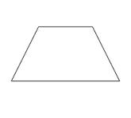
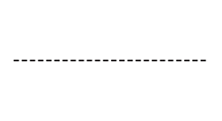
Expression Challenges
Area of a Trapezium
area = ½ ( a + b ) h
a
area = ½ * ( a +b ) *h
height
Height = h
b
b
Notes:
Now lets look at the next challenge
Area of a trapezium on the left you see a picture of a trapezium
Why’s this called a trapezium?
Two sides are parallel, the other two arent
If the other two were parallel it’d be a parralellogram or maybe its a rectangle or even a square, but this is a trapezium
So I’ve labeled the top as a the bottom as b, and I’ve drawn the height as a dotted line between a and b
So height is labeled as h
Now we’re going to find out the area of the trapezium
Then what’s the area?
Its half into a+b into h
This is the known formula
Thats it

Slide 56
Expression Challenges
Area of a Trapezium
Python Program
a= 4
b = 10
h = 5
Area = ½ * ( a + b ) * h
print ( ‘area:’ , area )
area = ½ ( a +b ) h
area =1/2 * ( a + b ) * h
a
b
h
Notes:
Ok, now lets write a python program on the left
So the values have been initialized for a and b and h
Then we write the expression for area and then printing it
Ok, now try this in your ide write it down and make it run make the a, b, h inputs
Now we’ll go on to circles

Slide 57
Expression Challenges
Area of a circle
Python Program
Import math
r = 10
area = math.pi * r * r
print ( ‘area:’ , area )
area = π r²
^{π = 3.14159}
r
area =math.pi * r * r
Notes:
So look at the circle, we have an arrow going from the middle to the outer edge, so what I mean by that its distance from the center to any point on the circumfrence, which means outer rim, this is called the radius, which I’ve labeled as r, so only one parameter is required for this calculation, so if you know the radius then you can find the area of a circle, so this is a known formula, called pi r squared
Pi r squared
Whats pi? Its a known constant 3.14159, its an irrational number in reality so theres no ending, I’ve just taken 5 places here
So this is the known pi value
So that into radius squared, which is r into r
Now we gotta write the expression area assigned pi times r times r, so how do we get pi?

Slide 58
Expression Challenges
Area of a circle
Import math
r = 10
area = math.pi * r * r
print ( ‘area:’ , area )
area = π r²
^{π = 3.14159}
r
area =math.pi * r * r
Notes:
The answer is you have to import it from a library the module is calle Math and the constants name is pi so you write math dot pi
Then this is multiplied into r into r
So this is the forumula
Ok on the left we have written the program
So we type import math
We define radius
Calculate the expression returning to the variable area
And then we print the result
Ok, so complete this challenge yourself now

Slide 59
Expression Challenges km to miles ( convert )
Python Program
km = 15
miles = 0.621371 x km
print ( ‘miles:’ , miles )
1 mile = 1.60934 km
1 km = 0.621371 miles
km = 15
miles = 0.621371 * 15
miles = 0.621371 x km
miles = 0.621371 x km
Notes:
Alrite this challenge is regarding converting kilometres to miles
If km is given convert to mile
So we need a formula which is known
So 1 mile is equal to so many kms
But the issue is we need to convert km to miles not the other way round
So the formula is the next one 1km to 0.6 etc
So if you know the kms you multiply it by the constant given here and it will convert it to miles
Suppose I have 15 kms
So how do I calculate miles?
For this we can do constant * 15
This is how you get the miles
So below in the yellow box you see the formula, miles = constant * km
Thats it

Slide 60
Expression Challenges km to miles ( convert )
Python Program
km = 15
miles = 0.621371 x km
print ( ‘miles:’ , miles )
1 mile = 1.60934 km
1 km = 0.621371 miles
km = 15
miles = 0.621371 * 15
miles = 0.621371 x km
miles = 0.621371 x km
Notes:
So on the left we see the python program
I’ve already taken the kms
Calculated miles from the kms
And then we print it
So this is the challenge you need to complete in the ide

Slide 61
Expression Challenges displacement
a
u
v
u = initial velocity
a = acceleration
v = final velocity
d = ?
Notes:
Ok lets move onto the next challenge
Calculating the displacement
We’re basically calculating a distance
Suppose look at the line thats the distance
Left side is the starting right side the ending point
Something is moving between them
Youve gotta calculate the distance
So something is moving with an initial velocity, lets call it u
And its moving with an acceleration, lets call that a, when it reaches its destination it has a final velocity which we’ll call v
So we know three things, initial velocity, acceleration and final velocity, from this you have to find distance
For this theres a known physics formula
We have nothing to do with physics, but we take the formula to practice how to write the expression right?

Slide 62
Expression Challenges displacement
a
u
v
d = v² - u²
2a
x
d = v * v – u * u / 2 * a
Notes:
Ok so the formula is d assign v squared – u squared over 2a
So final velocity squared minus initial velocity squared the result of which is divided by 2a
So take a look at the python expression below
V squared minus u squared and then divide this by 2 * a
This is wrong
Why?
We’re suppose to divide the entirety of v squared minus u squared, the result of it by 2a

Slide 63
Expression Challenges displacement
a
Python program
u = 4
v = 6
a = 3
d = (v * v – u * u) / (2 * a)
print ( ‘ displacement:’ , d )
u
v
d = v² - u²
2a
d = (v * v – u * u) / (2 * a)
Notes:
So we gotta put brackets like this, notice 2 * a is also in brackets because we don’t want to divide by 2 and then multiply by a we want to divide by 2 * a
This is the formula, if you don’t put these parantheses you’ll get the wrong answer thats it
Look to the left, thats how the program will look
U,v,a I’ve taken some simple values
Then I wrote the expression and assigned it to d
And then we print the displacement in the next line
Ok so write this up into a program, and if you want write u,v,a as inputs so you dynamically input them into the program
Also make sure when you’re writing your program the final velocity should be more then the initial velocity this means v has to be greater than u otherwise you’ll get negative results, distance cant be negative right?, so thats it, well, it can be zero so I suppose v and u can be equal, however v cannot be less than u, alrite, thats it for this section

Slide 64
Expression Challenges
Area :
Triangle area = ( base * height ) / 2
Trapezium area = ½ * ( a + b ) * h
Circle area = math.pi * r * r
Km to miles miles = 0.6213171 km
Displacement d = ( v*v – u*u ) / ( 2 *a)
Notes:
Alrite, here are the formulas, triangle trapezium circle km to miles and displacement
These are the formulas weve seen
So if you want to practice making these programs from scratch, you can use these formulas

Slide 65
Quiz 1

Slide 66
Coding Exercise 2 area of a triangle

Slide 67
Coding Exercise 3 area of a trapezium

Slide 68
Coding Exercise 3 area of a circle

Slide 69
Input From Keyboard
Notes:
Alrite, lets look at inputs from the keyboard
If you know this you wont have to put in direct values
You can instead take the input from the keyboard while the program is running and then you can process upon this data
Or you can take your input and use them as inputs in your expressions or formulas
Ok, so let us learn properly how to take inputs from the keyboard

Slide 70
Input From Keyboard
Program for area of rectangle
Taking input from keyboard
Notes:
So we’ll see a program for an area of a rectangle
Then we’ll see the need for taking inputs from the keyboard
Ok, lets begin

Slide 71
Input from keyboard
Program to find area of Rectangle
Python program
length = 15
breadth = 5
area = length * breadth
Print (‘ area :’ , area )
breadth
length
area = length * breadth
Notes:
So as you see theres a rectangle with a length and breadth
And below that is the formula for area
So to the left we’ve written a python program
Thats it
If u observe, we’ve directly taken the values of the inputs 15 and 5
Whenever you run this program
It will only ever calculate the area based on the hardcoded values
Now you can just edit the file and change the values
But suppose you give this program to a friend who doesn’t know python..what will they do? They want to change the values, thats where its important to be able to input the values using the keyboard
So let us see how to take the input from the keyboard

Slide 72

Input from keyboard
x = Input (‘ enter data :’ )
x
john
Enter data : John
Notes:
So lets look at this
Python has a built in function for doing this
The name is input
Input
Now listen carefully so you understand everything about it
Ok inside the quotes you can write a message like enter data
So when its reading something from the keyboard the user knows the program is waiting for them because of the message
This means something needs to be echoed or displayed on the screen for the user to see that the program is watiing for them
Whatever input comes from the keyboard you can put it in a variable, like x, like x assign input data

Slide 73
Input from keyboard
x = Input (‘ enter data :’ )
x
john
Enter data : John
Notes:
So for example take a look at that picture, its a screen with a message on, enter data,
Now you gotta type somethig from the keyboard in order to enter the data right?
Coz the program is waiting for something from the keyboard
So its waiting for you
Suppose we type in john
Now we hit enter
So then john will enter the variable x
And you can see how it looks like in memory
Thats it so whatever you entered from the keyboard
Thatll be stored in the variable
Another important point to be made is whatever this input function takes in will be stored as a string
It gives the result in the form of a string
Now let us go back to our python program for finding the area of a rectangle, so we’ll take input from the keyboard

Slide 74
Input from keyboard
input( ‘ enter length :’ )
length = input( ‘ enter length :’ )
Notes:
For this we have to write input enter length
This msg will appear on the screen
So you gotta enter a length value ok?
So whatever comes gonna be stored in length
Thats it so we get the length
But wait
I told you
Whatevers coming in from the input function gotta be a string
But a length is supposed to be an integer or a float right?
So lets say integer in this case
So what am I going to do now?
I have to convert the string into an integer using a type conversion function

Slide 75
Input from keyboard
input( ‘ enter length :’ )
length = input( ‘ enter length :’ )
Int ( )
Notes:
We need the int function
So whatever coming from the input gotta be written inside the int function

Slide 76
Input from keyboard
length = int ( input( ‘ enter length :’ ) )
Notes:
So this is how we do it
The input function Is written inside the int function, so you getting a string from the input function, which is run through the int function so it changes to an int datatype, so thats how you get your length
Thats it
And if you wanted it to be a float, then just replace the int with a float, thats also a valid function

Slide 77
Input from keyboard
length = int ( input( ‘ enter length :’ ) )
Enter length : 15
length
15
Notes:
Now how does it work? Lets see on the screen
When this is executed what appears on the screen is enter length
Now you enter 15
So its converted into an int from a string
And in memory it looks like the arrow diagram on the left
Thats it
So you gotta typecast
The data from string to whatever you want
Thats, now ive explained how to take inputs from the keyboard
Now you can use it in the programs whichever you’re writing
So if you writing standalone programs
So now we gonna change the rectangle program using inputs, so lets go to the program

Slide 78
Python program
length = 15 length = int ( input (‘ enter length’ ) )
Breadth = 5 breadth = int( input ( ‘enter breadth’) )
area = length * breadth
Print (‘ area :’ , area )
Notes:
So length was directly assigned 15
Breadth was 5
So I wanna take inputs for these

Slide 79
Python program
length = int ( input (‘ enter length’ ) )
breadth = int( input ( ‘enter breadth’) )
area = length * breadth
Print (‘ area :’ , area )
Notes:
So I write instead length = input enter length
But input is inside int so that length recieves an int
So for breadth, same thing, input inside int except the message here is enter breadth
So now we got a complete program using inputs from the keyboard
Thats all
Ok so now its time for you to try this out in the python editor

Slide 80
Let’s write this in jupyter

Slide 81
Coding exercise 5
Problem Statement:
Write a Python program that converts a distance given in kilometers to miles. Display the result in a formatted output.

Slide 82
Coding exercise 6
Problem Statement:
Write a Python program to calculate the displacement (d) of an object using the second equation of motion: d = ( v * v - u * u ) / (2 * a)

Slide 83
Surface area of a cuboid
Notes:
Aight, now we gonna do the surface area of a cuboid
Now you already know how to write expression formulas
Youve seen various formulas
For this you have to also write a formula
But you need to understand what the topic is
In this we need to understand what a cuboid is

Slide 84
Surface area of a cuboid challenge
What is a cuboid?
What is total surface area?
Formula for total surface area
Notes:
Also what total surface area means
Then whats the formula for that

Slide 85
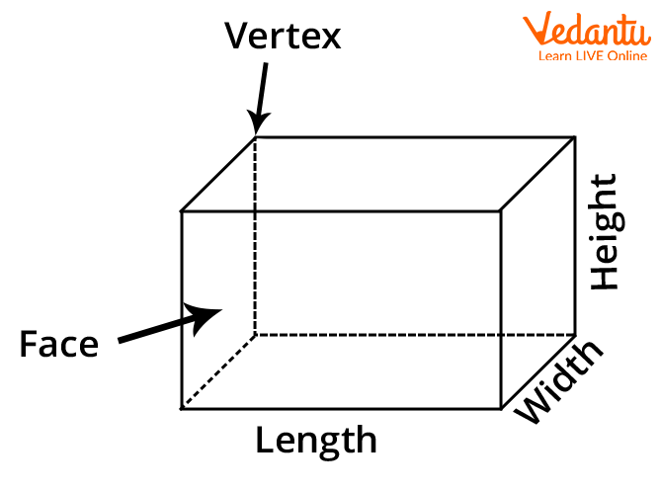
Surface area of a cuboid
Width = breadth
Notes:
So lets start with what a cuboid is
Heres a picture of it
Its a 3 dimentional figure and it has 6 faces or surfaces, so here we got width, length and height so these are 3 dimensions all perpendicular to each other
So this is a 3d figure
This is nothing but a box or like a brick the official name of this shape which is cuboid
Next point this has 6 faces

Slide 86
Surface area of a cuboid
Width = breadth
front
Notes:
This is the front face

Slide 87
Surface area of a cuboid
Width = breadth
back
Notes:
This the back

Slide 88
Surface area of a cuboid
Width = breadth
top
Notes:
top

Slide 89
Surface area of a cuboid
Width = breadth
bottom
Notes:
Bottom face

Slide 90
Surface area of a cuboid
Width = breadth
left
Notes:
Left face

Slide 91
Surface area of a cuboid
Width = breadth
right
Notes:
And the right face
So we learnt 2 things
This a 3d figure
Which has length, width and height
And it has 6 faces
Thats it

Slide 92
What is total surface area?
Notes:
Next we gotta learn whats the total surface area
Lets see

Slide 93
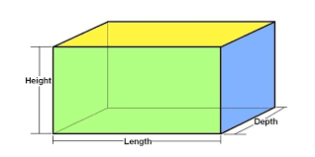
Surface area of a cuboid
For front face
area = length * height
as front face = back face area becomes
area = 2 * ( length * height )
area = 2 * ( l * h )
Notes:
So we already saw it has 6 faces
So we gotta find the areas of all those faces
So all the sides
This is nothing but the total surface area
How do we do this?
Lets see
So first of all we’ll take the front face
So whats the area of this?
So we do length * height
This will give us the area of this face
So you can see the formula ive written
So now we look at the back face, thats exactly the same length into height
So now we can change it to 2 * length * height
Since length and height are big words lets take them as l and h so area = 2 * l * h
So far we have the total surface area of the front and back sides, we have 4 more faces left, lets look at them next

Slide 94
Surface area of a cuboid
For top face
area = length * breadth
as top face = bottom face area becomes
area = 2 * ( length * breadth )
area = 2 * ( l * b )
breadth
Notes:
Now now we take the top surface
This would be length * breadth
So what do we do next?
That would be to bottom surface
This is also length into breadth
So this would also be 2 length into breadth and again we can abbreviate to l and b
So 2 into l into b

Slide 95
Surface area of a cuboid
For left face
area = breadth * height
as left face = right face area becomes
area = 2 * ( breadth * height )
area = 2 * ( b * h )
breadth
Notes:
Now next we gotta take the sides
So for the left hand side
How do we get the area?
So we gotta take breadth and hegiht
So the area is breadth times height for the left hand side
Then we do the same for the right hand side
This is also breadth times height
So again this gonna be 2 into breadth into height
So we can say 2 into b into h
Thats it
Now we have the area for all the faces of the cuboid
So whats the total surface area
Finding the sum of the area of all faces
Just add them all
Thats it

Slide 96
Formula for total surface area
Notes:
So lets put the formula together
Now we gonna look at the formula for the total surface area
Lets see the formula

Slide 97
Formula for total surface area
Total area = 2 * l * h
Notes:
So what are the things we have learned
We’ve taken all the faces and prepared the area for the individual surfaces
Now lets add them
So front and backside if you remember is 2 into l into h

Slide 98
Formula for total surface area
Total area = 2 * l * h + 2 * l * b
Notes:
Then we get the bottom and top add it to the previous sides

Slide 99
Formula for total surface area
Total area = 2 * l * h + 2 * l * b + 2 * b * h
Notes:
Then we get the left and right sides and add it to the previously added sides
So this is the total surface area
2 into l into h plus 2 into l into b plus 2 into b into h
Theres a lot of 2s arent there?

Slide 100
Formula for total surface area
Total area = 2 * l * h + 2 * l * b + 2 * b * h
Notes:
Yup too many of them

Slide 101
Formula for total surface area
Total area = 2 * ( l * h + l * b + b * h )
Notes:
Lets factor it out
This is the formula
Thats it
So ive explained what it means by cuboid and heres the final formula for its surface area
Ok

Slide 102
Formula for total surface area
Total area = 2 * ( l * h + l * b + b * h )
Python program
l = 10
b = 5
h = 7
area = 2 * ( l * h + l * b + b * h )
Print ( ‘ area :’ , area )
Notes:
So heres the program on the left
Suppose the length is 10, breadth is 5 and height is 7
Those will be the three dimensions
And you got to put the three dimensions in the formula
This is how youd get the answer
So look on the left, I’ve declared the variables l, b , h
Then I just use those variables to calculate the area with the formula we worked out
And then simply print the area
Thats it
So this is the program
Ok, try this in the editor now, write it

Slide 103
Let’s try this in jupyter

Slide 104
Coding exercise 7
Problem Statement:
Write a Python program to compute the total surface area of a cuboid. Use pre-defined values for length, breadth, and height, then calculate the surface area using the provided formula.
Formula:
Total Surface Area = 2 * (length * breadth + length * height + breadth * height)
Instructions
1. Three variables: length, breadth, and height, with pre-defined values are assigned..
2.Write down only the formula to calculate the total surface area of a cuboid in the coding window.
3. Print the calculated surface area with a clear message.

Slide 105
Finding roots of quadratic equation
Notes:
Alrite, our next challenge is finding the roots of a quadratic equation
This is a seperate section because first I have to explain what im actually talking about, so whats a quadratic equaiton
Usually students don’t really remember this topic or maybe they don’t know it
Its in basic mathematics
The benefit of covering this is you’ll learn something new in writing expressiosn
So you’ll learn something new in this challenge
So thats why im covering this
So lets start

Slide 106
Finding roots of quadratic equation
What is a quadratic equation?
Roots of a quadratic equation
Formula for roots
Notes:
You see first of all
In this lecture ill explain what a quadratic equation is
Then what are the roots of a quadratic equation
Then we’ll what is the formula for finding the roots of a quadratic equation
This is a known formula but I’ll explain it to you so theres no confusion
Once you know the formula then you can convert it into a python program
So lets start

Slide 107
Quadratic equation
ax² + bx + c = 0
Notes:
This is how we represent a quadratic equation
So ax squared plus bx plus c equals 0
If the equal wouldnt be there this would just be an expression in mathematics
When its equal to something then its called an equation
Now why is it called quadratic?

Slide 108
Quadratic equation
ax² + bx + c = 0
degree = 2 = highest power in the equation
an equation with degree two is called a quadratic equation
Notes:
Look here what is the degree?
Its 2
The highest power in this equation is 2
So the highest power is 2 thats why its called quadtratic
So whats the a b c

Slide 109
Quadratic equation
ax² + bx + c = 0
a , b and c are co-efficients
Notes:
These are coefficients
A is the coefficient of the highest term
B of the middle x
And c is a constant
So these are called coefficients
So thats it, I’ve explained to you what it means by quadratic equation
Ok now we’ll see what it means by roots of a quadratic equation

Slide 110
Roots of quadratic equation
Notes:
So lets take the quadratic equation here again

Slide 111
Roots of quadratic equation
ax² + bx + c = 0
the value of x for which the entire equation becomes zero is called the root of the quadratic equation
x = ?
Notes:
So what do we mena by roots
Look at the x
If I substitute some value of x such that the final result becomes 0, you’ve discovered a root
Whats the value of x for which the entire equation becomes 0, this is the question
Thats the root
So lets take some examples for a b and c

Slide 112
Roots of quadratic equation
1x² - 5x + 6 = 0
let’s take x =2 and check the answer
1(2)² - 5(2) + 6 = 0
Notes:
This is the quadratic equation
Ok here 1 x squared, so a is one
B is -5
And c is 6
Now lets try to substitute some value in this equation
So which values should we try?
Lets try 2
So x = 2
And so we substitute on the third line

Slide 113
Roots of quadratic equation
1(2)² - 5(2) + 6 = 0
4 - 10 +6 = 0
-6 + 6 = 0
so this means 2 is the root of this quadratic equation
Notes:
So its 2 squared which is 4
And 5 into 2 is
10
And 4 – 10 is -6
+6 to that gives 0
So yes,
2 is a root
2 is a root
We got it
See it was a random value, but I already knew what it was just to explain to you what a root is
You can try any other value 5 10 12 etc, if the input results in a 0 its a root otherwise no
Now since this is a quadratic equation it has 2 roots
It will have 2 roots, this means there exists another value that will satisfy this equation, lets try one more value, so x = 3

Slide 114
Roots of quadratic equation
1x² - 5x + 6 = 0
as this is a quadratic equation this will have two roots so
let’s take x = 3 and check the answer
1(3)² - 5(3) + 6 = 0
Notes:
So lets substitute
So this becomes 3 squared

Slide 115
Roots of quadratic equation
1(3)² - 5(3) + 6 = 0
9 - 15 +6 = 0
-6 + 6 = 0
so this means 3 is also the root of this quadratic equation
Notes:
Which is 9
5 3s are 15
9 - -15 is -6
Plus 6 which is again 0
Yes threes also a root

Slide 116
Roots of quadratic equation
ax² + bx + c = 0
roots
x1 = 2
x2 = 3
Notes:
So we have two roots now
So for the quadratic equation we have 2 distinct roots
X is 2
And x is 3
So we can call them x1 and x2
Thats it

Slide 117
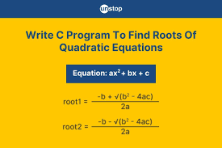
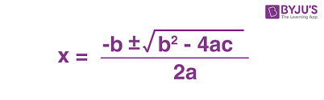
Formula for roots
ax² + bx + c = 0
Notes:
Ok lets move on
Lets take a quadratic equation here
Now I’m also showing you its formula
[read the formula]
This is the formula
But just now we saw its going to have two roots
Notice the plus minus sign
Its explained in the yellow box
So the formula is expressed with a plus or a minus
Thats how you get the two roots
So everythings the same except for those signs
So lets try the formula out

Slide 118
Formula for roots
ax² + bx + c = 0
b² – 4ac >= 0
discriminant
Notes:
Before doing this let me tell you about the portion inside the square root
This is called the discriminant
So b squared minus 4ac is called the discriminant
So this value has to be greater or equal to 0 to be a real and proper result
So as a beginner we’re talking about imaginary or complex numbers, so we have to be careful to select a b and c such that the discriminant is greater or equal to 0 otherwise, you’re not going to find any real solutions
Ok lets move on, lets substitute some values

Slide 119
Roots of quadratic equation
1x² - 5x + 6 = 0
a = 1
b = -5
c = 6
X = -b
2a
d =
Notes:
So a is 1, b is -5 and c is 6
Lets put the values in the formula and see if it gives the roots or not
So you remember the roots for this equation from before, 2 and 3 right?
So we should get the same result
Ok look at the formula on the right
Lets first solve the discriminant
So b squared minus 4ac

Slide 120
Roots of quadratic equation
1x² - 5x + 6 = 0
a = 1
b = -5
c = 6
X = -b
2a
d =
Notes:
So minus 5 squared
And 4 a c

Slide 121
Roots of quadratic equation
1x² - 5x + 6 = 0
a = 1
b = -5
c = 6
X = -b
2a
d =
Notes:
So thats 4 into 1 into 6
So weve substituted it

Slide 122
Roots of quadratic equation
1x² - 5x + 6 = 0
a = 1
b = -5
c = 6
X = -b
2a
d =
Notes:
Now -5 squared is 25
4 into 1 into 6 is 24
Subtract and the answer is 1

Slide 123
Roots of quadratic equation
1x² - 5x + 6 = 0
a = 1
b = -5
c = 6
X = -b
2a
d =
= 1
Notes:
So d value is nothing but 1, square root of 1 is 1

Slide 124
Roots of quadratic equation
1x² - 5x + 6 = 0
a = 1
b = -5
c = 6
X = - (-5)
1
2a
Notes:
Alrite so far we’ve substituted this much we’ve got - - 5 and + or minus 1
Now we gotta solve the rest
Now minus minus 5 is 5
Now whats remaining a
So 2 into 1 which is 2

Slide 125
Roots of quadratic equation
1x² - 5x + 6 = 0
a = 1
b = -5
c = 6
X = 5
1
2.1
Notes:
So it becomes 2

Slide 126
Roots of quadratic equation
1x² - 5x + 6 = 0
a = 1
b = -5
c = 6
X = 5
1
2
Notes:
So now we got 5 plus or minus 1 by 2
Until now I took this as a single formula but now we can split it

Slide 127
Roots of quadratic equation
1x² - 5x + 6 = 0
a = 1
b = -5
c = 6
X1 = 5
+
1
= 3
2
X2 = 5 – 1
= 2
2
Notes:
As you can see we got x1 and x2
So we’re getting 2 roots
So x1 is 6 by 2 and x2 is 4 by 2
So x1 is 3 and x2 is 2
Thats what we got previously
Thats it
So we’ve learned about quadratic equations so far
Then we saw what it means by roots
And we saw theres a formula if you put the values in you’ll get the answer
Now lets see how to write this in python
With the same formula

Slide 128
Formula for roots in python
Notes:
So formula for roots in python

Slide 129
x = - b + √b² - 4ac
2a
x₁=(-b + math.sqrt(b**2 -4*a*c))/(2*a)
x2=(-b - math.sqrt(b**2-4*a*c))/(2*a)
Notes:
So here I’ll write down the formula
Looking at this we have to frame the formula in python
This is important now
Lets write it
Ok now so complete the program by yourself with this

Slide 130
Python Program
import math
a = 1
b = -5
c = 6
r1 = (-b + math.sqrt(b**2 - 4*a*c))/(2*a)
r2 = (-b - math.sqrt(b**2 - 4*a*c))/(2*a)
print('Roots are', r1, r2)
Notes:
Ok so lets write the program here
First we import math
I need the sqrt function
We’ll take 3 variables a b c
Then we got the formula for the two rules
R for root
Then print both the roots
Thats it
Ok I’ll write this up in the editor so should you, follow along

Slide 131
Let’s do this in jupyter

Slide 132
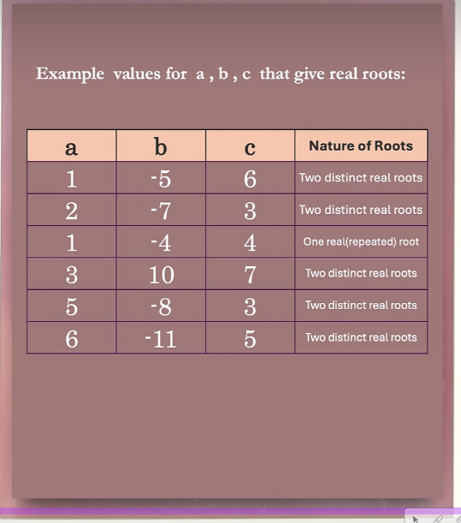
Python program
a = int(input('Enter a:'))
b = -5
c = 6
r1 = (-b + math.sqrt(b**2 -4*a*c))/(2*a)
r1 = (-b - math.sqrt(b**2 - 4*a*c))/(2*a)
print('Roots are', r1, r2)
Notes:
Alright, to test out the values plug these values in
Or you can reprogram it to take the keyboard as input and then plug it in with the keyboard

Slide 133
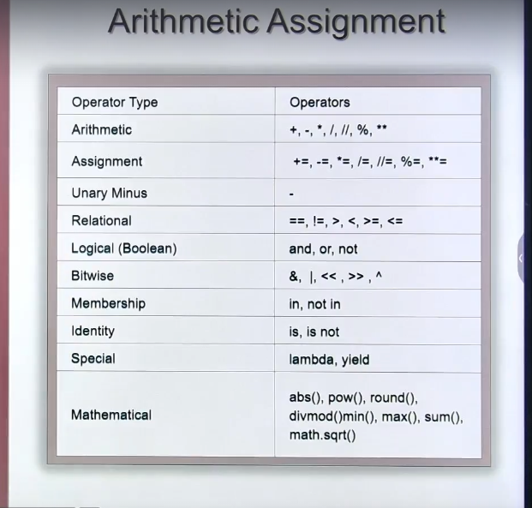
Arithmetic assignment
Notes:
Now the topic is arithemetic assignment operators
Although we’ve seen these before and we’ve done some challenges regarding this
So what is this?
This is nothing but an extension of arithemetic operators
Special types of arithemetic operators
You can say combined arithemetic and assignemtn operators
So they have a special usage that we will learn here
Its a simple topic
So first of all let me show you the table here, its already here
Look at the arithemetic assignemnt operator row
Wait, plus, minus multiply these are arithemetic operators
But the one below it is plus asign, minus asign multiply assign etc

Slide 134
Arithmetic assignment
Notes:
These are arithemetic assignment operators so lets learn about them

Slide 135
Notes:
This is the table of all arithemetic assignment operators
Addition
Subtraction
Multiplication
Division (float)
Floor division
Etc
So the way its written you see plus assign
Minus assign
Multiply assign and so on
And power assign
All the arithemetic operators we can convert them into arithemetic and assignemtn operators combined
Ok, lets analyze this further

Slide 136
Addition assignment
a
a= 5
b = a + 1
5
b
6
Notes:
Ok, lets start with the first operator, I’ll explain one of them then you’ll be able to understand the rest easily
So first we’ll start with the addition assignment
So what does this do
Let us understand
So first I’ll take a assign 5 and you can see what it looks like in memory to the right
Now if I write a statement
B assign a plus 1
What happens?
A value 5 plus 1 is 6 this is stored in b and to the right of the statement we see how it looks in memory again
So be has the value 6
Thats it
Now lets look at a special statement, look at this

Slide 137
Addition assignment
a
a= 5
a = a + 1
5
6
Notes:
Look at the second statement
A assign a plus 1
On both sides I have a
What does this mean?
Is it lying? How can a be a plus one??
No no,
This is an assignment operator not equals
So lets analyze
A is 5 at first
5 plus 1 is 6
So what do we do?
We store this new value back into a
So look at the right, a used to be 5, then we re assigned it! Its 6 now

Slide 138
Addition assignment
a
a= 5
a = a + 1
6
Notes:
And then the 5 disappears, the garbage collector takes care of it
So python creates a new memory location with another value for the same variable and the previous memory with the value is garbage collected
Thats whats happened
So whats the value of a now?
Its 6
Thats it
Ok lets take another example

Slide 139
Addition assignment
a
a= 1
a = a+ 1
1
Notes:
So a is assigned 1 and the corresponding memory picture now if I write the next statement a assign a plus 1 and if it executed then 1 plus 1 is stored in a

Slide 140
Addition assignment
a
a= 1
a = a+ 1
2
Notes:
So a becomes 2
If I do it again
Then 2 plus 1 that is 3 is stored in a again

Slide 141
Addition assignment
a
a= 1
a = a+ 1
a = a+ 1
3
Notes:
A becomes 3
Then once again if I do it
Then 3 plus 1 that is 4

Slide 142
Addition assignment
a
a= 1
a = a+ 1
a = a+ 1
a = a+ 1
4
Notes:
So now 4 is stored in a
This means if im continously doing this the value of a is incrementing one by one just like a counter
Its like counting
Counting 1 2 3 4
Yes
One of the special usages of this is for counting
So this type of expression is used for counting
Yes
This is a commonly used expression in programming
Usually used in loops
When you come across loops you’ll be using this type of expression
So whats the speciality of this expression?
On both sides of the assignment operator you have the same variable which is being modified

Slide 143
Addition assignment
a
a= 1
a = a+ 1
a += 1
4
Notes:
Ok lets put it like this
Now this can be written using the arithemetic assignemnt operator
When you have a on both sides you want to say that add one to a and store the result back in a itself
So you can write it like below a plus assign 1
A plus assign 1
This means the same thing as a assign a plus 1
Thats it
This operation is called arithemetic addition
So now you’ve understood what arithemetic assignemnt is
So now its very easy to understand the rest of them
So lets look at all these operations one by one

Slide 144
Arithmetic assignment
a = 6 b = 3
a = a + b a += b
Notes:
Ok lets take some examples
Look at a and b
A is 6 and b is 3
Ive taken two variables
Lets write the statement a assign a plus b
What does this mean
Add b to the value of a and store the result in a itself
So the statement can be written as a plus assign b
So as you can see im using the addition assignment operator
Earlier I was adding 1 and now im adding b
Im using a and b and showing you how to express this with the addition assignment oeprator

Slide 145
Arithmetic assignment
a = 6 b = 3
a = a + b a += b
a = a – b a -= b
Notes:
Lets look at a assign a minus b
So how do we do this using the subtract assignemtn operater?
Its on the right, very intuitive, looks like the previous construct we wrote

Slide 146
Arithmetic assignment
a = 6 b = 3
a = a + b a += b
a = a – b a -= b
a = a* b a *= b
Notes:
Now the third with the multiplication operator
So multiply assign same thing
Now you’ve understood

Slide 147
Arithmetic assignment
a = 6 b = 3
a = a + b a += b
a = a – b a -= b
a = a* b a *= b
a = a/b a /= b
Notes:
For division also you can write the division assignment operator
You can do floor division also
Mod also
And also power like this
Now I have to show you one more expression
Look at this
Suppose im writing

Slide 148
Arithmetic assignment
a = 6 b = 3
a = a + b a += b
a = a – b a -= b
a = a* b a *= b
a = a/b a /= b
x = x + a * b – c x += ( a * b - c)
Notes:
X assign x plus a into b minus c some convoluted expression
A,b,c and x are the variables
So the expression is calculated and added with x and stored into x
So x is on both sides
So you can simplify this into the addition assignment operator because you got x on both sides
So you can write it as the expression on the right
So x plus assign this entire thing
So it doesn’t have to be just with one value, it can be a lengthy expression
You can write it like this
Thats it
Ok lets try this in our editor

Slide 149
Let’s try these things in jupyter

Slide 150
String concatenation and repetition
Revising arithmetic operator
String concatenation and repetition
Arithmetic with All datatypes
Resultant datatype of expression
Notes:
Ok, so now we’re going to look at string concatenation and repitition
So this is the repitition or concatenation of a string
So actually in this section we’ll be convering multiple topics
Not just this
So the first thing we’ll do is revisit arithemetic operators
You already know what these do
We’ll have a look at them once more
Then we’ll see string conatenation, string repitition
Then arithemetic with all datatypes, so far we’ve only seen this with integers lets just have a look if they work on other datatypes
So this is also important, we’ll just go a little deeper
The final thing we’ll look at is whats the resultant datatype of an expression, these are the 4 things we will cover so lets cover them quickly so lets start

Slide 151
Notes:
So the first thing is revisiting arithemetic operators so you can see them here again in this list
Addition, subtraction, multiplication, float division, integer division, mod and exponents

Slide 152
Data types
Integer
Float
Boolean
Complex
String
Notes:
So lets discuss how all the operators work on the listed datatypes
So integers floats, booleans, complex and strings
These are the datatypes
We’ve seen how these operators work on integers
So now we gotta see how they work on the rest of them
The most important one is string

Slide 153
Data types
string
Integer
Float
Boolean
Complex
Notes:
So im going to bring it up
Thats our topic isnt it?
String concatenation and repitition
So lets pickup string

Slide 154
Data types
string
string concatenation
string repetition
Notes:
Now we’re going to talk about the operators which we’ll apply on strings such that we get string concatenation and reptition
I will show you how these operators work on strings so we’ll understand these two operators
There are only two operators work addition and multiplication upon strings
Thats it
Only two operators work
So arithemetic operators work, but not all of them
Only two
That is addition and multiplication
Addition is for concatenation
And multiplication is for repetition
How?
Lets see this in detail

Slide 155
string
s = ‘abc’
s + 10 ?
Notes:
So I’ll make string as a topic
Now lets take s assign abc
Lets try this in the editor and see what happens
We know that addition works
But how it works what will it give?
Let us see
So lets go to the editor

Slide 156
Let’s see this in jupyter

Slide 157
string
s = abc
s + 10 ?
x
Notes:
So it was wrong right?
So lets try something else in our editor

Slide 158
string
s = abc
s + ‘10’ abc10
so we can only add two strings together no other datatype
concatenation
Notes:
Lets do s + ‘10’ in speechmarks in the editor

Slide 159
string
s = abc
s + str (10)
‘abc10’
Notes:
So now lets use the str method
We get the same result
So I can either write it in quotes
Or I can convert the int into a string
Thats it
Lets try another example now

Slide 160
string
s1 = ‘ abc’
s2 = ‘def’
s1 + s2
‘abcdef’
Notes:
So I’ll try two strings
One is abc
S2 is def
Lets concatenate this to make abcdef
So when I do s1 plus s2
The result what do we get
Lets try in the editor
So now ive shown string concanation
Addition can add only two strings
The behavior has changed upon strings
Its not adding its concatenation
Now lets learn the next operator

Slide 161
string
s = ‘a’
s * 5
‘aaaaa’
Notes:
So now again we take string as a
Now if we do s multiplied by 5
Whats the result?
Lets try and see
So as you can see we get a repeating 5 times
Its making a single string repeat 5 times thats the behavior
Thats all its doing, repeating the string

Slide 162
string
s = ‘ a’
s * 5.5
Type error
Notes:
Lets try to multiply 5.5 times now
Now lets try another example

Slide 163
string
s = ‘abc ’
s * 5
abc abc abc abc abc
Notes:
S assign abc
I’ll multiply this with 5
So I’ve given abc space
So there are 4 letters
Abc then space
So lets try this in the editor see what happens

Slide 164
Data types
Float
all operators work on float data type.
Notes:
Ok lets see float now, well, all operators work for floats same as integer theres nothing to learn here except for one important thing
You remember floor division and mod
This works if you’re not using decimals
If you’re not using floating point decimal then floor division and mod, how is this suppose to work on float?
So lets how they will work and what they do

Slide 165
Data types
10.5 3.1
Notes:
So I’ve taken two values
Now lets perform division upon them

Slide 166
Data types
10.5 // 3.1
Notes:
This is a floor division
That is integer division
Whats the result we get?
Both of them are floating point numbers
Hows this going give an integer result?
So lets do the operation

Slide 167
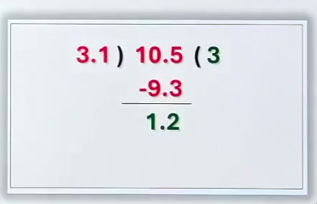
Data types
10.5 // 3.1
Notes:
So 3.1 will divide it thrice
That’ll give 9.3 the remainder being 1.2
So its not completely divided
So should we stop here or put a decimal and continue?
No, no don’t put a decimal
Don’t put a decimal in quotient
Thats it
So whats the floor division?
The quotient itself 3

Slide 168
Data types
3 ← 10.5 // 3.1
Notes:
Thats how this works
So it does not give you the decimal part
The quotient will be an integral type only
Now if you want to know the remainder
You can use the mod operator

Slide 169
Data types
3 ← 10.5 // 3.1
10.5 % 3.1
Notes:
And you get the remainder 1.2

Slide 170
Data types
3 ← 10.5 // 3.1
1.2 ← 10.5 % 3.1
Notes:
Here
Thats it
This is how floats handle these operators differently from integers
Now we’ve completed float operations

Slide 171
Data types
Boolean
Notes:
So lets look at boolean now
What operator works for boolean?

Slide 172
Data types
Notes:
All the operators do
Boolean means true and false
So how are these operators gonna work?
Boolean also means 0 and 1 right?
Yes
This means all the operators will work on it

Slide 173
Data types
2 ← True + True
Notes:
Lets take an example true plus true
Thats like 1 plus 1, so the answer is 2
Ok, exactly
The point is whenever you perform operations
On boolean values you only get an integer result
You wont get a boolean result
You’ll only get an integer result
And this is important to remember
So try all the operators yourself and check them in your editor
And false just means 0
So try all the operators

Slide 174
Data types
Complex
Notes:
Ok lets look at the complex type
So lets talk about complex
The arithmetic operations, they work on complex aswell
Which operation works?
All of them work
No
Floor division and mod don’t work
Every other operator works
Floor division and mod don’t make sense thats why they don’t work
So you can try this
Thats it
Now we’ve completed all the datatypes

Slide 175
Resultant Datatype of Expression
Notes:
Now lets go to resultant datatype of expression
What does this mean?
Let me show you

Slide 176
Resultant Data type
Notes:
Ok lets take some examples

Slide 177
Resultant Data type
True + True
Notes:
The first expression is true plus true
Both are boolean
The result is what?

Slide 178
Resultant Data type
2 ← True + True
Notes:
2 and whats the type? Integer
Next expression

Slide 179
Resultant Data type
2 ← True + True
True + 5
Notes:
True plus 5
Boolean and integer
Whats the result
5 plus 1
6
Whats the type

Slide 180
Resultant Data type
2 ← True + True
6 ← True + 5
3 + 2.4
Notes:
Integer only this is the same thing
Now lets take another example
3 plus 2.4
So we have an integer and float
One of them is a float

Slide 181
Resultant Data type
2 ← True + True
6 ← True + 5
5.4 ← 3 + 2.4
Notes:
So the result will be a float
So the datatype is a float

Slide 182
Resultant Data type
2 ← True + True
6 ← True + 5
5.4 ← 3 + 2.4
True + 2.4
Notes:
Lets take another one
Here one is boolean and the other is a float
So you’ll get float only
One plus 2.4

Slide 183
Resultant Data type
2 ← True + True
6 ← True + 5
5.4 ← 3 + 2.4
3.4 ← True + 2.4
Notes:
The result is 3.4 so its a float
Right?
So how do we know for which expression we’ll get what datatype?
Ill show you

Slide 184
Resultant Data type
2 ← True + True
6 ← True + 5
5.4 ← 3 + 2.4
3.4 ← True + 2.4
3 + (2 + 3j)
Notes:
One more example
3 plus 2 plus 3j
This is a complex number added to an integer
So whats the result going to be
So the first two 3 plus 2 will be added because thats the real part

Slide 185
Resultant Data type
2 ← True + True
6 ← True + 5
5.4 ← 3 + 2.4
3.4 ← True + 2.4
5 + 3j ← 3 + (2 + 3j)
Notes:
This is 5 plus 3j
And this is nothing plus complex
Why not integer why complex
Because complex is greater
Yes,
Why not boolean why float
Because float is greater than a boolean
Thats the meaning
Why not integer why float
Because float is greater
Thats the meaning
Yes, I’ll take one more example for you to see

Slide 186
Resultant Data type
2 ← True + True
6 ← True + 5
5.4 ← 3 + 2.4
3.4 ← True + 2.4
5 + 3j ← 3 + (2 + 3j)
True + 3 + 4.5 + (2 + 3j)
Notes:
So we’ve got boolean, integer float and then complex
So the result will be what?
So 2 plus 4.5 plus 3 plus 1 so 10.5 plus 3j

Slide 187
Resultant Data type
2 ← True + True
6 ← True + 5
5.4 ← 3 + 2.4
3.4 ← True + 2.4
5 + 3j ← 3 + (2 + 3j)
10.5 + 3j ← True + 3 + 4.5 + (2 + 3j)
Notes:
So we get a complex number
Because the highest datatype is what?
Complex
So which datatype is smaller and which is larger

Slide 188
Resultant Data type
2 ← True + True
6 ← True + 5
5.4 ← 3 + 2.4
3.4 ← True + 2.4
5 + 3j ← 3 + (2 + 3j)
10.5 + 3j ← True + 3 + 4.5 + (2 + 3j)
bool < int < float < complex
Notes:
And here I’ve written the comparison for you to see
The smallest is bool then int then float and then complex
In an expression whichever expression you’re using
The result will be the same as the largest datatype used
Thats it
Except in the case of floor division and mod they’ll get the integer values, so leave that
Rest of the operations give you the largest datatype
Thats all
So we’ve learned quite a few things
Combined together in this lecture
The important point was string concatenation and repitition then the floor division for floats and mod and finally this point which result do we get so we know which datatype we get based on the expression thats it

