Slide 1
Formatted printing
- ASCII vs Unicode
- Print function
- C-Style Printing
- Escape Sequence
Notes:
Hi this section is about formatted printing
You’ve already used the print function
But the same printing can be done in a more formatted way
So what are the possible formatted ways?
We will see that
So in this section we will learn how to format the display in various ways
So how efficiently can we utilize the print function
We’ll also learn about some important functions regarding ascii codes and unicodes
We’ll be learning about these
So these are just concepts
And theres something called c style printing, whatever is available here is similar to that which is in the c language regarding print formatting
So this section is only about print formatting, this is the angle we’re going to learn this topic from

Slide 2
ASCII Codes
Notes:
Now we’re going to talk about ascii codes
So in this lecture we are going to learn what ascii codes are
So you’ll get the introduction to them
Every electronic device has these ascii codes
Whether its your pc or you mobile phone or any other electronic device, they use these ascii codes
Ok, let us start

Slide 3
ASCII Codes
Number System
Notes:
Ok, our computer works on a number system
Yes
This means computers can understand numbers only
But actually they understand numbers which are in binary form

Slide 4
ASCII Codes
Binary Number System
Notes:
So they understand only the binary number system
So binary means that a number will only contain zeros and ones

Slide 5
ASCII Codes
Binary Number System
1001010
Notes:
For example this is a binary number
This understands zeros and ones
But we understand decimal numbers
So whats the decimal form of this

Slide 6
ASCII Codes
Binary Number System
1001010 = 74(10)
Notes:
74, which is of base 10
So this is the decimal form of the binary number
The computer works on the binary number system that is zeros and ones but we understand decimal number systems
So for decimals we convert it into binary and feed it into the computer system
Thats all
So as they work on numbers only, how do they support various data types?
Lets see the various data types supported

Slide 7
ASCII Codes
Binary Number System
1001010 = 74(10)
Data Types
Notes:
So the first one

Slide 8
ASCII Codes
Binary Number System
1001010 = 74(10)
Data Types
Integer → 125
Notes:
Integers, these are numeric values only 125 this is a number
Its easily supported by our computers

Slide 9
ASCII Codes
Binary Number System
1001010 = 74(10)
Data Types
Integer → 125
Float → 9.75
Notes:
What about float type of data
This is also numbers only
You remove the decimal point, and you remain with numbers only
So this is also a number
It is easily supported by our computer system

Slide 10
ASCII Codes
Binary Number System
1001010 = 74(10)
Data Types
Integer → 125
Float → 9.75
Boolean → True
Notes:
Then we have another basic data type like bool
And this one means what?
True
But you remember true is nothing but 1

Slide 11
ASCII Codes
Binary Number System
1001010 = 74(10)
Data Types
Integer → 125
Float → 9.75
Boolean → True = 1
Notes:
Yes this is one
Again its a number only
So all these are numbers
Ok, theres another data type supported by programming languages and even by python that is

Slide 12
ASCII Codes
Binary Number System
1001010 = 74(10)
Data Types
Integer → 125
Float → 9.75
Boolean → True = 1
String → ‘ABC’
Notes:
String
Whats a string? This is an example of a string
These are alphabets
These are not numbers
Our machine supports numbers
Then how does it support alphabets?
Characters
So to support the characters; codes are given
Numeric codes represent these characters
So characters are also represented in a numeric form

Slide 13
ASCII Codes
American Standard Code for Information Interchange
Notes:
So that numeric form is called nothing but ascii codes
Which stands for american standard code for information interchange
Listen to this carefully
When the computers were being developed
Or electronic machines were being developed
There was a requrnment that it should also work on characters
Electronic devices or computers work on numbers only
Then what should we do?
So we should reserve some codes or numbers and call them as characters
So some numbers they will represent characters so theres a range of them
So what numbers should be given? So this is how the standard was developed and thats what ascii codes are and this is followed globally, so lets see the codes given for the english alphabet

Slide 14
ASCII Codes
ASCII Codes
Notes:
So if you take the letters

Slide 15
ASCII Codes
ASCII Codes
A 65
Notes:
Capital a, for that a code is given 65
But 65 is an integer number
Yes if you say its a number then 65 will be treated as a number
If you say its an alphabet then it will be treated as capital A thats all
So for b also

Slide 16
ASCII Codes
ASCII Codes
A 65
B 66
Notes:
A number is written that is 66, the code

Slide 17
ASCII Codes
ASCII Codes
A 65
B 66
C 67
Notes:
For c its 67
So you’ve understood for d it will be 68 and so on

Slide 18
ASCII Codes
ASCII Codes
A 65
B 66
C 67
.
.
.
Z 90
Notes:
So if you continue until z it will be 90
So these are the codes given for capital letters of english or uppercase alphabets of english, you must remember this, if you remember the first and the last its sufficient 65 and 90, each letter you can get by adding 1 to it
So ive shown you the codes given for alphabets
But the english language has upper and lower case alphabets
Yes
So most of the latin languages have upper and lower case alphabets

Slide 19
ASCII Codes
ASCII Codes
A 65 a 97
B 66 b 98
C 67 c 99
. .
. .
. .
Z 90 z 122
(bicameral)
Notes:
Such langauges are called bicameral languages meaning they have representations for both upper and lower case characters
So for example if you take the chinese language it doesn’t have upper or lower case characters or the arabic characters they don’t either
So for the lower cases here are the codes
For a to z so their codes start from 97 to 122
Now one more important thing
Actually all the keys you find on the keyboard
For every key there is a ascii code reserved
So there are special characters also, theres also tab escape, caps lock shift ctrl alt these keys are also there
These are actually non printable keys they don’t have any characters or symbols for them, so then what are the codes for those keys? First ill show you the keys for numbers

Slide 20
ASCII Codes
ASCII Codes
0 48 A 65 a 97
1 49 B 66 b 98
2 50 C 67 c 99
. .
. .
. .
9 57 Z 90 z 122
(bicameral)
Notes:
So these are the codes for the numbers zero to nine
They are 48 to 57
This is the sequence
You can see some codes are missing here
This is not starting from 0 onwards
From 57 to 65, there are more gaps in the code
90 to 97 there are gaps
Yes, thats for other alphabets or other characters
What are those? Ill show you
But one more thing, all the ascii codes are ranging from zero to 127

Slide 21
ASCII Codes
ASCII Codes
0 48 A 65 a 97
1 49 B 66 b 98
2 50 C 67 c 99
. .
. .
. .
9 57 Z 90 z 122
(bicameral)
0 - 127
Notes:
Zero to 127
This means a total of 128 codes
128 means 2 to the power of 7

Slide 22
ASCII Codes
ASCII Codes
0 48 A 65 a 97
1 49 B 66 b 98
2 50 C 67 c 99
. .
. .
. .
9 57 Z 90 z 122
(bicameral)
0 - 127
(7 - bits)
Notes:
So yes 7 bits are enough to represent ascii codes
But usually one byte is taken for one character
One alphabet or one character
One byte is taken
Because the seven bits cannot be reserved so
One byte is taken
But actually it requires 7 bits
So ascii codes are of 7 bits
Remember this
Thats it ive explained
What ascii codes are
And ive shown the codes
Lets see the chart for all ascii codes now

Slide 23
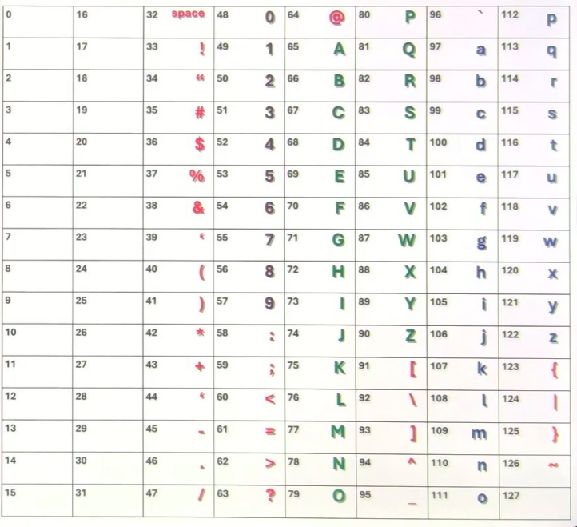
ASCII Codes
ASCII Codes
Notes:
So heres a chart for all ascii codes
So they start from 01234567 and the last one is 127
And you can see the special characters like space, exclamation mark etc
You see the nubmers, the capital letters, lower case ones
So observe 65 to 90 are all uppercased letters
And 97 to 122 are lower cased letters
And you find numbers represented from 48 to 57, and you can see the rest are all special characters like colon semi colon less than equals to and so on, now look at the left most column, theres nothing there
These represent non printable characters
Like 13 is for the enter key
And 27 is for escape
You can google it and read the chart if you wish, so the 2 left columns are for the non printable characters they’re also called control keys
So what should you remember from all this?
Well, just upper, lower and digits, thats enough, just remember these, as for the rest, google is fine
So thats it about ascii codes
Now how are they used, let me give you a demonstration

Slide 24
ASCII Codes
X = 65
Notes:
So if I declare a variable x assign 65
What is the type of the variable?
Yes, its an integer
And in the memory

Slide 25
ASCII Codes
X
X = 65
65
Notes:
65 is stored like this
This is an integer variable, that is x is
Lets take another variable

Slide 26
ASCII Codes
X
X = 65
Y = ‘A’
65
Notes:
Y is assigned with a
Whats the type of this variable?
String
But it has a single variable
And we can also call it a character
Y assign capital a in quotes, its a string or an alphabet or a character
Whats the code for it?

Slide 27
ASCII Codes
X
Y
X = 65
Y = ‘A’
65
65
Notes:
65 only
What is that?
The ascii code of a
If you observe x is also 65 and y is also 65
But when you print x you’ll get 65 printed
But for y it will print the letter a
So the point of observation to be made here is that in memory those are numbers only
But whats displayed on the screen? That is different
And when you perform operations thats based on the datatype aswell
No doubt the data value stored in the memory is numeric only
Thats it
Now is there a way to verify this, all that I’ve explained to you so far?
Yes, python has some functions for this. Lets see those functions

Slide 28
ASCII Codes
X
Y
X = 65
Y = ‘A’
65
65
ord(‘A’)
Notes:
So one function is ord
Ordinal value
Or ascii code of a given letter
If you give a single letter here then it will give you the ascii code for that so ord is a function that takes a single letter

Slide 29
ASCII Codes
X
Y
X = 65
Y = ‘A’
65
65
65 ← ord(‘A’)
Notes:
And it gives you the corresponding ascii for the letterr like this, so captial a will give you 65

Slide 30
ASCII Codes
X
Y
X = 65
Y = ‘A’
65
65
65 ← ord(‘A’)
chr(97)
Notes:
Now theres one more function that is chr it takes the code and gives the character of the keyboard, 97 is for lowercase a

Slide 31
ASCII Codes
X
Y
X = 65
Y = ‘A’
65
65
65 ← ord(‘A’)
a ← chr(97)
Notes:
Lets check this in our python editor
88p1.py

Slide 32
ASCII Codes vs Unicode
Notes:
Alrite, so we spoke about ascii codes now lets talk about unicodes

Slide 33
ASCII Codes vs Unicode
English
Notes:
Ascii codes are only for the english language
Now when computers started supporting various other languages, they had to define the codes for them
So just like english, the codes for every languages are available, seperate codes
Like german seperate codes exist, for french seperate codes exist, siberian there are seperate codes, arabic codes exist etc
And these group of codes combine together and are called unicode
Here uni can be termed as unique code or unified codes
So what about english?, so english is a subset aswell which means its included
So unicodes are the set of codes of all national languages, english has 26 alphabets, lower and upper combines to 52 apart from that, special characters inclusive, now when all languages are combined this means there are a lot of codes

Slide 34
ASCII Codes vs Unicode
English
8 bit – 1 byte
Notes:
So the english language it used to take one byte only
But unicode takes 2 bytes, but english is also included in unicode, so if you’re using english alphabets in unicode, then it maybe 1 byte, if you’re using other languages then it maybe 2 bytes

Slide 35
ASCII Codes vs Unicode
English
8 bit – 1 byte
16 bit – 2 bytes
Notes:
Or it may be 4 bytes also

Slide 36
ASCII Codes vs Unicode
English
8 bit – 1 byte
16 bit – 2 bytes
32 bit – 4 bytes
Notes:
It may be 4 bytes meaning its supporting languages whose codes are much larger, so unicodes can be of 8 bits
So that is one byte
Or 16 bit that is two bytes
Or 32 bit 4 bytes
So for representing unicode
There are some formats followed that is utf format
Unicode tranformation format

Slide 37
ASCII Codes vs Unicode
English
8 bit – 1 byte UTF 8
16 bit – 2 bytes
32 bit – 4 bytes
Notes:
That is called utf 8

Slide 38
ASCII Codes vs Unicode
English
8 bit – 1 byte UTF 8
16 bit – 2 bytes UTF 16
32 bit – 4 bytes
Notes:
Or utf 16

Slide 39
ASCII Codes vs Unicode
English
8 bit – 1 byte UTF 8
16 bit – 2 bytes UTF 16
32 bit – 4 bytes UTF 32
Notes:
And utf 32
These types of formats are followed
Utf 8 means it will take 1 byte

Slide 40
ASCII Codes vs Unicode
1 byte,
2 bytes
4 bytes
English
8 bit – 1 byte UTF 8
16 bit – 2 bytes UTF 16
32 bit – 4 bytes UTF 32
Notes:
This means it allows 1 byte or 2 bytes or 4 bytes

Slide 41
ASCII Codes vs Unicode
1 byte,
2 bytes
4 bytes
English
8 bit – 1 byte UTF 8
16 bit – 2 bytes UTF 16
32 bit – 4 bytes UTF 32
2 bytes
4 bytes
Notes:
16 allows 2 bytes or 4 bytes

Slide 42
ASCII Codes vs Unicode
1 byte,
2 bytes
4 bytes
English
8 bit – 1 byte UTF 8
16 bit – 2 bytes UTF 16
32 bit – 4 bytes UTF 32
2 bytes
4 bytes
4 bytes
Notes:
32 is constant and only allows 4 bytes
Utf 8 doesn’t mean 8 only it means minimum 8 and a maximum of 32
When you say 32, there no minimum it only takes 32
So these are the formats followed by unicode
Now let us look at some codes
For various languages
If I want to know some code for some language how do I this?
Let me show you the codes for unicodes and how to use them

Slide 43
ASCII Codes vs Unicode
https://home.unicode.org/
Notes:
In the browser I want you to type in this link
https://home.unicode.org/

Slide 44

ASCII Codes vs Unicode
https://home.unicode.org/
Notes:
Then on the bottom left of the page, you’ll see a search bar, for here lets take the example of greek

Slide 45
ASCII Codes vs Unicode
https://home.unicode.org/
Notes:
This then prompts google to search the following

Slide 46
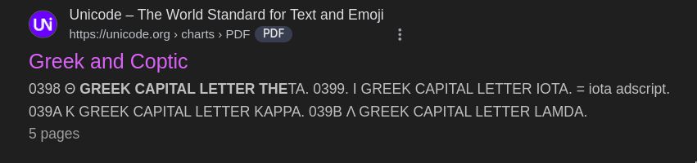
ASCII Codes vs Unicode
https://home.unicode.org/
Notes:
Scroll down to this link

Slide 47
ASCII Codes vs Unicode
https://home.unicode.org/
Click it
Notes:
And click it

Slide 48
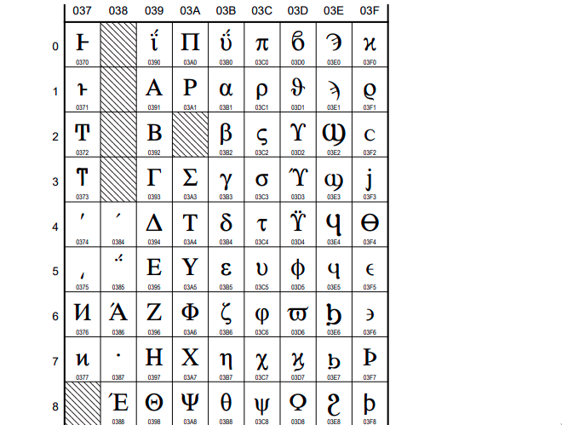
ASCII Codes vs Unicode
https://home.unicode.org/
Notes:
And here you get a bunch of greek unicodes which you can use for your programming purposes
I want to use \u03b1\u03b2\u03b3' so let me demonstrate in the python editor
89p1.py
So as you can see every code is called a code point
So all the alphabets have codes here and they’re unique and they’re all represented as hexadecimal codes, so each of these are called code points
If you want to look at other languages just repeat the process I showed you

Slide 49
ASCII Codes vs Unicode
1 byte,
2 bytes
4 bytes
English
8 bit – 1 byte UTF 8
16 bit – 2 bytes UTF 16
32 bit – 4 bytes UTF 32
2 bytes
4 bytes
planes
4 bytes
Notes:
Ok so we’ve seen unicode, the individual codes for are called codepoints, now we’ll look at planes, whats this?
We’ll talk about this and then diagraphs

Slide 50
ASCII Codes vs Unicode
1 byte,
2 bytes
4 bytes
English
8 bit – 1 byte UTF 8
16 bit – 2 bytes UTF 16
32 bit – 4 bytes UTF 32
2 bytes
4 bytes
Planes
diagraphs
4 bytes
Notes:
ok

Slide 51
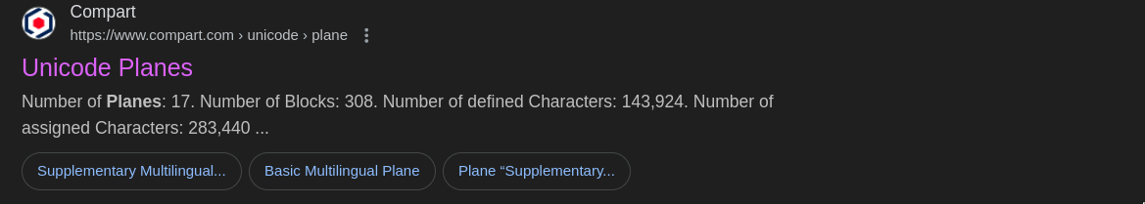
ASCII Codes vs Unicode
1 byte,
2 bytes
4 bytes
English
8 bit – 1 byte UTF 8
16 bit – 2 bytes UTF 16
32 bit – 4 bytes UTF 32
2 bytes
4 bytes
Planes
Click here
4 bytes
Notes:
Im going to search in the browser about unicode planes
Then click on the link

Slide 52
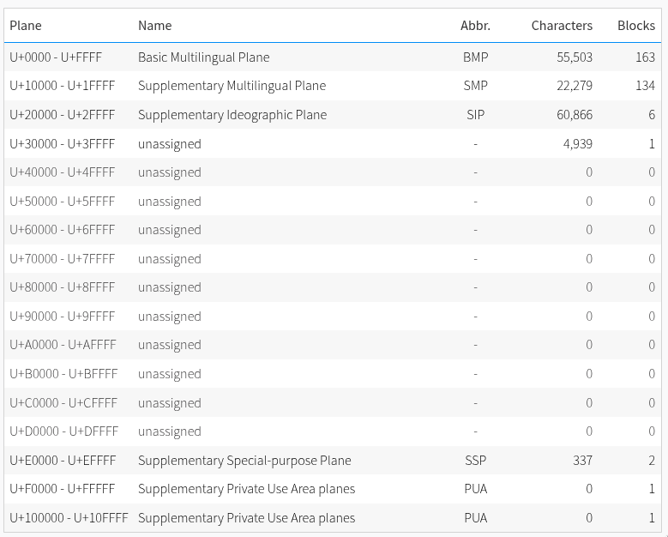
ASCII Codes vs Unicode
1 byte,
2 bytes
4 bytes
English
8 bit – 1 byte UTF 8
16 bit – 2 bytes UTF 16
32 bit – 4 bytes UTF 32
2 bytes
4 bytes
Planes
4 bytes
Notes:
So the unicodes start from 0000
And the last one is 10ffff
So how many are these?
1,114,111
So this is divided into planes
There are a total of 17 planes
Some of the planes arent used
And some of the planes are used for assigning the codes for different languages
So when the codes are smaller in size
It may take just one byte
So utf 8
If the codes are bigger they may require 2 bytes
And if they’re even bigger they may require 4 bytes
Depending on the size of the memory required

Slide 53
ASCII Codes vs Unicode
1 byte,
2 bytes
4 bytes
English
8 bit – 1 byte UTF 8
16 bit – 2 bytes UTF 16
32 bit – 4 bytes UTF 32
2 bytes
4 bytes
Planes
1 byte
4 bytes
Notes:
So the unicodes are divided into planes and those planes require different memory sizes
And this is the reason different formats are followed
If you’re using the english language then utf 8 is sufficient
This will take less memory
If you’re using utf 32 then it will take more memory
And in that if you’re using the english language then you’re wasting memory
So you should use utf 32 only if the language is falling in the larger size planes
So thats all about planes
Now lastly
Diagraph
Some languages, some languages have letters or characters that combine

Slide 54
ASCII Codes vs Unicode
1 byte,
2 bytes
4 bytes
English
8 bit – 1 byte UTF 8
16 bit – 2 bytes UTF 16
32 bit – 4 bytes UTF 32
2 bytes
4 bytes
Planes
1 byte
4 bytes
D’z
Notes:
Like in the siberian language
The two letters are combined together

Slide 55
ASCII Codes vs Unicode
1 byte,
2 bytes
4 bytes
English
8 bit – 1 byte UTF 8
16 bit – 2 bytes UTF 16
32 bit – 4 bytes UTF 32
2 bytes
4 bytes
Planes
1 byte
4 bytes
D’z
One letter ‘dzhe’
Notes:
Ok, now if you use arabic

Slide 56

ASCII Codes vs Unicode
1 byte,
2 bytes
4 bytes
English
8 bit – 1 byte UTF 8
16 bit – 2 bytes UTF 16
32 bit – 4 bytes UTF 32
2 bytes
4 bytes
Planes
1 byte
4 bytes
D’z
One letter ‘dzhe’
Notes:
This is fa and ya combined together
So these are combined together

Slide 57
ASCII Codes vs Unicode
1 byte,
2 bytes
4 bytes
English
8 bit – 1 byte UTF 8
16 bit – 2 bytes UTF 16
32 bit – 4 bytes UTF 32
2 bytes
4 bytes
Planes
1 byte
4 bytes
D’z
One letter ‘dzhe’
Diagraphs
Notes:
And this is what diagraphs represent
Ok so that was all with regards to unicode

Slide 58
Escape Sequences
Notes:
Okay now we gonna look at escape sequences
What are these
These are nothing but special characters

Slide 59
Escape Sequences
print(‘ ‘)
Notes:
That are used with the print function
These are related to the print function
What are those?
Whats the use
We’ll learn about these things
There are many escape sequences
But one important thing
These sequences are supported by all programming languages
Like c c++ java javascript and even in python they have these
So when you learn this, it’ll be useful in all programming languages
So let us start and see what are escape sequences first and then see what the use of them is
ok

Slide 60
Escape Sequences
print(‘ ‘)
\n new line
\r carriage return
\f line feed
Notes:
Ok the first one is \n which is a newline
They all start with backslash
The next one is r which is a carriage return
F for line feed

Slide 61
Escape Sequences
print(‘ ‘)
\n new line
\r carriage return
\f line feed
\t tab
Notes:
Then t for tab

Slide 62
Escape Sequences
print(‘ ‘)
\n new line
\r carriage return
\f line feed
\t tab
\v vertical tab
Notes:
Then v for vertical tab

Slide 63
Escape Sequences
\n new line
\r carriage return
\f line feed
\t tab
\v vertical tab
\b backspace
print(‘ ‘)
Notes:
Then backspace

Slide 64
Escape Sequences
\n new line
\r carriage return
\f line feed
\t tab
\v vertical tab
\b backspace
\a alert
print(‘ ‘)
Notes:
And alert
These are the escape sequences
There are a few more

Slide 65
Escape Sequences
\n new line
\r carriage return
\f line feed
\t tab
\v vertical tab
\b backspace
\a alert
\ ignore new line
print(‘ ‘)
Notes:
Ignore newline

Slide 66
Escape Sequences
\n new line
\r carriage return
\f line feed
\t tab
\v vertical tab
\b backspace
\a alert
\ ignore new line
\\ back slash
print(‘ ‘)
Notes:
Backslash itself

Slide 67
Escape Sequences
\n new line
\r carriage return
\f line feed
\t tab
\v vertical tab
\b backspace
\a alert
\ ignore new line
\\ back slash
\’ quote
print(‘ ‘)
Notes:
Single quote

Slide 68
Escape Sequences
\n new line
\r carriage return
\f line feed
\t tab
\v vertical tab
\b backspace
\a alert
\ ignore new line
\\ back slash
\’ quote
\” double quote
print(‘ ‘)
Notes:
Double quote

Slide 69
Escape Sequences
\n new line
\r carriage return
\f line feed
\t tab
\v vertical tab
\b backspace
\a alert
\ ignore new line
\\ back slash
\’ quote
\” double quote
\o octal
print(‘ ‘)
Notes:
octal

Slide 70
Escape Sequences
\n new line
\r carriage return
\f line feed
\t tab
\v vertical tab
\b backspace
\a alert
\ ignore new line
\\ back slash
\’ quote
\” double quote
\o octal
\x hexa-decimal
print(‘ ‘)
Notes:
And hexadecimal
So these are the escape sequences
So let us learn about all these
So actually these are related to display
90p1.py

Slide 71
Escape Sequences – Printable and non Printable
Notes:
So now we’re going to look at escape sequences again
But we’ve already learned about this in the previous section

Slide 72
Escape Sequences – Printable and non Printable
print(‘ ‘)
Notes:
They are special characters used with the print function
And weve learned most of them in the previous lecture
Few remain and we’ll learn about them
In this lecture
Lets see what those two are

Slide 73
Escape Sequences – Printable and non Printable
print(‘ ‘)
\xhh 2 digit Hexa
Notes:
First one is slash x for hexadecimal
Two digit hexadecimal
We’ve already seen this,
Yes
But related to it there are a few more

Slide 74
Escape Sequences – Printable and non Printable
print(‘ ‘)
\xhh 2 digit Hexa
\uxxxx 4 Digit Hexa
Notes:
Slash u 4 digit hexadecimals
So this is for unicodes the above is for the english language
And this is for all the languages
Including english also
Various other national languages you can give the characters of all the various languages in unicode format

Slide 75
Escape Sequences – Printable and non Printable
print(‘ ‘)
\xhh 2 digit Hexa
\uxxxx 4 Digit Hexa
\Uxxxxxxxx 8 Digit Hexa
Notes:
You can also make 8 digit unicodes also
So 8 digits of hexadecimal means it can take 4 bits
Or you can say its 32 bit unicode
The above is 16 bit unicode
And the 2 digit one is 8 bit unicode
So you can do this in 3 different formats
8 utf
16 utf
And 32 utf
So these are how the different escape sequences are given
One more escape sequence
Whats that

Slide 76
Escape Sequences – Printable and non Printable
print(‘ ‘)
\xhh 2 digit Hexa
\uxxxx 4 Digit Hexa
\Uxxxxxxxx 8 Digit Hexa
\N{name} name in Unicode Database
Notes:
That is slash n and we can mention a name in the curly braces, so the name in the unicode database
So ill give some examples

Slide 77
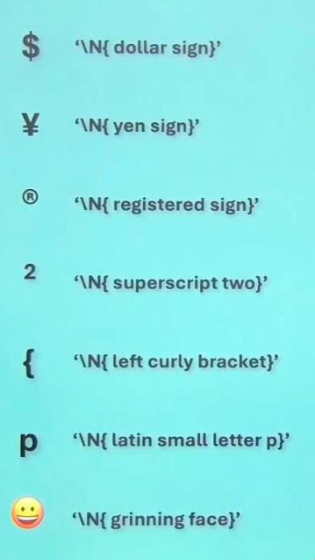
Escape Sequences – Printable and non Printable
print(‘ ‘)
\xhh 2 digit Hexa
\uxxxx 4 Digit Hexa
\Uxxxxxxxx 8 Digit Hexa
\N{name} name in Unicode Database
Notes:
So one sign is the dollar symbol
Then you get the yen symbol
Can I write anything in the curly braces?
no.
There are predefined names that are there in the database
If you go through them you get an idea what they are
Based on that you can give the name
Ok lets see here, registered sign
This is the register symbol
You could also have a trademark symbol
Or a copyrite symbol
For them also names are given
Even the alphabets there are names
Look at latin alphabet p, it just means p
So everything has a symbol, you can use the name instead of unicodes, this is the point
91p1.py

Slide 78
Print Function
Notes:
Now we’re going to look at the print function
We’ve already used this function in our programs
Whenever we wanted to display something we used it
But now we’re going to learn it in detail

Slide 79
Print Function
Seperator
Notes:
We’re going to learn some things about the seperator

Slide 80
Print Function
Seperator
End of Line
Notes:
And also end of line

Slide 81
Print Function - Seperator
Notes:
So lets start with seperator

Slide 82
Print Function - Seperator
print( )
Notes:
So for that lets first take a print function
What are the parameters it takes

Slide 83
Print Function - Seperator
print(object)
Notes:
It takes an object
What is an object
Anything in python is nothing but an object
So the print function can take any object and print
it

Slide 84
Print Function - Seperator
print(object)
Print(35) - int
print(12.75) - float
print(‘Hello’) - str
print(3+4j) - complex
Notes:
For example it can take an integer
Or a float
Or string
Or a complex number
It can print any type of data
So the print function can print any object

Slide 85
Print Function - Seperator
print(object)
print(‘hi’, 35, 12.75)
Notes:
Now, can we print multiple objects?
Yes, you can say print a string, then an integer, then a float value, so you can print multiple values, but how does this print look?
So lets open our python editor
92p1.py

Slide 86
Print Function - Seperator
Default space
print(object, sep = ‘ ‘)
Notes:
Ok, so I wanted to show you the print signature quickly, we’ve got the object to be printed, and then we’ve got the parameter called sep, which is the sperator. The space is the default argument
Go back to 92p1.py

Slide 87
Print Function - Seperator
print(object, sep = ‘ ‘, end = ‘\n’)
Notes:
Go back to 92p1.py
So we’ve already seen these two
Now theres one more argument

Slide 88
Print Function - Seperator
print(object, sep = ‘ ‘, end = ‘\n’, file = sys.stdout)
Notes:
File
That is by default system dot standard output sys.stdout
Sys is system
Std is standard
And out
So standard output
So we’re printing to the system standard output device, which is the monitor

Slide 89
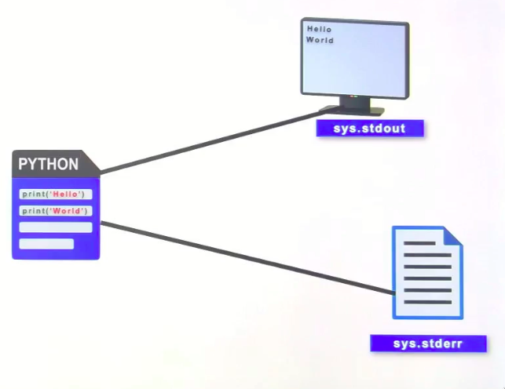
Print Function - Seperator
print(object, sep = ‘ ‘, end = ‘\n’, file = sys.stdout)
Notes:
Here you see on the left the python program
When you say print
It prints to the monitor because its the system standard output device, so it prints to the monitor this is the default
So can you change the output device?
Yes
Its called standard error
Stderr is nothing but standard error
So our python program can also print in the
Standard error log
Theres something called a log and you want to report a problem you can make your program prepare a log giving information about the program issues faced during the execution so the user can go through the log later on and correct the issues
Now theres one more argument

Slide 90
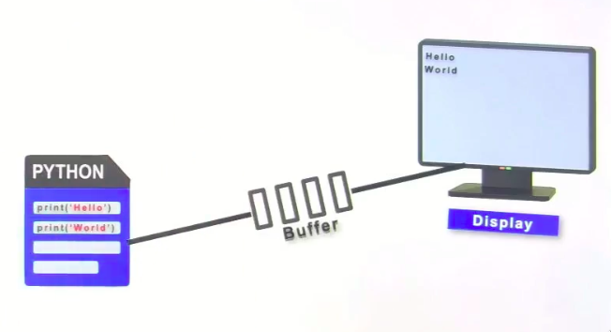
Print Function - Seperator
print(object, sep = ‘ ‘, end = ‘\n’, file = sys.stdout)
Notes:
Take a look at this picture, when any program prints to the output device, it prints onto some temporary memory between the program and the thing to be printed to, which is called the buffer
Whatever has to be printed, it will go to the buffer and then flushed onto the display
So it goes to the buffer and then flushed onto the display this is automatic, the flushing process
But sometimes, it could be stuck in the buffer so you have to forcefully flush it
So when does it get stuck
In multithreaded programs, then the output may remain in the buffer so you have to forcefully flush it

Slide 91
Print Function - Seperator
print(object, sep = ‘ ‘, end = ‘\n’, file = sys.stdout, flush = False)
Notes:
So theres one more argument to the print method called flush, by default it is false, because its not required most of the time
So this is all about the print method

Slide 92
C Style Printing
Notes:
Ok we’re going to see c style printing

Slide 93
C Style Printing
print(‘ ‘)
Notes:
Python supports c style printing
Whats this?
So this is related to the print method
You’ve already learned about the print method in detail
But you’re going to learn something new about it
So c style printing is related to the print method

Slide 94
C Style Printing
print(‘ ‘)
Formatted Printing
Notes:
To understand this you have to understand what it means by formatted printing
Once you understand this then you can understand what c style printing does
93p1.py

Slide 95
C Style Printing
print(‘ ‘)
Formatted Printing
Control Characters
Notes:
To understand this you have to understand what it means by formatted printing
Once you understand this then you can understand what c style printing does
In c there is something called as control characters that are used for formatted printing
And obviously you can use them in python also apart from c
So lets first look at formatted printing
Then we’ll see the control characters
That are coming from the c language
So for this lets open up the editor to understand formatted printing
93p1.py

Slide 96
C Style Printing – control characters
%s String
Notes:
So all the control characters start with the percentile sign
So for string its percent s

Slide 97
C Style Printing – control characters
String
%s String
Integer
%d Decimal
%i Integer
%o Octal
%x Hexadecimal
Notes:
These are for integer types of data

Slide 98
C Style Printing – control characters
String
%s String
float
Integer
%d Decimal
%i Integer
%o Octal
%x Hexadecimal
%f Float
%F Float
%g General Float
%e Scientific
%E Exponent
Notes:
And these are for the float types
So the c programming language is giving these controls for different data types
So if you’re printing a string you should write percent s
If youre printing an integer then you can mention everything under integer and likewise for float
Lets look at them once
Percent d is a decimal value
I for integer
O for octal value
X for hexadecimal
Ok f for float
Capital f also for float
G for general form of a float value
E for scientific or exponential value
Capital e also for that
How do I use this
Alrite lets demonstrate some c style strings in the python editor
93p2.py

Slide 99
Python’s Formatted Printing
Notes:
Ok this is python’s formatted printing
Ive already gone through this with c style printing
But now we will see that python has its own method of formatted printing
So we’ll learn whats provided for this

Slide 100
Formatted printing in Python
name = “Khan”
roll = 10
avg = 78.5
Notes:
For this ill take some variables
Name
Roll
And avg
Suppose I want to print this in a formatted way

Slide 101
Formatted printing in Python
name = “Khan”
roll = 10
avg = 78.5
print(‘ ----- ---- ‘)
Notes:
So I want to print it like this
First I want to print a name then some spaces or text then I want to display the roll number, then after some text I want to print the average within this string so this is a complete string I want to print within the string I want to take the values of the variables how do I do this?
For this you can follow the c style printing you can use percentile for d and so on but here in python a different method is given
So first of all followed by the string you should give a dot

Slide 102
Formatted printing in Python
name = “Khan”
roll = 10
avg = 78.5
print(‘{} -----{}----{}‘.format(name, roll, avg))
Notes:
And follow it by a method called format, and within this method give all the variables you want to print within the string, so ill take all those variables, name, roll and avg, now those three variables the values will be included within this string? But where, so for that you have to show the placeholders, these curly braces are the placeholders, and they will be in order by default with regards to the names given in the format method
So the braces are the placeholders

Slide 103
Formatted printing in Python
name = “Khan”
roll = 10
avg = 78.5
print(‘{0} -----{1}----{2}‘.format(name, roll, avg))
0
1
2
Notes:
Also you can mention the indicies
So thats it
This is how you can use the values of the variables
Within a string
By using a placeholder
Now you don’t have to remember the control characters, just make the placeholders
Now there are a few features that we’ll be looking into

Slide 104
Formatted printing in Python
print(‘ ‘)
Notes:
So let us see, suppose you want to print something
A string and you want to do formatted printing
So for that you have some variable

Slide 105
Formatted printing in Python
Print(‘ ‘.format(data))
Notes:
So you can metnion the variable in dot format, suppose the variable name is data
Now within the string you want to pritn the value of the data
Now for printing the data you can use a

Slide 106
Formatted printing in Python
Print(‘{ }‘.format(data))
Notes:
Placeholder, there should not be any gap inbetween the brackets, so you follow the opening bracket immediately by a closing bracket
Now lets see what you can do with the placeholder
Whatch this carefully

Slide 107
Formatted printing in Python
Print(‘{index }‘.format(data))
Notes:
You can mention the indicies here
Or you can mention the index
And they start from 0 onwards

Slide 108
Formatted printing in Python
Print(‘{index }‘.format(data))
- Place Holder
0 1 2 3 4 ...

Slide 109
Formatted printing in Python
Print(‘{index:w }‘.format(data))
- Place Holder
0 1 2 3 4 ...
- Width
Notes:
Now if you want to display the data in a particular size, in a particular width, then you can mention the width also here
I’ve just written a w here, but its actually a number you give
Size 10 15, 20 etc
Next if it is a float type of value you can also give the precision followed by width

Slide 110
Formatted printing in Python
Print(‘{index : w.p }‘.format(data))
- Place Holder
0 1 2 3 4 ...
- Width & Precision
Notes:
So you can mention the width and the precision
Now next

Slide 111
Formatted printing in Python
Print(‘{index : f w.p }‘.format(data))
- Place Holder
0 1 2 3 4 ...
- Width & Precision
- Flag :< :^ :> :+ :-
Notes:
Now next, you have something called a flag you can mention here
And these are the flags
These are related to alignmetn
Left right center alignments
Then
Whatever data you have, you might want to print it in some other format
Like octal or hexadecimal or exponential format, so for that we also have conversion methods
So followed by the width you can put the conversion

Slide 112
Formatted printing in Python
Print(‘{index :f w.p con }‘.format(data))
- Place Holder
0 1 2 3 4 ...
- Width & Precision
- Flag :< :^ :> :+ :-
- Conversion
d b o x f F g e E , _ %
Notes:
These are the features of formatted printing in python
Using the placeholder method
Now how do they work?
So now we’ll take some examples in our editor
We’ll see how to do all these one by one
94p1.py

