Slide 2

Multiple Time Scale Dynamics in Mathematical Biology
Supervised by Assoc. Prof Vivien Kirk
A project by Winston Su

Slide 3





Multiple Time Scales
FAST
Atlantic Tuna
Birth rate (per tuna):
≈800,000 Tuna per month
Neuron Firing
(General brain use)
Firing rate:
≈ per millisecond
SLOW
Great White Shark
Birth rate (per shark):
≈1 Shark per month
Synaptic Plasticity (Memory)
Occurrence rate:
≈ per hour

Slide 4



Dynamical Systems
Pendulum
Ball swinging from string
Simple motion, and simple dynamics.
Thus able to analyse and predict
Other Applications
All sorts of phenomena that change over time in:
Biological sciences
Social Sciences
Physics
Pure maths
And much more
Weather
Complex & Unpredictable
Detailed models ->
Hard to analyse
Simple models -> easier to analyse, but less applicable

Slide 5




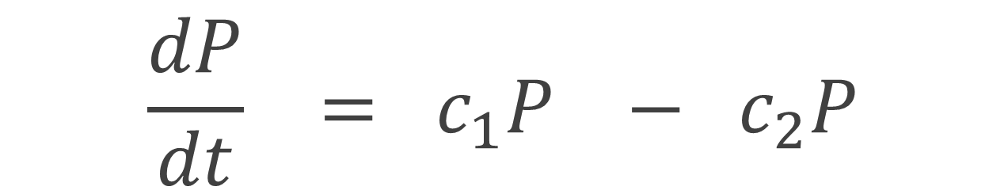

Modelling Dynamical Systems
A Differential Equation
$$=$$
$$−$$
Number of people joining Population
e.g. immigration, births
Number of people leaving Population
e.g. emigration, deaths
Change in Population
over time
$$\frac{dP}{dt} ={ c}_{1}P −{ c}_{2}P$$

Slide 6
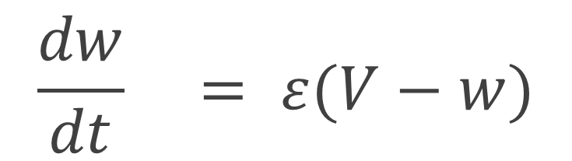



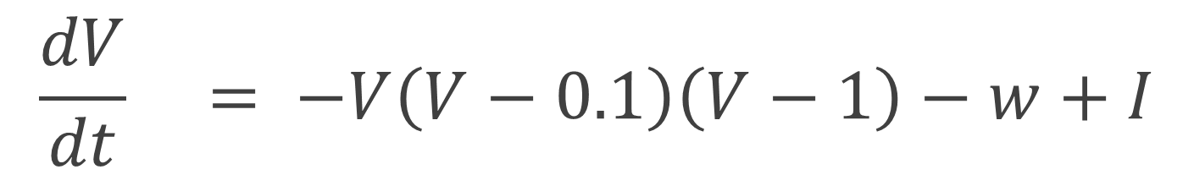
The FitzHugh-Nagumo Model
Developed in 1961 to study the basic electrical properties of neurons
$$Voltage$$
$$\frac{dV}{dt} = −V\left(V−0.1\right)\left(V−1\right)−w+I$$
FAST
$$\frac{dw}{dt} = ε(V−w)$$
$$External Current$$
$$Parameter$$
SLOW
$$Recovery variable$$

Slide 7
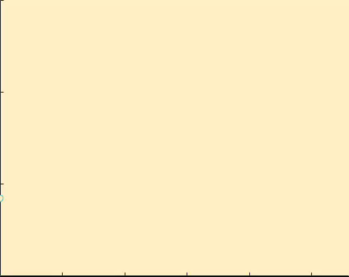
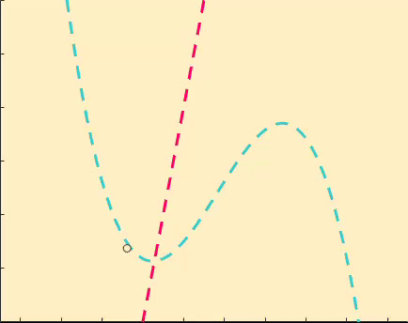
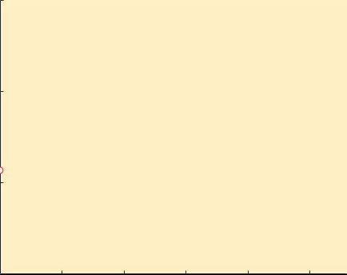







FitzHugh-Nagumo Analysis I
For current parameter, $I=0.059$
Phase Plane
Time Series
1.0
0.3
-- V nullcline
-- w nullcline
- trajectory
0.5
$$V$$
0.0
0.2
-0.5
$$w$$
0
200
400
600
1.0
0
$$t$$
0.1
0.5
$$w$$
0.0
0.0
-0.2
0.0
0.2
0.4
0.6
-0.5
$$V$$
600
0
200
400
$$t$$

Slide 8
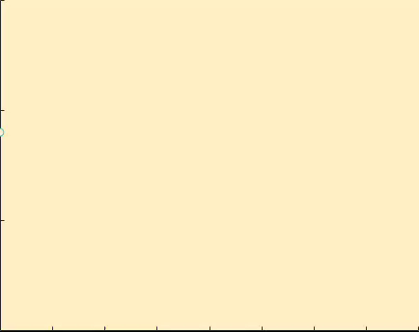
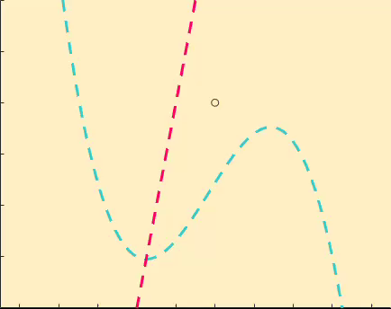
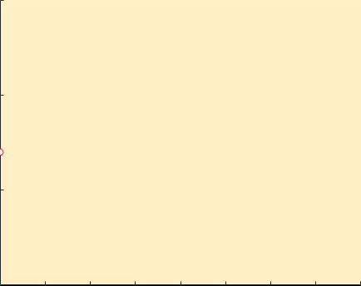

FitzHugh-Nagumo Analysis II
For current parameter, $I=0.05$
Phase Plane
Time Series
1.0
0.3
0.5
$$V$$
0.0
0.2
-0.5
$$w$$
0
200
400
1.0
0
$$t$$
0.1
0.5
$$w$$
0.0
0.0
-0.2
0.0
0.2
0.4
0.6
-0.5
$$V$$
0
200
400
$$t$$

Slide 9
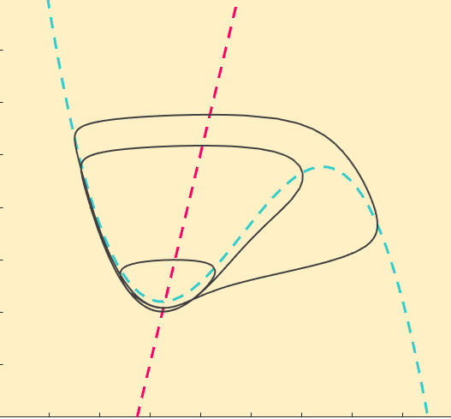
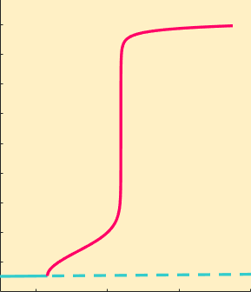




FitzHugh-Nagumo Bifurcation
Analysing the onset of oscillations
Phase Plane
(a). $I=0.05835$
(b). $I=0.058431$
(c). $I=0.0625$
Bifurcation Diagram
1.0
(c).
0.3
(b).
0.8
(c).
(b).
0.2
0.6
$$w$$
$$V$$
0.1
(a).
0.4
(a).
0.2
0.0
-0.4
0.0
0.4
0.8
1.2
0
$$V$$
0
0.056
0.058
0.060
0.062
$$I$$
Notes:
Maximum v on bifurcation

Slide 10
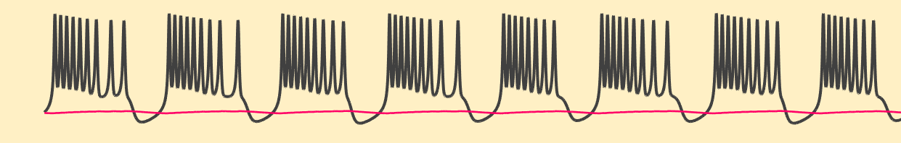
The Research
Systems with two time scales are relatively well understood.
Our interest is in 3 time scale systems.
More behaviour to study including spiking which is common in excitable cells
Hope to find mathematical mechanisms behind the onset of spiking.
And find behaviour intrinsic to 3 time scale systems

Slide 11
Thank You

Slide 12


References
‘The Effect of Geometry on the Dynamics of a Three Timescale System’ – Uzma Atiq, Master’s thesis, UoA 2018
‘Analysing mathematical models of Intracellular Calcium Dynamics using Geometric Singular Pertubation Techniques’ – Emily Paige Harvey, Doctoral Thesis, UoA, 2011
https://ocean.si.edu/ocean-life/sharks-rays/great-white-shark
http://bioweb.uwlax.edu/bio203/2011/bularz_noah/reproduction.htm
http://www.scholarpedia.org/article/FitzHugh-Nagumo_model
https://mathematical-neuroscience.springeropen.com/articles/10.1186/2190-8567-2-13

