Slide 1
BIFURCATION ANALYSIS OF CELL BURSTING
SUMMER RESEARCH PROJECT
WINSTON SU
BSc IN MATHEMATICS AND COMPUTER SCIENCE
SUPERVISORS: DR CRIS HASAN & DR ANDRUS GIRALDO
DEPARTMENT OF MATHEMATICS

Slide 2

INTRO
WHAT
Bursting, a type of cell signalling
Mathematically and biologically interesting
Comparing square-wave and pseudo-plateau bursting
WHERE
Occurs in excitable cells
Neuron & endocrine cells
WHY
Motor pattern generation
Neurological disorders like epilepsy
Understanding fast-slow timescale processes
Nature of bifurcations
HOW
Studying simple biophysical model
Full system bifurcation analysis
Numerical Continuation

Slide 3
BURSTING PATTERNS
Bursting is a very diverse phenomena
We study the following patterns
SQUARE-WAVE
FOLD/HOMOCLINIC
Large consistent amplitude spikes
PSEUDO-PLATEAU
FOLD/SUBHOPF
Small varying amplitude spikes

Slide 4
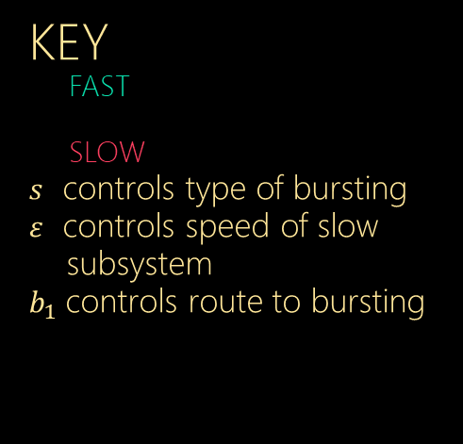





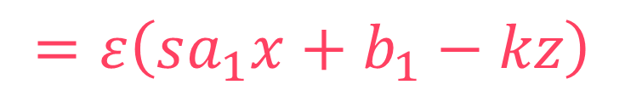
EQUATIONS
{
$$=sax^{3}−sx^{2}−y−bz$$
$$\dot{x}$$
KEY
FAST
SLOW
$s$ controls type of bursting
$ε$ controls speed of slow subsystem
$b_{1}$controls route to bursting
$$\dot{y}$$
$$=φ(x^{2}−y)$$
$$\dot{z}$$
$$=ε\left(sa_{1}x+b_{1}−kz\right)$$

Slide 5
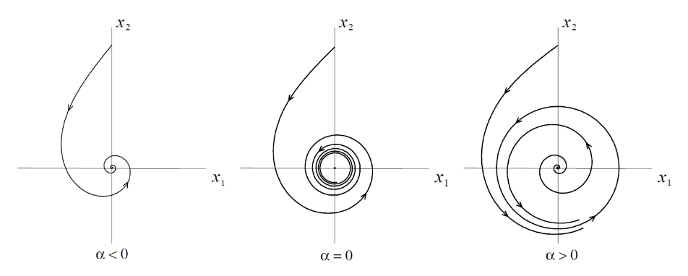
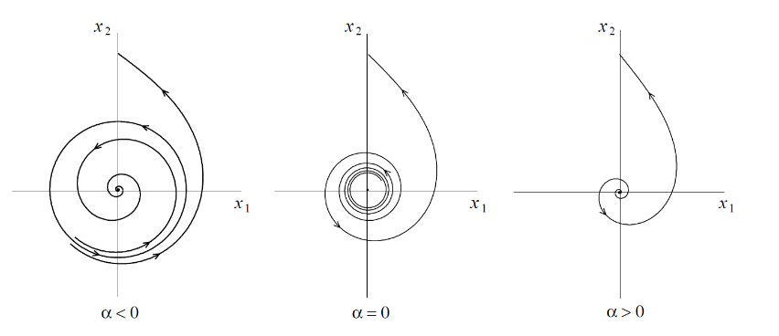
BIFURCATIONS
“A bifurcation occurs when the change of a parameter causes a qualitative change in the behaviour of the system”
SUPERCRITICIAL HOPF BIFURCATION
STABLE PERIODIC ORBIT CREATED
SUPERCRITICIAL HOPF BIFURCATION
UNSTABLE PERIODIC ORBIT DESTROYED

Slide 6
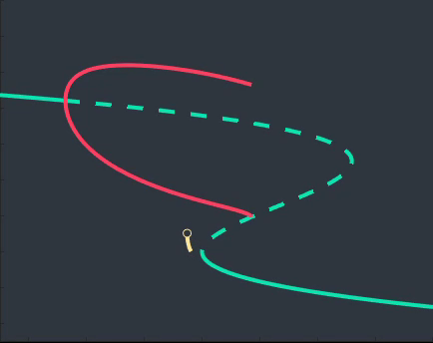
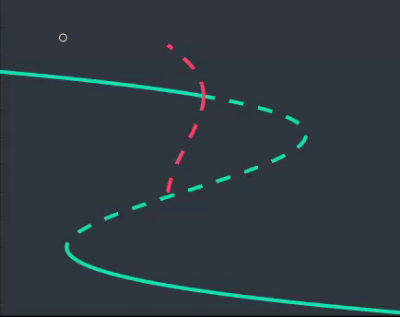







FAST-SLOW ANALYSIS
Taking the limit as $ε→0$ we treat $z$ as a bifurcation parameter and plot the corresponding bifurcation diagrams
Dotted lines represent instability, solid lines are stable
Green lines are equilibrium points, red lines are periodic orbits
SQUARE-WAVE
FOLD/HOMOCLINIC BURSTING
PSEUDO-PLATEAU
FOLD/SUBHOPF BURSTING
$s=−2.6$
$s=−1.6$
1.0
1.5
HB₁
HB₁
SN₁
SN₁
$$x$$
0.5
$$x$$
0.75
HC
HC
SN₂
SN₂
0.0
0.0
-0.1
0.05
0.1
0.1
0.2
0.5
$$z$$
$$z$$

Slide 7

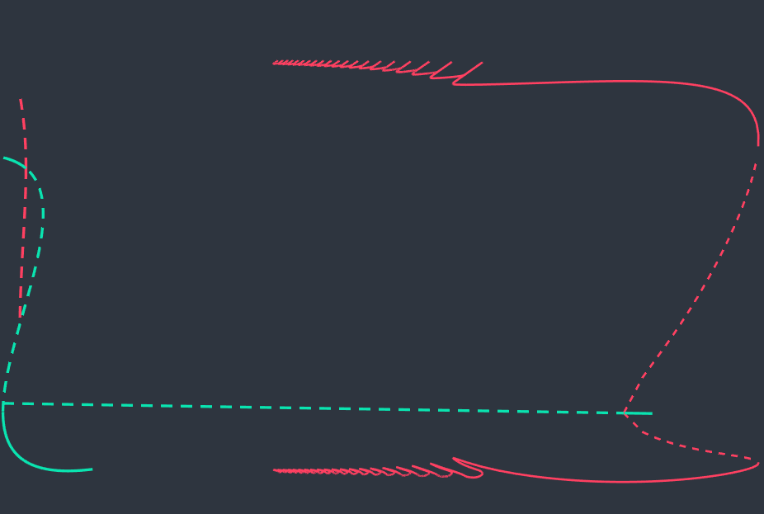
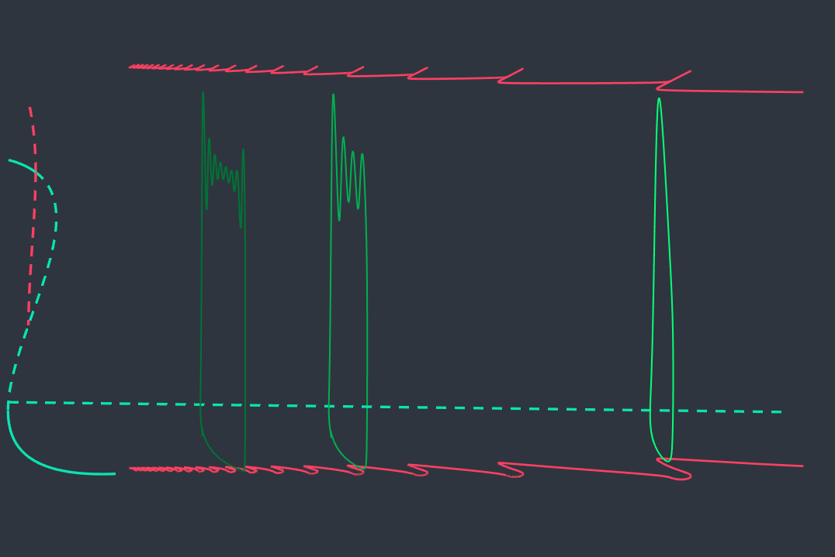

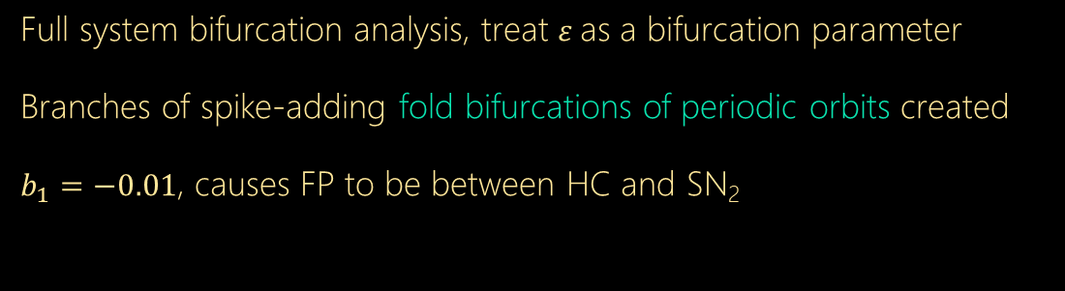





BURSTING VIA FOLD OF ORBITS
Full system bifurcation analysis, treat $ε$as a bifurcation parameter
Branches of spike-adding fold bifurcations of periodic orbits created
$b_{1}=−0.01$, causes FP to be between HC and SN₂
1.5
FBO_{n}
FBO₂
1.5
FBO₃
FBO₁
SN₁
$$x$$
0.5
HC
$$x$$
0.5
8 Spikes
FP
HB₂
4 Spikes
1 Spike
SN₂
-0.5
-0.5
0.6
0.6
10⁻³
0.0
$$z$$
10⁻²
$$ε$$
10⁻¹
10⁰
0
0.05
$$ε$$
0.1
0.0
$$z$$

Slide 8

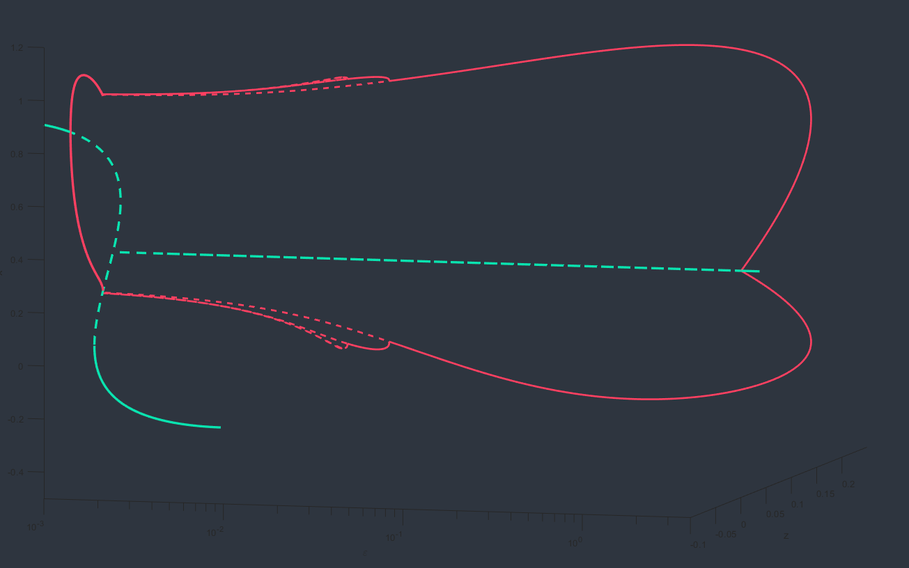
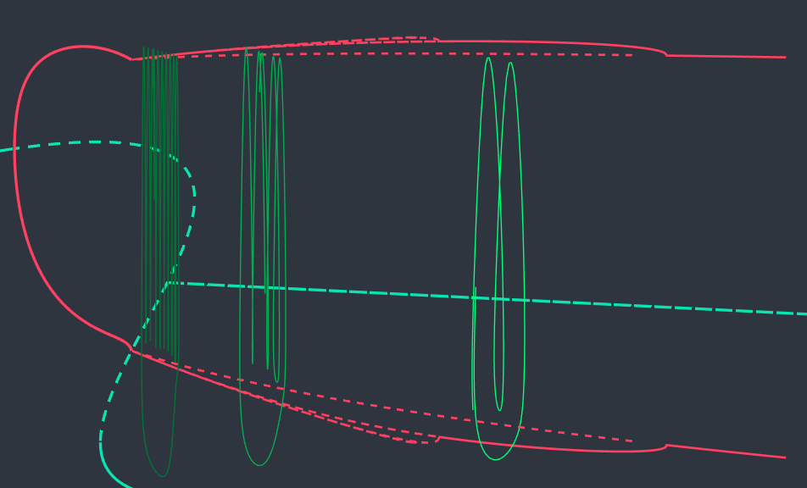
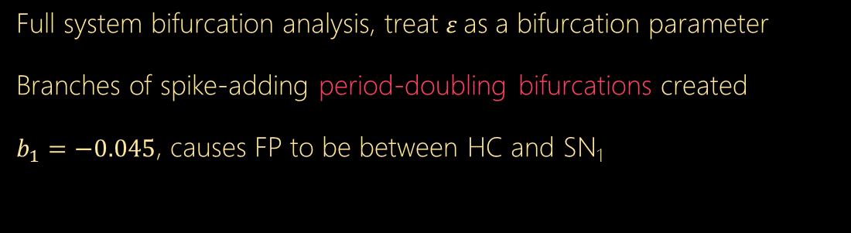

BURSTING VIA PERIOD-DOUBLING
Full system bifurcation analysis, treat $ε$as a bifurcation parameter
Branches of spike-adding period-doubling bifurcations created
$b_{1}=−0.045$, causes FP to be between HC and SN₁
1.0
1.0
PD_{n}
PD₂
PD₁
SN₁
10 Spikes
4 Spikes
2 Spikes
$$x$$
FP
HB₂
0.4
$$x$$
HC
0.5
SN₂
-0.4
-0.1
0.2
0.02
10⁻³
-0.1
$$z$$
10⁻²
$$ε$$
10⁻¹
10⁰
0
0.025
$$ε$$
0.045
0.0
$$z$$

Slide 9
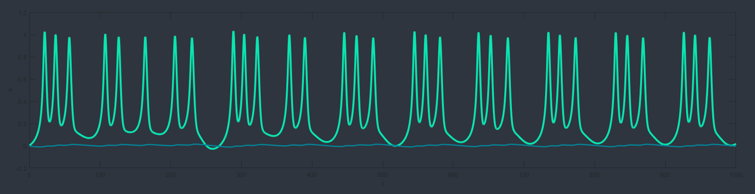
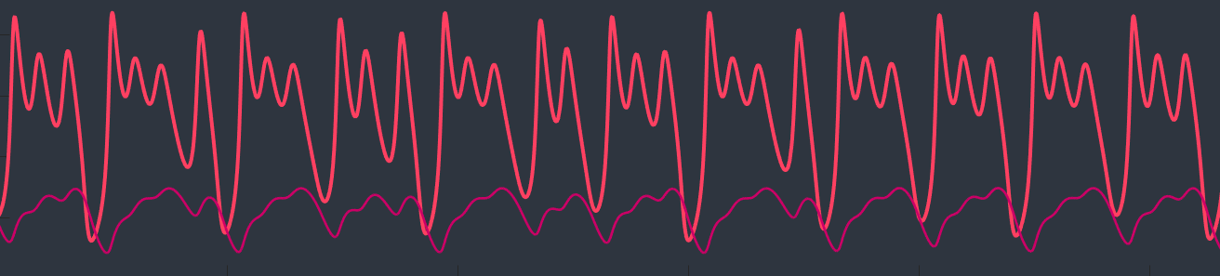
CHAOTIC BURSTING
“When the present determines the future, but the approximate present does not approximately determine the future”
- Edward Lorenz
Period Three Theorem implies chaotic cycles

Slide 10



FURTHER DIRECTIONS
CONCLUSION
Analyse different bursting such as Fold/Hopf.
Two parameter bifurcation diagrams
CHAOS
Irregular spiking behaviour yet to be investigated in great depth
ROUTE TO BURSTING
Via branches of spike adding:
Fold Bifurcations of Periodic Orbits
Period-doubling bifurcations
depending on FP
FUTURE IMPLICATIONS
Greater understanding of the theory behind neuron cell communication and why bursting occurs

Slide 11

REFERENCES
Izhikevich, Eugene M. Neural excitability, spiking and bursting. International journal of bifurcation and chaos. 2000. Section 4, Pages 1171 - 1266.
Kuznetsov, A. Yuri. Elements of Applied Bifurcation Theory, Second Edition. Springer-Verlah NewYork, Inc. 1998, 1995.
Tsaneva-Atanasova, K., Osinga, H. M., Rieß, T., \& Sherman, A.
Full system bifurcation analysis of endocrine bursting models.
Journal of theoretical biology, 264(4), 2010. Pages 1133-1146.
Weisstein, Eric W. “Period Three Theorem.”From MathWorld--A Wolfram Web Resource. http://mathworld.wolfram.com/PeriodThreeTheorem.html
Doedel, E. J., Fairgrieve, T. F., Sandstede, B., Champneys, A. R., Kuznetsov, Y. A., \& Wang, X.
AUTO-07P: Continuation and bifurcation software for ordinary differential equations, 2007.
Hindmarsh,J.,Rose,R.,1984. A model of neuronal bursting using 3 coupled 1st order differential-equations.Proc.R.Soc.London Ser. Biol. SCi. 221
Hodgkin AL, Huxley AF (August 1952). “A quantitative description of membrane current and its application to conduction and excitation in nerve”. The Journal of Physiology. 117 (4): 500–44.
THANK YOU
THANK YOU

