Slide 1


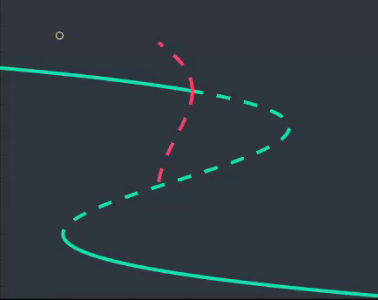
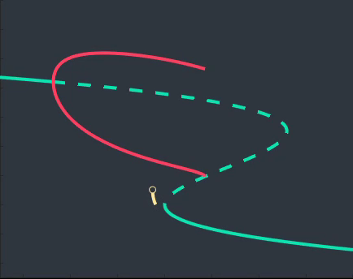





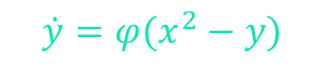
BIFURCATION ANALYSIS OF CELL BURSTING
WINSTON SU. SUPERVISORS: DR CRIS HASAN & DR ANDRUS GIRALDO MUNOZ
MOTIVATION, GOALS, TOOLS
BURSTING PATTERNS
BURSTING BEHAVIOUR IS COMMON IN
NEURON AND ENDOCRINE CELLS
UNDERSTANDING MATHEMATICAL
MECHANISM FOR DIFFERENT
BURSTING AND TRANSITIONS
BETWEEN THEM
BIFURCATION THEORY AND
NUMERICAL CONTINUATION
SQUARE WAVES
PSEUDO-PLATEAU WAVES
BIFURCATION
EQUATIONS
{
1.5
1.0
$$\dot{x}=sax^{3}−sx^{2}−y−bz$$
HB₁
HB₁
$$\dot{y}=φ(x^{2}−y)$$
$$x$$
.75
SN₁
$$x$$
0.5
SN₁
HC
SN₂
HC
$$\dot{z}=ε\left(sa_{1}x+b_{1}−kz\right)$$
SN₂
0.0
0.0
0.1
0.2
0.5
-0.1
.05
0.1
$$z$$
$$z$$

