Slide 1
Task 3
Team Orange

Slide 2
Scoping – project scope
basic user data: Provide basic information about the patient and the relatives
information & notification: Standardized data exchange between medical staff and relatives
activity tracking: Consistent history of the patients activities to improve the medical treatment by the staff

Slide 3
Scoping – out of scope
creating user accounts: This feature is subject to the administration office
sensitive information: The app doesn’t provide sensitive data to match with the medical confidentiality law

Slide 4
Scoping – goals
easy to use
minimize effort for medical staff & administration
support relatives in their daily business
monitoring
sharing information between relatives

Slide 5

Research
brainstorming
defined tasks for each team member
created notes for the interview
defined storyboards

Slide 6


Synthesize
summarized all information
removed unnecessary and added important functions
extended storyboards and prototypes
defined target users

Slide 7
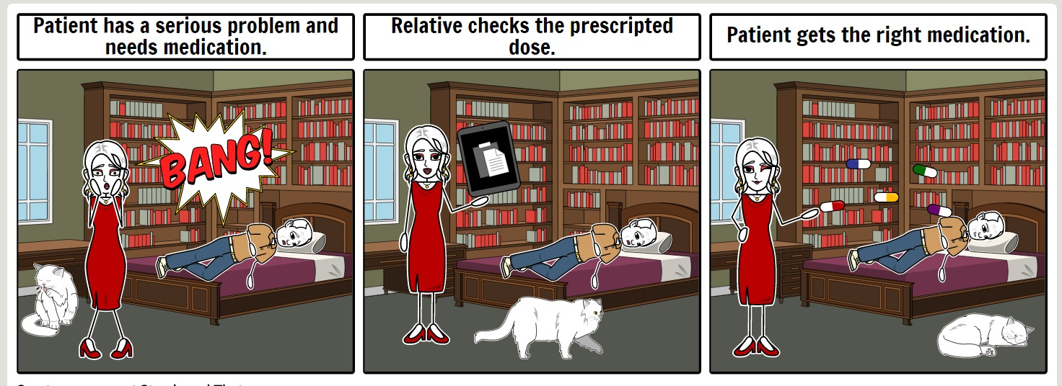
Storyboard - medication

Slide 8
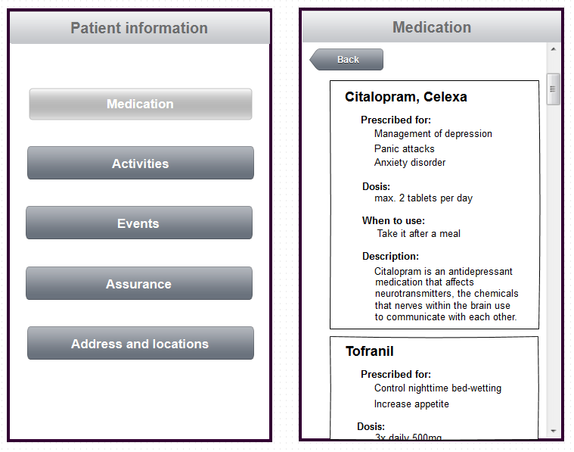
Prototype - medication

Slide 9
Fazit
brainstorming
defined tasks for each team member
created notes for the interview
defined storyboards

