Slide 1
Task 3
Team Orange
Notes:
Joy
Begrüssung, User Group = relatives
Thema schizophrenie

Slide 2
Scoping – project scope
basic user data
information & notification
activity tracking
minimize effort for medical staff &
administration
support relatives in their daily business
Notes:
Joy
Provide basic information about the patient and the relatives
Standardized data exchange between medical staff and relatives
Consistent history of the patients activities to improve the medical treatment by the staff

Slide 3
Scoping – out of scope
creating user accounts
sensitive information
monitoring
sharing information between relatives
Notes:
Yves
This feature is subject to the administration office
The app doesn’t provide sensitive data to match with the medical confidentiality law

Slide 4

Research
brainstorming
defined tasks for each team member
created notes for the interview
defined storyboards
Notes:
Joy

Slide 5
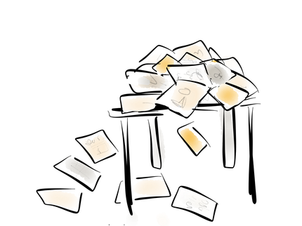

Synthesize
summarized all information
removed unnecessary and added important functions
extended storyboards and prototypes
defined target users
Notes:
Yves

Slide 6
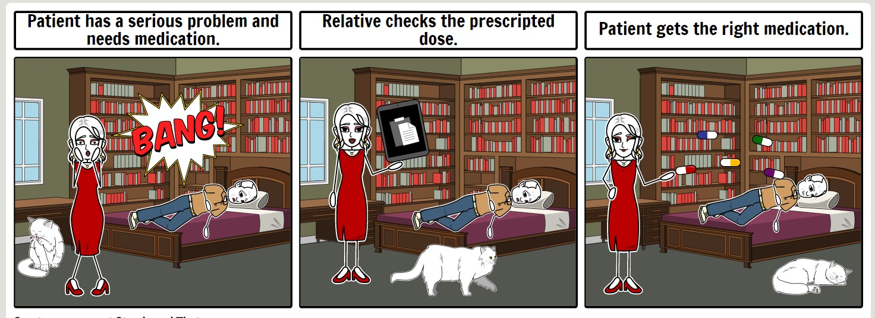
Storyboard - medication
Notes:
Joy

Slide 7
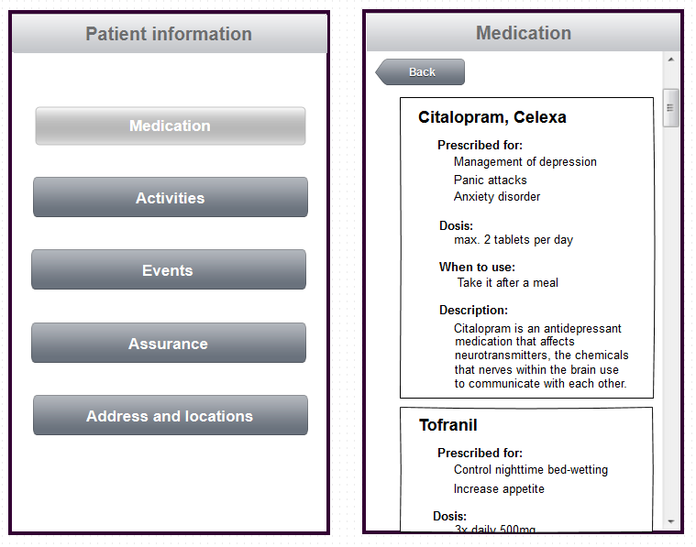
Prototype - medication
Notes:
Yves

Slide 8
Discussion
Notes:
Joy
Patient muss gleich viel sehen können wie Relatives
Interview hat sehr geholfen
überwachung

