Slide 1

Load Balancing using Docker Containers
McCade Freeman
Colton Smith
Ryan Caudill
Drew Jones

Slide 2
Introduction
Dean Pulsifer – Software Engineer at Lexmark / Customer
McCade Freeman – Testing
Colton Smith – Website, Client, Server, Load Balancer
Ryan Caudill – Data Analysis, Testing
Drew Jones – Project Design, Testing

Slide 3
Docker
Docker containers are used to wrap a piece of software in a complete filesystem that contains everything needed to run: code, runtime, system tools, system libraries, etc. This guarantees that the software will always run the same, regardless of its environment.
Multi-platform: Linux, Mac, Windows
Lightweight
Configurable

Slide 4
Project Goal
Run clients/servers with Docker
Optimization. Limits?
Load balancing
Compare algorithms
Analysis & Data

Slide 5
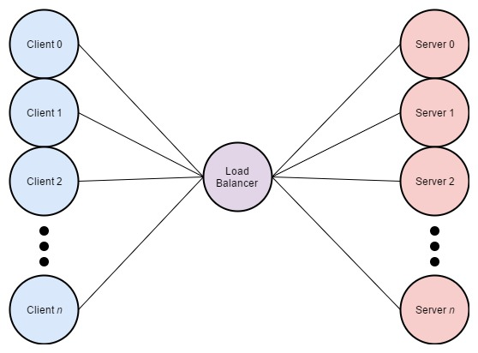
Load Balancing

Slide 6
Load Balancer
Based on latest Nginx distribution
Dockerfile
default.conf
buildImage.sh
startBalancer.sh
stopBalancer.sh
access.log
Notes:
Colton

Slide 7
Clients
Based on latest Alpine Linux distribution
Dockerfile
runMultiple.sh
runClient.sh
URL
buildImage.sh
makeClients.sh
downloadFiles.sh
clientStats
Notes:
Colton

Slide 8
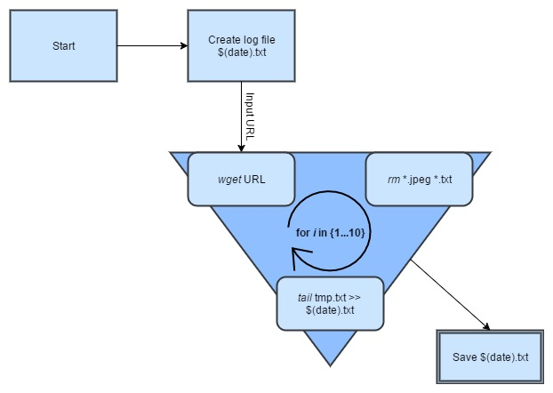
downloadFiles.sh
Notes:
Colton

Slide 9
Servers
Based on latest Nginx distribution
Dockerfile
default.conf
html
buildImage.sh
startServers.sh
stopServers.sh
/nginx_status
getStats.sh
Notes:
Colton

Slide 10
Demo

Slide 11
Problems Encountered
Docker swarm vs. Nginx Load Balancing
Bash scripts running inside of containers
Deploying containers on Mac/Linux vs. Windows

Slide 12
Future Enhancements
Client script compatibility with Windows
Custom load balancing algorithms
More lightweight server and load balancer images
Notes:
Colton

Slide 13
Questions?

