Slide 1

Angular Js
HTML enhanced forWeb Apps

Slide 2
About Me
Abhinav Gujjar
12+ years of experience
Microsoft, Thomson Reuters
Startup, Consultant, Trainer

Slide 3
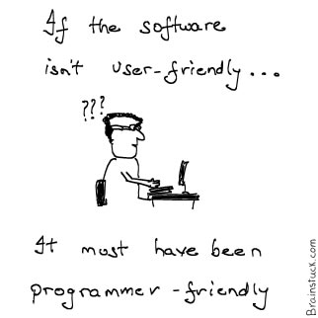
Guidelines
Phones on Silent
Concepts, not Syntax
Fundamentals, not specifics
Questions…. Lots !

Slide 4
Pre-requisites
Javascript knowledge
Editor
Node.js installation
Chrome preferably

Slide 5
Agenda
Web Applications
Http and Internet Refresher
Single Page Applications
Angular Concepts
What and Why, MV*
Angular Components
Controllers, Services, Filters, Routing & Views, Binding
Advanced Angular
Custom Directives, Communication, Scopes, $http, Best Practices

Slide 6
Web Applications

Slide 7
Internet History refresher
Resources, not applications
The great resurgence of Javascript
More browser less server

Slide 8
SPA Characteristics
No URL Change
Back Button
Bookmarking of links
Offline (well… kinda)
Subsequent requests only for data.
HTML is cached

Slide 9
Angular Fundamentals

Slide 10
Philosophy
Opinionated
Comprehensive
Open Source
MV*
Extends HTML vocabulary

Slide 11

Demo – Hello World

Slide 12

Basic Application
Include angular.js in the page
Add ng-App Directive
Angular Directive
ng = Angular
Notes:
ng-App is a Gotcha
Ng-App starts the compilation process
Angular js must be included

Slide 13
Expressions
Javascript like code snippets
Forgiving
No Control flow
DEMO
Notes:
{{ 10 * 3 }}
{{ 'hello ' + 'world }}
{{ [1,2,3][2] }}
{{ Math.min(2,3) }}

Slide 14
Controller Demo
Notes:
{{ 10 * 3 }}
{{ 'hello ' + 'world }}
{{ [1,2,3][2] }}
{{ Math.min(2,3) }}

Slide 15
Controllers
Are the CENTRAL Element in Angular
Prepare the model to the View
Via Scope
DEMO
Notes:
{{ 10 * 3 }}
{{ 'hello ' + 'world }}
{{ [1,2,3][2] }}
{{ Math.min(2,3) }}

Slide 16
Directives Usage
<ng-form />
<div ng-form>
<div class=“ng-form”>

Slide 17
Other Directives
ngApp
ngBind
ngBindTemplate
ngBindHtml
ngHide
ngShow
ngCloak
ngModel
ngStyle
ngClass
ngClassEven
ngClassOdd
ngDisabled
ngChecked
ngMultiple
ngReadonly
ngSelected
ngForm
ngSubmit
ngHref
ngSrc
ngNonBindable

Slide 18
Directives - Events
ngClick
ngDblClick
ngMousedown
ngMouseenter
ngMouseleave
ngMousemove
ngMouseover
ngMouseup
ngChange
<input type="checkbox" ng-change="handleChange()"
ng-model="property" />

Slide 19
GOTCHA!
ngClassEven in HTML = ng-class-even
Notes:
Since HTML is case insensitive, we use dash-delimited

Slide 20
Enough Snippets!
Real World (ish) application
Angular Seed
Bower
Bootstrap
Notes:
Since HTML is case insensitive, we use dash-delimited

Slide 21
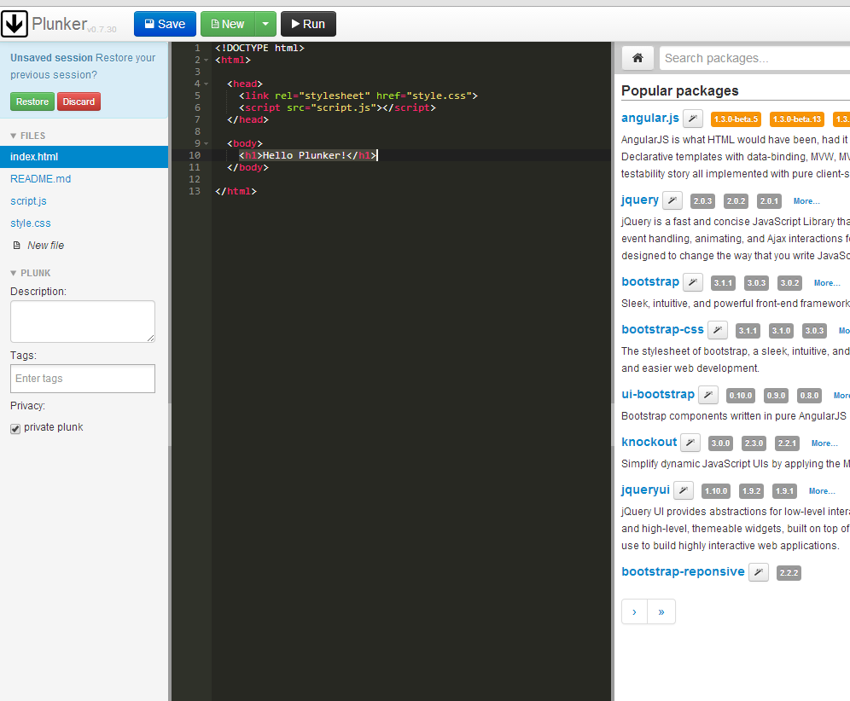

plnkr.co

Slide 22
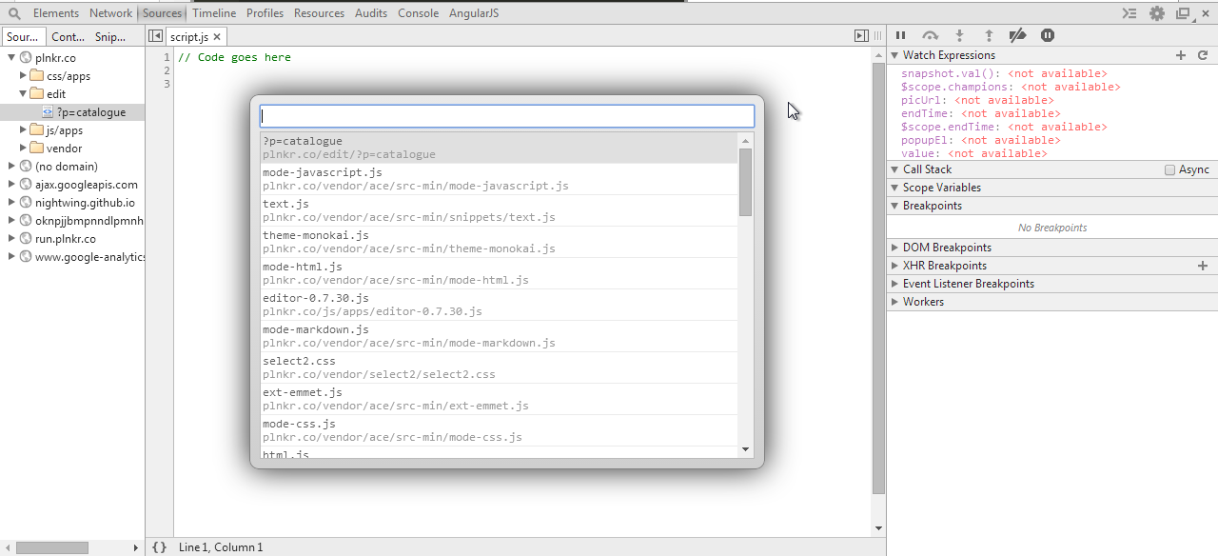
Developer Tools

Slide 23
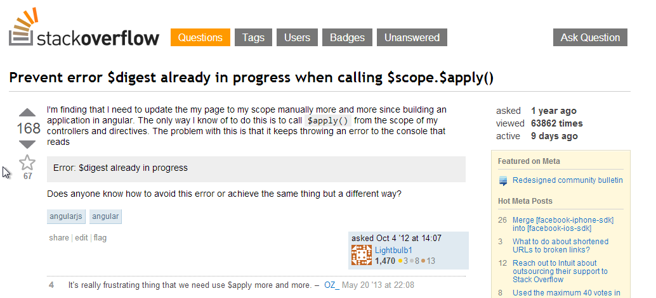
StackOverflow

Slide 24
Angular - MV*
Model
Controller
View
Server

Slide 25
Components
Services
Controllers
Views / Directives

Slide 26
Filters
Modifying output
Formatting output
Sorting
Filtering
{{ expression | filter }}

Slide 27
Built in Filters
uppercase
lowercase
number
currency
date
json
orderBy
limitTo
filter

Slide 28
Two-way Binding - ngModel
Input
Select
Textarea

Slide 29
Functions
forEach
isUndefined
isObject
toJson
equals
copy
angular.forEach(values, function(value, key){
//dosomething
});

Slide 30
Validation
Required
ngPattern
Form properties
CSS classes

Slide 31
Services
Not Web Services
Some worker object really
Typically stateless

Slide 32
Why Service
Single Responsibility principle
Reusable
Dependency Injection
Testable

Slide 33
What is it?
Registration required
Can be then injected

Slide 34
Built in Services
Navigation
Location
http
q

Slide 35
Custom Service
Value
Factory

Slide 36
Routing
Single Page Application
$route service
$location service
Browser history

Slide 37
$location service
When you need to REACT to a change in the URL
When you need to MAKE a change to the URL

Slide 38
$route service
Access information about a route
current
routes
Reload !

Slide 39
Template and Resolve
Template
Custom inline HTML
Resolve

Slide 40
Browser History
Automatically managed by AngularJs

Slide 41
Accessing route parameters
$routeParams

Slide 42
Custom Directives
Dynamic HTML
Separating markup from logic
Isolate scope

Slide 43
Uses
Custom Elements
Custom Events
Observe and react to changes

Slide 44
Communicating
Inherited Scopes
Events
Shared Service

Slide 45
Unit Testing

Slide 46
Single Page Applications

Slide 47
Best Practices
Directory Structure- Angular-seed
Script tags at the bottom – loading is blocking

