Slide 1
Best Secure Coding Practices
XSS

Slide 2
What is XSS?
Cross-site scripting (XSS) is a code injection attack that allows an attacker to execute malicious JavaScript in another user's browser.
Notes:
Source:
http://excess-xss.com/
https://www.owasp.org/index.php/XSS

Slide 3
What is a malicious script?
Notes:
At first, the ability to execute JavaScript in the victim's browser might not seem particularly malicious. After all, JavaScript runs in a very restricted environment that has extremely limited access to the user's files and operating system. In fact, you could open your browser's JavaScript console right now and execute any JavaScript you want, and you would be very unlikely to cause any damage to your computer.
However, the possibility of JavaScript being malicious becomes more clear when you consider the following facts:
JavaScript has access to some of the user's sensitive information, such as cookies.
JavaScript can send HTTP requests with arbitrary content to arbitrary destinations by using XMLHttpRequest and other mechanisms.
JavaScript can make arbitrary modifications to the HTML of the current page by using DOM manipulation methods.

Slide 4
How malicious script is injected ?
Notes:
The attacker does not directly target his victim. Instead, he exploits a vulnerability in a website that the victim visits, in order to get the website to deliver the malicious JavaScript for him. To the victim's browser, the malicious JavaScript appears to be a legitimate part of the website, and the website has thus acted as an unintentional accomplice to the attacker.
The only way for the attacker to run his malicious JavaScript in the victim's browser is to inject it into one of the pages that the victim downloads from the website. This can happen if the website directly includes user input in its pages, because the attacker can then insert a string that will be treated as code by the victim's browser.

Slide 5
Types of XSS:
Persistent XSS
Reflected XSS
DOM-based XSS
Notes:
While the goal of an XSS attack is always to execute malicious JavaScript in the victim's browser, there are few fundamentally different ways of achieving that goal. XSS attacks are often divided into three types:
Persistent XSS, where the malicious string originates from the website's database.
Reflected XSS, where the malicious string originates from the victim's request.
DOM-based XSS, where the vulnerability is in the client-side code rather than the server-side code.

Slide 6
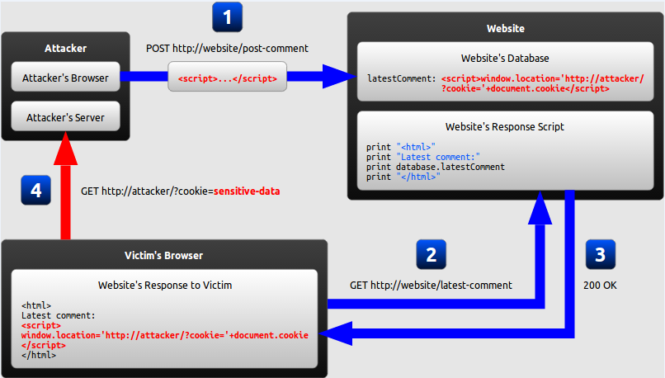
Persistent XSS :
Notes:
The attacker uses one of the website's forms to insert a malicious string into the website's database.
The victim requests a page from the website.
The website includes the malicious string from the database in the response and sends it to the victim.
The victim's browser executes the malicious script inside the response, sending the victim's cookies to the attacker's server.

Slide 7
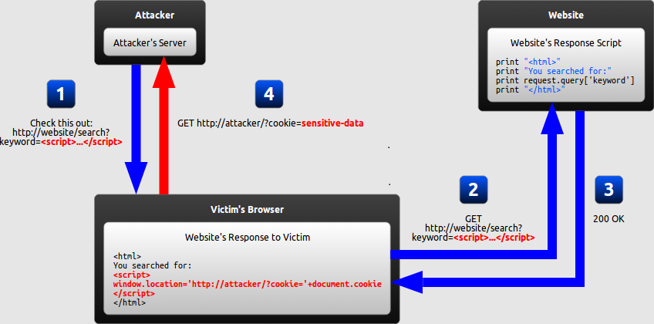
Reflected XSS:
Notes:
The attacker crafts a URL containing a malicious string and sends it to the victim.
The victim is tricked by the attacker into requesting the URL from the website.
The website includes the malicious string from the URL in the response.
The victim's browser executes the malicious script inside the response, sending the victim's cookies to the attacker's server.

Slide 8
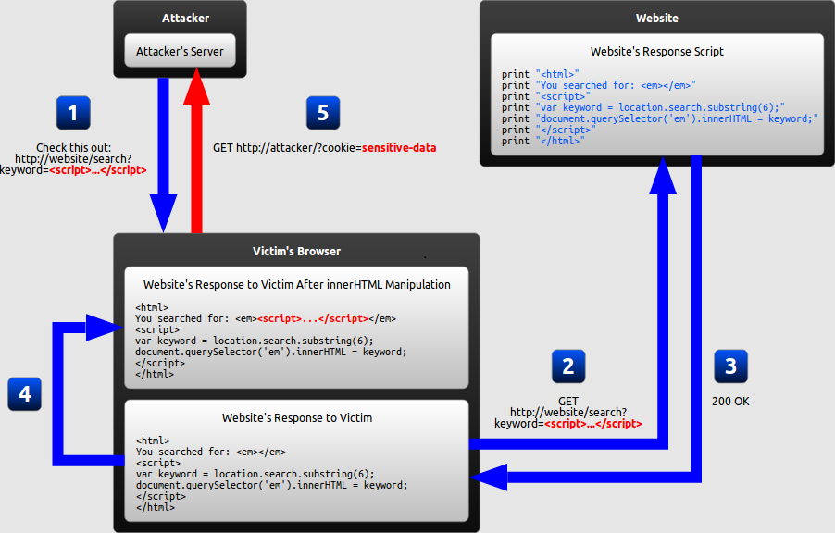
DOM-Based XSS
Notes:
The attacker crafts a URL containing a malicious string and sends it to the victim.
The victim is tricked by the attacker into requesting the URL from the website.
The website receives the request, but does not include the malicious string in the response.
The victim's browser executes the legitimate script inside the response, causing the malicious script to be inserted into the page.
The victim's browser executes the malicious script inserted into the page, sending the victim's cookies to the attacker's server.

Slide 9
Preventing XSS:
Encoding
Validation
Notes:
Encoding, which escapes the user input so that the browser interprets it only as data, not as code.
Validation, which filters the user input so that the browser interprets it as code without malicious commands.
Inbound/outbound: Secure input handling can be performed either when your website receives the input (inbound) or right before your website inserts the input into a page (outbound)

Slide 10
Example 1
The following JSP code segment reads an employee ID, eid, from an HTTP request and displays it to the user.
<% String eid = request.getParameter("eid"); %> ...
Employee ID: <%= eid %>

Slide 11
Example 2
The following JSP code segment queries a database for an employee with a given ID and prints the corresponding employee's name
Statement stmt = conn.createStatement(); ResultSet rs = stmt.executeQuery("select * from emp where id="+eid);
if (rs != null) { rs.next();
String name = rs.getString("name"); %>
Employee Name: <%= name %>

Slide 12
Example 3
Suppose the following code is used to create a form to let the user choose his/her preferred language. A default language is also provided in the query string, as the parameter “default”.
http://www.some.site/page.html?default=French
-----------------------------------------
… Select your language:
<select>
<script>
document.write("<OPTION value=1>"+document.location.href.substring(document.location.href.indexOf("default=")+8)+"</OPTION>");
document.write("<OPTION value=2>English</OPTION>");
</script>
</select> …
----------------------------------------
http://www.some.site/page.html?default=<script>alert(document.cookie)</script>

Slide 13
Example 4
Let's assume that we have an error page, which is handling requests for a non existing pages, a classic 404 error page. We may use the code below as an example to inform user about what specific page is missing:
<html> <body> <print "Not found: " . urldecode($_SERVER["REQUEST_URI"]); > </body> </html>
------
http://testsite.test/file_which_not_exist
-----
http://testsite.test/<script>alert("TEST");</script >

Slide 14
Source:
http://excess-xss.com/
https://www.owasp.org/index.php/XSS

