Slide 1
State St Traffic
Songyang Cheng, Mianzhi Huang, Nelson Linscott, Shou Kurosu

Slide 2
Pedestrain Flow
One peak around 12 pm - 2 pm on both Saturday and Sunday.
Two peaks, one around 12 pm and the other around 6 pm, from Monday to Friday. (commuting)
The number of people who walk on Saturday is almost as twice large as the number who walk on weekdays.
Notes:
Nelson

Slide 3
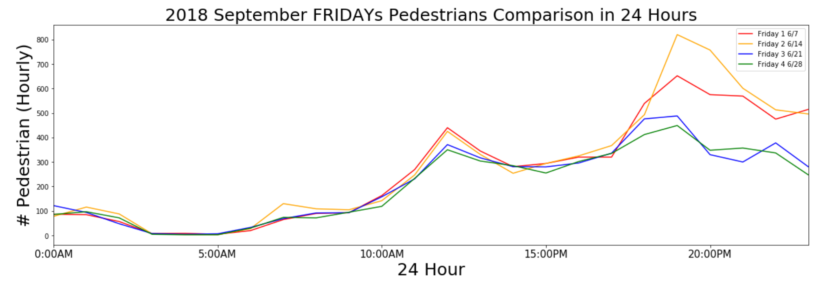
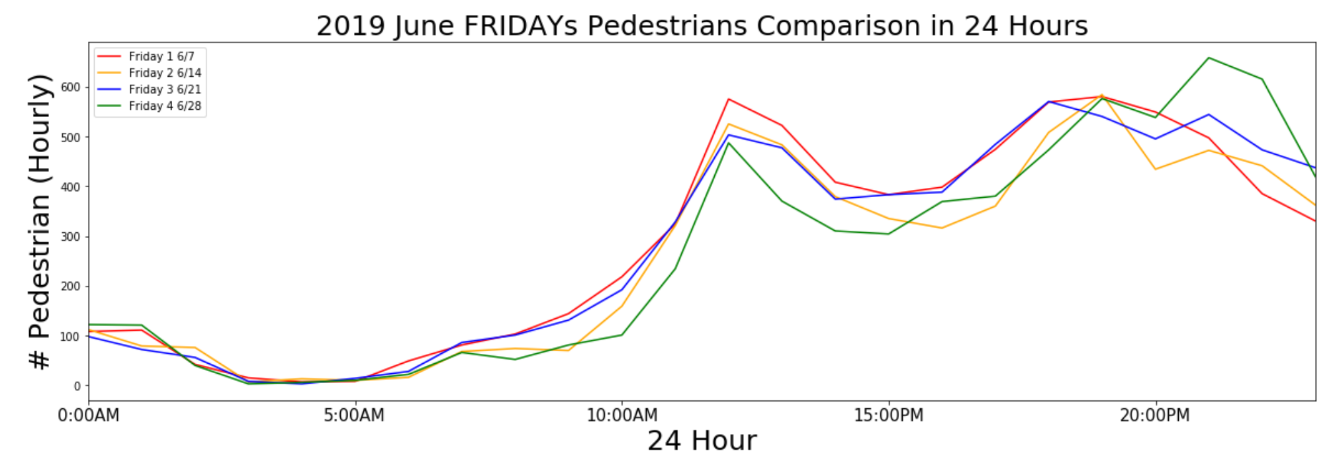
Patterns on Friday in 2018 Sep and 2019 June
Indicate a need to focus on controls based on Friday night variations
Notes:
As we will see later that the Saturday and Sundays are the peak times for pedestrian numbers. But during weekdays, we begin to see big ups and downs starting at around 11AM on Fridays every week. What we can work on further is to have find data on traffic flows on Friday, which is not available to us during the analysis.

Slide 4
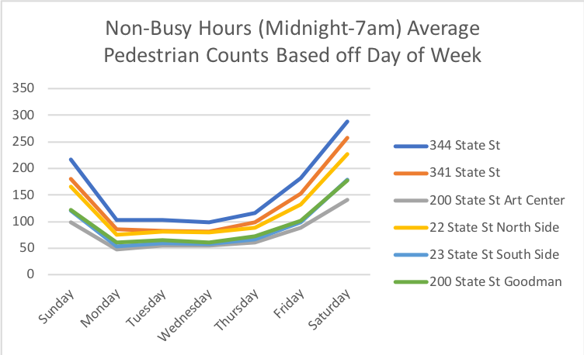
Notes:
Nelson

Slide 5
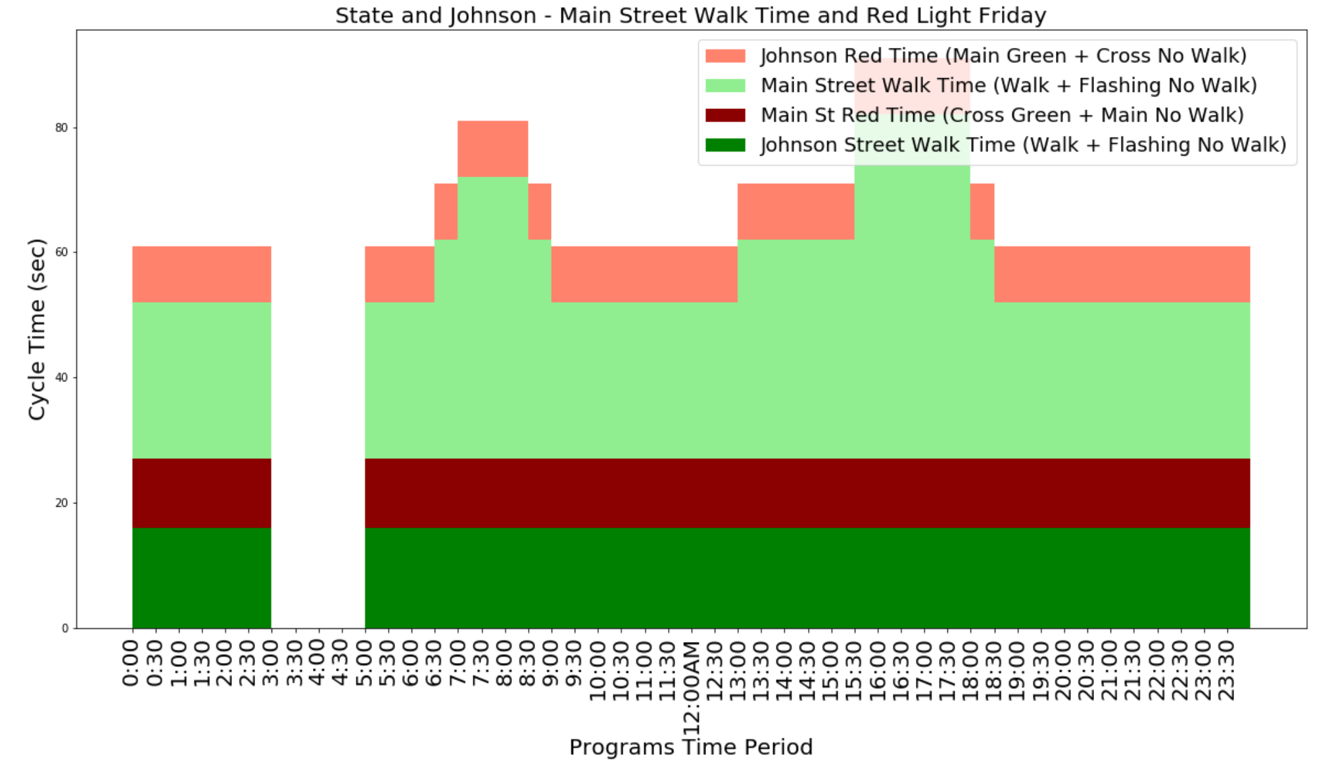
Notes:
Also, by looking at the Friday traffic light patterns for one specific street for example, it’s really not adjusted based on the pedestrian numbers, it is not echoing the peak time and the rising pedestrians after 11AM all the way til midnight. So I believe traffic light pattern may need to look at that to optimize its patterns.

Slide 6
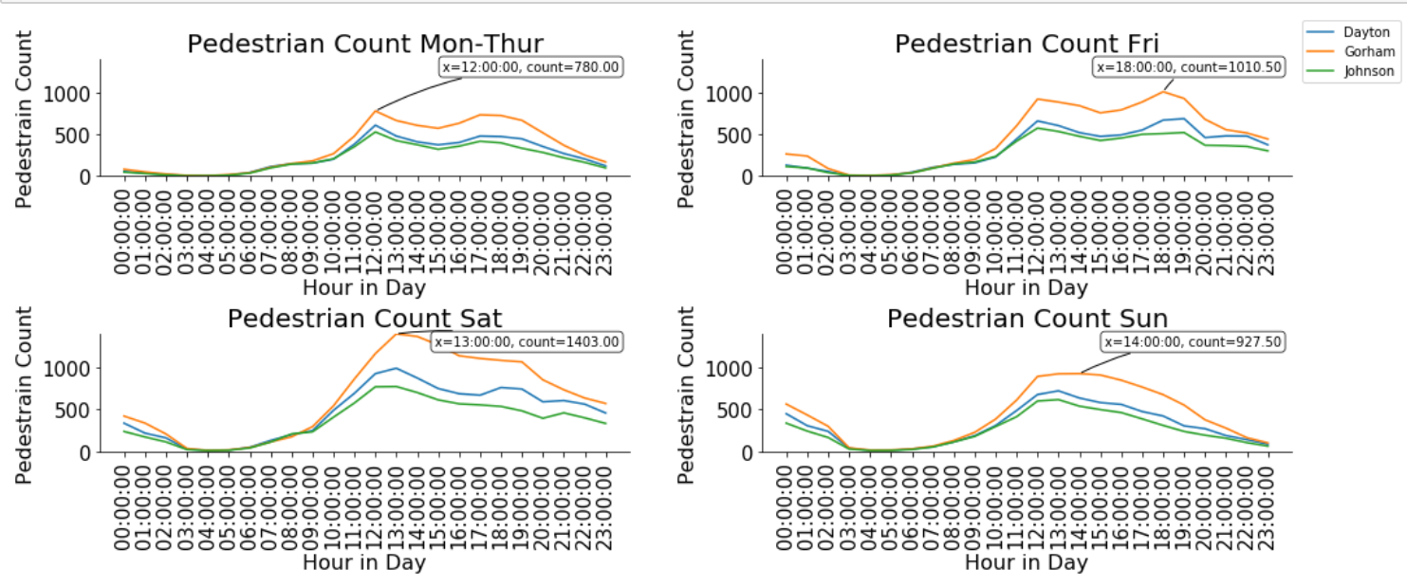
Notes:
We can see the pedestrian patterns from another angle, by breaking down on different days in a week. Patterns are similar among different intersections. Also, I label the peak for Gorham intersection, and it is clear that most pedestrian walk on Saturday.

Slide 7
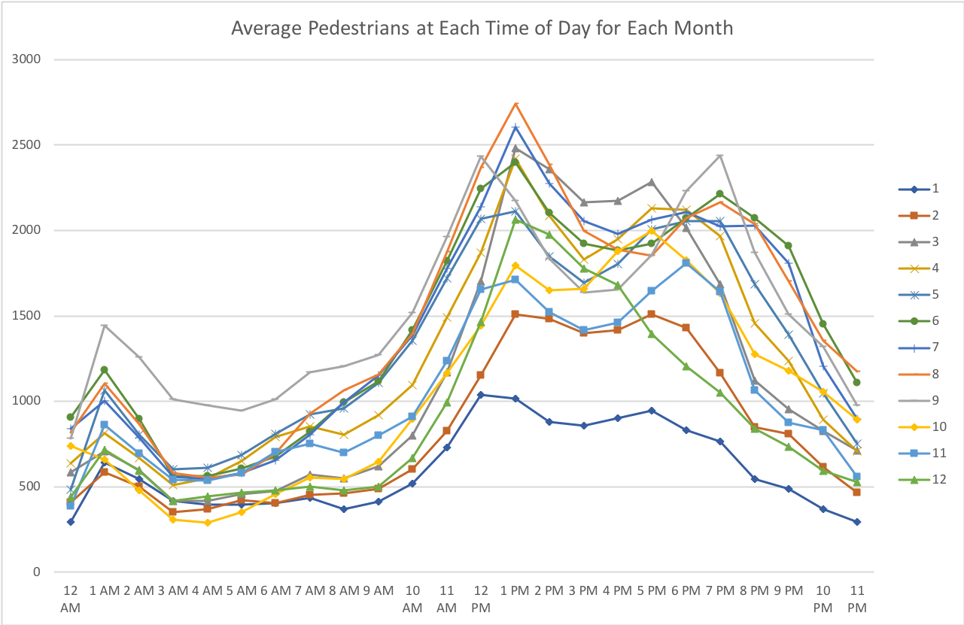
Notes:
Nelson

Slide 8
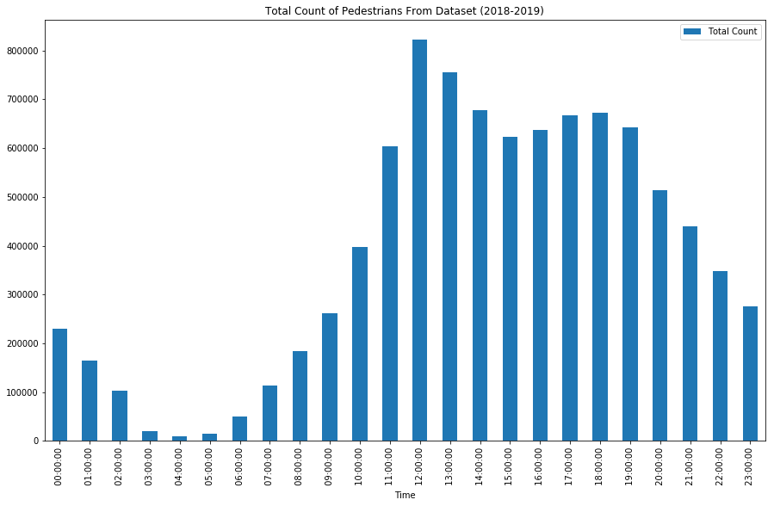
Notes:
Nelson

Slide 9
Green Lights Cycle
Go across Main Street(Dayton/Gorham/Johnson) = go along State St wait for a long time.
about three or four times than the other way around

Slide 10
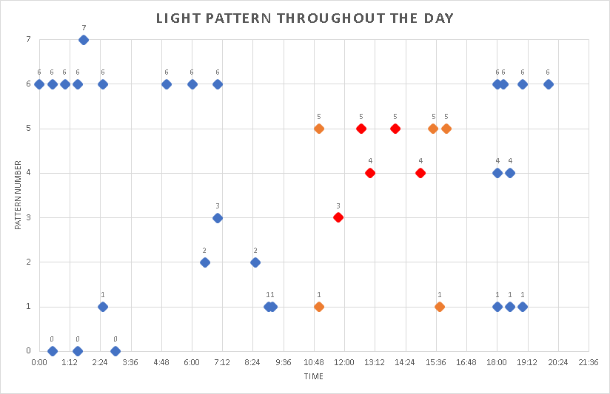
Notes:
Nelson

Slide 11
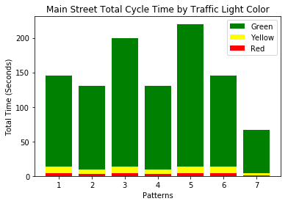
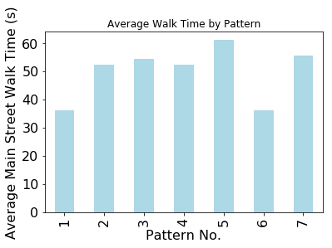
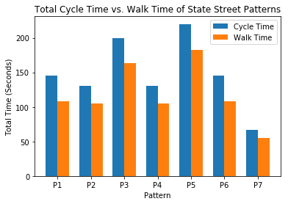
Notes:
Nelson

Slide 12
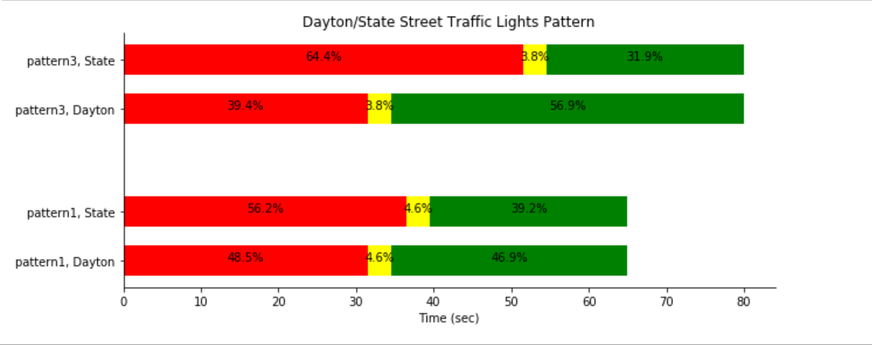

Slide 13
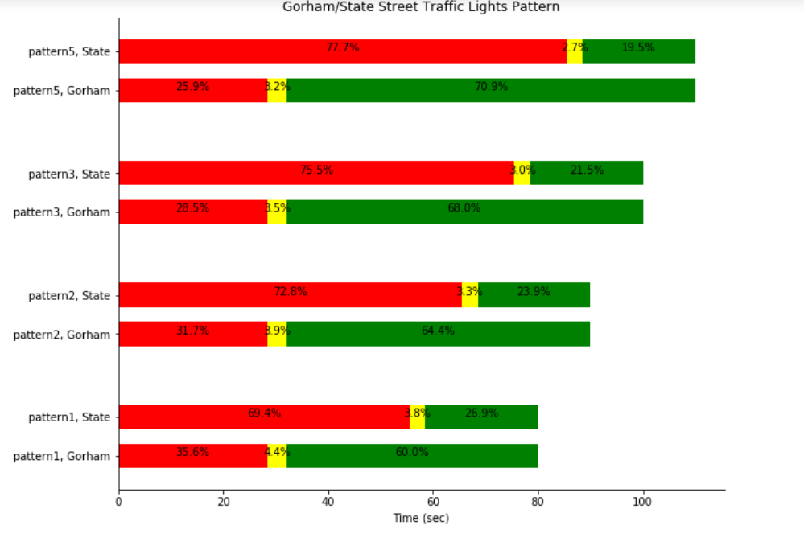
Notes:
These are the visualization on light patterns. Red light time is adjusted based on the whole cycle time. As you noted, red light takes up a large amount.

Slide 14
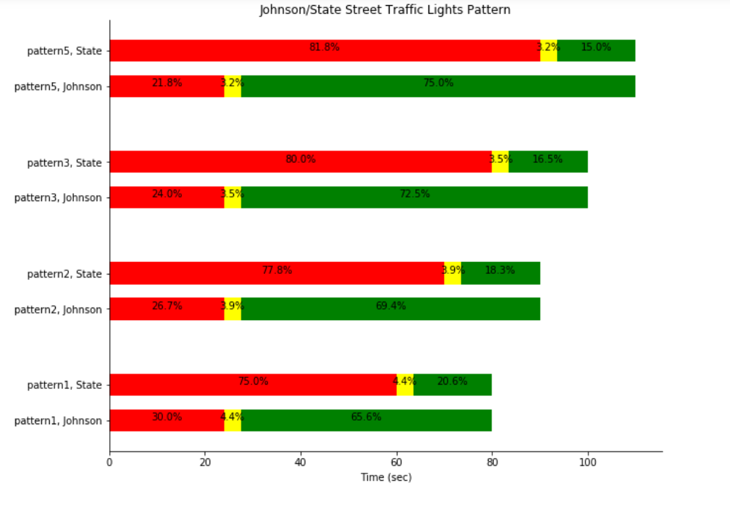

Slide 15
Light Pattern, Pedestrian and Traffic
Light cycle are too long, should adopt shorter and more frequent cycle pattern.
Pattern does not align with morning peak (6 - 8 am).

Slide 16
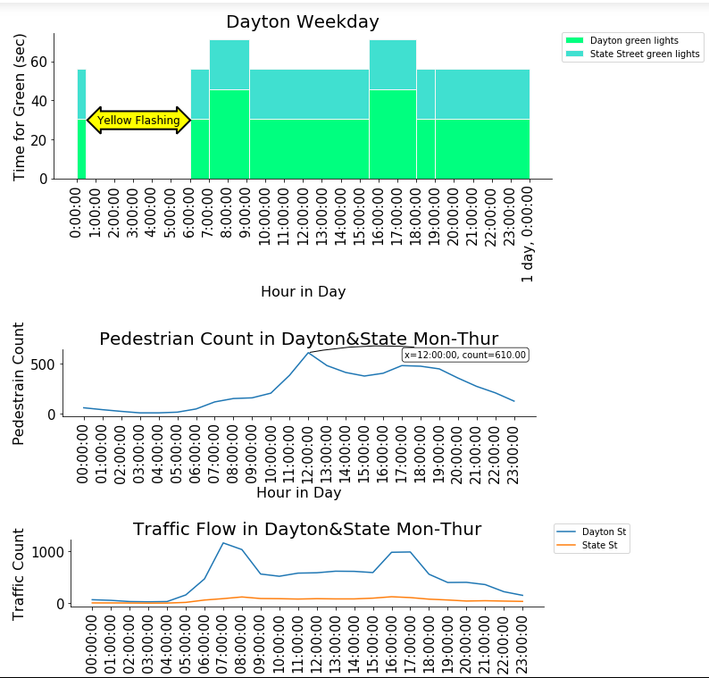
Notes:
Light cycle are too long, should adopt shorter and more frequent cycle pattern.
Pattern does not align with morning peak (6 - 8 am).

Slide 17
Metric and Optimization
Assumption:
4/5 pedestrain wait for Main Street Red Light,
3/5 pedestrians will wait for Cross Street Red Light.
Every car will pass the intersection in 2 seconds.
Pedestrian and Cars come in a constant speed. Uniformly distributed according to time.
Define anger index = 1/3000*(waiting time)^2

Slide 18
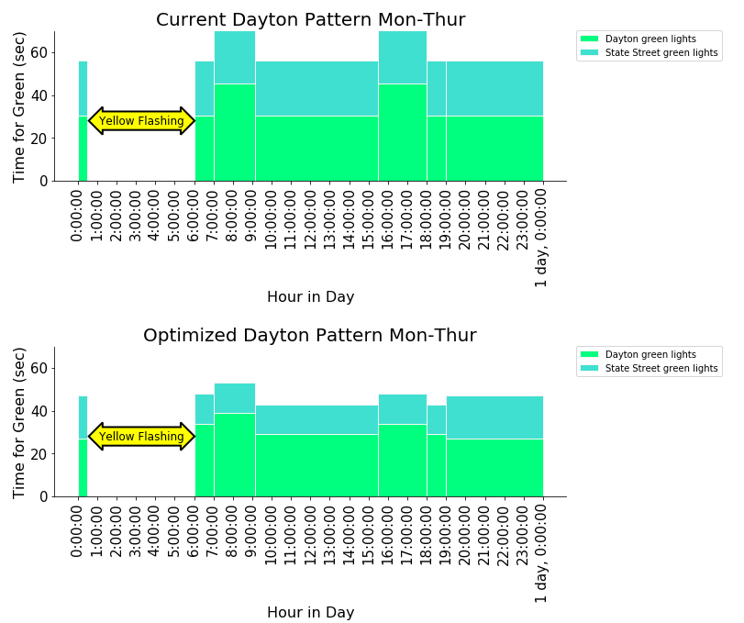

Slide 19
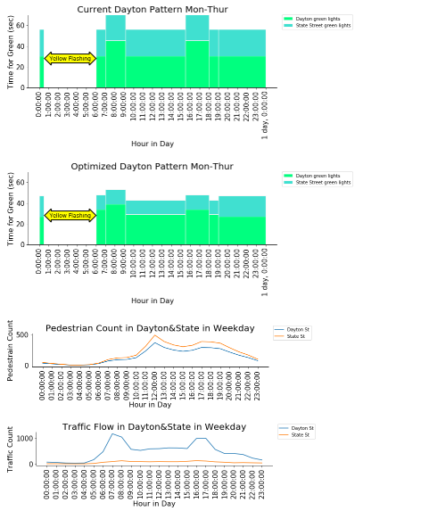

Slide 20
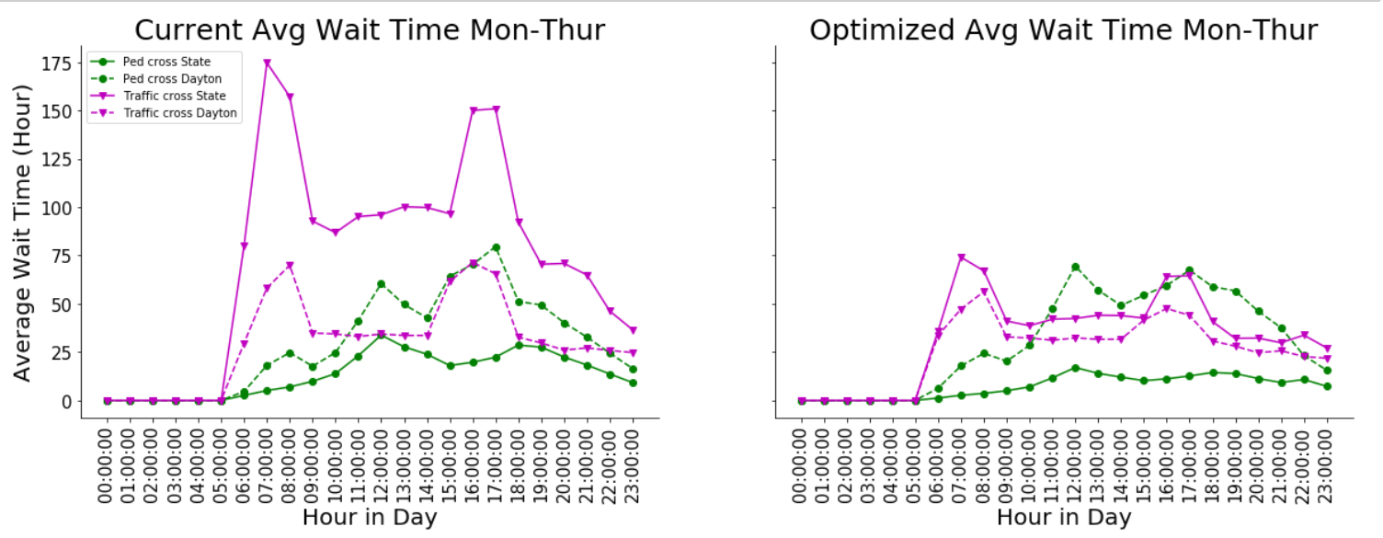
Notes:
This is the comparison between current average waiting time and optimized one. We can see although Main Street traffic benefits the most, the waiting time for pedestrian also decrease overall.

Slide 21
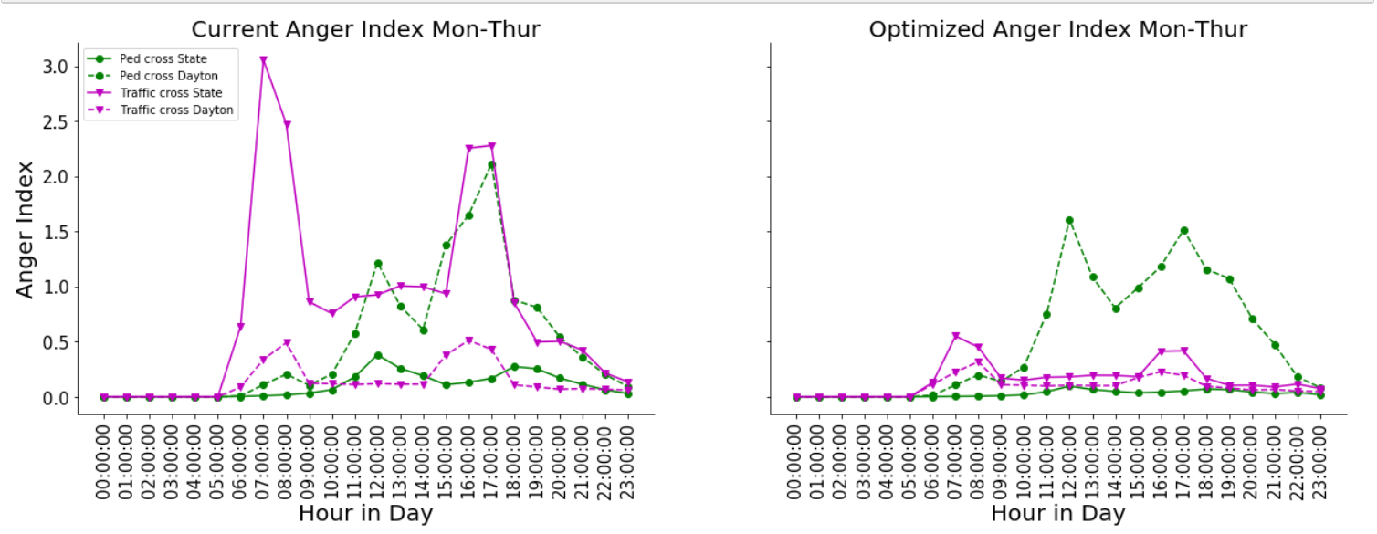

Slide 22
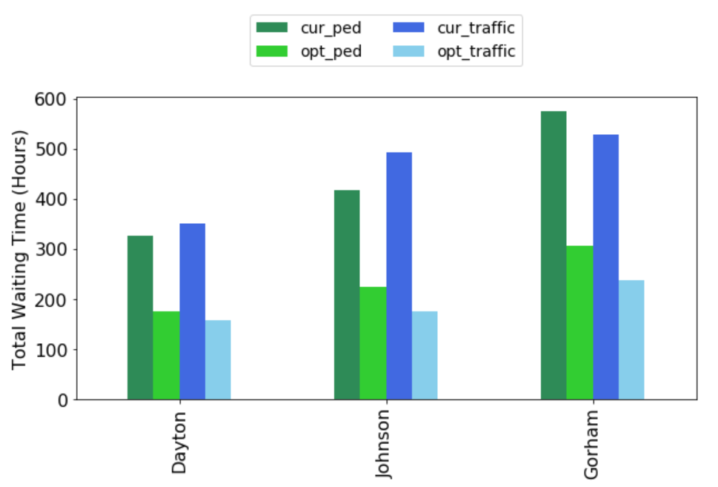
Notes:
Only a projection.

Slide 23
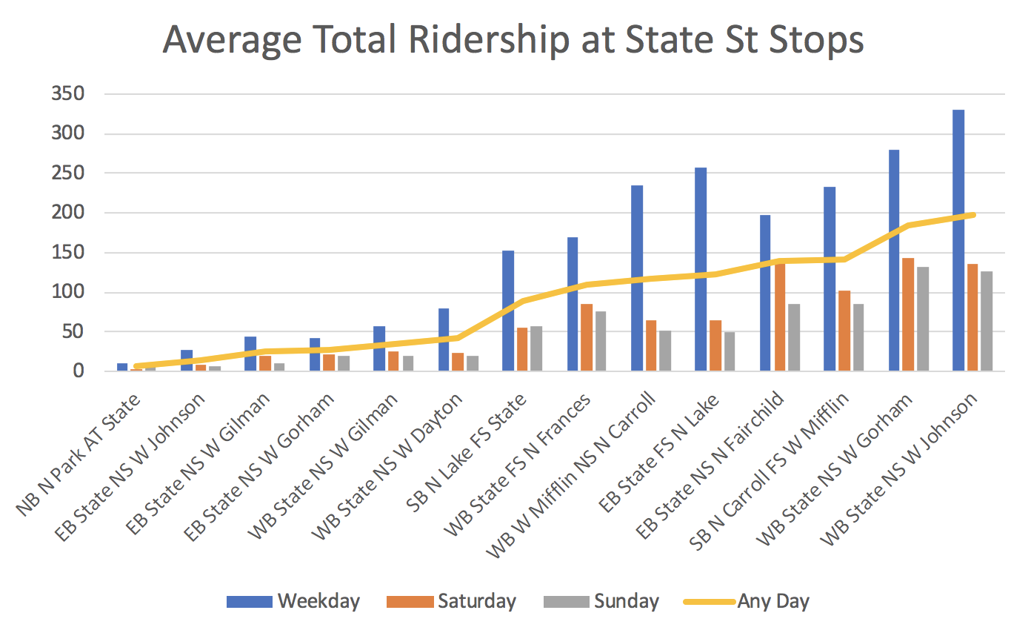
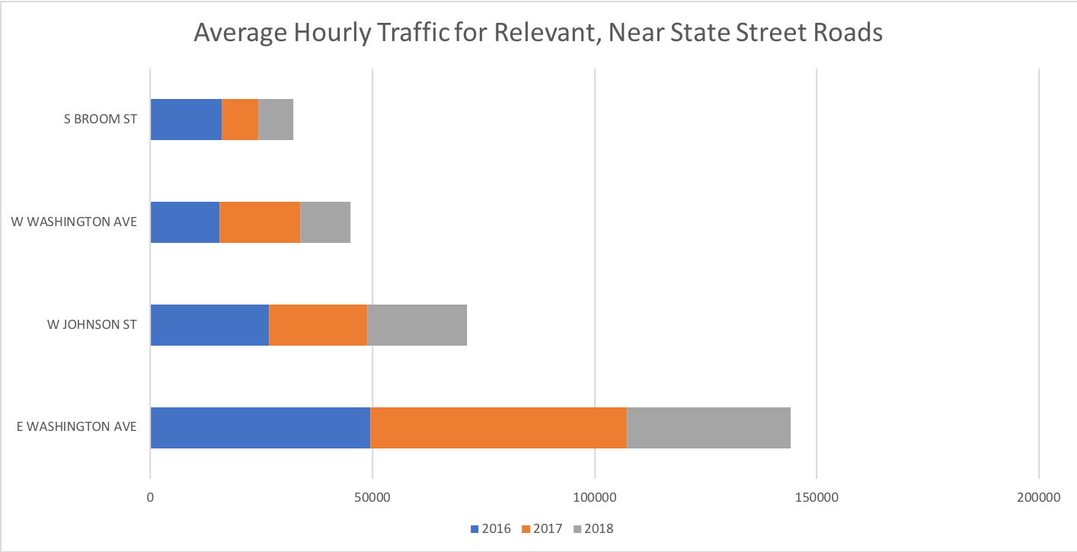
Other Considerations Going Forward
Bus Patterns
Traffic Patterns

