Slide 1
Reducing Bus Route Redundancy
By: Jin, John, and Hunter

Slide 2
Main Goal of Project
We wanted to reduce redundancy between the existing bus routes and BRT routes.
To do this we identified 8 routes, and a number of stops that may be candidates for elimination.
The funds spent on these routes may be better used for other resources.
We define redundant to be distance from existing stop to BRT stop <= 0.5 Km.

Slide 3
How we identified our redundancy (Methodology)
Mapped individual existing bus stop distance to closest BRT location
Point comparison using Point object distance method
If an existing stop was within a 5-7 minute walk from the nearest BRT stop, it was identified as redundant
5-7 minute walk estimated as 0.5 Km, or about 500 meters away
We calculated the distances of all bus stops to the nearest brt stop and then group each stop by route.

Slide 4
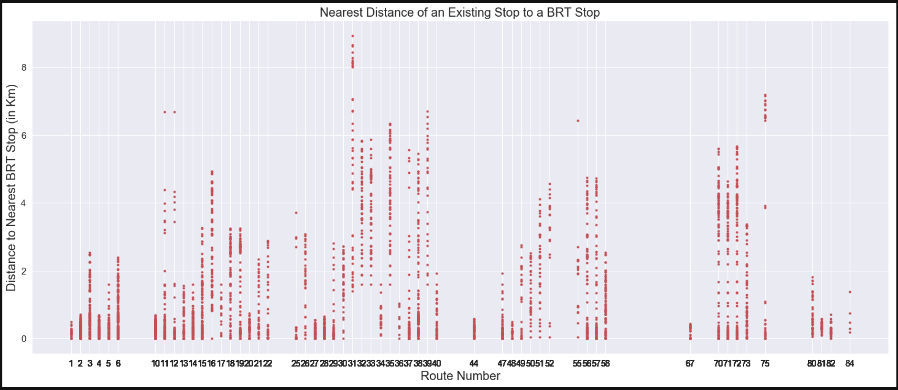
How we Identified the Redundant Routes

Slide 5
In the previous slide, we can see we have routes 1, 4, 5, 27, 28, 44, 48, and 67 which have a disproportionate number of stops close to a BRT stop.

Slide 6
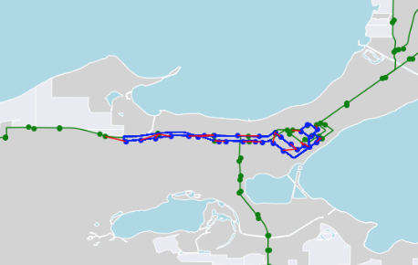
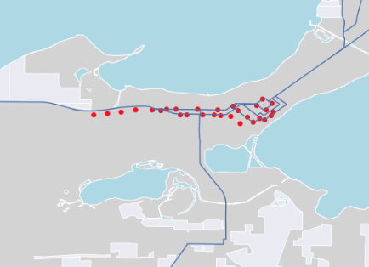
Route 1

Slide 7
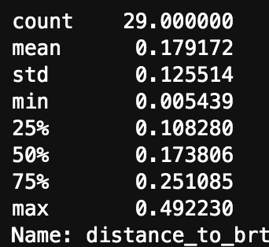
Route 1
100% of stops along this line were redundant with BRT stops.
Meaning that 100% of stops are either along the BRT line or are less than .5 Km from a BRT stop.
The following table contains the summary statistics of distances from existing stops to BRT stops along the 1 route.
The values in the table are in Km.

Slide 8
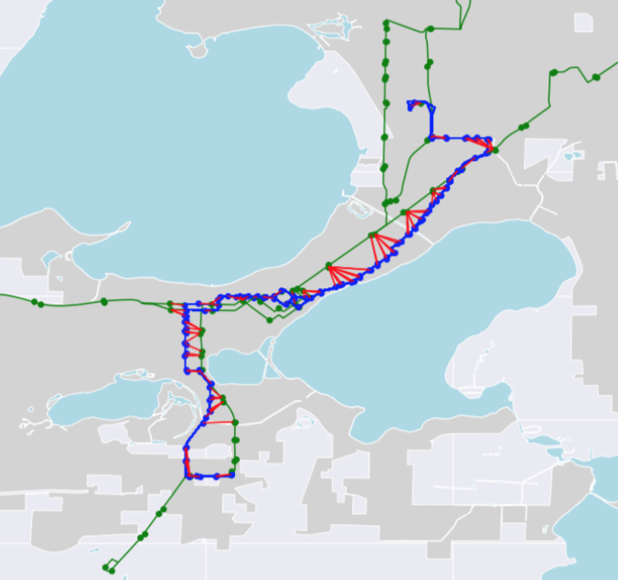
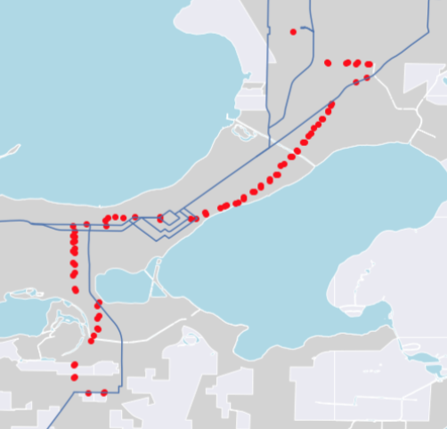
Route 4

Slide 9
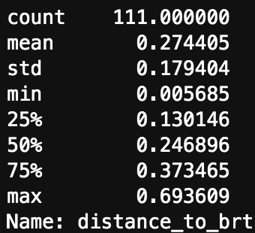
Route 4
82% of the stops along route 4 are redundant.

Slide 10
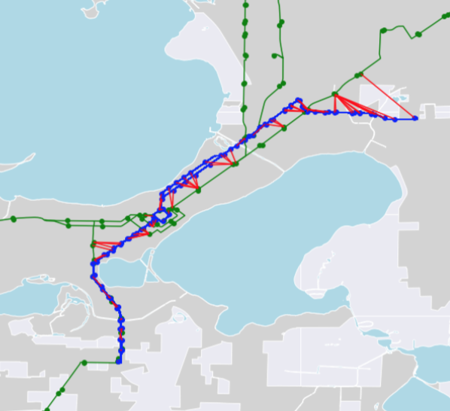
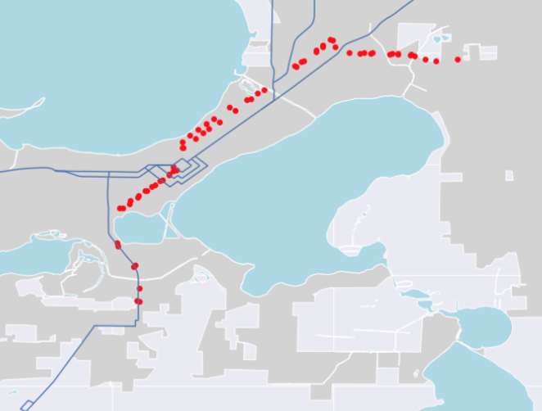
Route 5

Slide 11
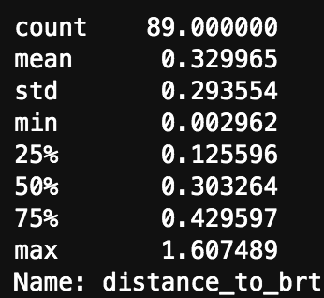
Route 5
84% of stops are redundant.

Slide 12
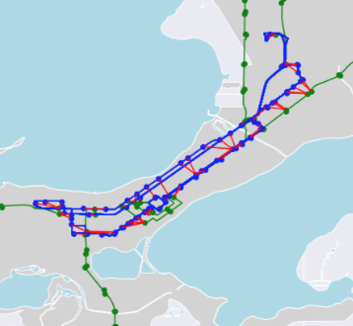
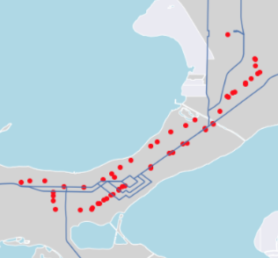
Route 27

Slide 13
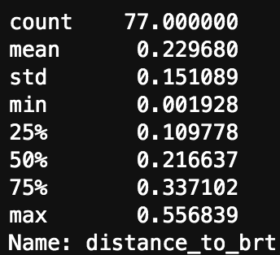
Route 27
96% of stops are redundant.

Slide 14
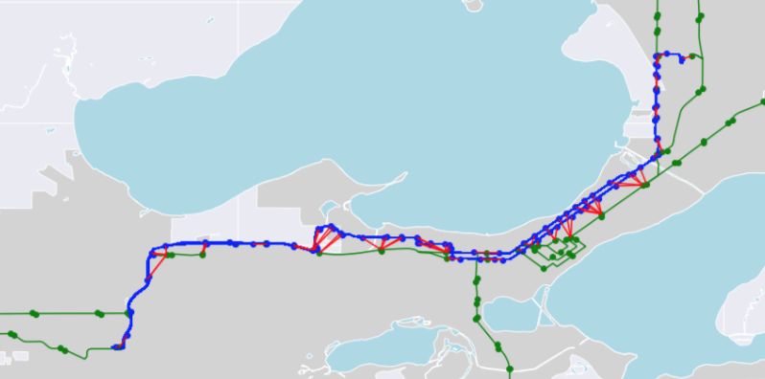
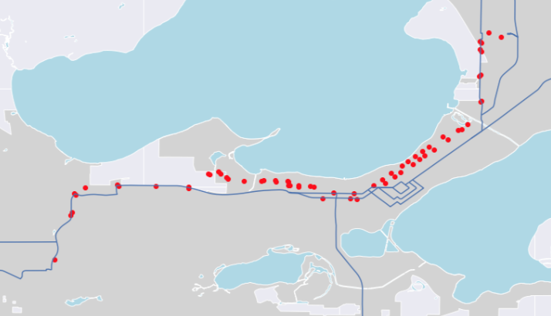
Route 28

Slide 15
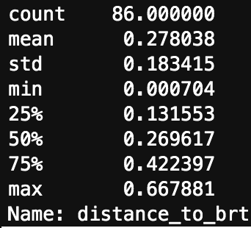
Route 28
87% of routes are redundant.

Slide 16
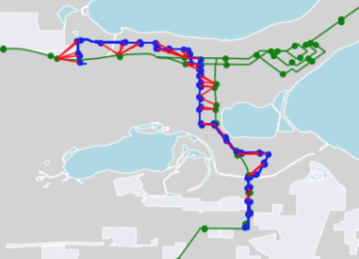
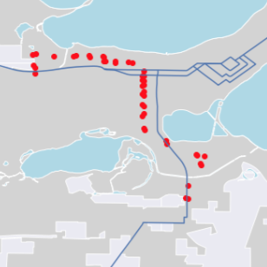
Route 44

Slide 17
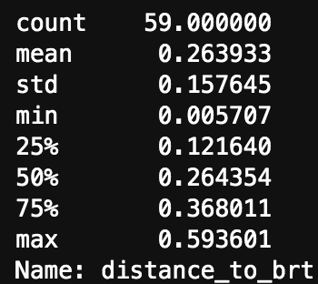
Route 44
89% of routes are redundant.

Slide 18
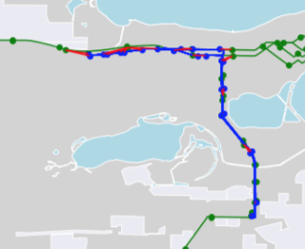
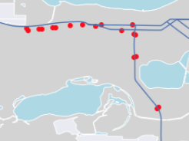
Route 48

Slide 19
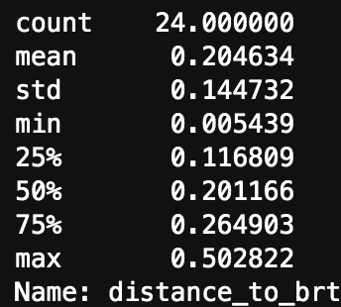
Route 48
95% of routes are redundant.

Slide 20
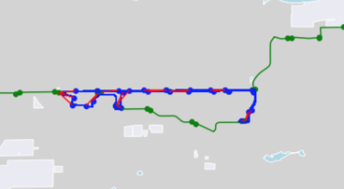
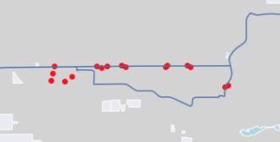
Route 67

Slide 21
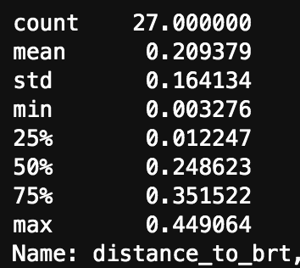
Route 67
100% of stops on this route are redundant.

Slide 22
Total Effect of Redundant Bus Stops
Redundant bus stops had on average 16.8% more boardings per stop compared to stops not covered by BRT
Total ridership on existing redundancies: 13,343 daily boardings
Estimated annual total cost of maintaining redundancies: $1,597,500
639 bus stops costing an estimated annual $2,500 each to maintain (Salt Lake City, City Council Archives)
Notes:
Bus stop maintaining:
http://www.slcinfobase.com/CouncilArchives/agendas/2006reports/September2006/092106A6.pdf

Slide 23
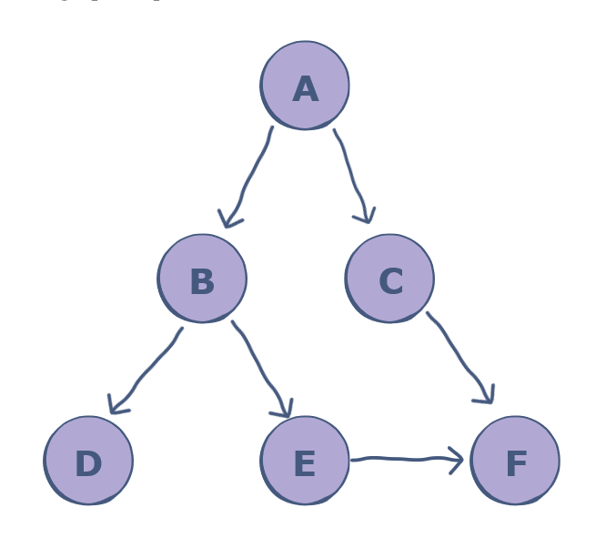
Finding Inefficiencies
Create a Deep For Search function for bus
Depth-first search (DFS), is an algorithm for tree traversal on graph or tree data structures. It can be implemented easily using recursion and data structures like dictionaries and arrays.

Slide 24
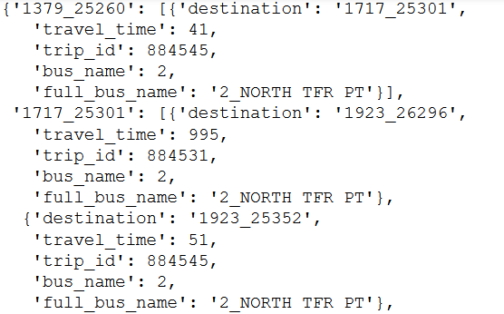
Created a graph of the current nodes next possible node
Times set between 7 – 9 am when people are going to work.
Made to avoid ‘drop off only’ buses

Slide 25
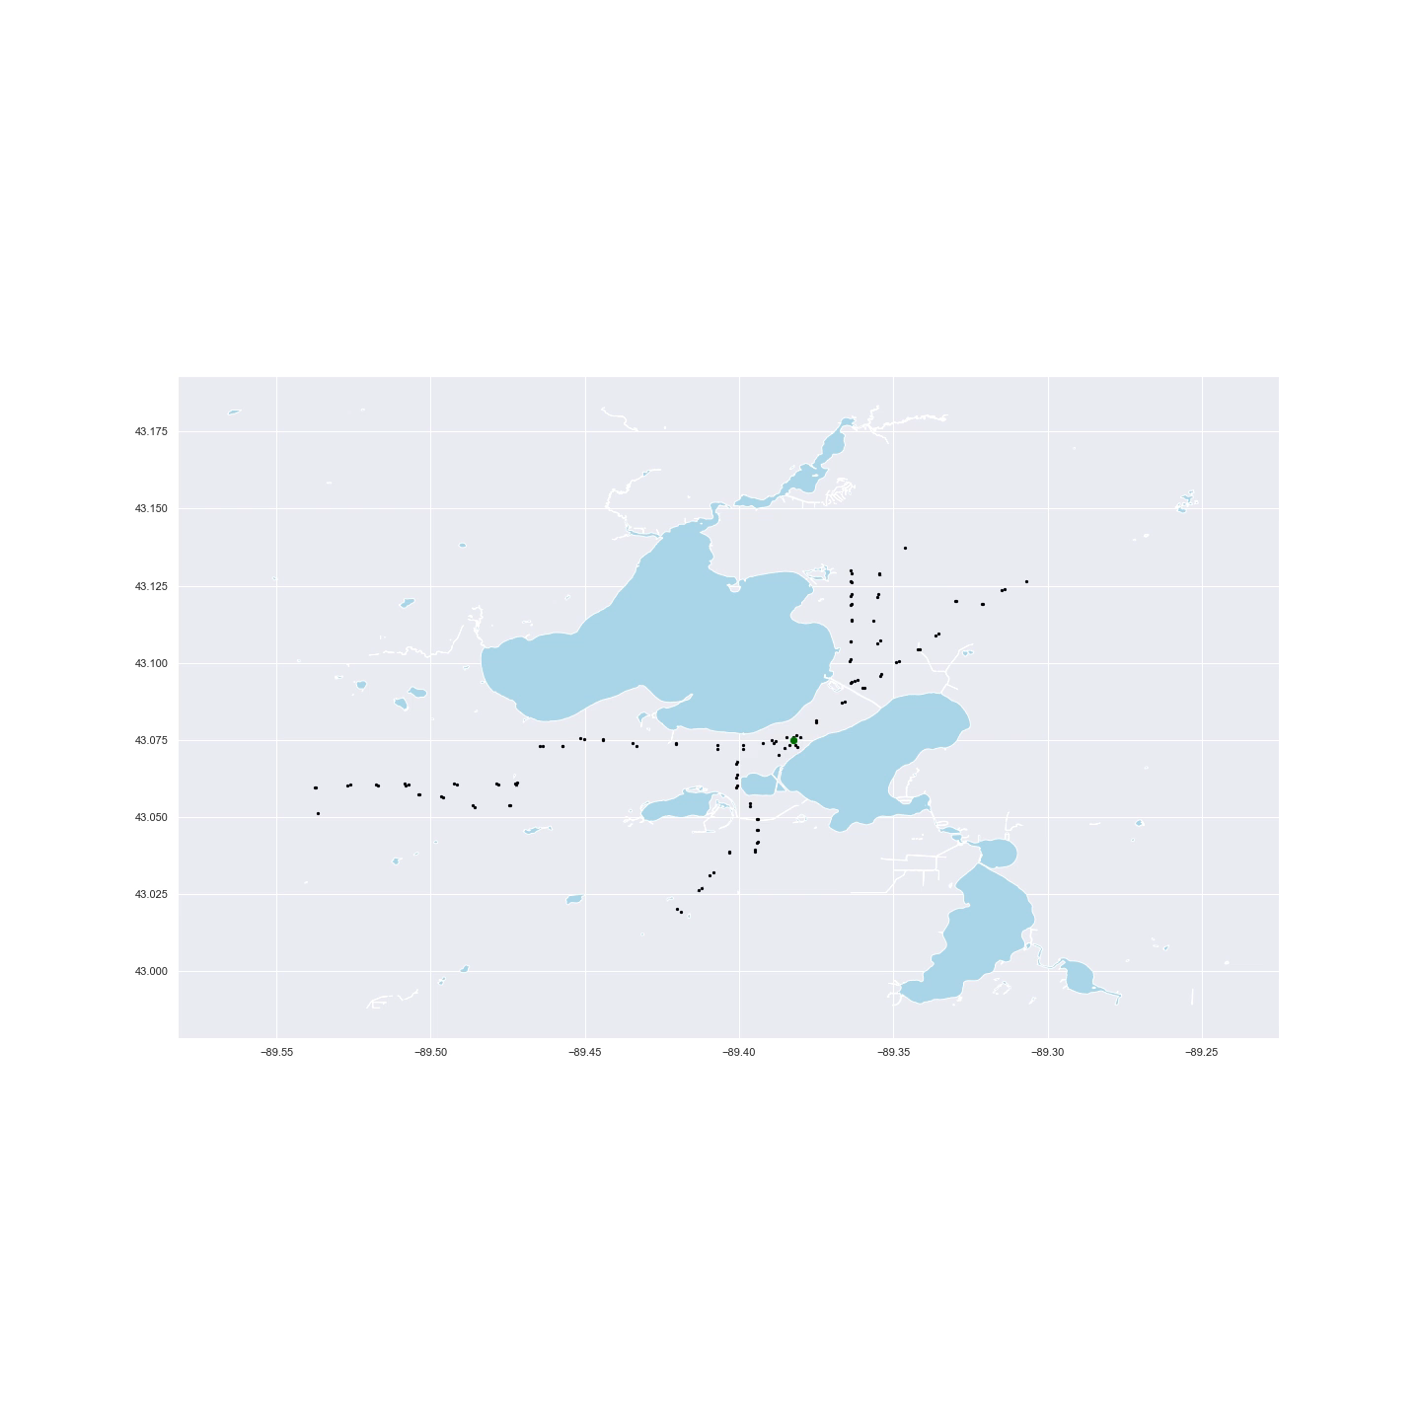
Travel time for an hour
Starting at stop 1787 covered the highest ratio of covered stops/all stops with 0.799
Most of the other starting stops with higher ratio near the campus

Slide 26

Reduced travel time to 30 minutes
In the US, Average commute time for people is 26.6 min.
Stop 741 had the highest stop coverage ratio with 0.226

Slide 27

Unlike the one-hour travel time, 30 minute travel time had starting stops out side of campus which had a high coverage ratio as well.
Stop 7100 had coverage of 0.224

Slide 28
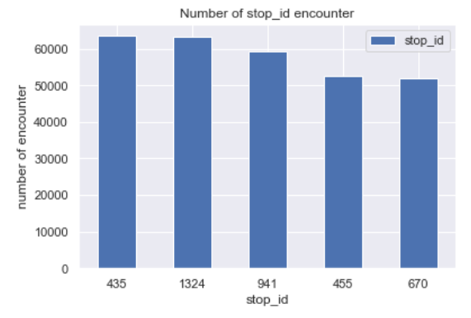
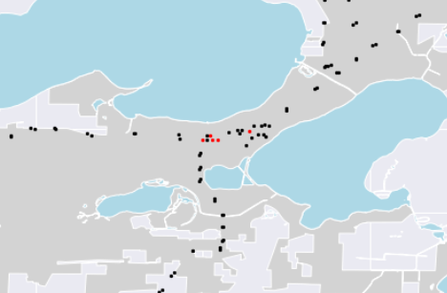
The top encountered stop ID for the 30-minute travel

Slide 29
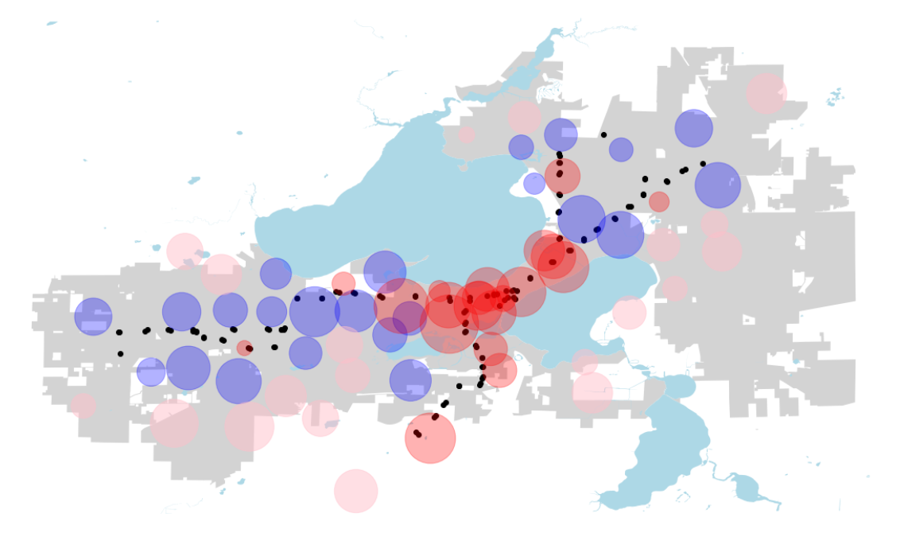
How to go forward…
Future work
Use distance covered instead of stops covered as measurement
Compare how the BRT would change the graph output

