Slide 1
Voter Registration and Turnout
Kristie Bodak, Emma Brostrom, Gunnar Schmitz

Slide 2
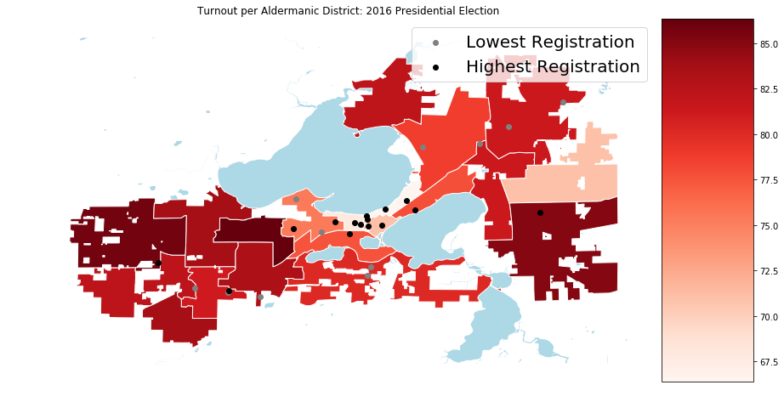
Top 15 highest and lowest pre-registered locations in comparison to turnout percentage.

Slide 3
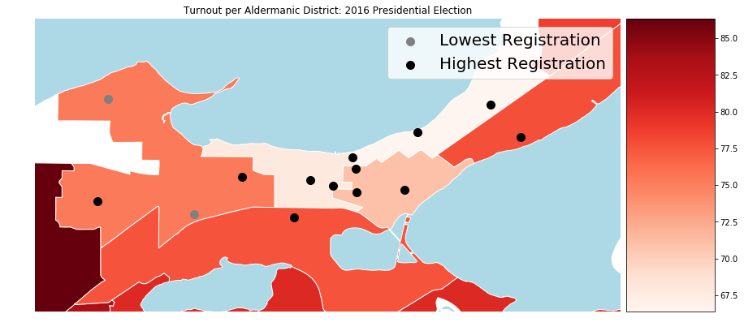

Slide 4
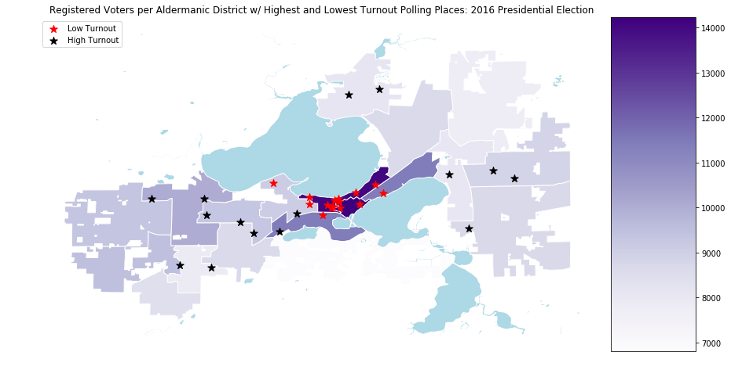

Slide 5
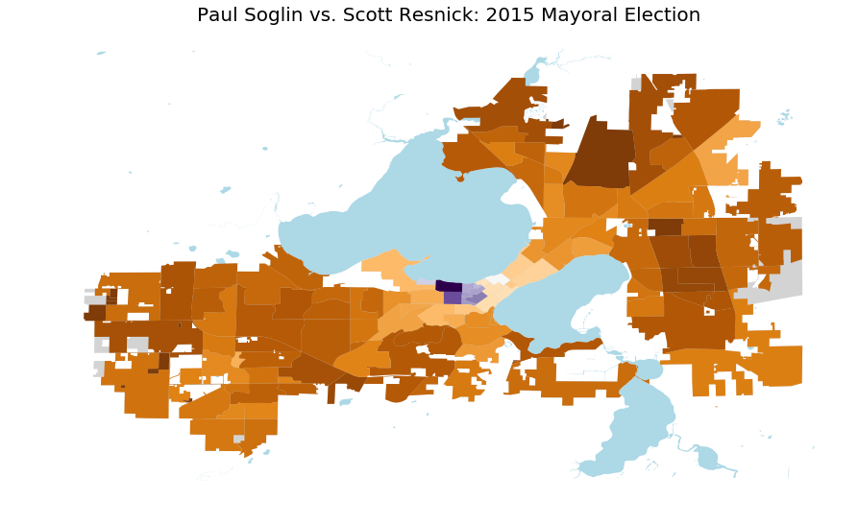
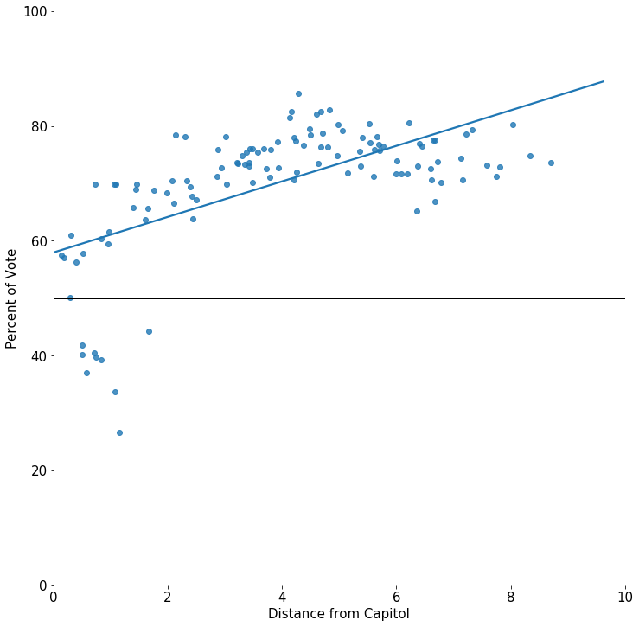
2015 Mayoral Election (Winner - Paul Soglin)
Avg. Paul Soglin Voter = 4.18 miles from Capitol Building

Slide 6
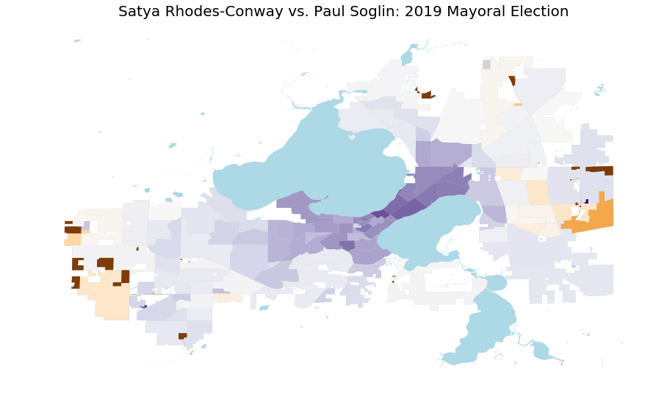
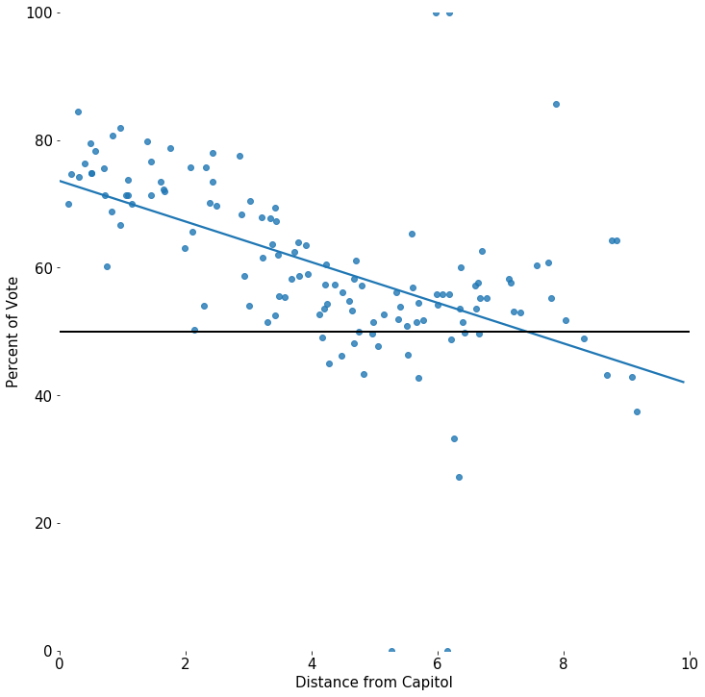
2019 Mayoral Election (Winner - Satya Rhodes-Conway)
Avg. Satya Rhodes-Conway Voter = 3.86 miles from Capitol Building

Slide 7
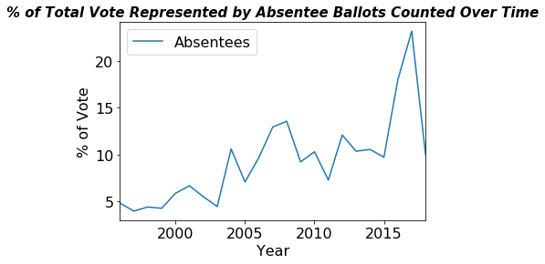
The Rise of Absentee Voting
~140% increase in absentee presence from 2015 to 2017
12 additional absentee polling places were added in 2016

Slide 8
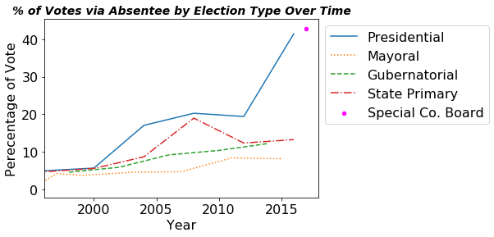
The Rise of Absentee Voting
2016 Presidential Election
41% Absentee
100% increase from 2012

Slide 9
Recommendations
Target voter turnout as much as promoting registration
Incentivize voting for a younger population
Advertise + provide more access to absentee voting

Slide 10
Questions/Suggestions?

