Slide 1
Vision Zero Madison
Tongkai Yang, Siyuan Ji, Clarence Kuo

Slide 2
3 Main Part:
Intersection Crash
Car to Truck Crash
Bike Crash Analysis

Slide 3
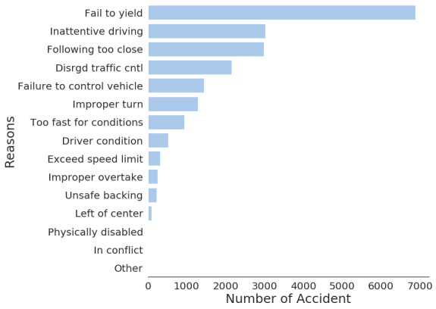
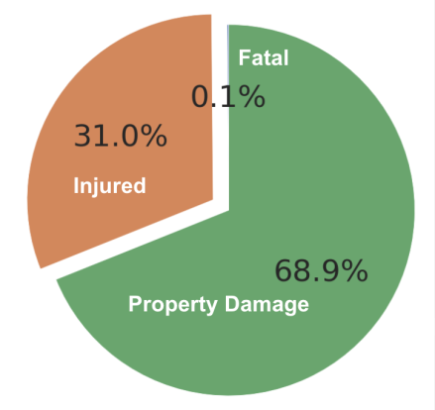
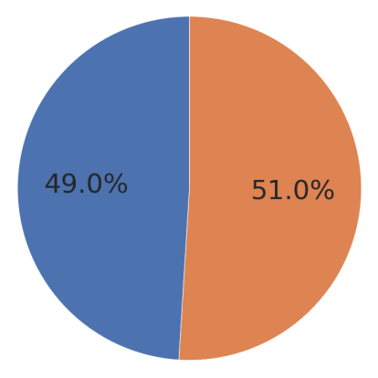
Intersection Crash
Intersection
Intersection
Non-Intersection
Non-Intersection

Slide 4
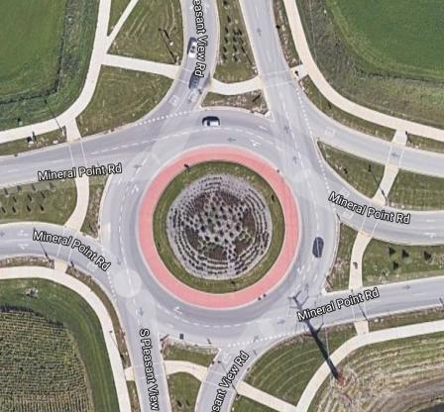
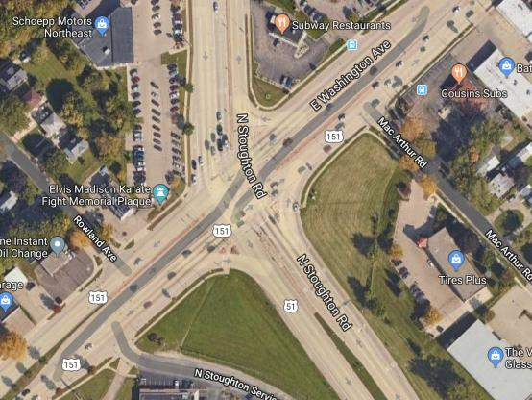
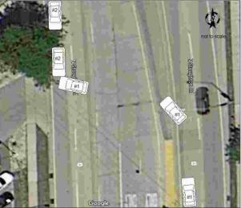
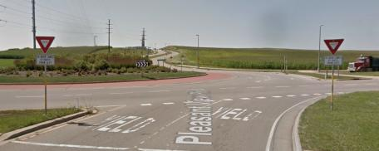
The Most Dangerous Intersections
City Street: Mineral Point Rd & Pleasant View Rd
Highway: E Washington Ave. & S Stoughton Rd.
2009 - 2018
Total: 272
Fail To Yield: 65%
2015 - 2018
Enter Loop vs. On Loop: 35%
2009 - 2018
Total: 346
Inattentive Driving: 26%
2015 - 2018
Go Straight vs. Left Turn: 20%

Slide 5
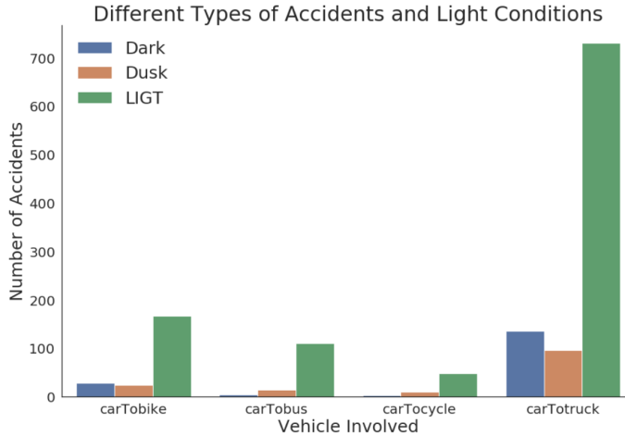
Car to Truck Crash

Slide 6
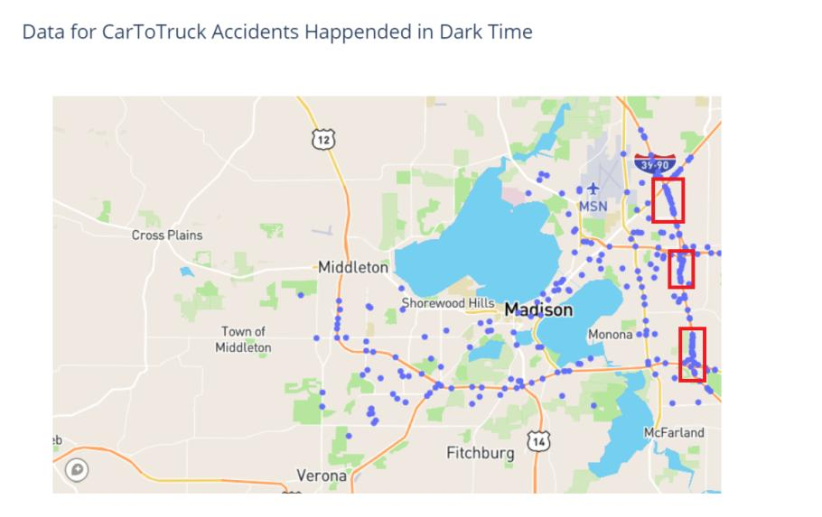
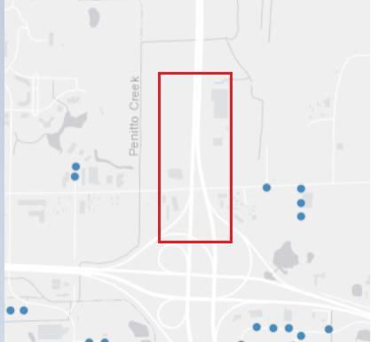
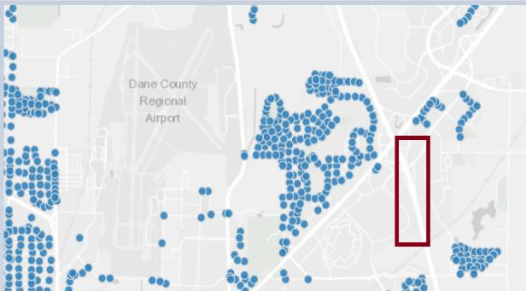
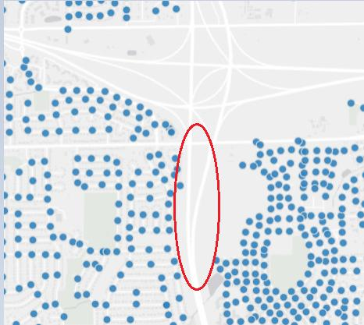
I-90
I-39

Slide 7
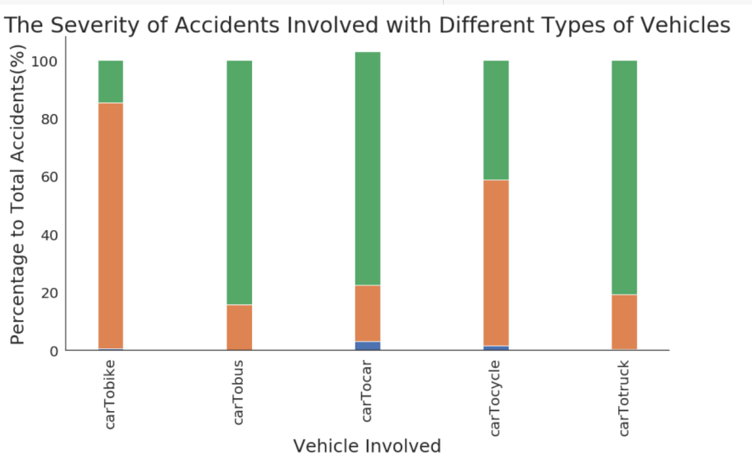


Slide 8
Bike Crash Analysis
Clarence

Slide 9
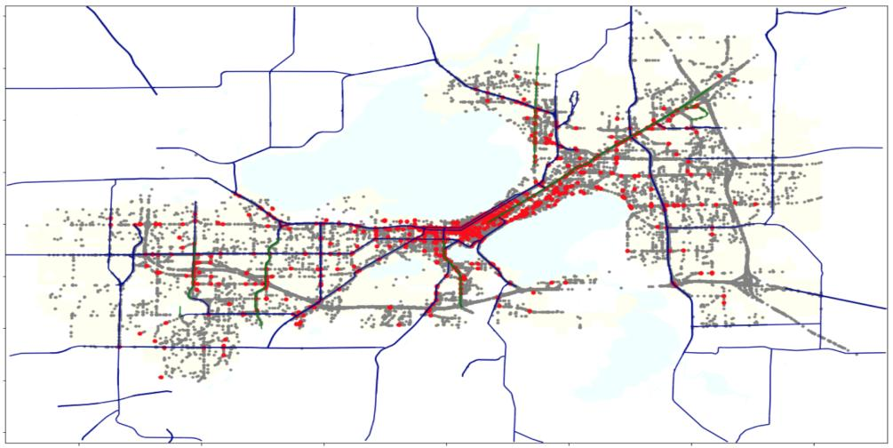
Why Bikes?
All accidents
Bike accidents
Existing Bike Path
Major road
Among all the accidents, only 0.7% of them involved bikes.
However, 88.7% of the bike accudents ended up in injury or death.

Slide 10
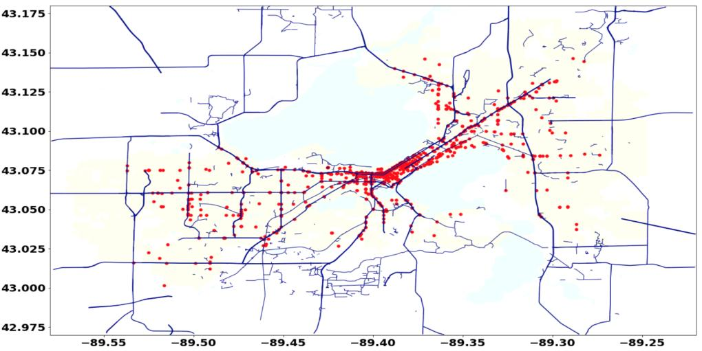
Dangerous sections
N Shermen Ave
E Washinton Ave
S Garmmon Rd
S Park Street
S Whitney Way

Slide 11
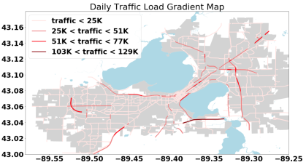


Analysis and Ranking
Check current status of the target
Google maps
Dane County Bike Map
Is there enough room for new bike facilities?
Check traffic load/ lane for availability:
The average theoretical maximum saturation flow rate per lane is 1800 vehicles/ hour
Assume 70% of the daily traffic load occurred within 3 hours of peak time.
Calculate score:
The higher the score, the higher the priority.
From Open Data Madison

Slide 12
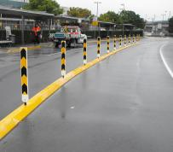
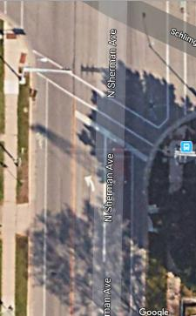
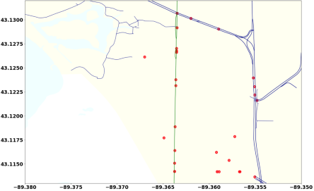
North Shermen Avenue
N Sherman Ave
only 1 narrow lane
E Washinton Ave
S Garmmon Rd
S Park Street
N Sherman Ave: Isolator
S Whitney Way
Comment
Since the road is narrow and its loading is high, we recommend installing some isolation.

Slide 13
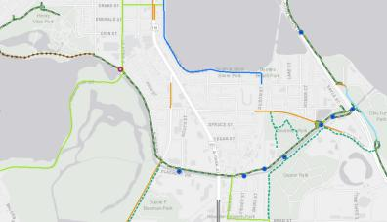
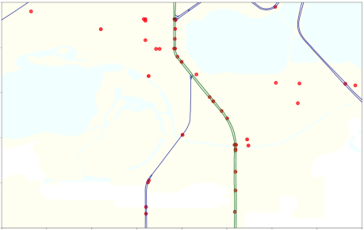
2. South Park Street
N Sherman Ave
E Washinton Ave
S Garmmon Rd
S Park Street
N Sherman Ave: Isolator
S Park St : New bike lane
S Whitney Way
Comment
South Park St. has a section without bike lane that might be the major cause for bike crashes.

Slide 14
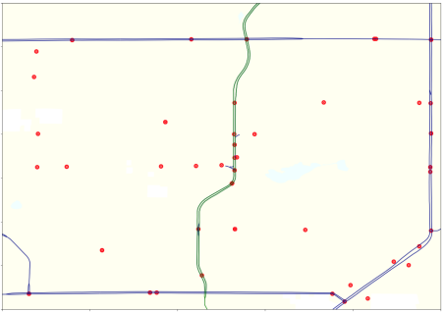
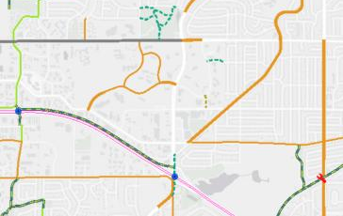
3. South Whitney Way
N Sherman Ave
E Washinton Ave
S Garmmon Rd
S Park Street
N Sherman Ave: Isolator
S Park St : New bike lane
S Whitney Way
S Whitney Way: New bike lane
Comment
Similarly, South Whitney Way also has the same condition as South Park St.

Slide 15
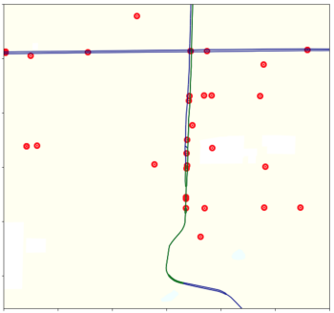
4. South Gammon Road
Comment
This section is near a big shopping mall. We recommend installing seperators for bikes.
N Sherman Ave
E Washinton Ave
S Garmmon Rd
S Park Street
N Sherman Ave: Isolator
S Park St : New bike lane
S Whitney Way
S Whitney Way: New bike lane
S Gammon Rd: Isolator

Slide 16
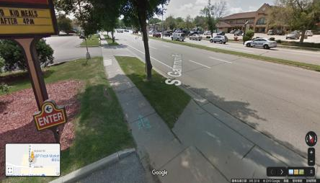
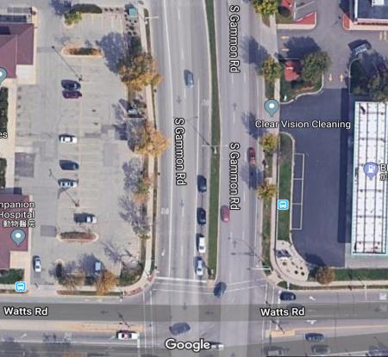
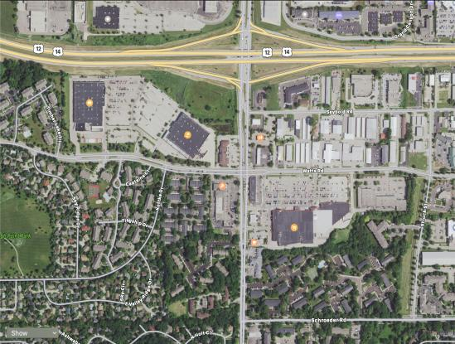
4. South Gammon Road
Extra Bike Lane
Sudden Stop
Additional Comment
Crossing Watts Rd, the bike lane continued for a short distance and disappeared. It might be better to remove it.

Slide 17
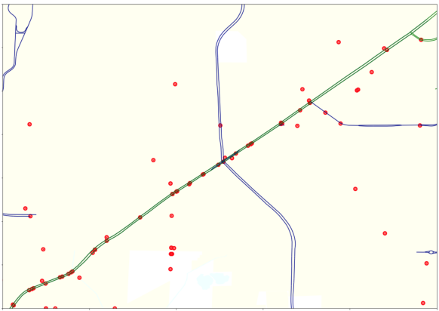
5. East Washington Avenue
N Sherman Ave
E Washinton Ave
S Garmmon Ave
S Park Street
N Sherman Ave: Isolator
S Park St : New bike lane
S Whitney Way
S Whitney Way: New bike lane
S Gammon Rd: Isolator
E Washinton Ave: Discrete bike path

Slide 18
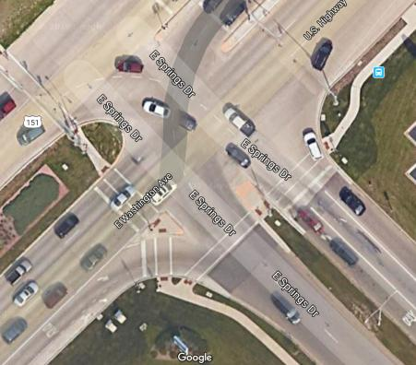
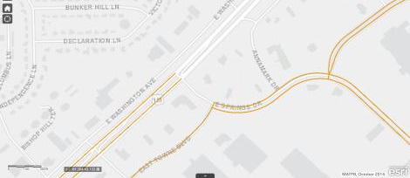
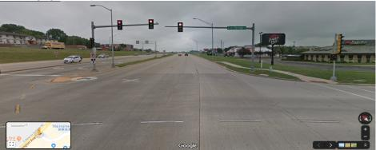
5. East Washinton Avenue
Additional Comment
The bike lane comes to a sudden stop at the cross of E Springs Drive. We suggest connecting it with adjacent bike lanes.
Disconnected Bike Lane
No Bike Lane here
No Bike Lane here
No warning sign

Slide 19


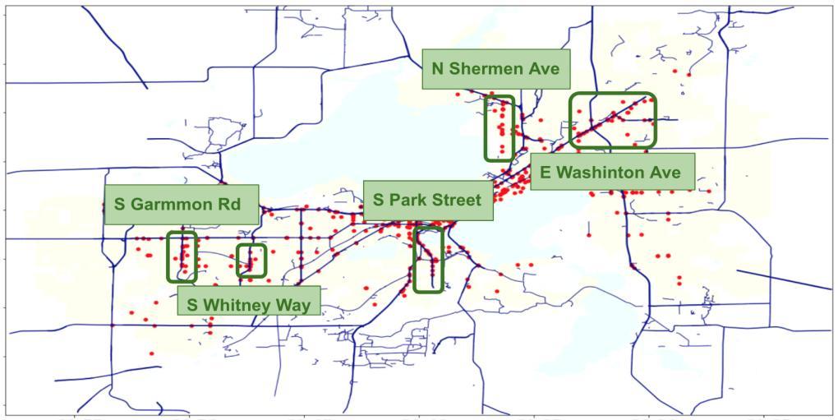
Conclusion
Load/lane:
Accident rate:
Rank: 5
Load/lane:
Accident rate:
Rank: 1
Loading/lane:
Accident rate:
Rank: 2
N Sherman Ave: Isolator
S Park St : New bike lane
Load/lane:
Accident rate:
Rank: 4
S Whitney Way: New bike lane
Loading/lane:
Accident rate:
Rank: 3
S Gammon Rd: Isolator
E Washinton Ave: Discrete bike path

Slide 20
Refferences
Dane County Bike Map
https://cityofmadison.maps.arcgis.com/apps/webappviewer/index.html?id=5d9b5793e6404b8c89872c06bd5f26c2
Open Data Madison
https://data-cityofmadison.opendata.arcgis.com/
Google Maps
https://www.google.com/maps
Distance calculator
https://www.movable-type.co.uk/scripts/latlong.html

Slide 21
Thank you!

