Slide 1
An Analysis of the City of Madison's Online Meeting Data
- Shri Shruthi Shridhar
- Terry Ghanty
Notes:
Good morning everyone.
This is Shri Shruthi Shridhar and this is Terry Ghanty. We will be presenting our analysis on City of Madison’s Online Meeting Data that was collected when the city moved its meetings to online platform because of COVID-19. We try to understand the different factors that affect the online meetings’ participation.

Slide 2
Key Questions to Consider
Meeting characteristics by Committees
Geography of participants
Views of the participants
Factors that affect meeting participants
Keywords that attract more participants - Answered in report
LINK TO REPORT: https://bit.ly/344rYSZ
Notes:
When we were analyzing these meetings, there are a few questions we wanted to consider. This is the structure of the report and will also be the structure of this presentation.
We first want to identify some characteristics and How are meeting characteristics different across committees? (Section 2)
From where are the attendants attending this meeting? (Section 2)
What are the views of the participants on a high level? (Section 3)
Are there enough metrics to predict the number of participants per meeting? What factors affect number of meeting participants? (Section 2 and 4)
Is there a relationship between number of participants and the other meeting metrics? (Section 4)
What topics attract more participants? (Section 2 and 4)

Slide 3
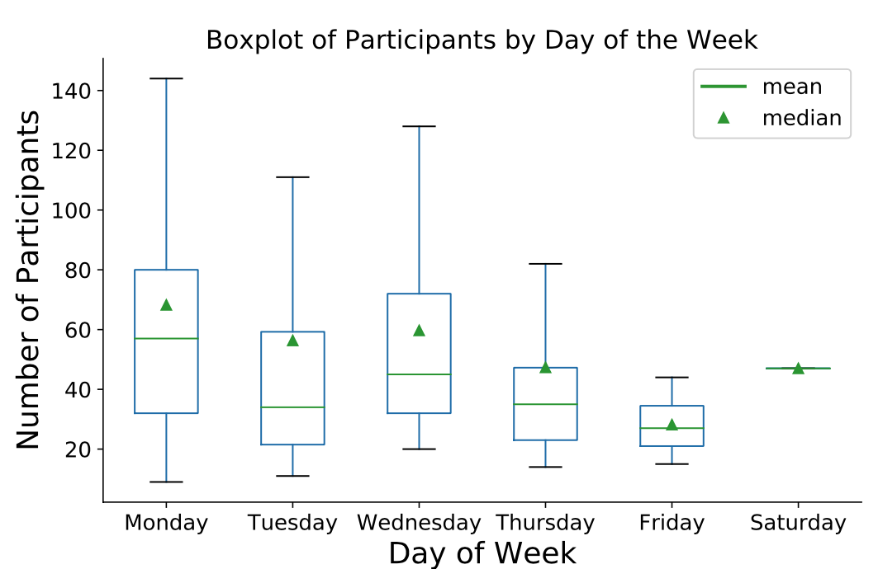
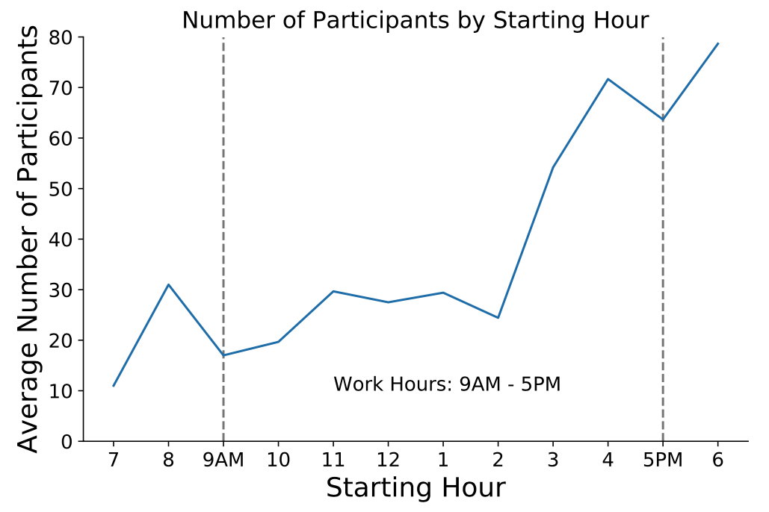
Meeting Characteristics: Time and Day
To maximize participation, committees should schedule meetings between Monday - Wednesday and after work hours
Notes:
Terry
THESE NEXT TWO SLIDES AIMS TO ANSWER Factors that affect meeting participants. The natural thing to do it to look at when these meetings take place.
These plots give a general idea of which days would give the highest participation on average.
We see a generally decreasing trend. Average participation is highest earlier on in the week with the lowest participation on Friday
The plot on the right tells us on on average, participation is highest after work hours. There is a general increasing trend throughout the day. With this information, it is reasonable to split up the general starting of the meeting into three categories: before work, during work, and afterwork. This is used in our forecasting later. In conclusion, a rule of thumb to increase participation is to schedule meetings earlier on the in the week on Monday-Wednesday and for afterwork hours.

Slide 4
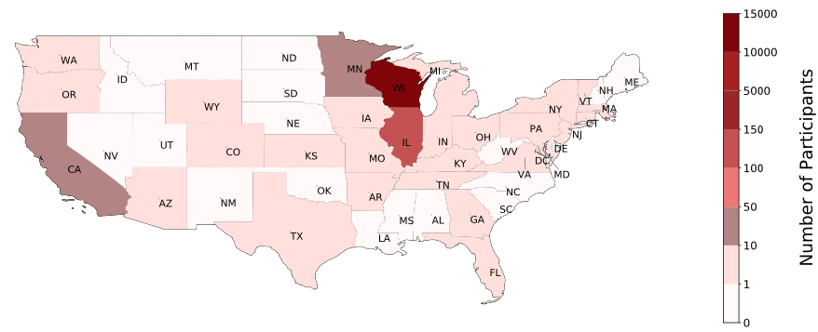
Meeting Characteristics: Out of State Participation
According to data - Wednesday 4:30 PM attracts most out-of-state participants
Meetings can be scheduled at selected time range and on selected days to either attract or avoid other state participants
Notes:
Shruthi
We looked at the zipcodes of the registered participants and found that most participants were from Downtown as expected and the number reduced as we moved further away from downtown.
We also noticed that there were participants from outside Madison and outside of Wisconsin attending the meetings and we plotted the counts here in this figure.
We found that these meetings that attracted other state participants were scheduled to start between 4.30 pm and 6.30 pm and most of these meetings were scheduled on Monday and Wednesday.
We can use these dates and times if we are looking to accommodate more participants from other states or avoid these times if the meetings are to be confined to Madison/Wisconsin participants.

Slide 5
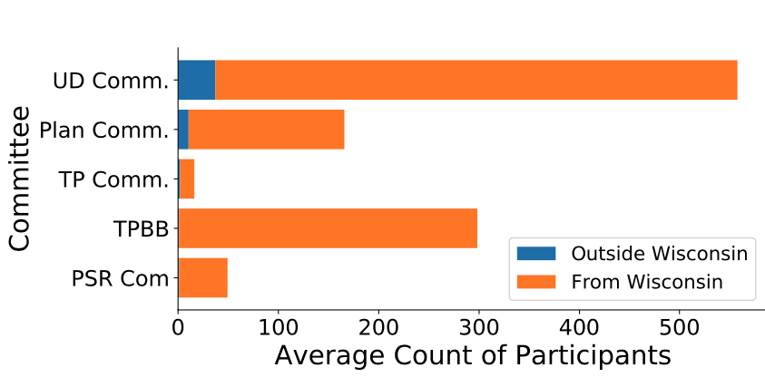
Meeting Characteristics: Out of State Participation
Suggests that out of state participants have investment ties to Madison
Have a separate field for out-of-state participants to mention their reason for participation
Notes:
Shruthi
We analyzed the committees that attracted the out of state participants and saw that Urban Design Commission and Plan Commission attracted the most out of state participants and analyzed the agenda items they were interested in.
They were related to developments, changes to heating/cooling plants, power production, mall permits, parks etc and changes related to the police department in the City of Madison.
These suggest that the other state participants attending these meetings might either have investments/properties in Madison or temporarily located in outside Wisconsin/have roots in Madison.
Their views on the mentioned agenda items (Oppose/Support) mostly matched with the views of those from Wisconsin.
This indicates a need for further analysis to understand these participants needs or reasons for participation. We can have separate fields for participants to indicate their state and the reason for their participation if they are from outside Wisconsin.

Slide 6
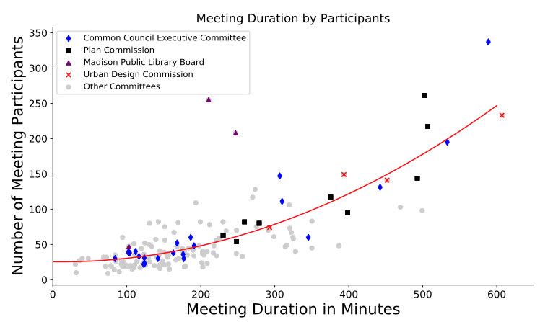
Meeting Characteristics: Participants vs. Duration
There are certain meetings with abnormally long durations.
The top 10% of all meetings account for about 32% of all participants.
Notes:
Terry:
This plot is to give a general idea of the relationship between Meeting Participants and Duration.
In general, there is a positive relationship between Duration and participations. Furthermore, the relationship isn’t linear but rather in a polynomial square fashion.
This plot also highlights which committees tend to have the highest number of participation. Apart from the common council, which is expected to have long meetings, the Plan commission, MPLB, and Urban design committees have extremely long meetings that are paired with a lot of participants.
The point of this plot is to confirm that relationship between duration and participation as well as to point out these committees that could potentially have more frequent meetings. I’ll be discussing this more.
But in general just to give an idea of how skewed the data, the top 10% of meetings account for about 32% of all participation.

Slide 7
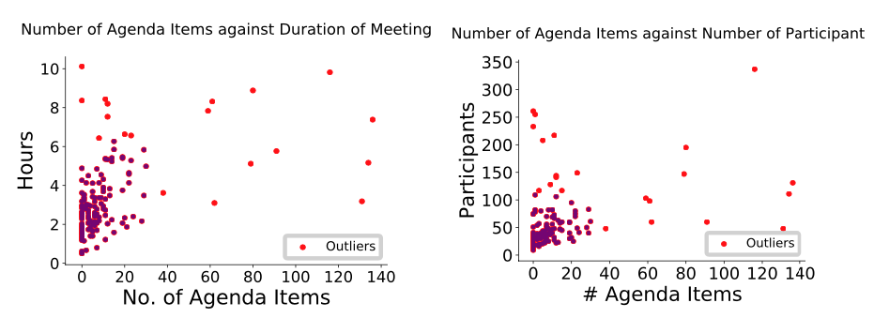
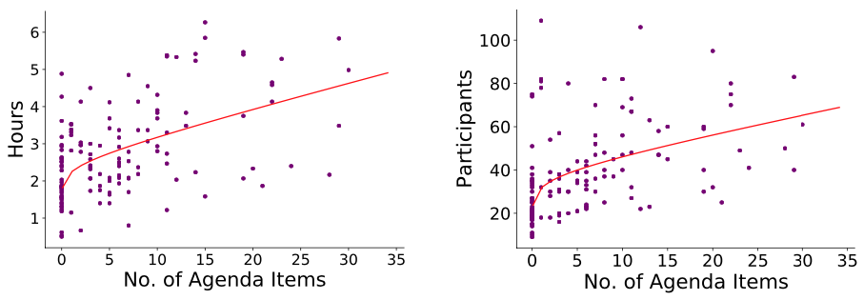
Meeting Characteristics: Agenda Items Analysis
It is possible to split up the agenda items and have more frequent meetings, while still maintaining a higher participation overall.
Notes:
Shruthi
To understand better how agenda items affected the duration and number of participants, we plotted those.
We can see that most of the meetings are clustered in the bottom left due to the existence of outliers.
So, we removed the outlier meetings from the analysis which are colored red
Terry
We fit a log function to both these outlier removed meetings. Basically we hypothesized that the number of agenda items would a strong indicator of the number of participants. This turned to be wrong, since the fit line doesn’t explain much of the variation in the data. The explained for both the figures without outliers are between 0.1 and 0.2. So weak fit but it does indicate that there is a positive relationship. And this makes. Obviously the more agenda items, the meeting will take longer and it has a higher chance of attracting more participants.
A meeting with 30 agenda items has a predicted number of 65.486 participants. Cutting that down to 15 agenda items renders a predicted number of 51.13 participants. We mention 30 agenda items particularly because the cut off for outliers is 31 agenda items.

Slide 8
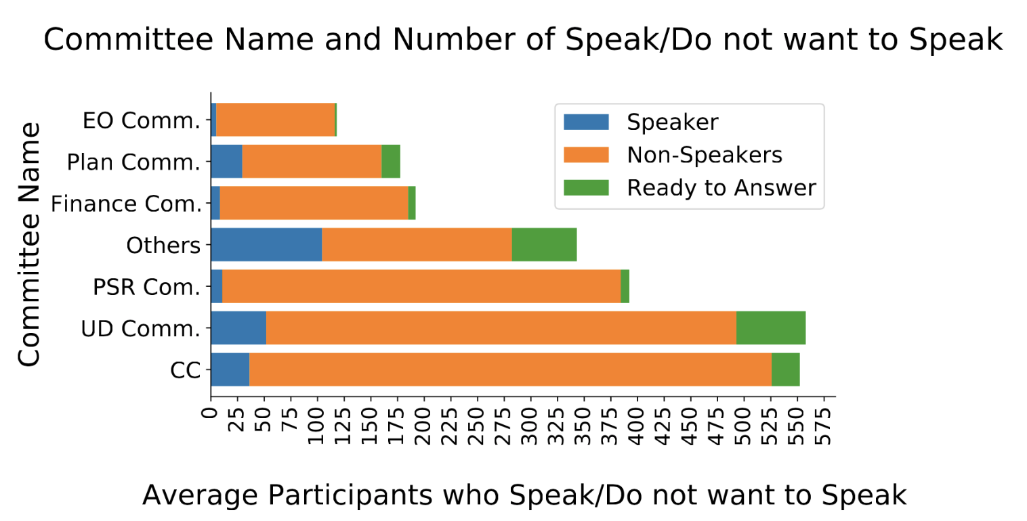
Speaker vs. Non-speaker
Have a separate field in registration for non speakers to voice out their opinions
Notes:
Shruthi
We have plotted the average number of speakers, non-speakers and answering members for each committee/board during all of their meetings.
The reason behind this analysis is because in online meetings, the meeting room space is often limited to 500 or 100 people at the maximum. By understanding the number of people who actively participate in the meetings (want to speak or answer), we can create a priority entry based on Speaker/Non-Speaker aspect and other aspects such as first-sign up, etc. to the meeting room when the meeting room is full.
From the plot, we can see that for almost all the committees/boards, especially the ones with higher participation, the number of non-speakers are high. Hence, we can create a priority entry system for the non-speakers when the meeting room is full.
We can also create a field in the registration form for non-speakers to voice their opinions incase these are people who are not comfortable talking in a public meeting.

Slide 9
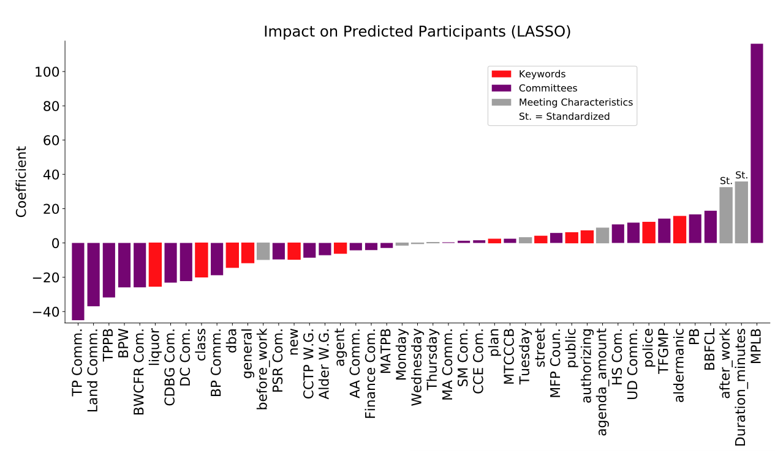
Forecasting Participants
Note
Meetings after work increase participation by about 32 people
Meetings that includes issues of aldermanic districts increase participation by about 16 people
Takeaway:
Confirms descriptive statistics
Participants are interested in local issues
Notes:
Terry
This plot aims to give a more complicated and well rounded approach to predicting which factors affect meeting participation
This model encapsulates things noted in the previous slides. So in addition to factors such as meeting duration, the number of agenda items, day of the week, time of the day (whether before, during, or after work) as well as certain keywords.
Using LASSO regression instead of multiple, factors such as Friday, Saturday, and during work got sent to 0 which supports the conclusion that meetings are attract more participants if they take place earlier on in the week and after work
The coefficient of before work predicts a decrease in in about 9 participants.
We also had a hypothesis that agenda amount had a positive relationship, but the relationship isn’t strong. This is also supported since teh coefficient is positive but is really small less than 1.
Additionally, we see that keywords such as aldermanic and police have a positive impact on predicted participants. Also, note that aldermanic is linked to the phrase aldermanic district. We hypothesize here that people are interested in local issues. The word aldermanic predicts increases of about 18 participants and police predicts and increase of about 9 participants.

Slide 10
Recommendations - Restated
Meetings after work hours and during the start of the week if want to attract more participants
Reduce long meetings by cutting agenda items without losing participants by dividing key agenda items (Board of Public Works, Alcohol Review Committee)
Separate field for non speakers and out-of-state participants
Notes:
Participant Outlier - Urban Design Commission, Plan Commission
In addition to the board of public works, and alcohol review committee, these three have abnormally large number of participants and long meeting duration. These committees can benefit from cutting down on the number of agenda items they have per meeting.

