Slide 1
Analyzing Tony Gitter’s chemical data set
Available on https://zenodo.org/record/1411506#.X7w4gs1KhPY

Slide 2
Data set
n_train = 72,423 training samples
p = 1024
Response = % inhibition
Predictors = binary vectors of Morgan fingerprints
Both predictors and response are standardized.

Slide 3
Training
blasso (‘monomvn’ package) just froze and crashed.
basad (‘basad’ package) works.
50,000 MCMC samples + 50,000 burn-in take ~ 3 hours+
glmnet (1 for common penalty, 1 for different penalty factor) is time-consuming.
2,000 iterations on 7 parallel CPU cores take ~ 11hours.
Randomly pick 2,000 MCMC samples from the last 10,000 MCMC samples.

Slide 4
Training
basad
Use default package setting
Set corresponding MCMC β samples to be zero where median probability model dictates latent variable Z = 0, to induce sparsity in MCMC β samples
glmnet
cv.glmnet gives lambda.min = 0.001 and lambda.1se = 0.006
Try lambda.1se to have slightly larger penalization

Slide 5
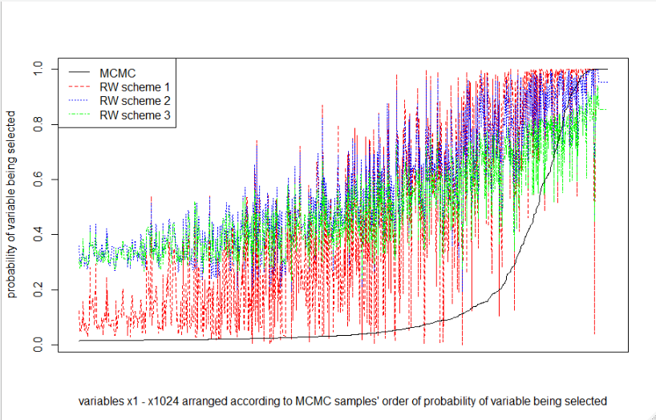
Compare probability of variables selected

Slide 6
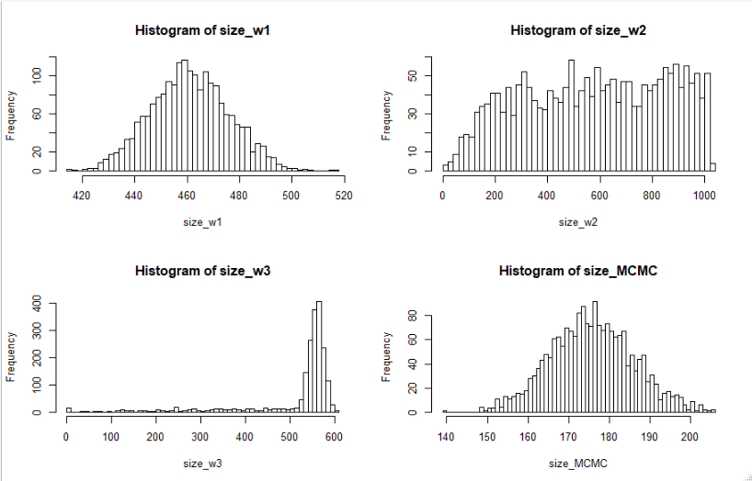
Compare model sizes

Slide 7
Compare marginal posterior distributions of β’s
Pick variables whose probability of being selected is larger than 0.93 for all basad’s MCMC and RW schemes 1, 2 and 3.
There are 10 of them.
Plot marginal distributions of their sampled β’s.

Slide 8
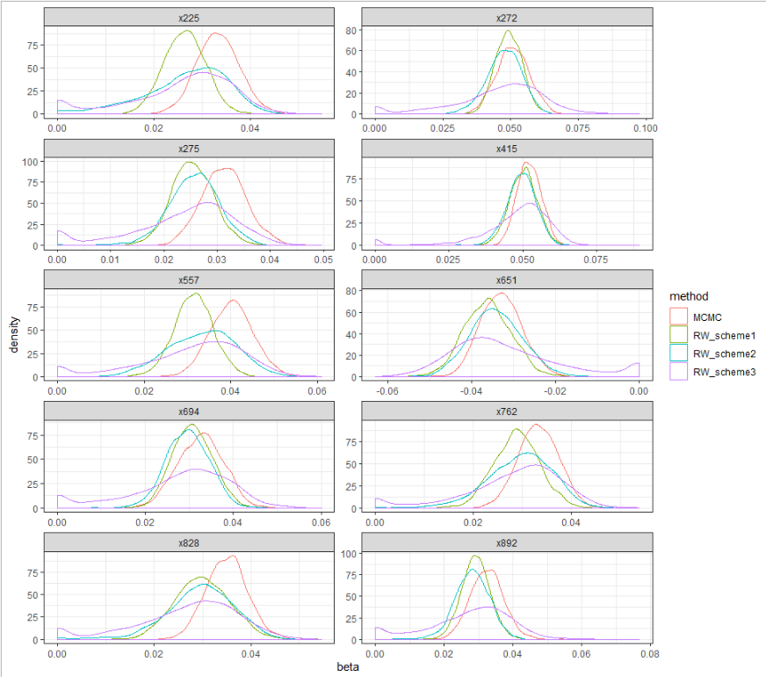

Slide 9
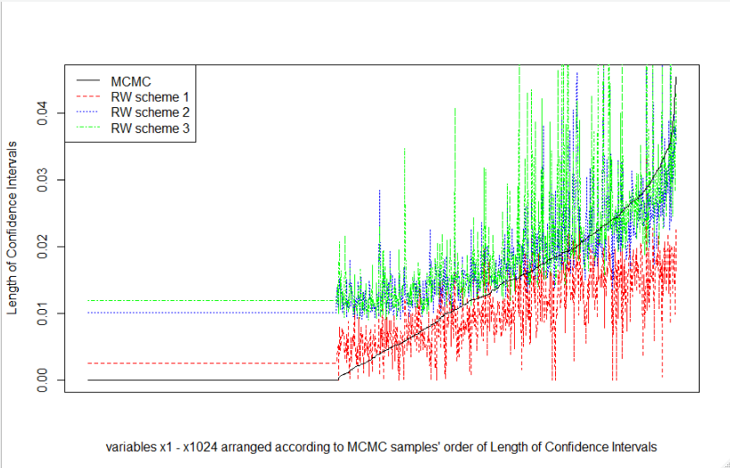
Compare length of 95% CI for β’s

Slide 10
Predictions
n_test = 22,423
For predictions, take sampled β’s from MCMC or RW, and multiply with test cases’ predictors.
Each test case has a distribution of predictions.

Slide 11
95% prediction interval coverage for the ~22,000 test cases is similarly poor for all schemes
RW scheme 1 = 12.5%
RW scheme 2 = 19.3%
RW scheme 3 = 23.0%
MCMC = 19.2% (based on sparsity-induced β’s)
Because length of prediction intervals for RW schemes 2 and 3 are relatively wider

Slide 12
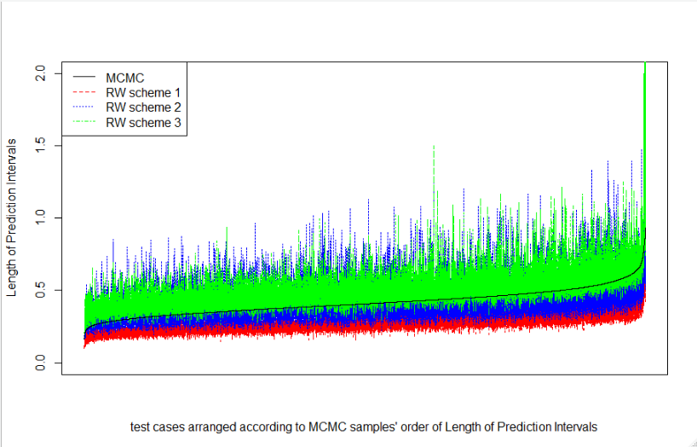
Compare 95% prediction interval length

Slide 13
Prediction
I considered 2 types of MSPE calculations
For each of B=2,000 iterations, compute MSPE (squared prediction errors averaged across all 22,423 test cases)
For each of n_test = 22,423 test cases, compute MSPE (squared prediction errors averaged across all 2,000 predictions)

Slide 14
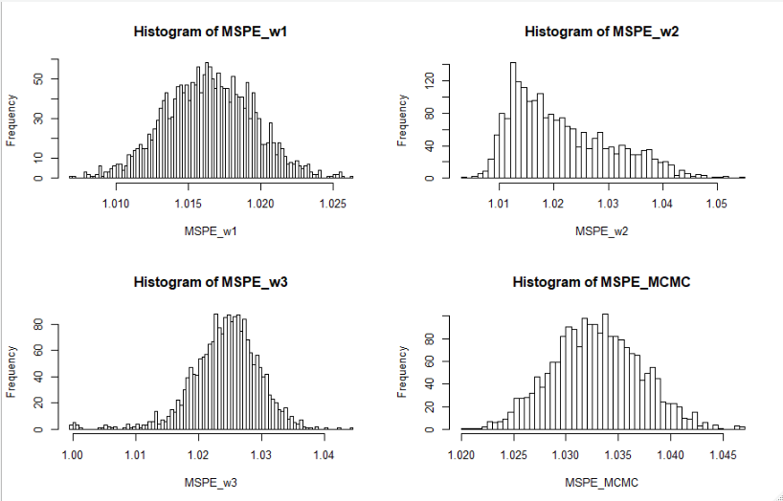
Distribution of 2,000 MSPEs (averaged across all test cases)

Slide 15
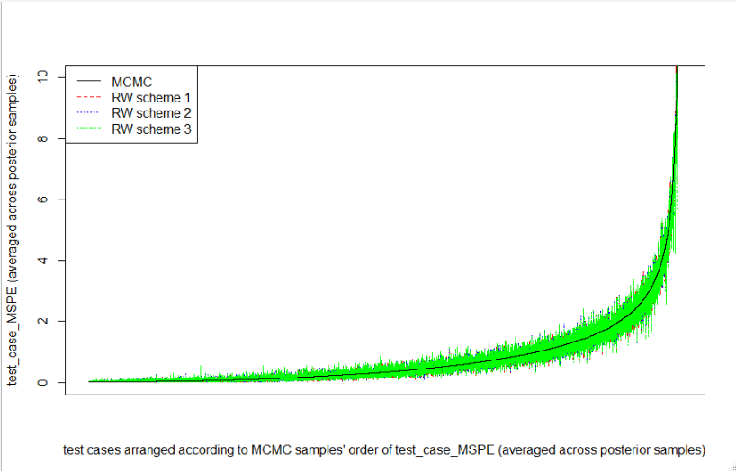
Compare distribution of MSPE for each test case

