Slide 1
Weighted Lasso Bootstrap
Tun Lee Ng & Michael Newton
Aug 29 2018

Slide 2

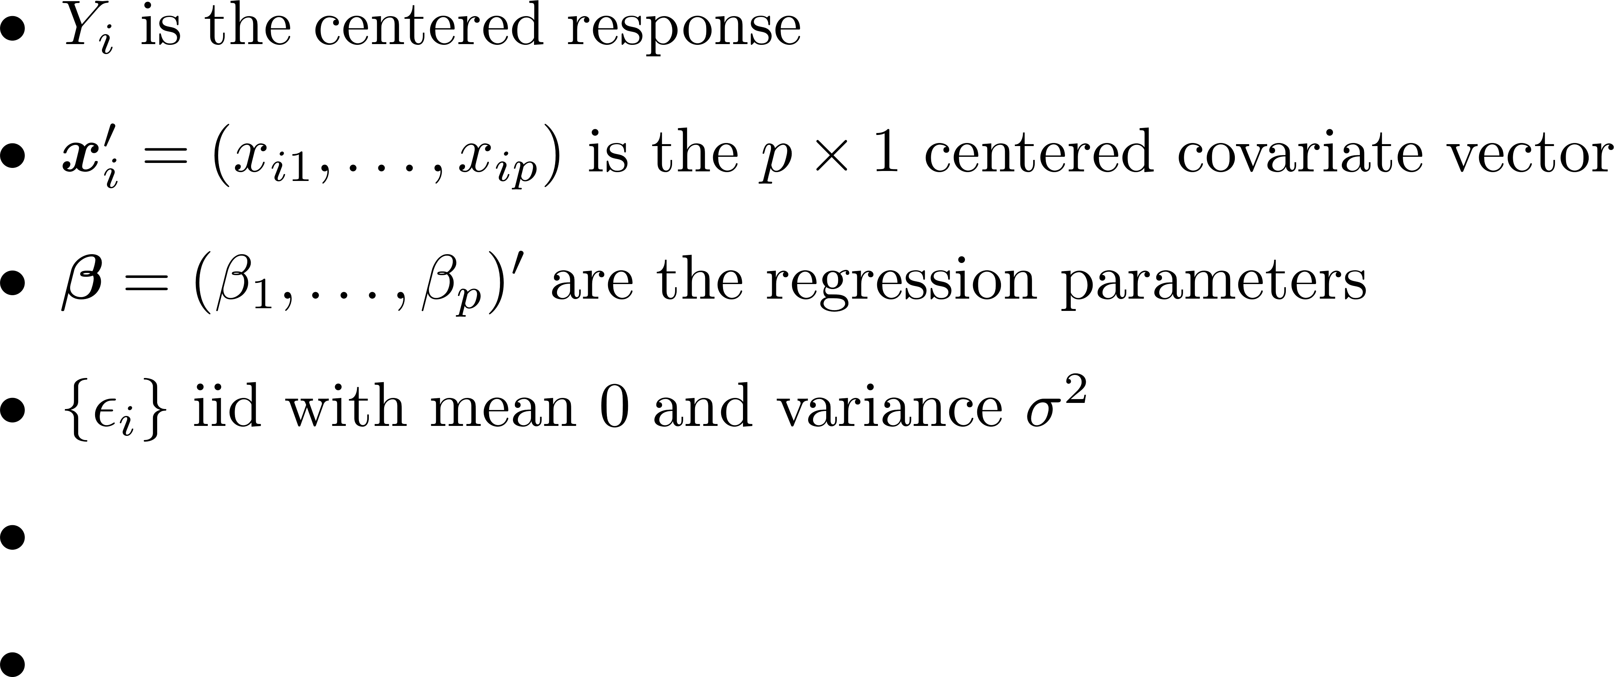


Introduction

Slide 3
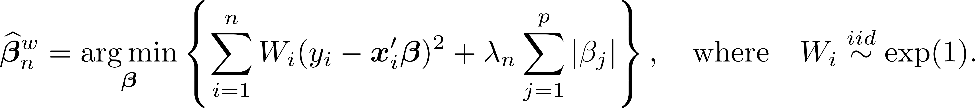
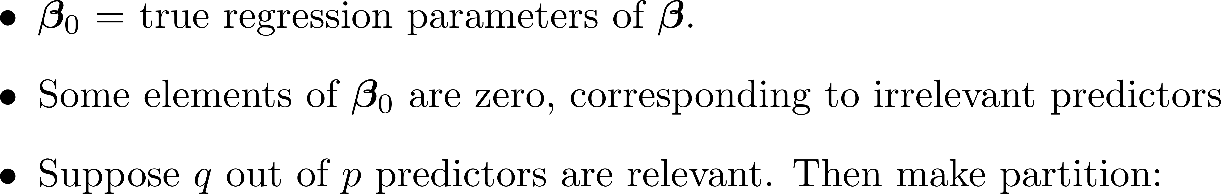

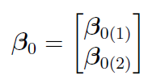
Notation

Slide 4
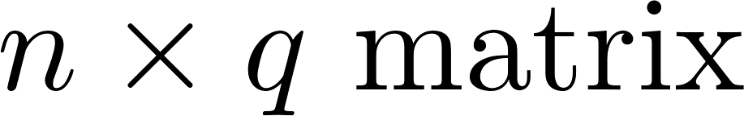
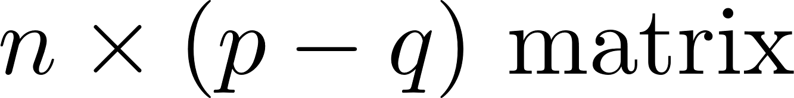
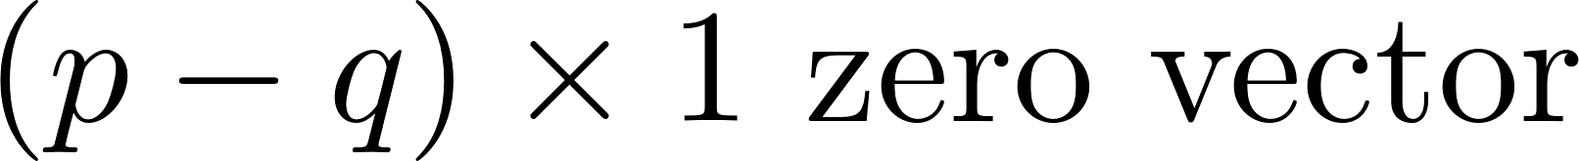
Notation

Slide 5
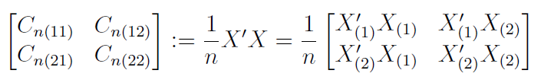
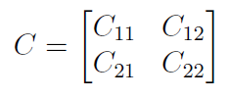
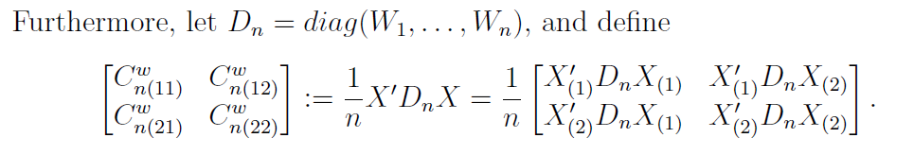
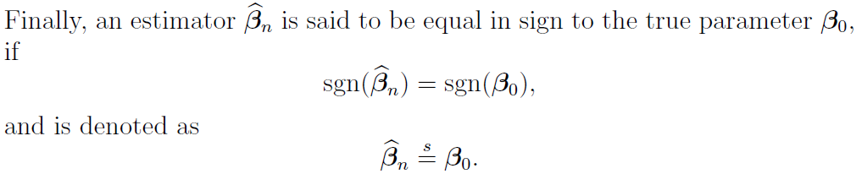
Notation
Similarly,

Slide 6
Asymptotic Results

Slide 7
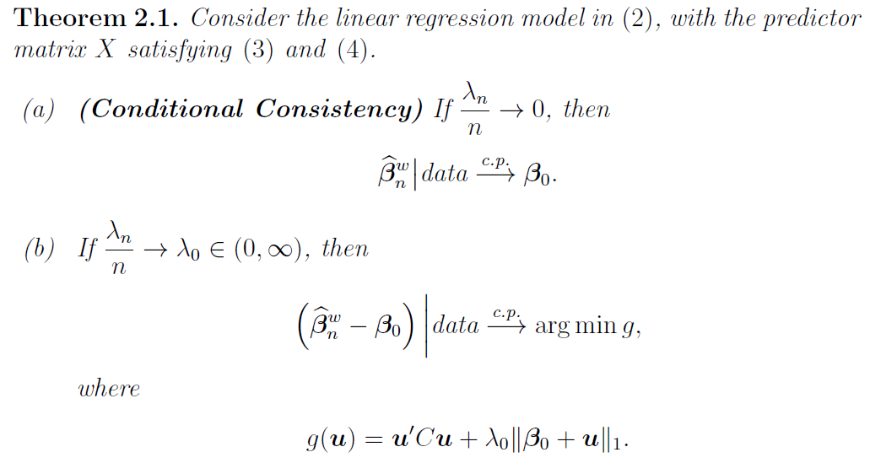
Asymptotic Results

Slide 8
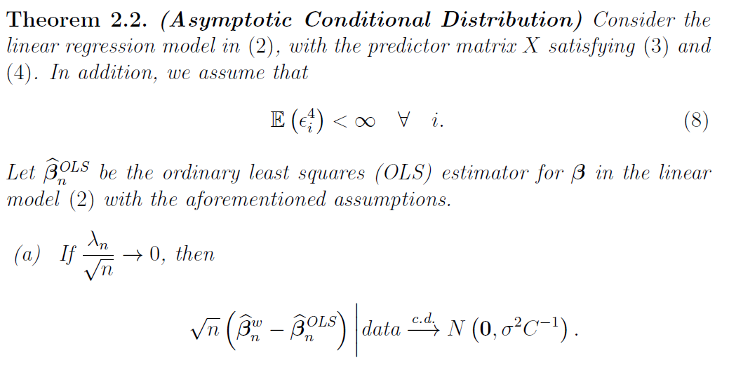
Asymptotic Results

Slide 9
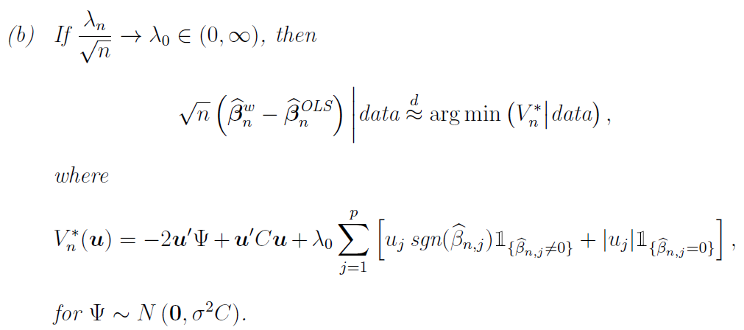
Asymptotic Results

Slide 10

Asymptotic Results
Results in parts (a) and (b) of Theorem 2.2 remain the same if
If
Penalty term still depends on sample path, and
Unless we assume more assumptions…

Slide 11
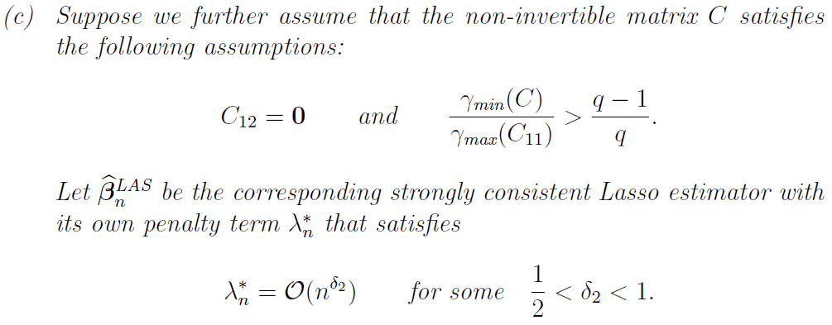
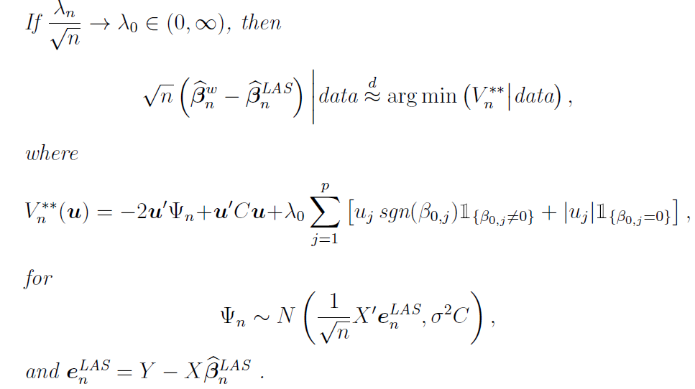
Asymptotic Results
Penalty term does not depend on sample path anymore, but the mean of the Normal limiting distribution still depends on sample path

Slide 12
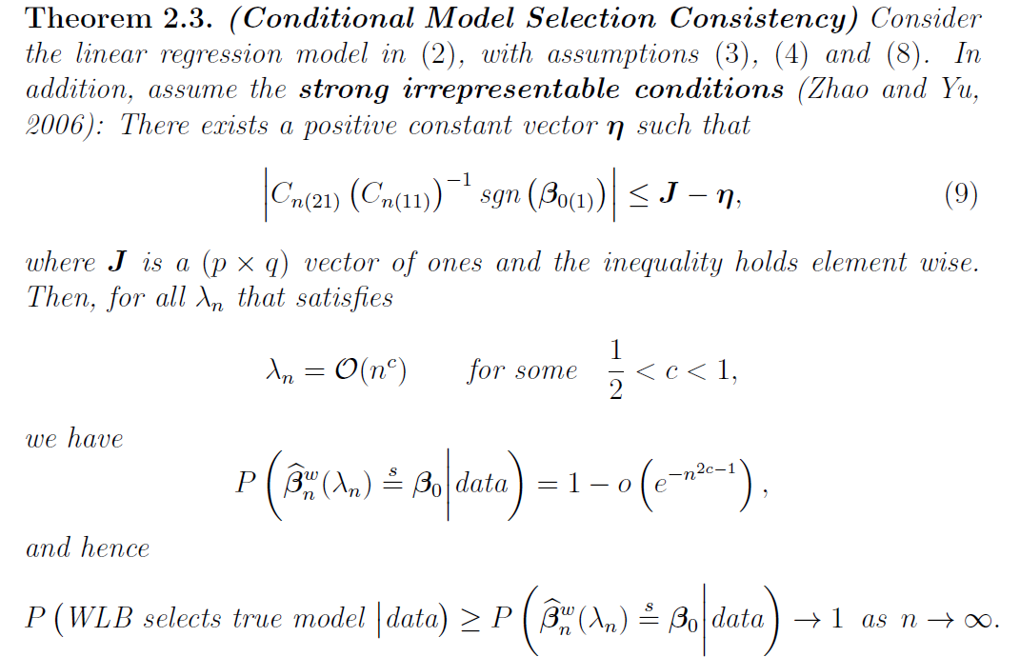
Asymptotic Results

Slide 13
Sketch of Proofs

Slide 14


Proof of Theorem 2.1
Conditional on data,
by Lemma 3.2
by Lemma 3.1

Slide 15

Proof of Theorem 2.2
Conditional on data,
by Lemma 3.4
by Lemma 3.1

Slide 16
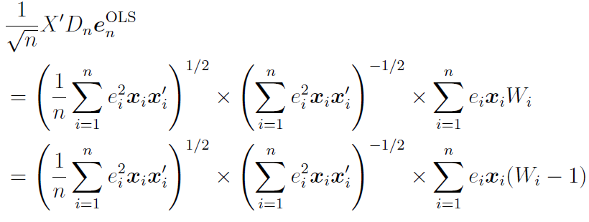
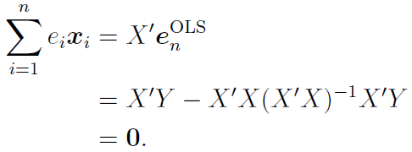
Proof of Theorem 2.2
Conditional on data,
by Lemma 3.4 :
Because:

Slide 17

Proof of Theorem 2.2
Conditional on data,
by Lemma 3.4 :
Because:
by Lemma 3.3

Slide 18
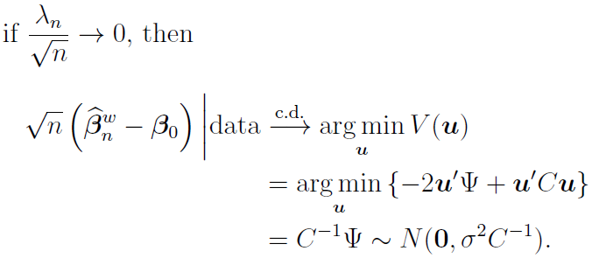
Proof of Theorem 2.2
Conditional on data,

Slide 19


Proof of Theorem 2.2
Conditional on data,

Slide 20
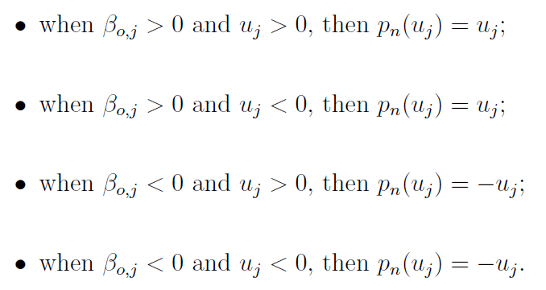
Proof of Theorem 2.2
Conditional on data,

Slide 21
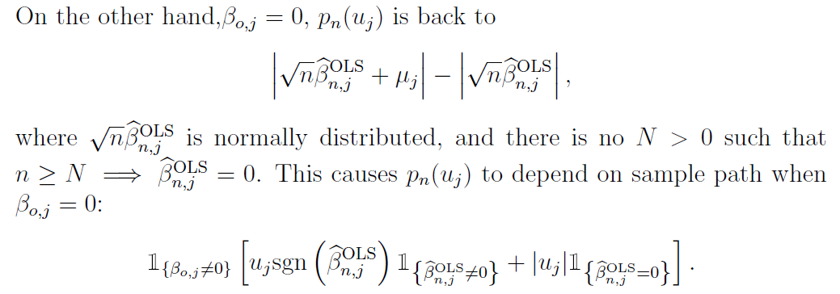
Proof of Theorem 2.2
Conditional on data,

Slide 22
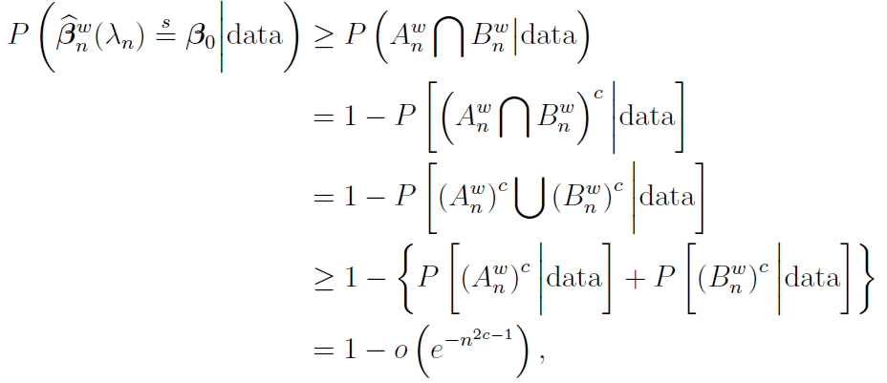
Proof of Theorem 2.3

Slide 23
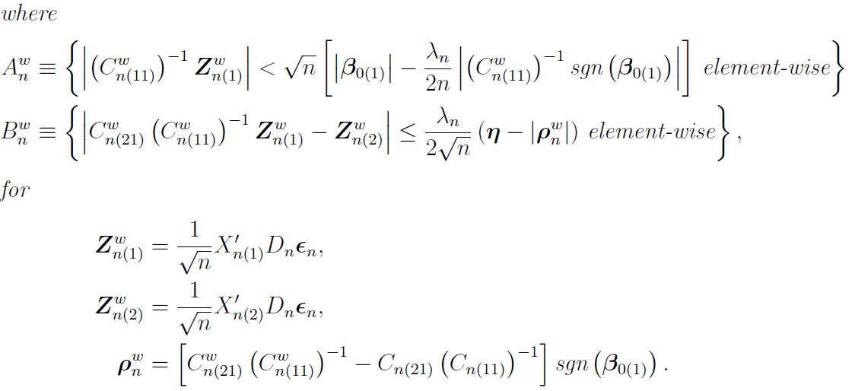
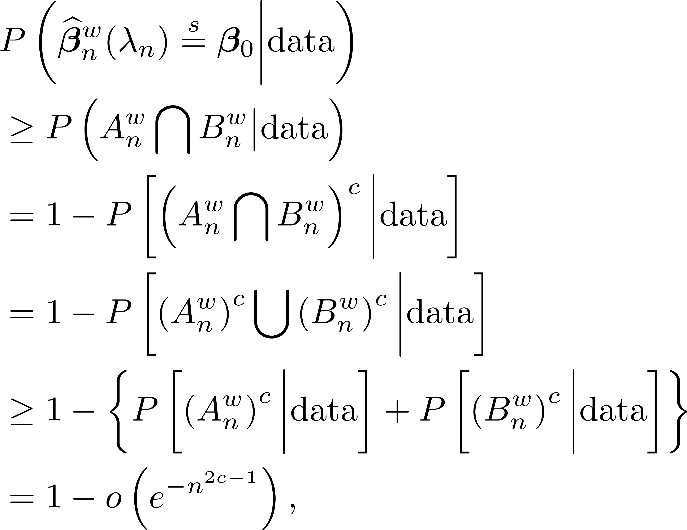
Proof of Theorem 2.3

Slide 24
Proof of Theorem 2.3
Establish this in Lemma 3.6
→ 0 by Lemma 3.7
→ 0 by Lemma 3.9

Slide 25
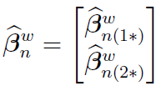
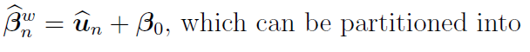
Proof of Lemma 3.6
Use KKT and properties of sub-differential to establish

Slide 26
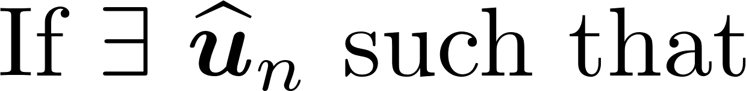
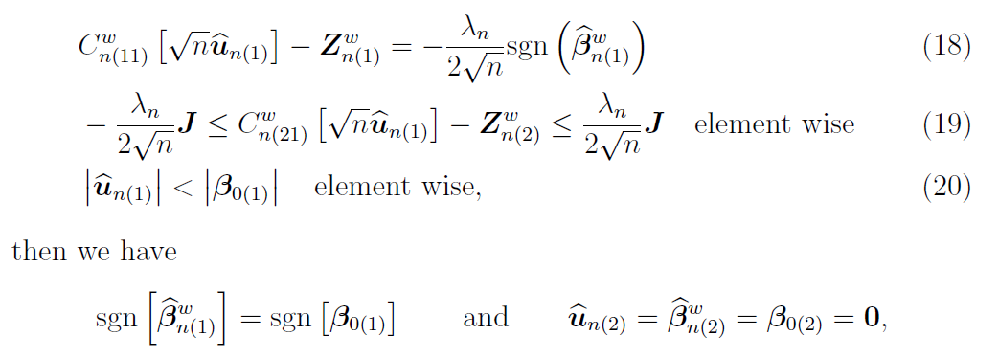
Proof of Lemma 3.6

Slide 27
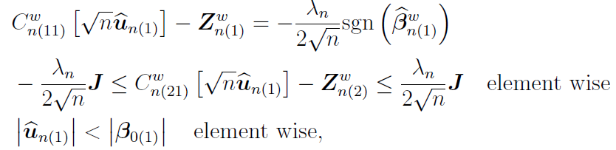
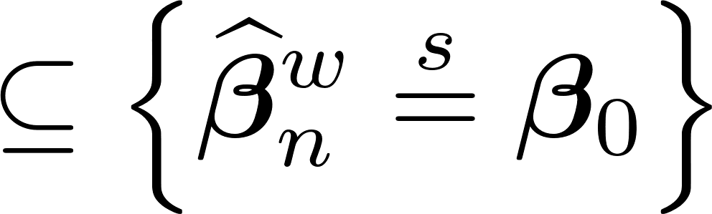
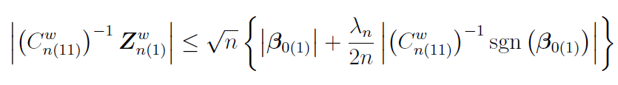
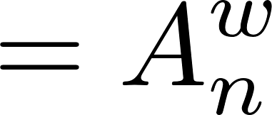
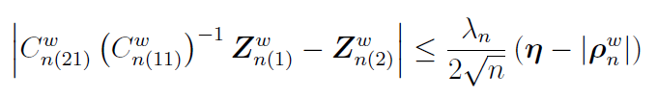
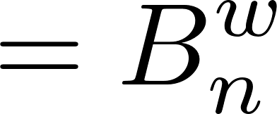
Proof of Lemma 3.6
Simplify

Slide 28

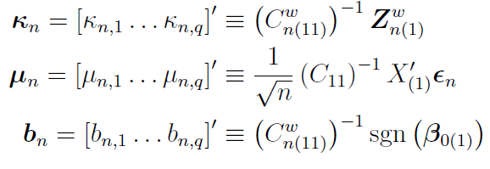
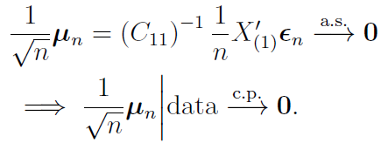

Proof of Lemma 3.7

Slide 29
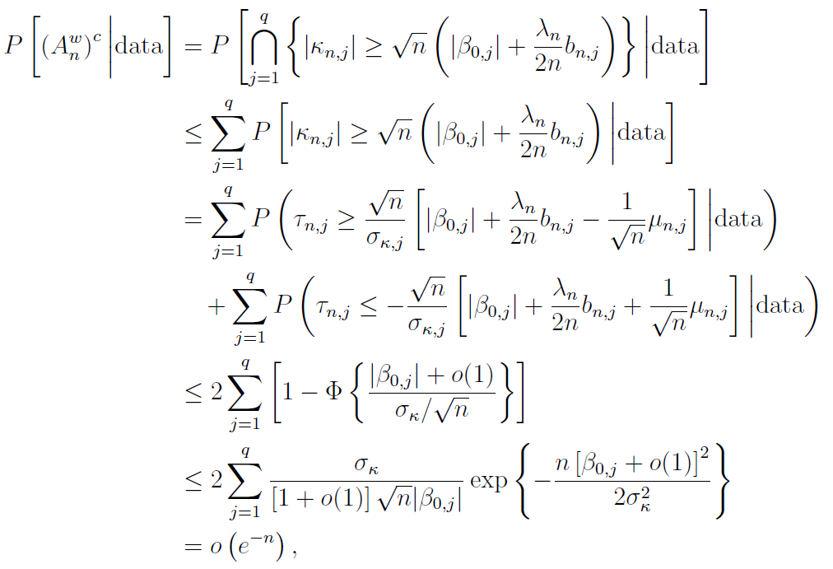

Proof of Lemma 3.7

Slide 30
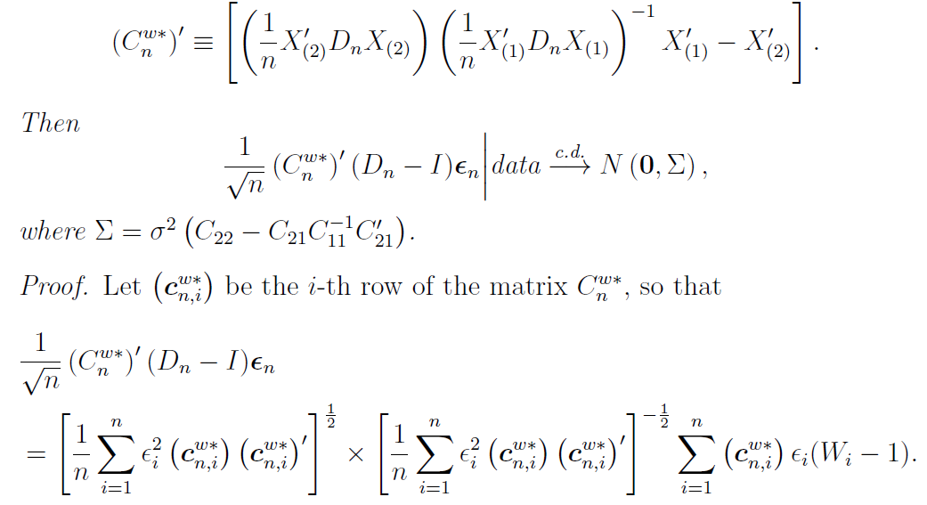

Proof of Lemma 3.8
Denote

Slide 31



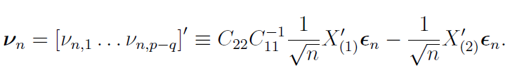
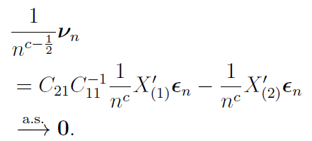
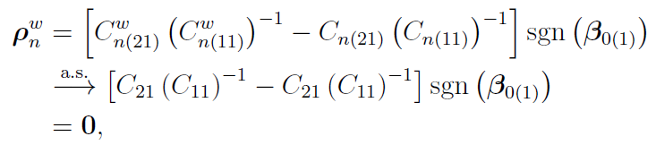
Proof of Lemma 3.9
by Lemma 3.8

Slide 32
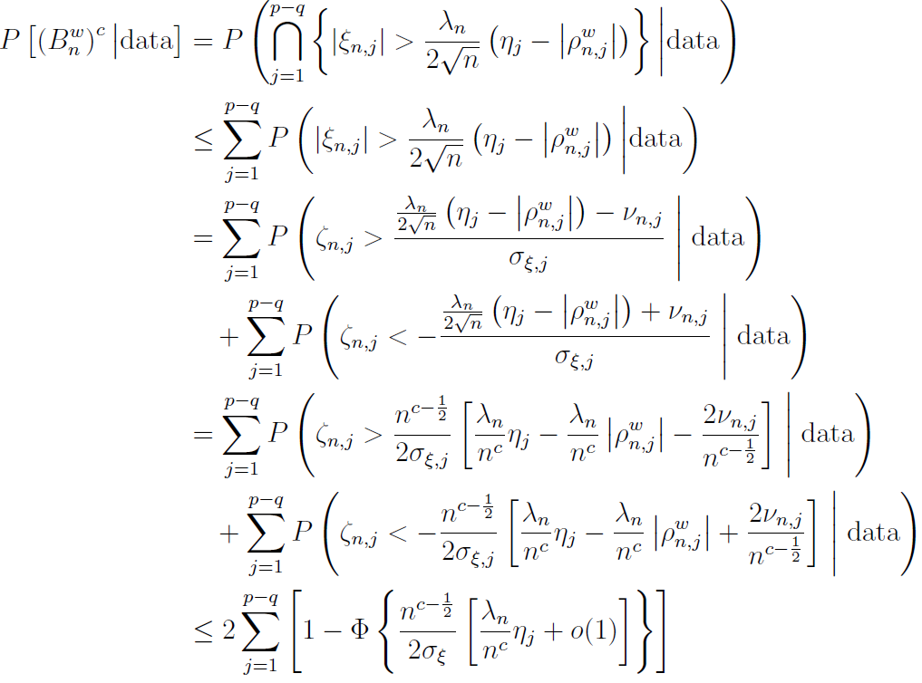
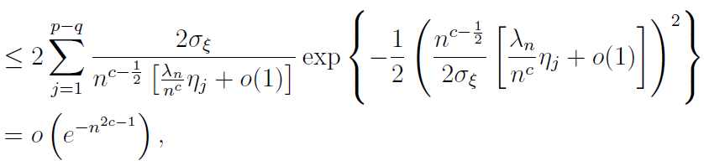
Proof of Lemma 3.9

