Slide 1
Analyzing Tony Gitter’s chemical data set
Available on https://zenodo.org/record/1411506#.X7w4gs1KhPY

Slide 2
Training
basad
Use default package setting
We use MCMC β samples exactly as they are for predictions, even though MCMC does provide probability of variables selected.
glmnet
cv.glmnet gives lambda.min = 0.001 and lambda.1se = 0.006
Try lambda.min
Less sparsity constraints on β’s for both MCMC and RW.

Slide 3
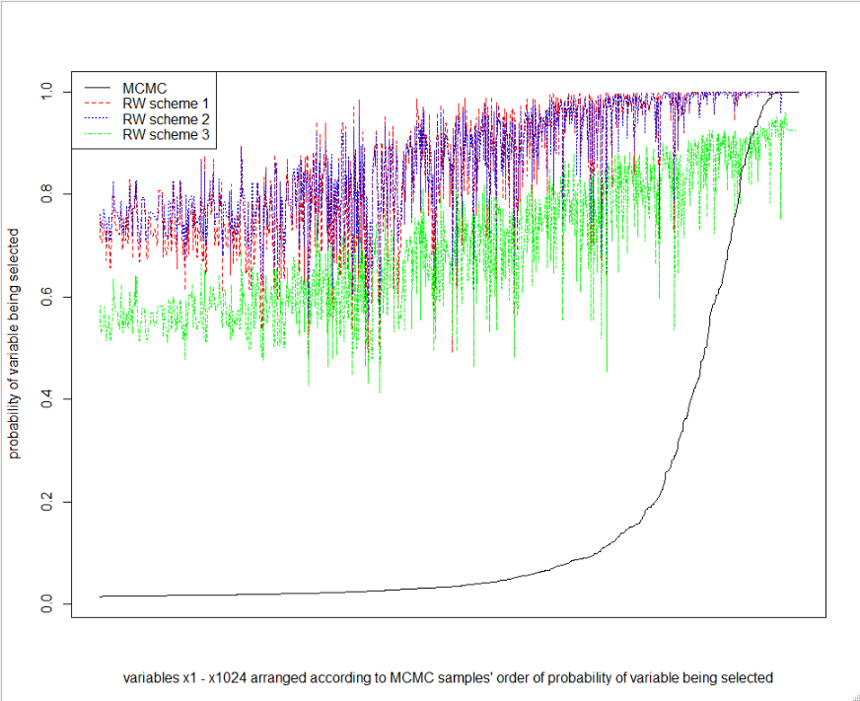
Compare probability of variables selected

Slide 4
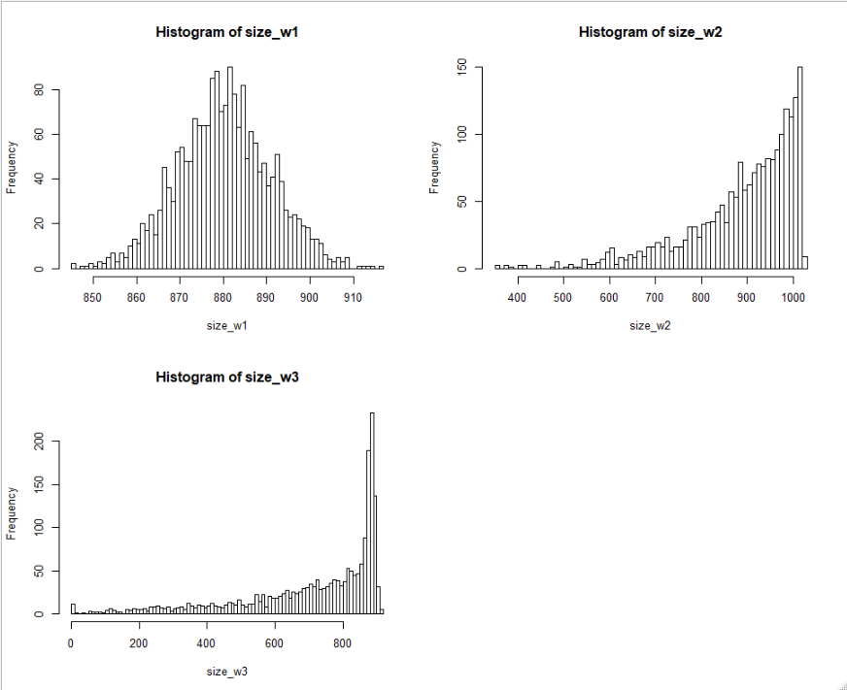
Compare model sizes

Slide 5
Compare marginal posterior distributions of β’s
Pick variables whose probability of being selected is larger than 0.955 for all RW schemes 1, 2 and 3.
There are 8 of them.
Plot marginal distributions of their sampled β’s.

Slide 6
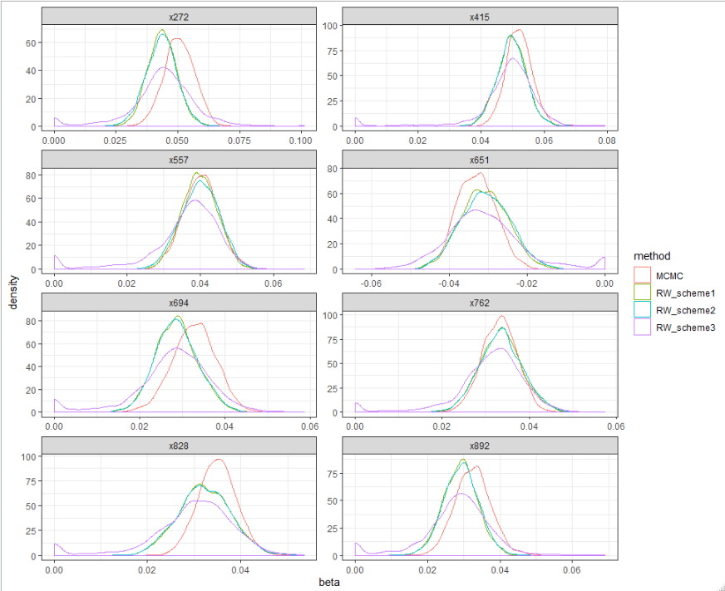

Slide 7
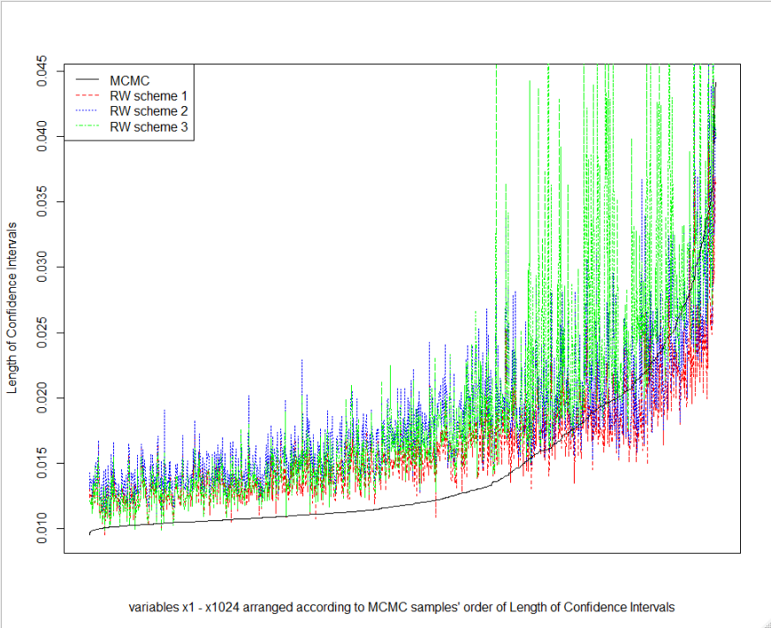
Compare length of 95% CI for β’s

Slide 8
Predictions
n_test = 22,423
For predictions, take sampled β’s from MCMC or RW, and multiply with test cases’ predictors.
Each test case has a distribution of predictions.

Slide 9
95% prediction interval coverage for the ~22,000 test cases is similarly poor for all schemes
RW scheme 1 = 17.7% (higher than lamb.1se case)
RW scheme 2 = 19.1% (close to lamb.1se case)
RW scheme 3 = 23.0% (close to lamb.1se case)
MCMC = 17.1% (lower than using lamb.1se case)
Because length of prediction intervals for RW schemes 2 and 3 are relatively wider

Slide 10
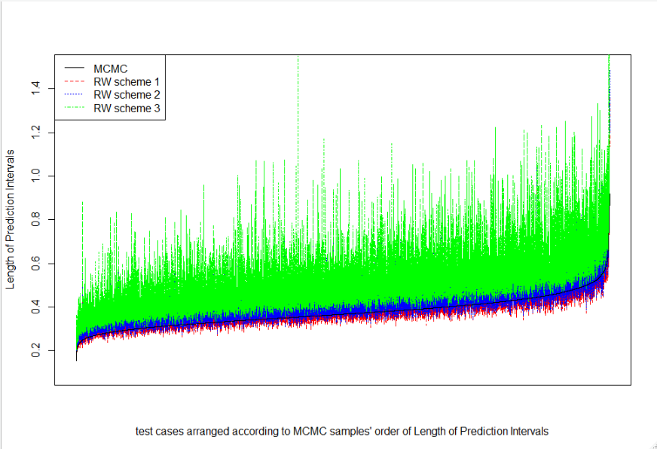
Compare 95% prediction interval length

Slide 11
Prediction
I considered 2 types of MSPE calculations
For each of B=2,000 iterations, compute MSPE (squared prediction errors averaged across all 22,423 test cases)
For each of n_test = 22,423 test cases, compute MSPE (squared prediction errors averaged across all 2,000 predictions)

Slide 12
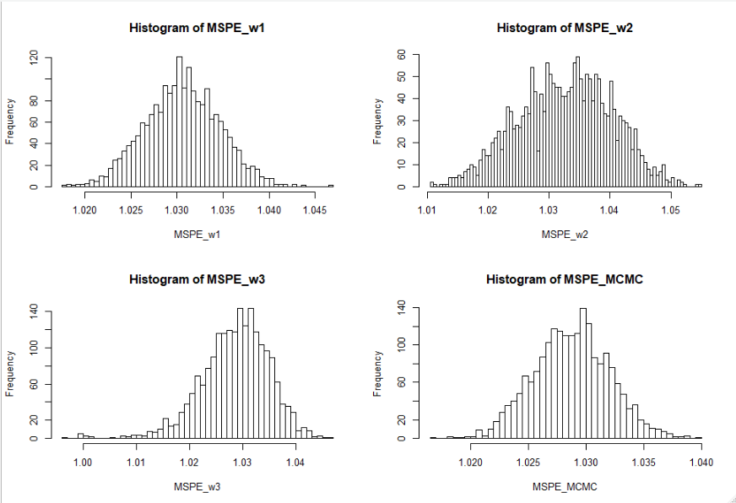
Distribution of 2,000 MSPEs (averaged across all test cases)

Slide 13
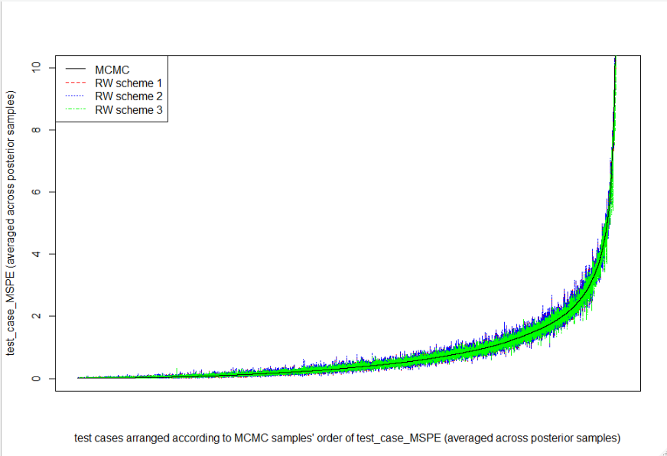
Compare distribution of MSPE for each test case

