Slide 1
Legal Document Analysis Portal
Harvey AI
Attorney Adoption Presentation
Bernhardt Riley | January 2026
Notes:
This is not a prototype or a beta test. This is production-ready software (Version 3.1.0) deployed live today to accelerate your document review and drafting process.

Slide 2
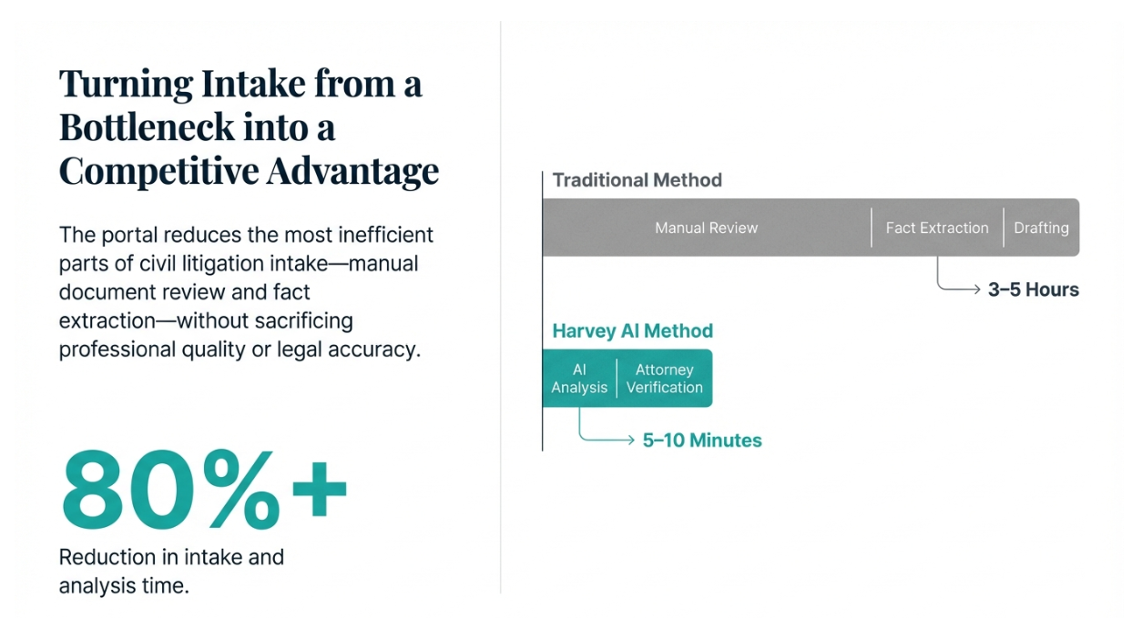
Notes:
We are solving for the bottleneck in case intake. The goal is to remove the "busywork" of reading 50 pages just to understand the basic timeline, allowing you to focus on strategy immediately.

Slide 3
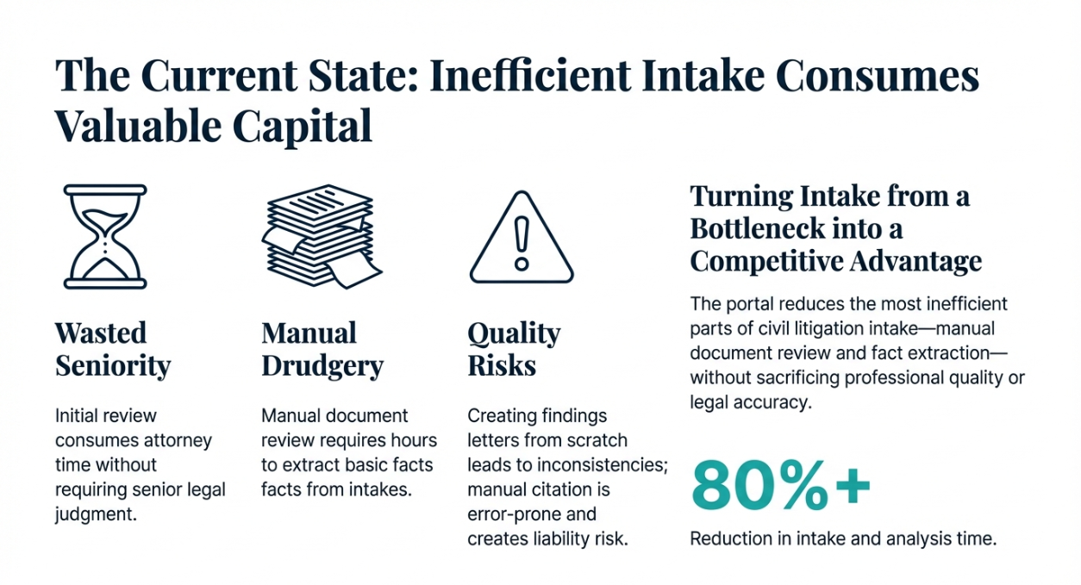

Slide 4
Covered Practice Areas
Consumer Protection & Business Misconduct
Contract disputes and breach claims (UCC Ch. 671–672)
FDUTPA consumer protection claims (Ch. 501, Part II)
Business organization disputes (LLCs Ch. 605; Corporations Ch. 607)
Timeshare disputes
Real Estate & Property Disputes
Landlord–tenant matters (Ch. 83)
Foreclosure defense and procedures (Ch. 702)
Property damage and insurance claims (Ch. 627)
Construction defects (Ch. 558)
Mechanic’s liens (Ch. 713)
Civil Litigation & Administrative Law
Statutes of limitation (Ch. 95)
Administrative procedure matters (Ch. 120)
Attorney fees and sanctions (Ch. 57)
Do not use for federal cases or criminal law.
Notes:
Do not use this for federal cases or criminal law. The legal validation corpus does not cover those areas, and results will be unreliable.

Slide 5
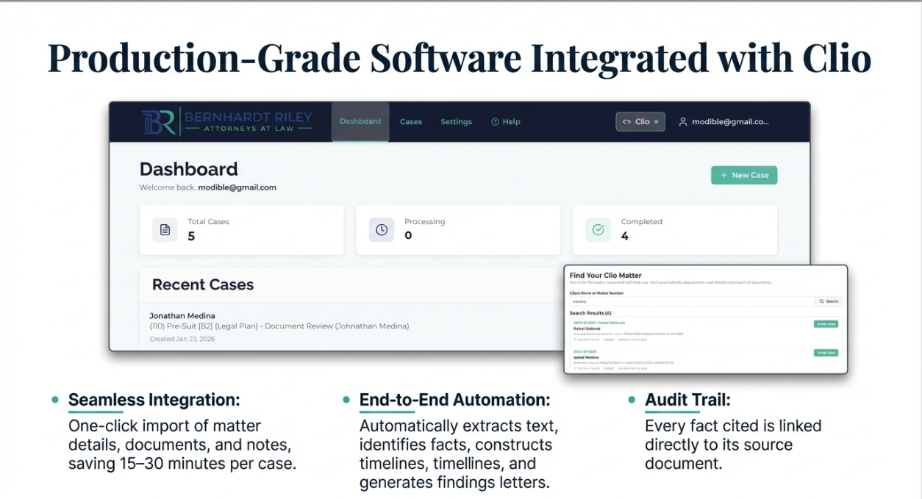

Slide 6
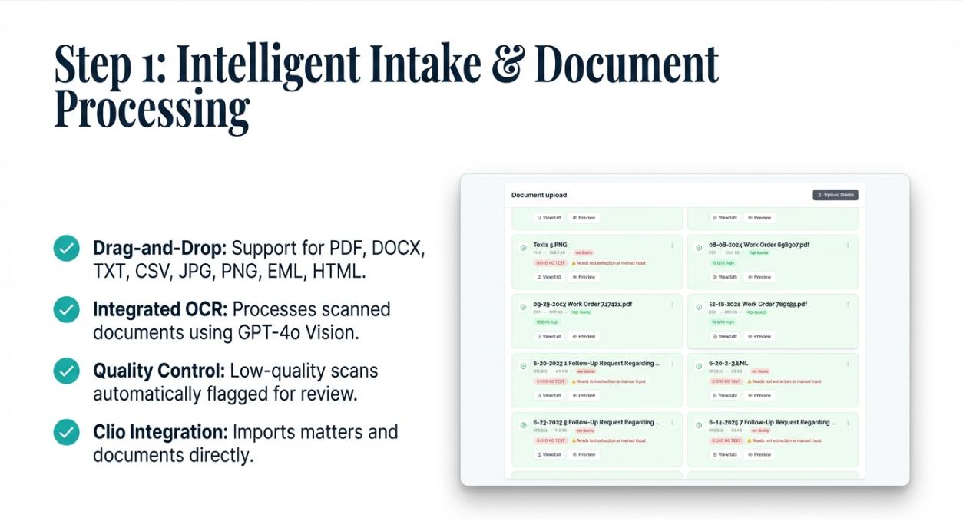

Slide 7
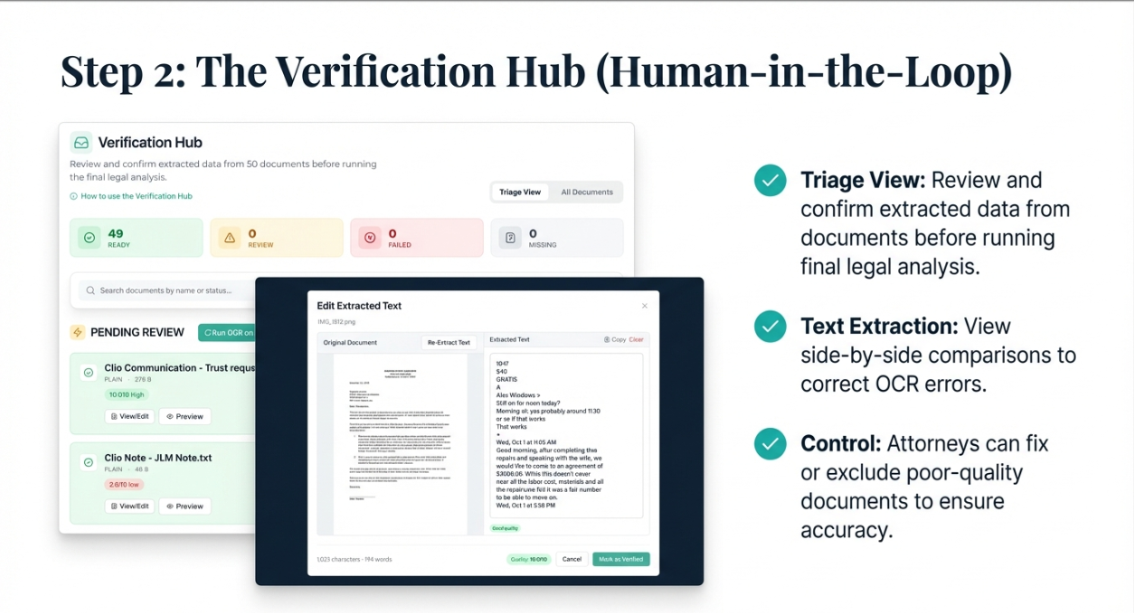

Slide 8
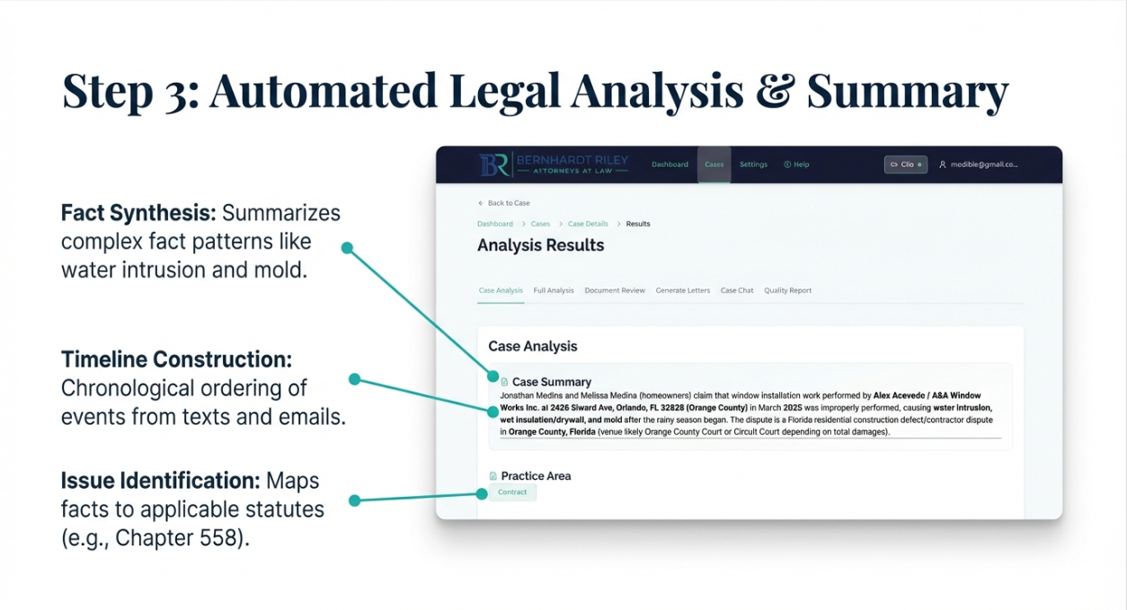

Slide 9
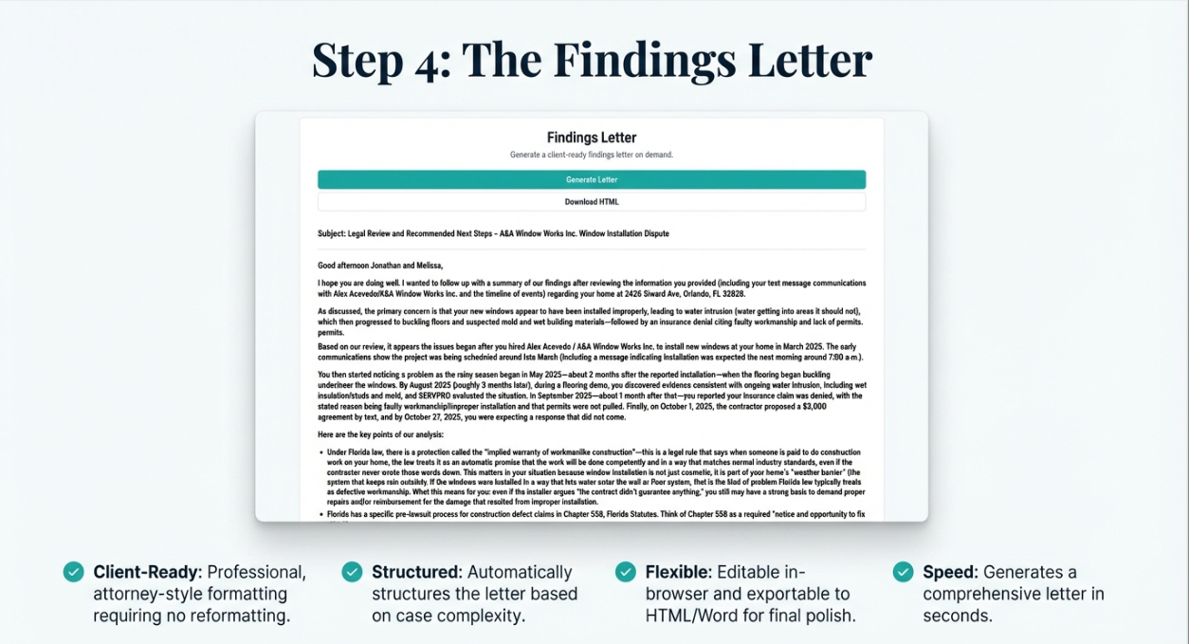

Slide 10
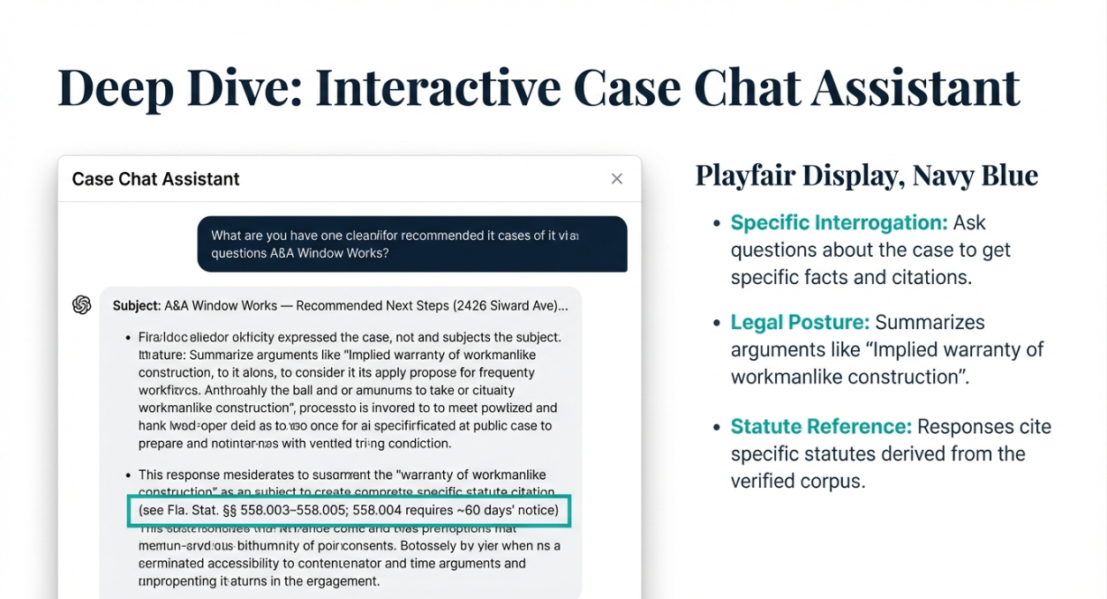

Slide 11
The Solution: Harvey AI
Production software that analyzes documents and generates findings letters.
Extracts text, identifies facts, and constructs timelines automatically.
Validates statute citations against verified legal corpus.
Every fact cited directly to its source document
Think of this as a tireless junior associate.
Notes:
Think of this tool as a tireless junior associate. It handles the initial review and drafting, giving you an 80% complete draft. You remain responsible for the final review and approval.

Slide 12
The Attorney Workflow
1
Create Case: Initialize case record with client name and reference number
2
Upload Documents: Drag-and-drop files or import directly from Clio
3
Run Analysis: AI processes documents (1–8 minutes)
4
Review Results: Verify findings letter, timeline, and document summaries
5
Export: Edit letter in-browser and export to HTML/Word
Notes:
The workflow is designed to be simple. There is no complex manual to study. You can run your first analysis in less than 5 minutes.

Slide 13
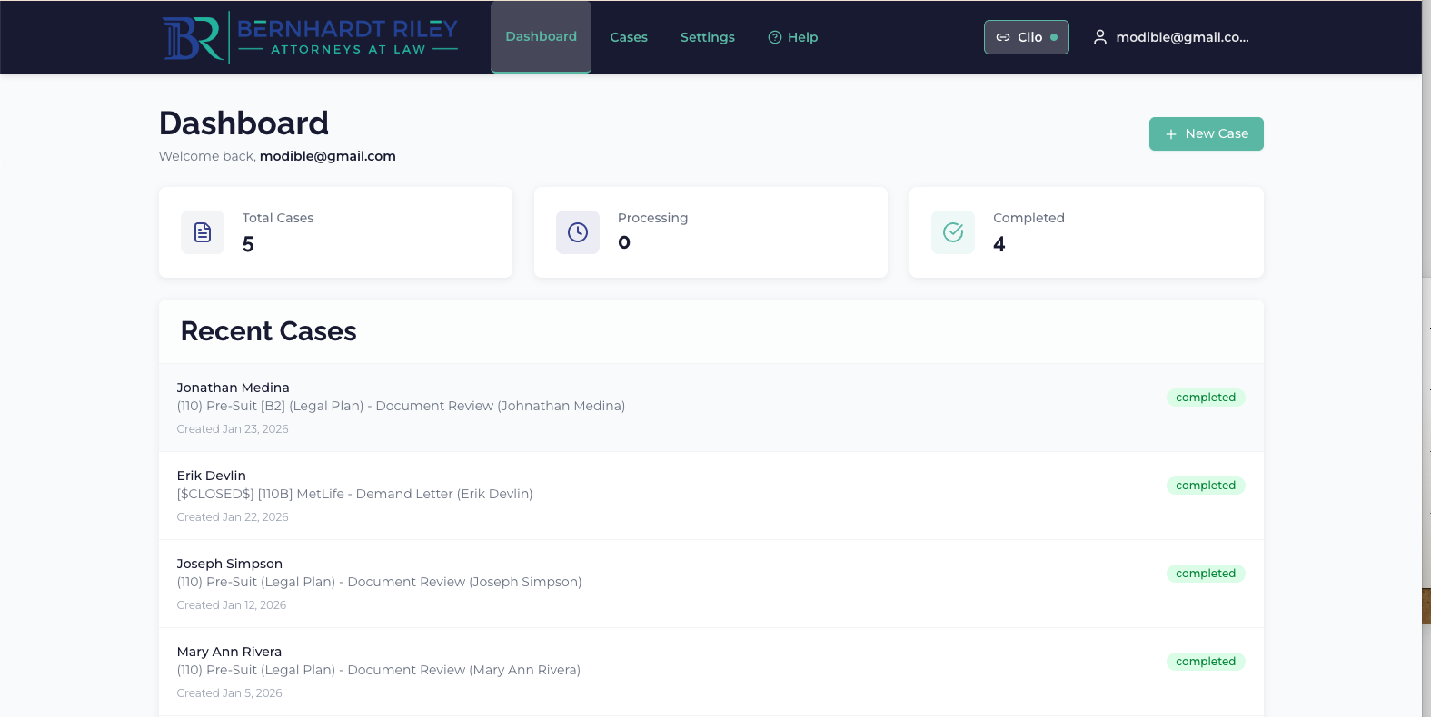
Notes:
This is your dashboard, it shows all recent cases, and allows you to create a new case.
To start you want to make sure to connect to Clio by clicking the Cio button on the top right of the screen. Once it is lit green, that indicates that it is connected. Then you can click the "New Case" button.

Slide 14
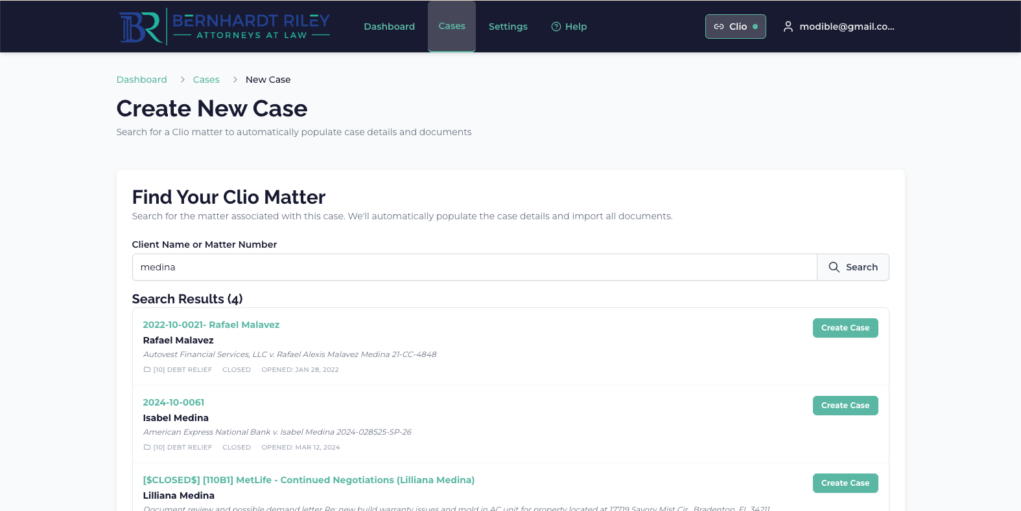
Notes:
Here you can type the name of the client and it will search Clio for that case. Find it on the bottom (some clients may have multiple cases) and then click "Create Case".

Slide 15
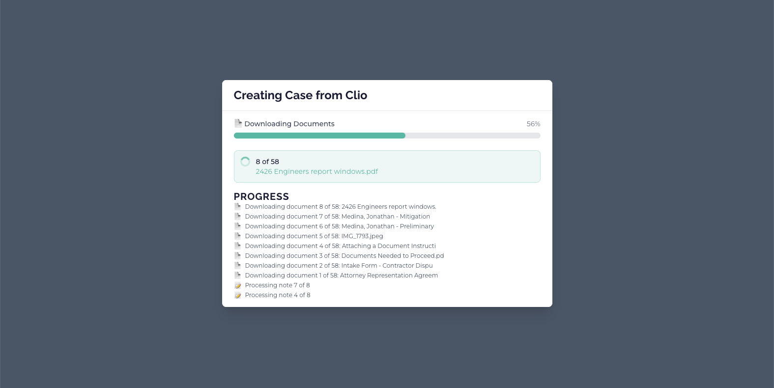
Notes:
You'll get a confirmation - click ok - and then it will begin importing the documents from Clio. There are some things here to note.
Once complete it will let you know if there were any documents that didn't load - mainly because they are very large. In the case that this happens, you may need to use. seperate tool to compress the pdf and you can manually upload it on a later screen.

Slide 16
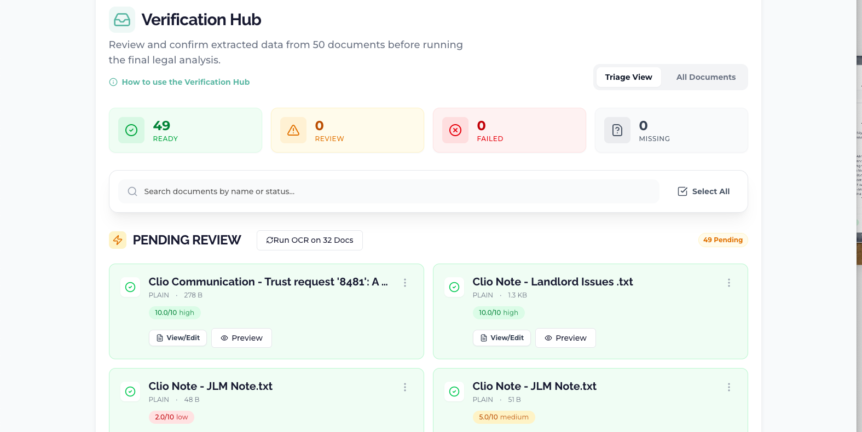
Notes:
Once complete you will be brought the the overview screen, here you can review the Overview and Documents for relevant information and understanding. The next step in the process is the Verification Page.
Here you will get a summary of the documents that were imported, it's important to review and make sure that they are all extracted.
You will want to review and remove any unneeded documents
For some items that were not extracted originally, you will need to click the "Run OCR on ## Docs" button - this will use a special Google Vision API to extract the text from the remaining docs.

Slide 17
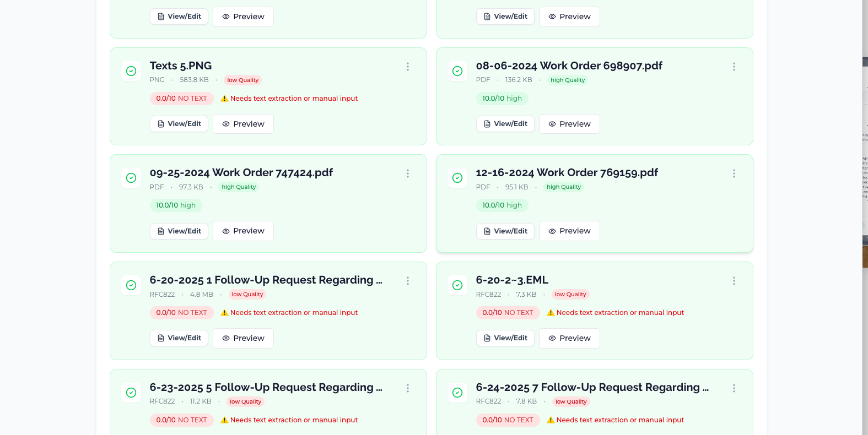
Notes:
This is to show the documents that weren't extracted correctly.
Once you run the OCR, it will update to show 10/10 or so. you can click View/Edit to see what was extracted.

Slide 18
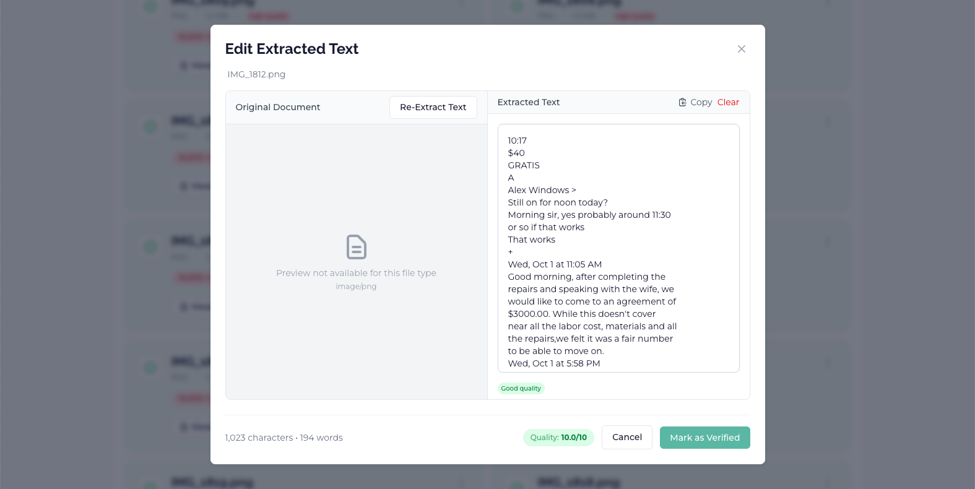
Notes:
This is an example of the extracted text view.

Slide 19
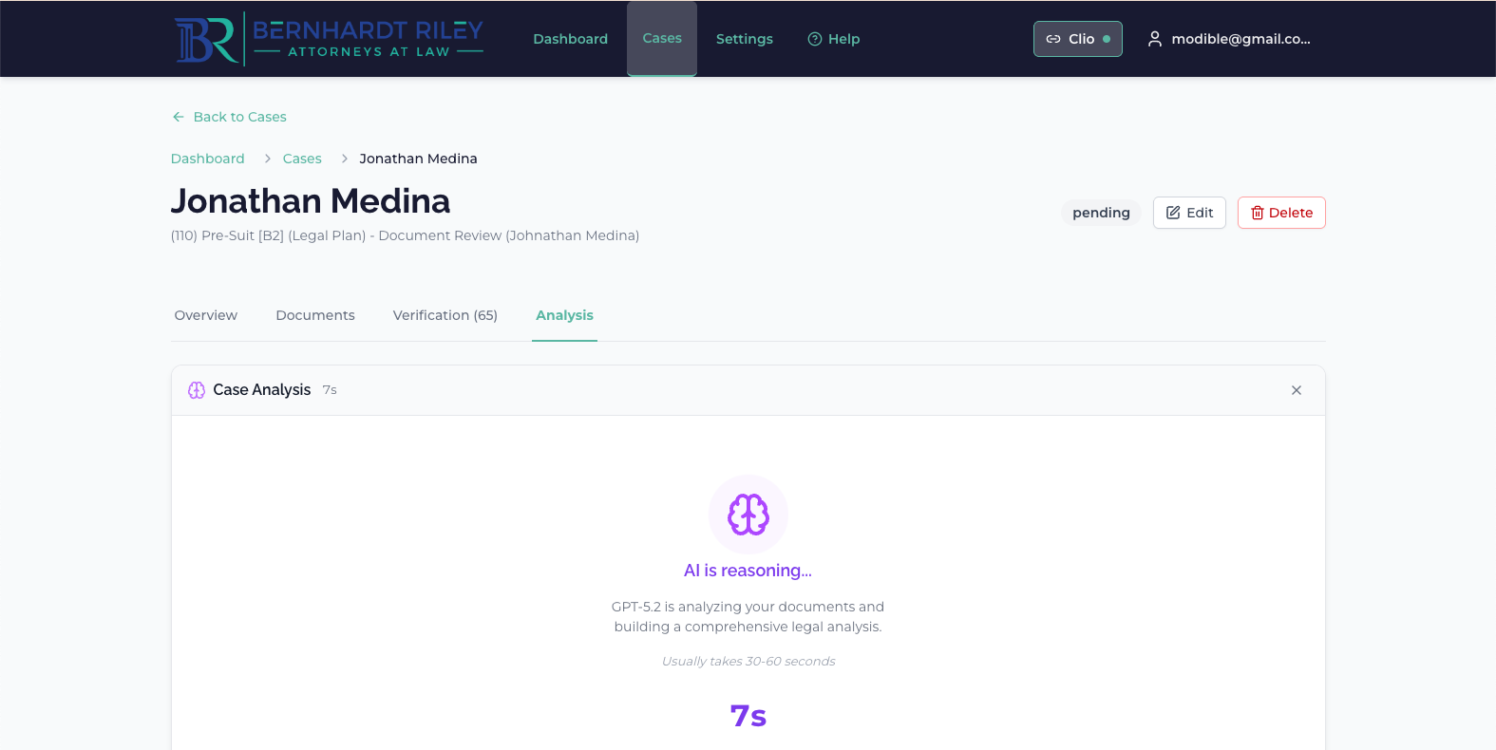
Notes:
Next we click on Anlaysis, and click start analysis button.
You'll see a loading screen like this.

Slide 20
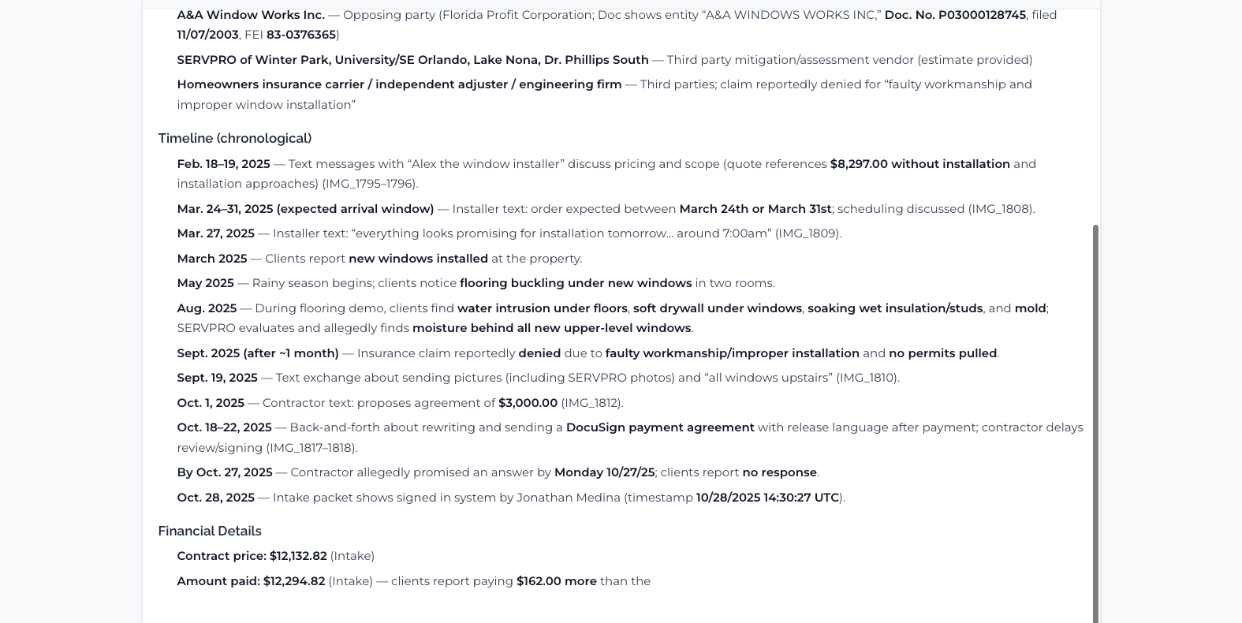
Notes:
Once it starts to load, text will begin to stream live. This is the actual analysis. It will complete by itself and then you click - "View Analysis"

Slide 21
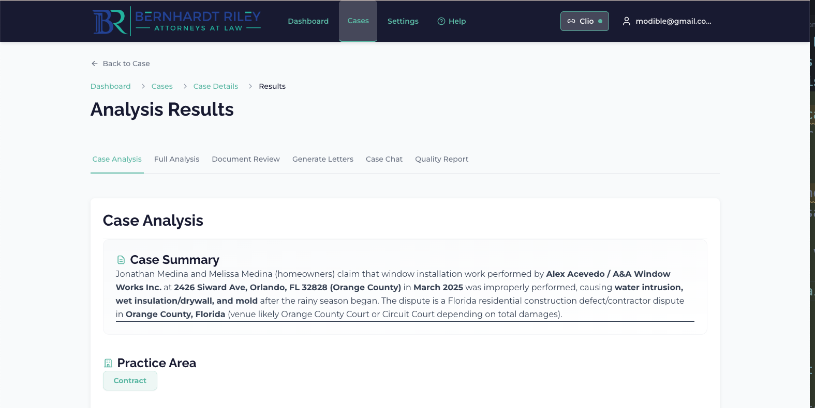
Notes:
These are the Analysis Results. From here you can view a variety of things - Case Analysis, Full Analysis (which is the full streaming document on the previous screen)
Document review
and Generate Letters is where we'll go next.

Slide 22
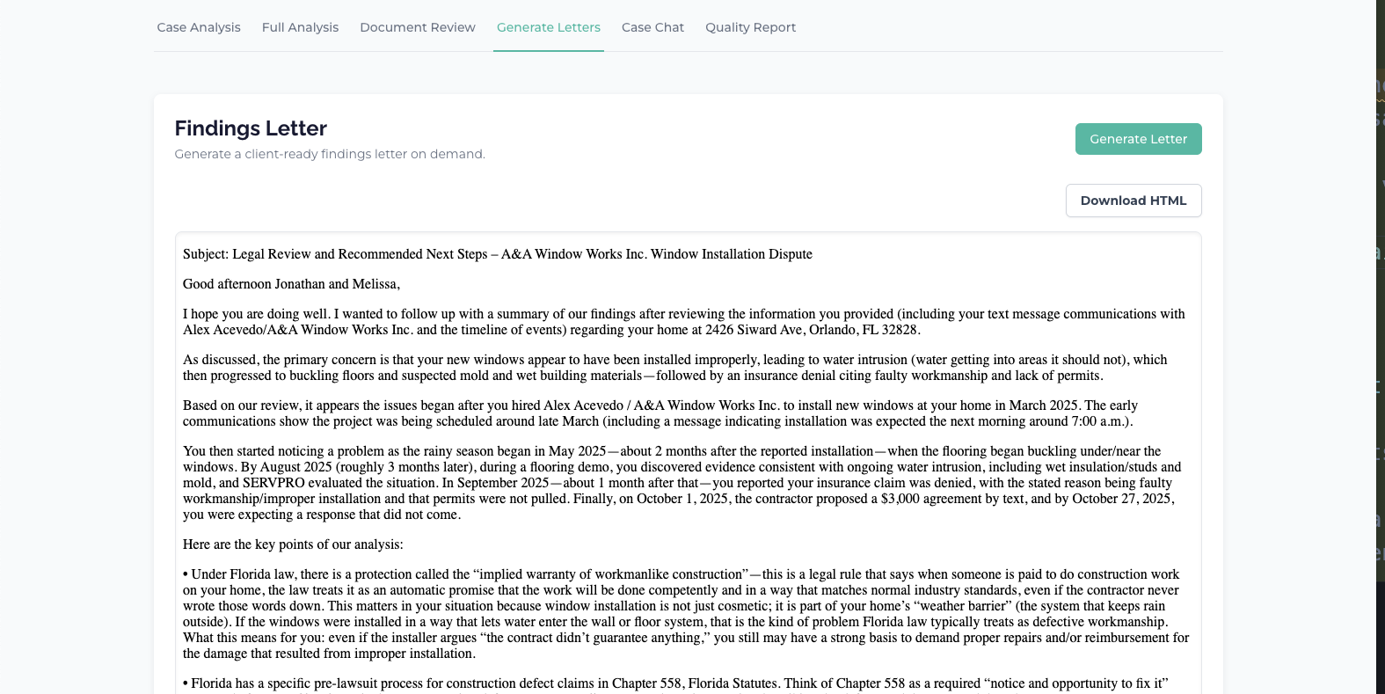
Notes:
On this page, you would simply click Generate Letter, and it will begin to generate. They can be a bit wordy, we will refine that later, but for now, it's better to have more to work with than not enough. If need be you can copy this letter and ask Chat to make it more concise or whatever you need..

Slide 23
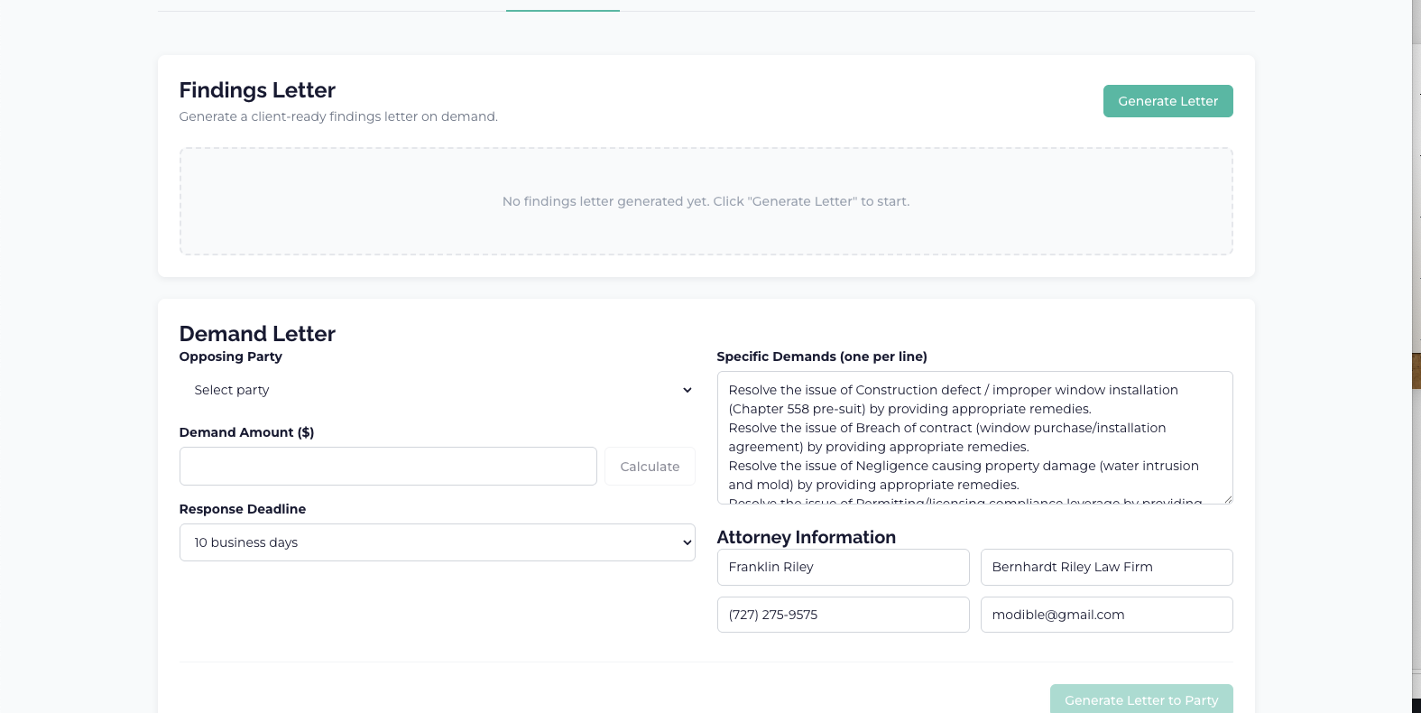
Notes:
Below the Findings Letter Section is a demand letter section, here you can select the opposing party you want to direct the letter to, and then press calculate to update the demand amount based on the case analysis. And the update Specific Demands and response deadline as needed- then click Generate Letter to Party to have a demand letter generated.

Slide 24
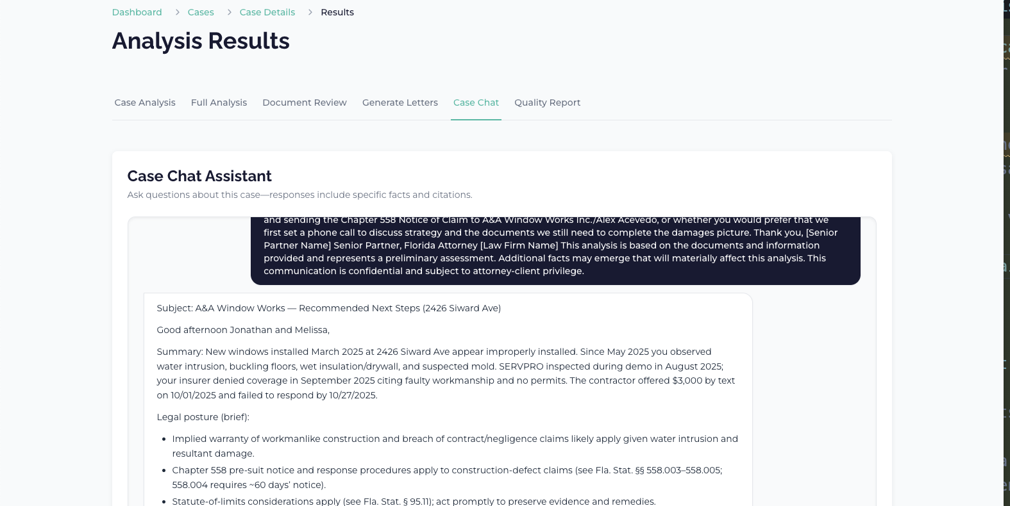
Notes:
I've also added a Case Chat assistant that has complete context of the case documents and case analysis. You can ask it any question. You can use this to compress your generated findings letter by pasting it in and asking it to compress it. It can also answer any questions about the case.

Slide 25
Supported Documents & Intake
Broad format support: PDF, DOCX, TXT, CSV, JPG, PNG, EML, HTML.
Integrated OCR processes scanned documents using GPT-4o Vision.
Clio integration imports matters and documents directly.
Verification Hub fixes or excludes poor-quality documents
Upload core documents first: intake forms, police reports, contracts
Notes:
For best results, upload core documents first: intake forms, police reports, contracts, and key correspondence. The system handles files up to 50MB each.

Slide 26
Findings Letters & Citations
Professional format: Structured, attorney-style letters.
Source linking: Every fact includes inline citation (e.g., [Client_Intake.pdf]).
Instant verification: Click any citation to view the original source.
Draft status: All outputs designed for attorney review
You can audit the AI's work by clicking the citations.
Notes:
This is the most critical feature for trust. You do not have to guess where a fact came from. You can audit the AI's work by clicking the citations.

Slide 27
Quality, Accuracy & Control
Verified legal corpus: AI checks citations against 51 FL + 42 NM statutes.
Hallucination guardrails: Citations rejected if not in verified corpus.
Jurisdiction limits: Optimized only for Florida and New Mexico civil litigation.
Attorney responsibility: You verify cited statutes are strategically applicable
You are the final decision-maker.
Notes:
The system prevents the AI from inventing laws. However, it cannot replace your judgment on whether a law is appropriate for the case strategy. You are the final decision-maker.

Slide 28
Adoption Plan & Expectations
Immediate access: Your accounts are created; credentials distributed.
Resources: One-page Quickstart Guide emailed to you.
Training: Live Q&A session next Wednesday for questions.
Support: Dedicated channels for technical issues and feature requests
Expectation: Log in and create a test case this week
Notes:
We expect every attorney to log in and create a test case this week. Success is defined by using this on real client matters to reduce your intake time.

Slide 29
Immediate Next Steps
1
Verify Access: Log in to the portal today
2
Create Test Case: Upload sample documents to familiarize yourself
3
Real Intake: Use Harvey AI for your next eligible case
4
Attend Q&A: Bring questions and feedback to next Wednesday's session
This is live. Use it on your next intake.
Notes:
The system is live. Please log in after this meeting and try it out. Trust the system to handle the reading, but verify the output before you send it.

