Slide 1
A group presentation on data structures USING BUBBLE SORT
By: SULEIMAN ADAM
(Group A Evening – group 6)

Slide 2
ROLES OF THE GROUP MEMBERS
WISDOM DZONTOH M.–4235230058 (Introduction and summary of Bubble Sort data
structure and algorithm)
DWAMENA YEBOAH SOLOMON - 4231230074 - (Algorithm development)
ISAAC ADJEI ADJETEY_4211231073 - (flowchart development)
ISAAC YEBOAH 4231230039 – (Code Implementation)
SULEIMAN ADAM– 1704371831 –(Suggestions and documentation review)

Slide 3
Introduction to what bubble sort is
A straightforward sorting method called bubble sort iteratively steps through the list, compares nearby components, and swaps them if they are out of order. Until the list is sorted, the trip through the list is repeated. Smaller elements "bubble" to the top of the list with each iteration, giving rise to the term.

Slide 4
Some Advantages Of Bubble Sort Algorithms
Easy to understand and implement.
Requires minimal additional memory space because it operates on the input array itself.
Works well for small datasets or nearly sorted datasets.

Slide 5
Some disadvantages of bubble sort algorithms
Due to its O(n^2) time complexity—where n is the number of elements in the array— it is inefficient for large datasets.
Unsuitable for datasets that have been largely sorted or for datasets with a high number of items.

Slide 6
Some Applications Of Bubble Sort Algorithm In Real Life Scenarios
Because bubble sort is so simple, it can be used in education to teach students about sorting algorithms.
When the input size is small and the algorithm's simplicity outweighs its inefficiency, it can be applied.
Additionally, bubble sort can be included into more intricate sorting algorithms as a subroutine.

Slide 7
Algorithm (pseudo code)
Start
Prompt the user to enter the size of the array.
Read the size of the array (sizeOfArray).
Declare an array 'numbers' of size 'sizeOfArray'.
Prompt the user to enter 'sizeOfArray' numbers.
For each number i from 0 to sizeOfArray - 1
a. Read the number and store it in numbers[i].
7. Display "Numbers to be Sorted are:" followed by the list of entered numbers. 8. For each pass from 0 to sizeOfArray - 2
a. For i from 0 to sizeOfArray - pass - 2
i. If numbers[i] > numbers[i + 1] then
- Swap numbers[i] and numbers[i + 1].
Display "Sorted Numbers:" followed by the sorted list of numbers.
End

Slide 8
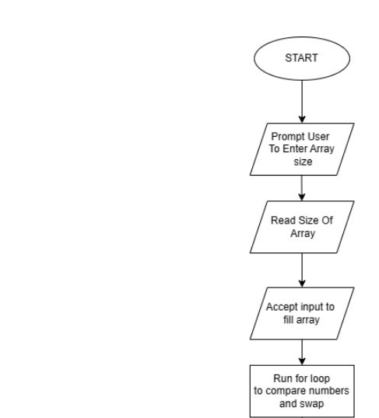
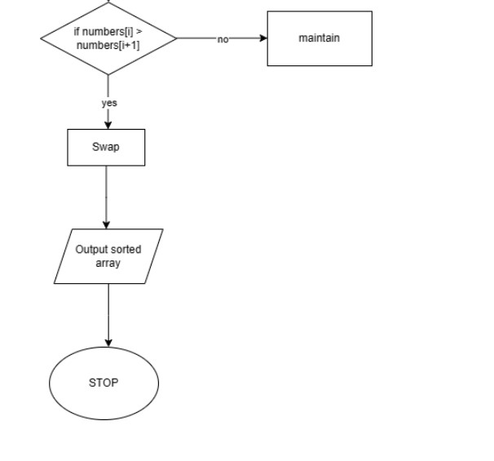
FLOW CHART

Slide 9
Summary of algorithm
The algorithm prompts the user to enter the size of the array and reads the size. Then, it declares an array of the given size and prompts the user to enter the numbers to be sorted. It iterates through the array to collect the numbers and displays them. Next, it performs a bubble sort algorithm on the array, comparing adjacent elements and swapping them if necessary. After sorting, it displays the sorted list of numbers. Finally, it ends the process.

Slide 10
Thank you!

