Slide 1

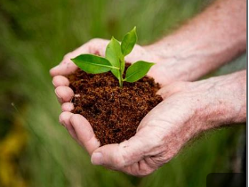


Brighter
Tomorrow
Community Project
Stronger People
Healthier Communities
A Brighter Future
Together we create a
lasting change.

Slide 2
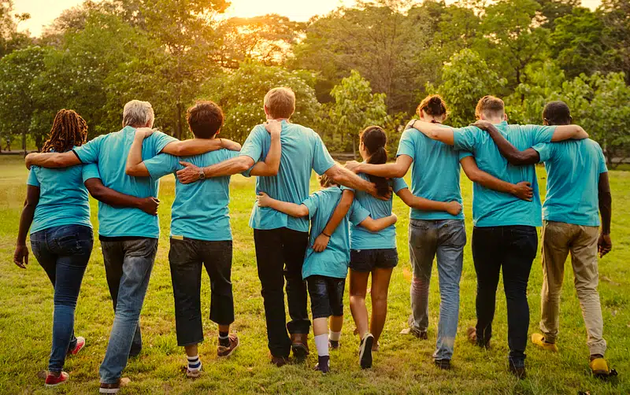



About the project
Brighter Tomorrow is a community
Initiative focused on creating positive
And lasting change through education,
Health, and environmental support.
We work together with local residents,
Volunteers, and partners to build a
Stronger, healthier, and more
Sustainable community for everyone.
Education
More learning opportunities
Health
Better wellness
And access
Environment
A cleaner greener
community

Slide 3



Our Goals
Support Education
Provide resources and mentorship
For students and young people
Improve Health & Wellbeing
Promote healthy living and increase
Access to basis healthcare.
Protect the Environment
Organize clean-up drives and
Promote sustainable practices.
Build community
Bring people together through
Projects, event and support networks

Slide 4
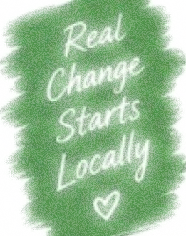




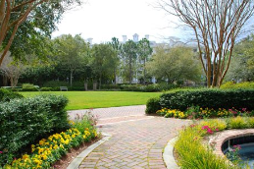
Why It Matters
More education lead to
Better opportunities
Healthier families build
stronger community
A cleaner environment
Create a safe, brighter futures
A cleaner environment
Create a safe, brighter futures

Slide 5
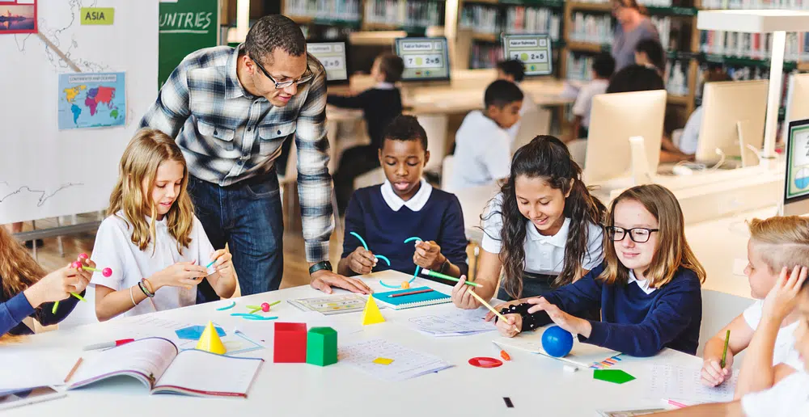
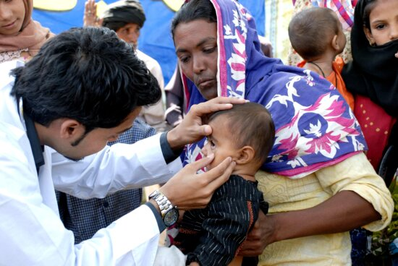
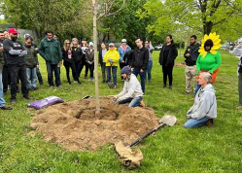
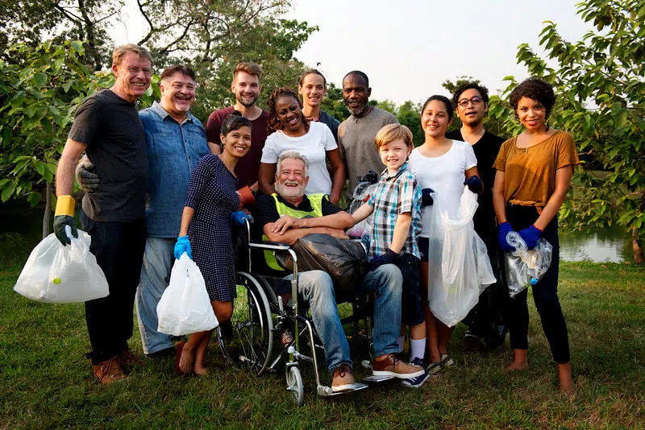
What We Do
Education Programs
Health Initiatives
Tutoring, school supplies,
Workshop and skills training
Health checks awareness
Campaigns & wellness drives
Environmental Projects
Community Events
Clean-up drives, tree planting
& recycling programs.
Fundraisers, outreach programs
& support network

Slide 6




Our Impact
small actions,
when multiplied
by many people
can make a
big difference
500+
Community members
reached
120+
Students supported
With learning resoures
15
Clean-up drives
completed
100%
Students supported
With learning resoures

Slide 7




Get Involved
There are many way you can help
Make Brighter Tomorrow a success!
Volunteer
Give your time
and skills
Donate
Support our
Programs and
initiative
Spread the Word
Share our mission
With friends,
Family and online.
Partner
Collaboration with
Us for greater
impact
Every hands helps!

Slide 8

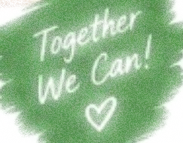

Join Us
In building a
Stronger, healthier
And brighter
Community!
Brighter
Tomorrow
Community Project

Slide 9








Get in Touch
We’d love to hear from you!
+1(565) 123-4567
Follow
Our Journey
brightertomorrow@community.org
123 community lane,
Hopeville, CA 90210
www.brightertomorrow.org

Slide 10

Our Vision
A future where every person
Has the opportunity to learn
Be healthy, and live in clean.
Safe and supportive community.
Better People
Better Communities
A Brighter Tomorrow

Slide 11

Our Mission
To empower individuals and
Communities through education,
Health, and environmental initiative
That create lasting, positive change.
Education
Support
Protect
Build

Slide 12
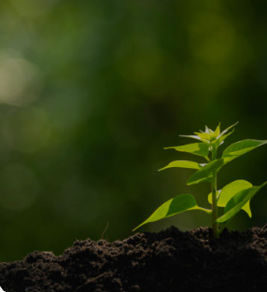
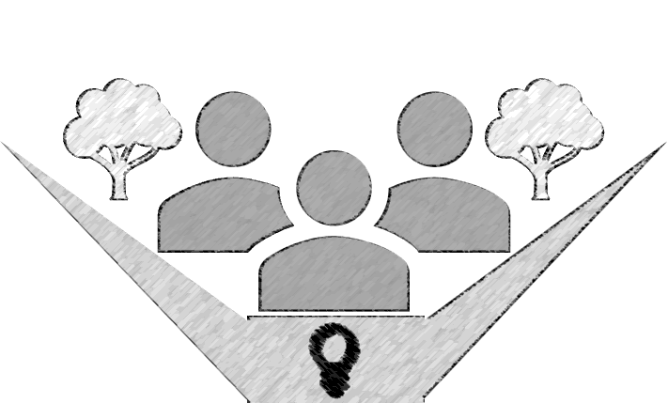
Thank you
For being part of
The change!
Brighter
Tomorrow
Community Project
EDUCATION HEALTH ENTERTAINMENT COMMUNITY

