Slide 1
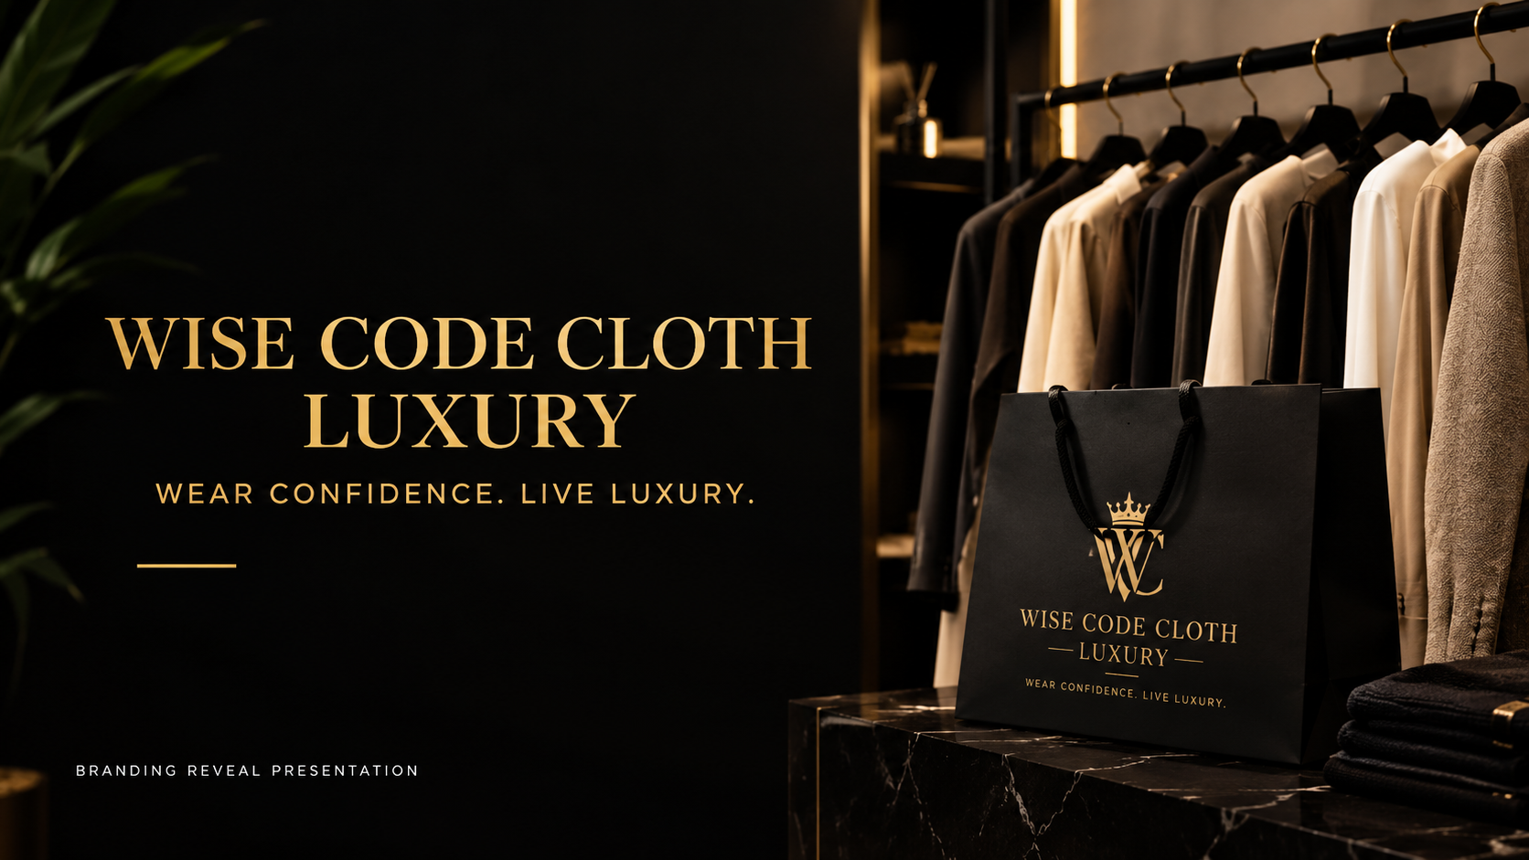

Slide 2

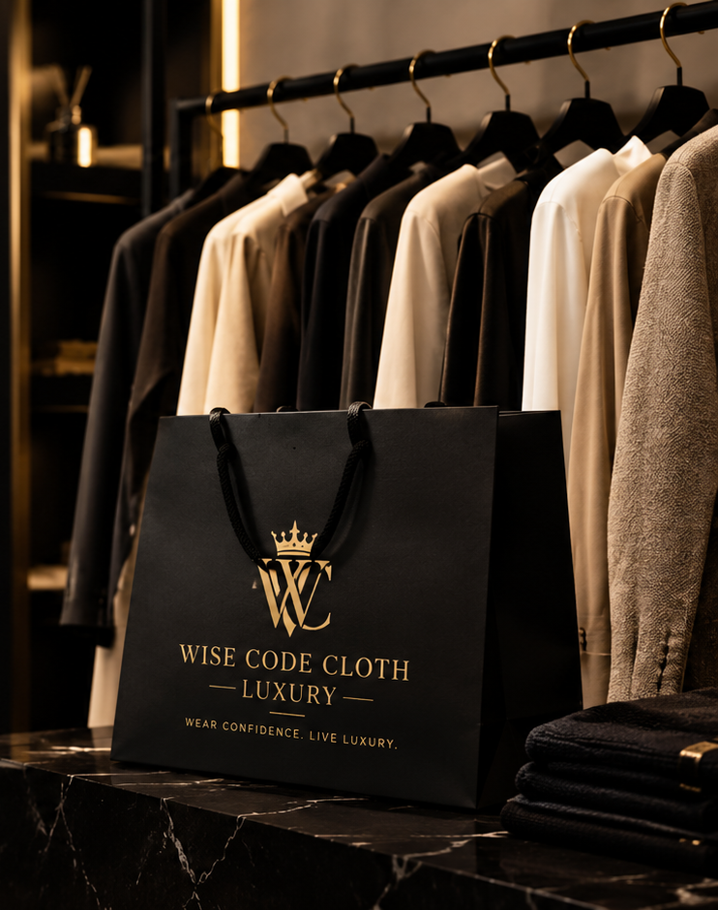

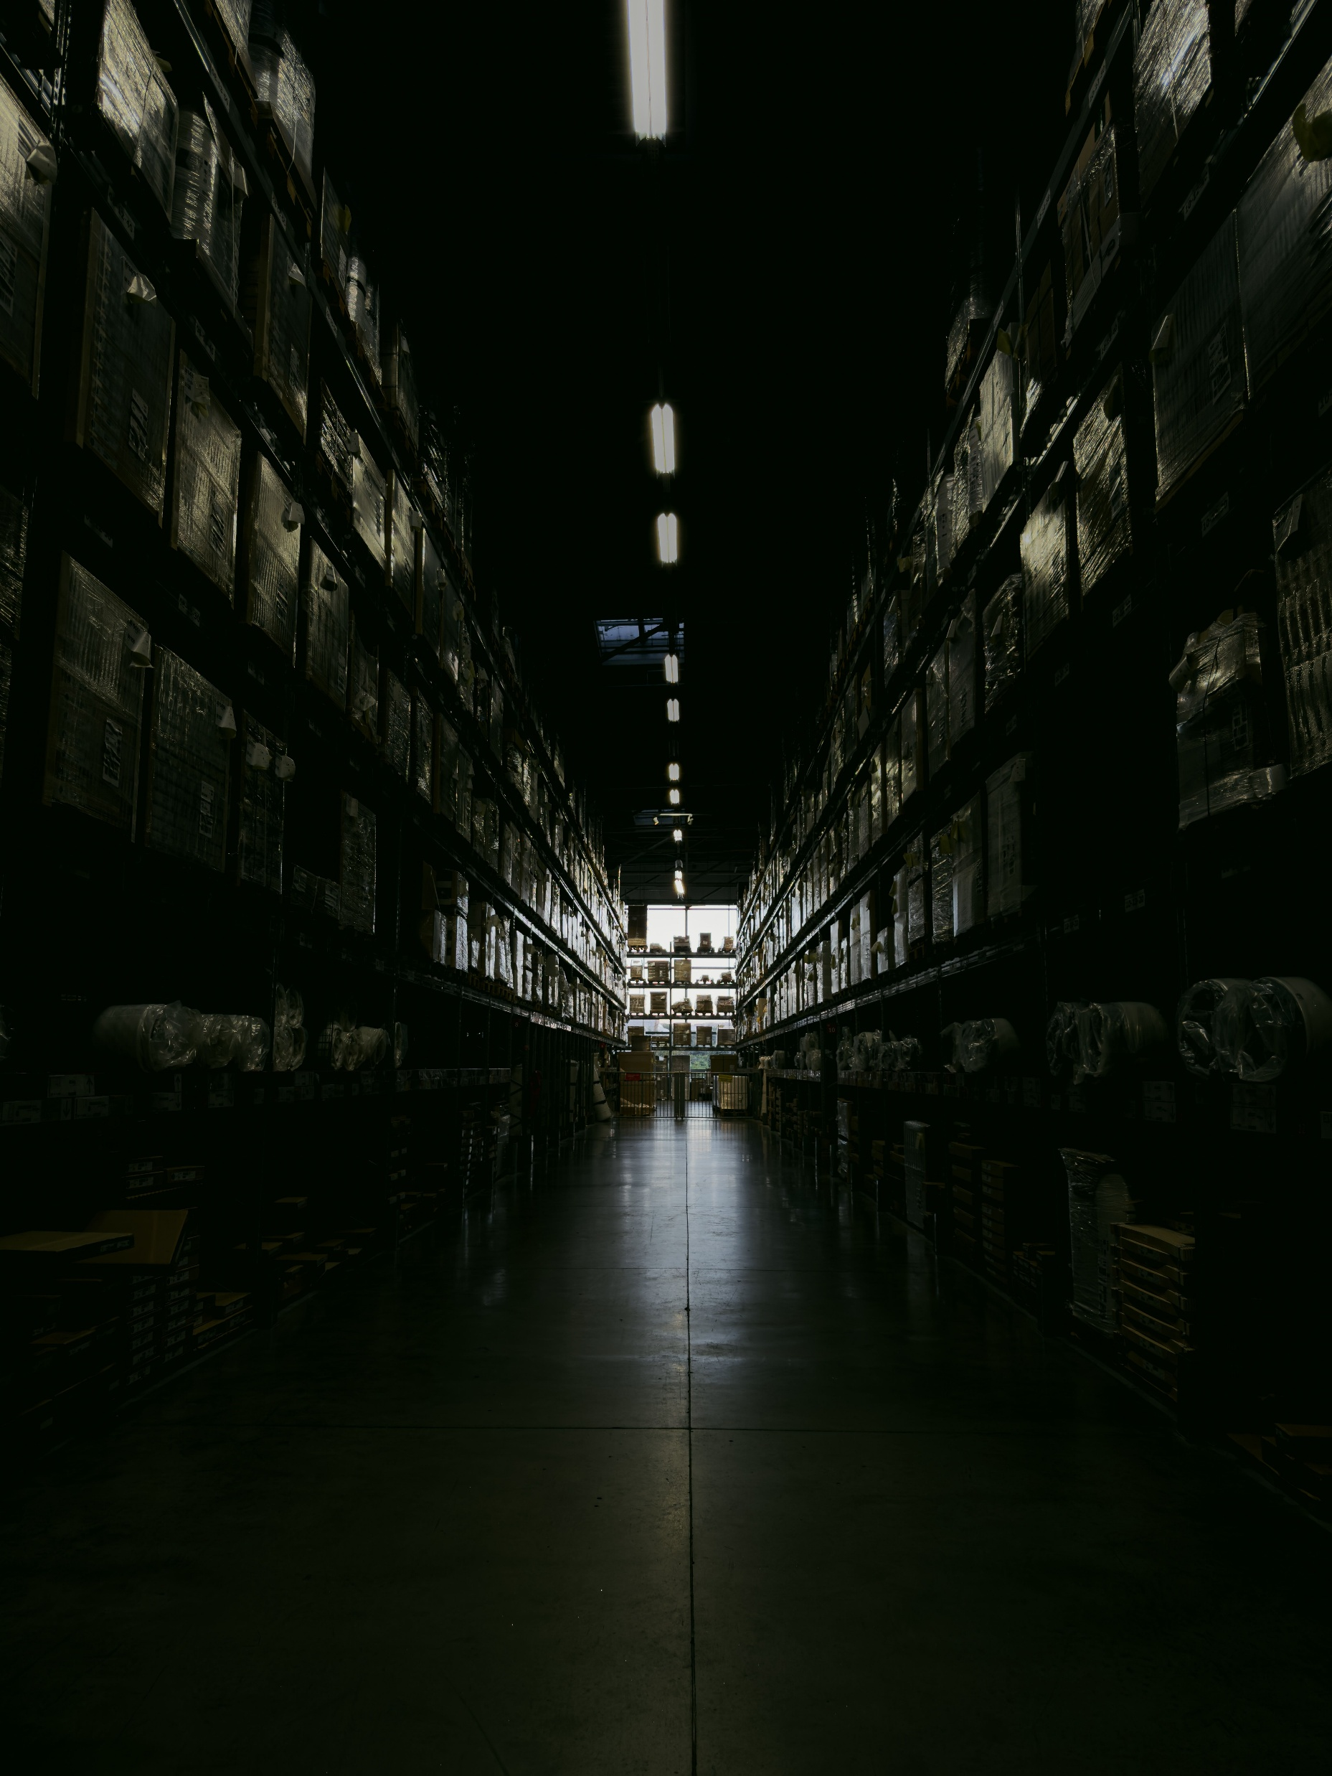
WISE CODE CLOTH
LUXURY
WEAR CONFIDENCE. LIVE LUXURY.
BRANDING REVEAL PRESENTATION

Slide 3

WISE CODE CLOTH
LUXURY
WEAR CONFIDENCE. LIVE LUXURY.
BRANDING REVEAL PRESENTATION

Slide 4
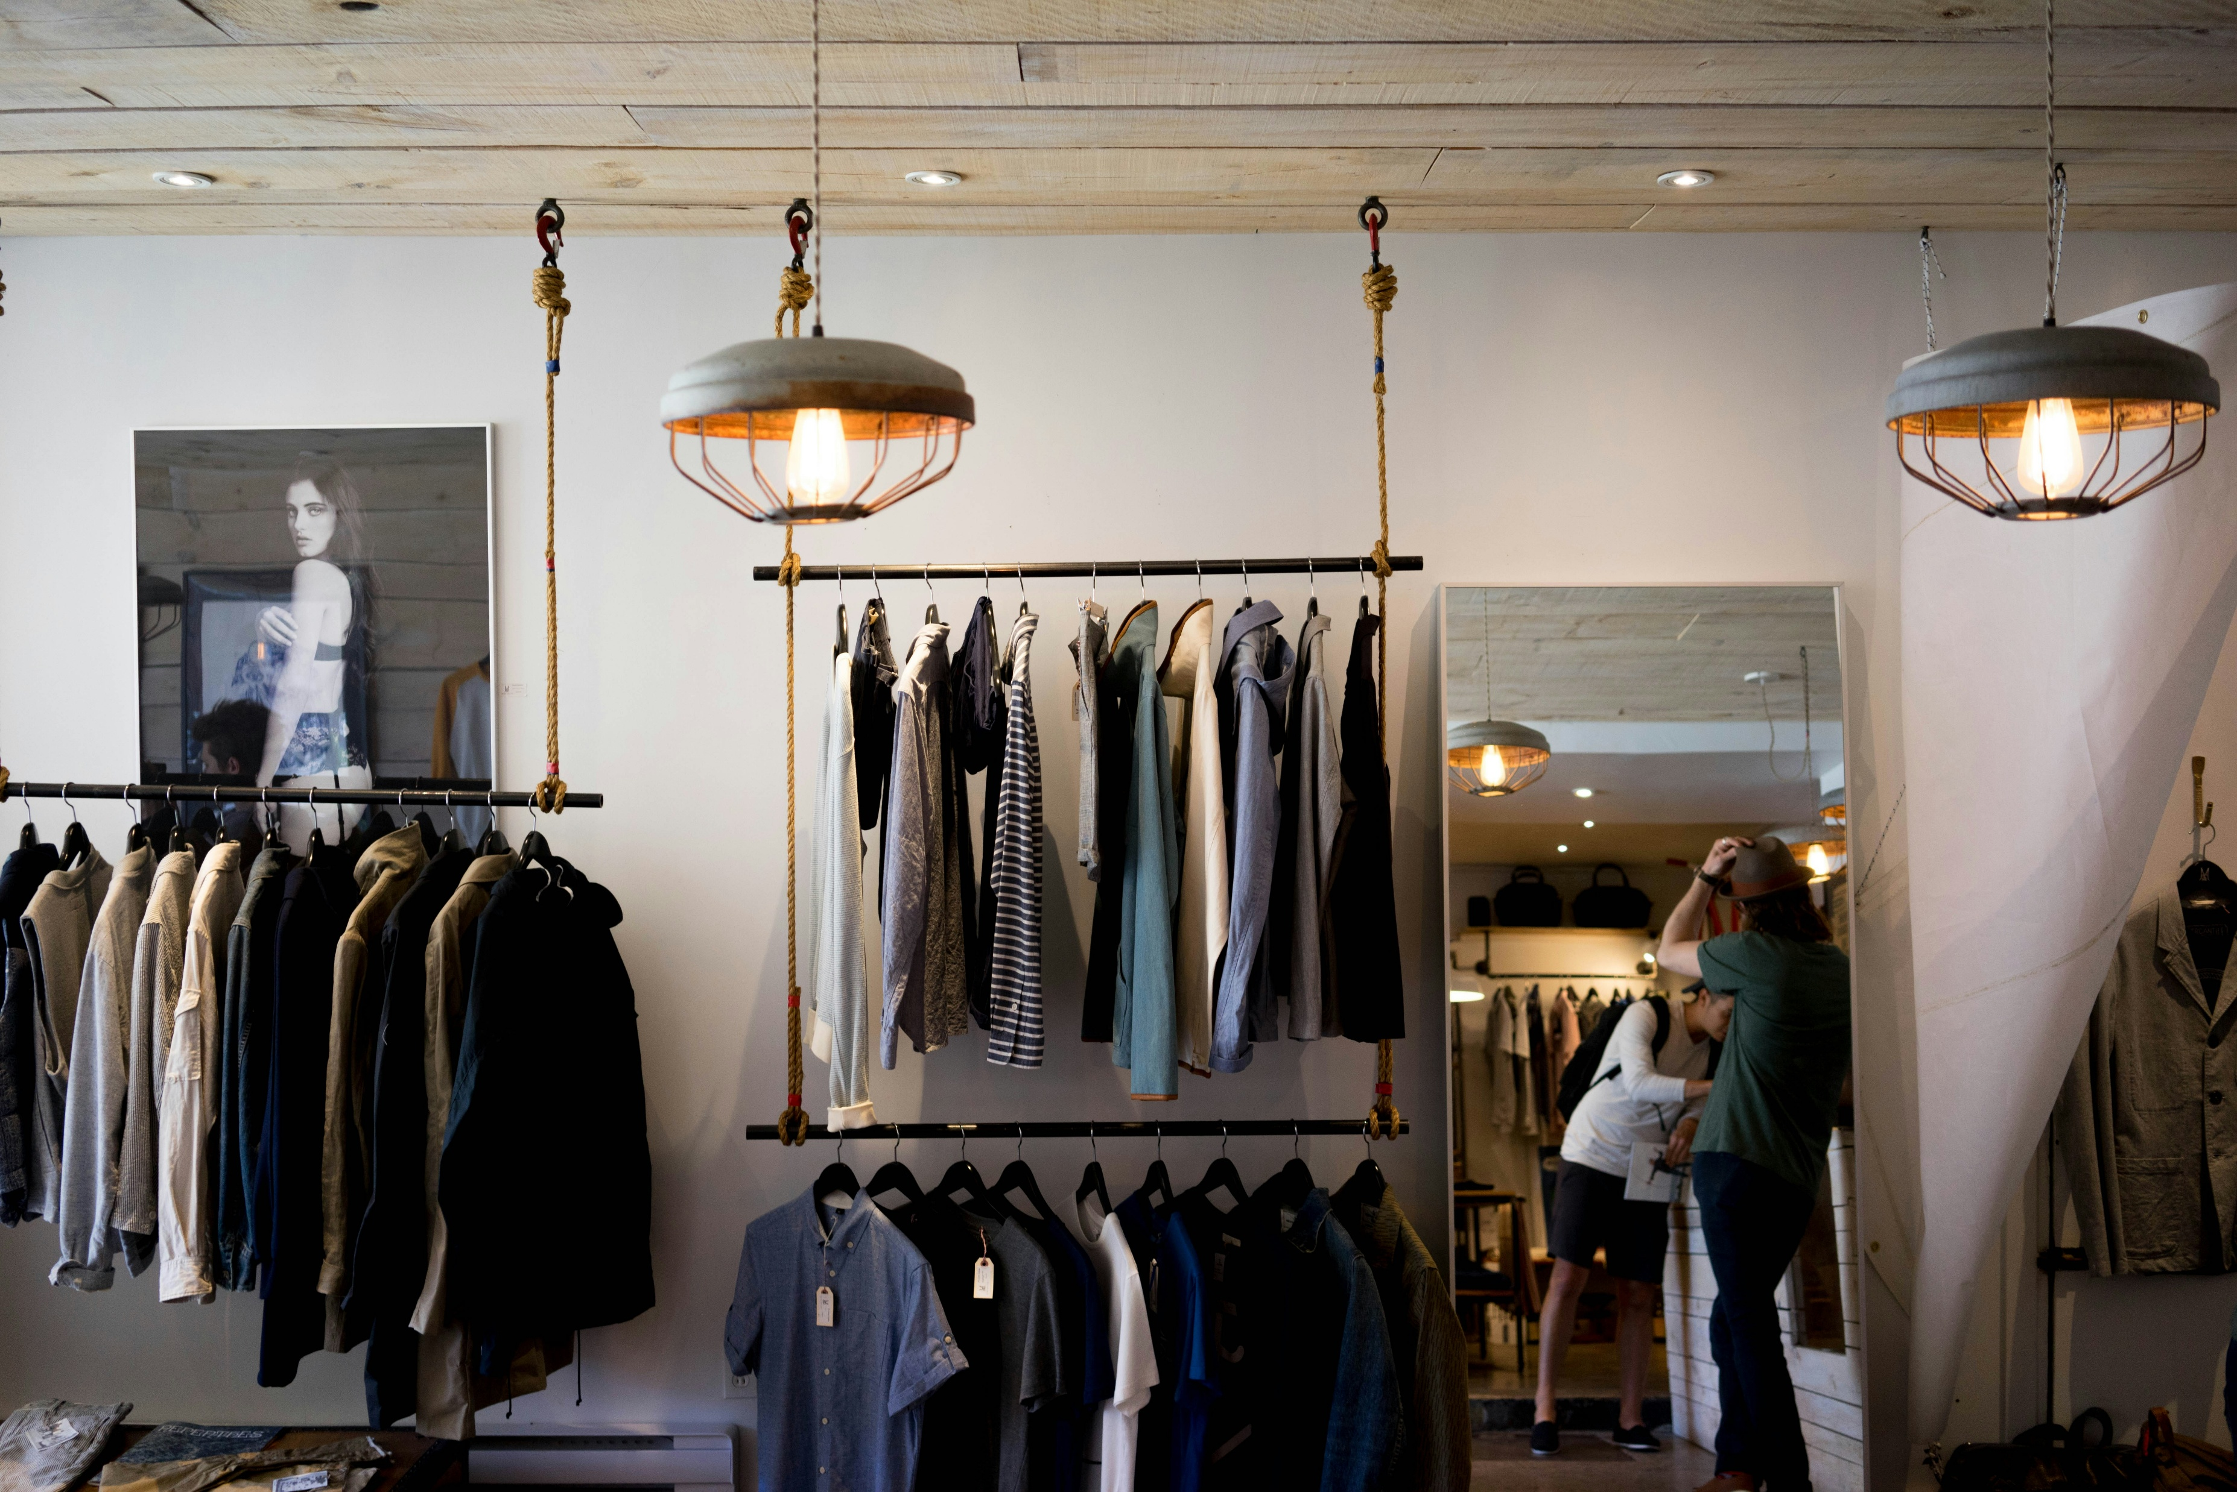




01
About the Brand
Wise Code Cloth Luxury
A Code Cloth Luxury is a premium
Clothing brand design for individuals
Who value style, Comfort and quality.
We offer modern, timeless pieces that
blend elegance with everyday wear,
helping you look good, feel good, and
Make a statement- always
Premium
Quality
Modern
Styles
Timeless
Elegance
For Every
you

Slide 5
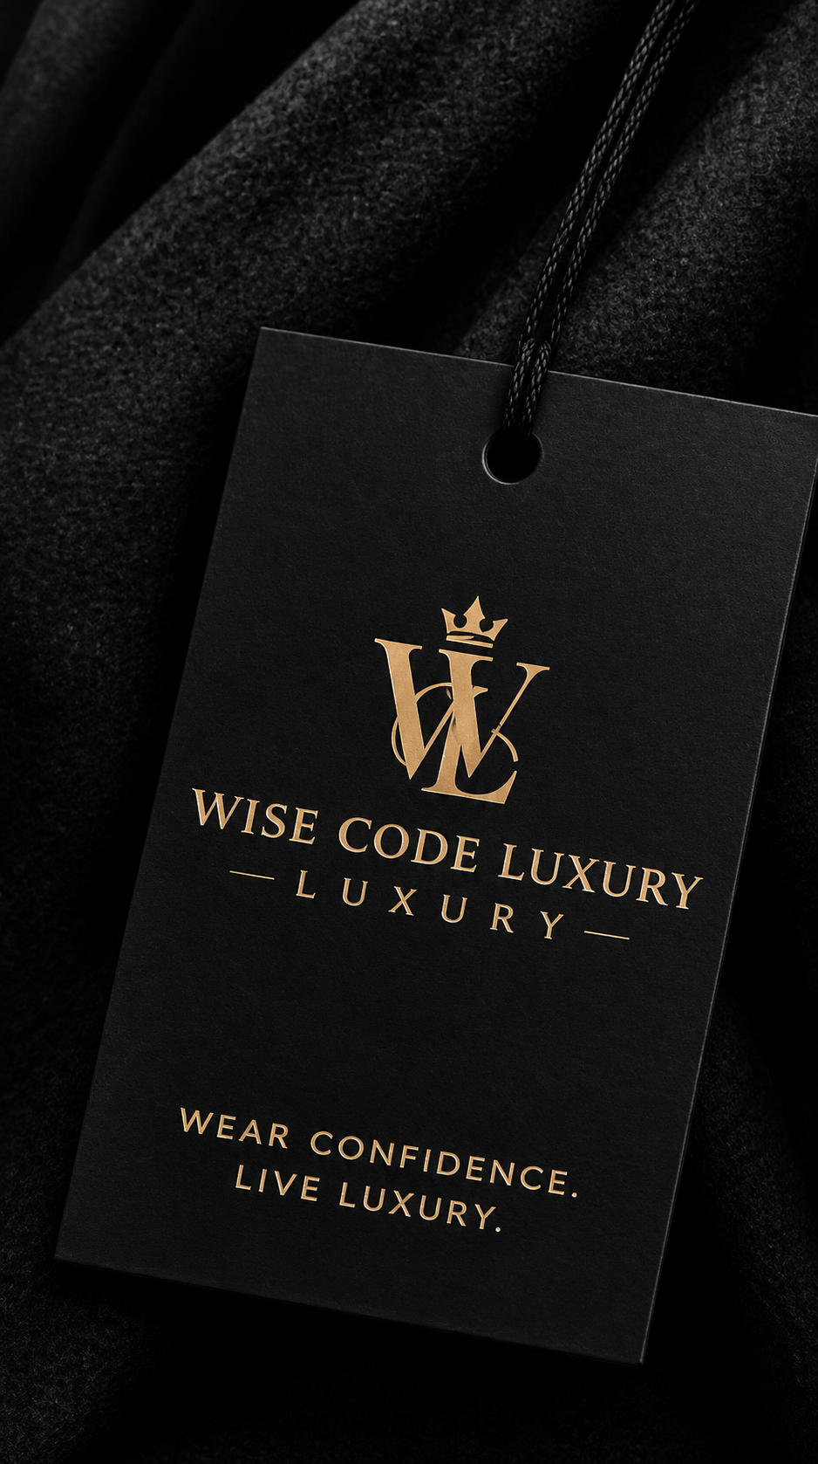

02
Our Mission
To provide high-quality, stylish and comfortable clothing that empowers individuals to express their unique identity, while delivering excellent customer service and lasting value.

Slide 6



03
Our Vision
To become a globally recognized luxury
clothing brand, known for its exceptional
quality, innovative styles and positive
Impact, inspiring confidence and elegance
in people around the world.

Slide 7

04
Our Cored Values
What We Stand For
Quality
Confidence
Style
Customer Care
We never
Compromised on the Quality of our
products.
We help you
feel good and
be your best
self.
We bring you
Modern, versatile
and timeless
fashion.
Your satisfaction
is our priority.

Slide 8
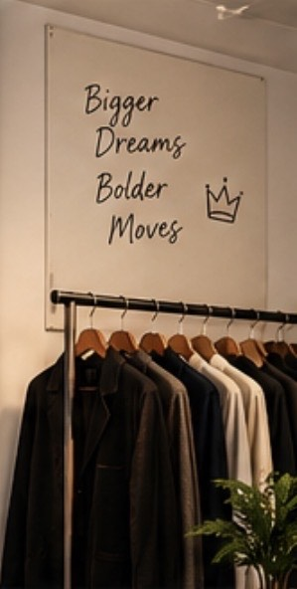
05
Our Goals
The Road Ahead
1
Launch the brand with a strong online presence and unique collection
2
Build a loyal customer community and
strong brand awareness.
3
Expand to physical stores and partner with trusted relatives.
4
Introduce sustainable and eco-friendly practice in our production and packaging.
5
Grow into a global brand. Known for quality.
Style and impact.

Slide 9
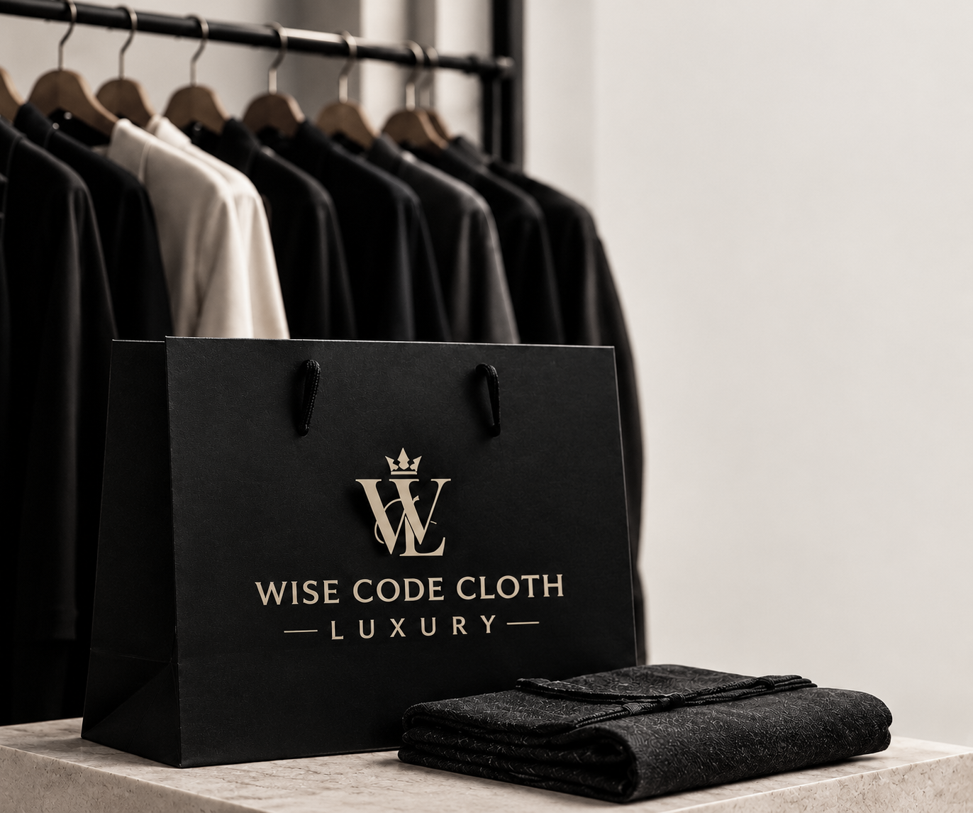
06
The Brand Reveal
Introducing
WISE CODE CLOTH
L U X U R Y
WEAR CONFIDENCE. LIVE LUXURY.

Slide 10


More than just clothing….
It’s a lifestyle.
Quality Products
Trendy
Styles
Happy
Customers
A brighter
Future

Slide 11

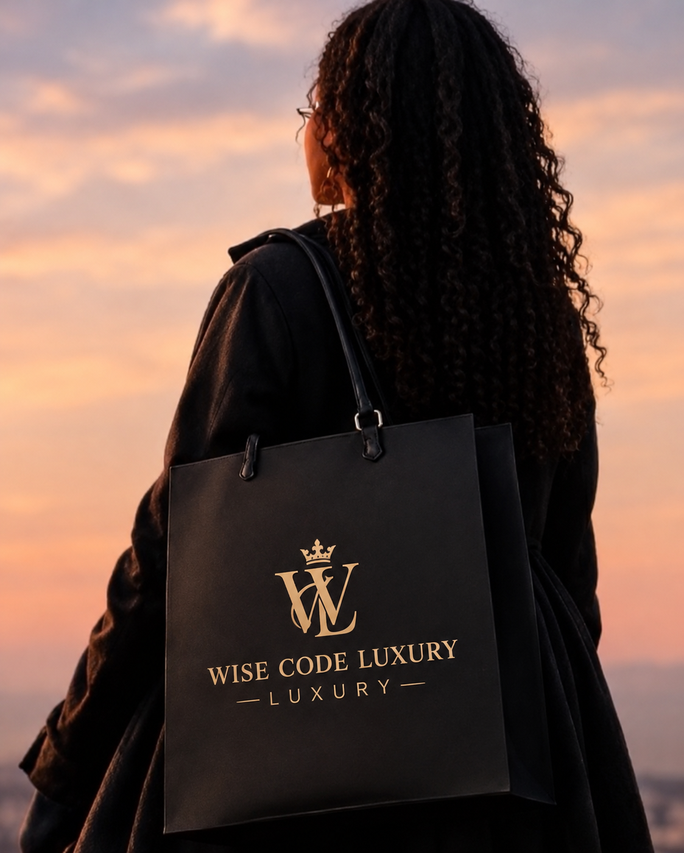
Thank You
FOR BEING PART OF
OUR JOURNEY
Together, we
Wear a better
Tomorrow.

