Slide 1
Technical Requirements

Slide 2
Artificial Intelligence
Heuristic Accelerator
Brute Force Algorithms
Machine Learning
Game Requirements
Board Games
Level Games
Puzzle Games
Maze Games
MMORPG

Slide 3
Custom learning x Engine learning
Our strategy is to implement any kind of artificial intelligence service to support games or game engines
Our main platform is the Wisebots Framework where all knowledge acquired through custom learning is incorporated
Custom learning is to develop heuristic accelerators, brute force algorithms or machine learning, according to customer needs
Engine learning is to use the knowledge gained from custom learning to create all the necessary abstractions in the Wisebots Framework

Slide 4
Wisebots services
Modeling AI for custom games
Developing API to make it easier
Developing self-learner engine
Analyzing and provide consulting for use as benefit to gain with AI

Slide 5
References
[Tesauro, 2005] State of art for Machine Learning (Backgammon)
http://www.research.ibm.com/massive/tdl.html
[MIT, 2011] State of art for MMORPG IA (Civilization)
http://web.mit.edu/newsoffice/2011/language-from-games-0712.htm
[Istoé Magazine, 2012] Commercial motivation for AI
http://web.mit.edu/newsoffice/2011/language-from-games-0712.htm

Slide 6
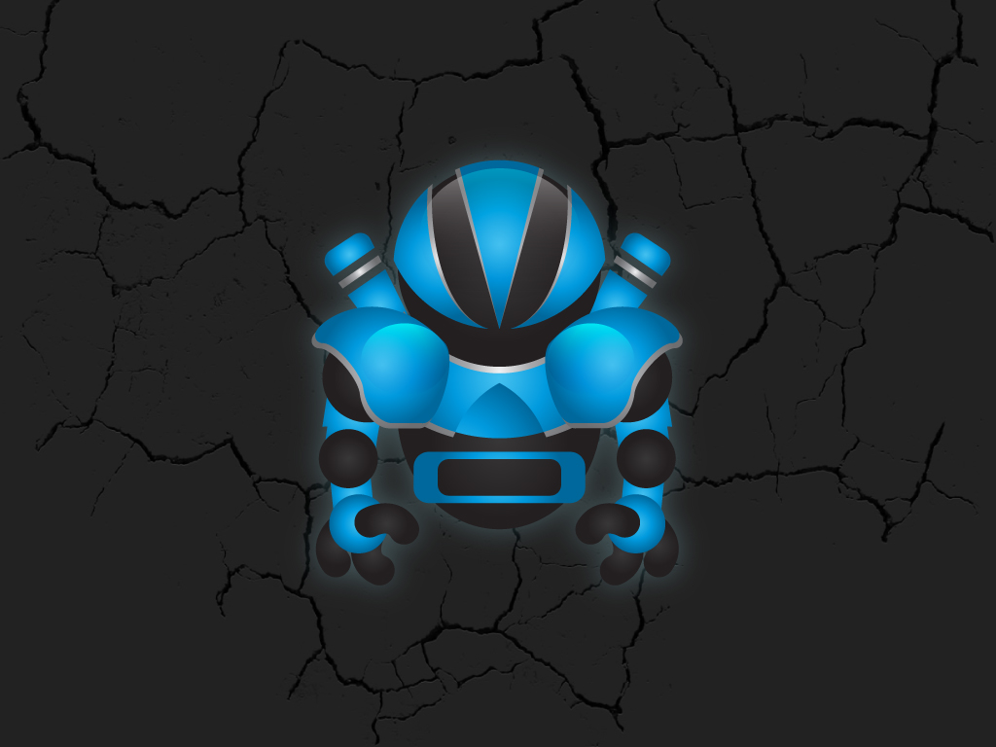
End

