Slide 1
MyRocks
DBA陈辉 chenhui13@baidu.com

Slide 2
agenda
LSM-tree/Compaction
事务
崩溃恢复
性能数据
限制

Slide 3
为什么要用LSM-tree
1 Byte Modification results in one page write (4~16KB)
InnoDB “Doublewrite” doubles write volume
B+Tree Fragmentation increases Space
压缩效率不高
  8K对齐

Slide 4
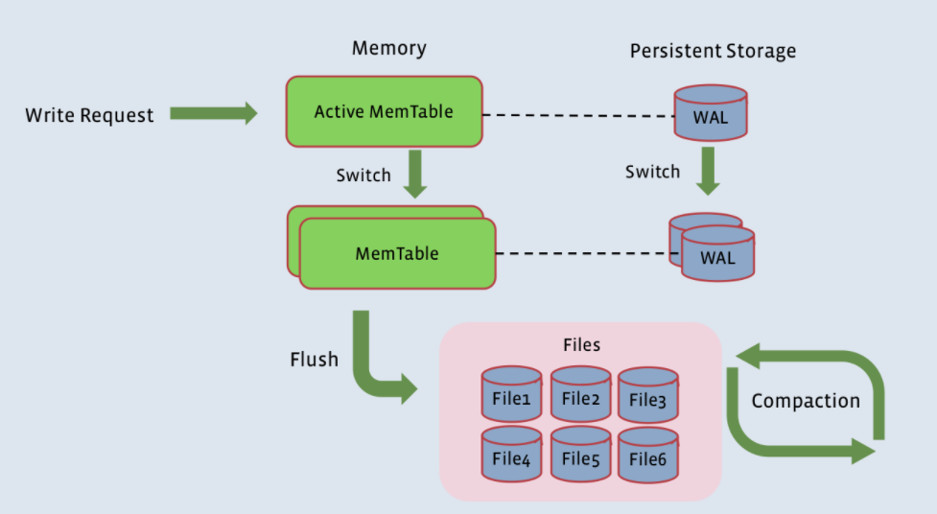
RocksDB架构

Slide 5
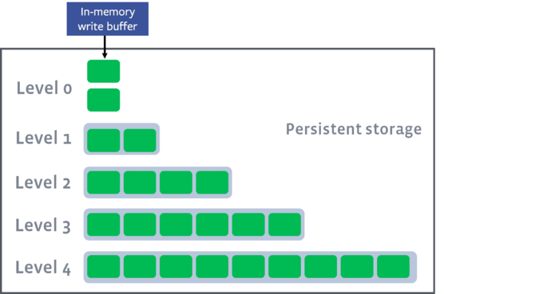
LSM-tree——磁盘文件组织方式
rocksdb在磁盘上的文件是分为多层的，分别叫做level-0, level-1等等
level0上包含的文件，是由内存中的memtable dump到磁盘上生成的，单个文件内部按key有序，文件之间无序。
其它level上的多个文件都是按照key有序的。

Slide 6
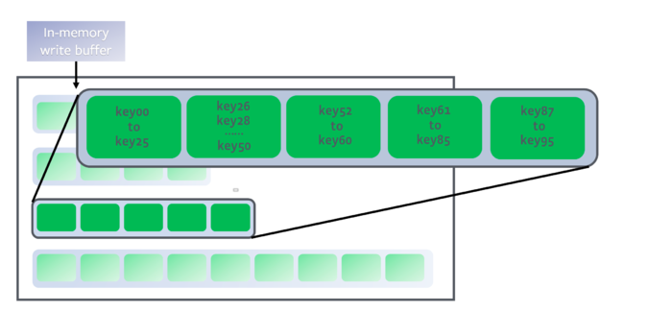
data range partition
非0 level上的key，按序分片，保存在不同的文件中。

Slide 7
key在SST文件中查找
每个level的文件都是整体有序，并且文件内有序的。要在某个level上查找某个key时：
  先根据每个文件的start/end key对所有文件进行二分查找来确定哪些文件可能包含key
  再通过二分查找在候选的文件中定位key的准确位置这是一次对一个level上所有文件的二分查找的过程。

Slide 8
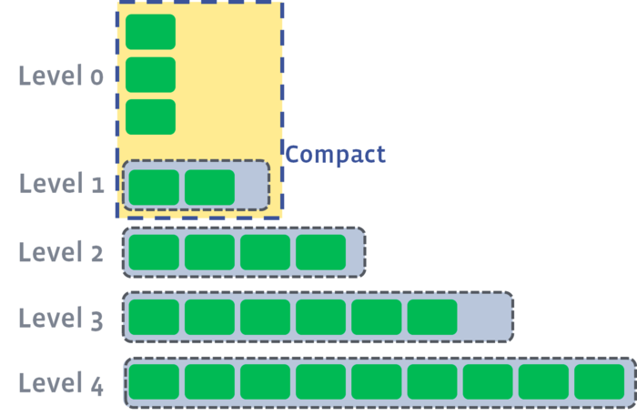
L0 campaction
当L0的文件数量达到level0_file_num_compaction_trigger的值时，触发L0和L1的合并。
通常必须将所有L0的文件合并到L1中，因为L0的文件的key是有交叠的(overlapping)。

Slide 9
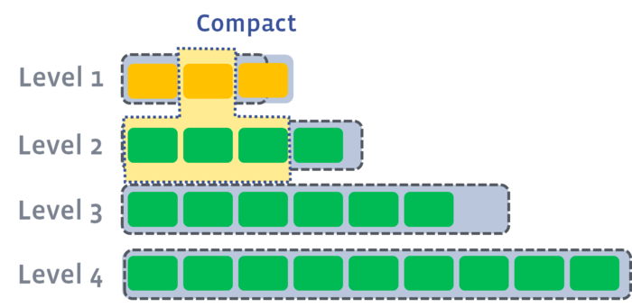
Ln(n>=1) compaction
当L0 compaction完成后，L1的文件总size或者文件数量可能会超过阈值，触发L1向L2的合并。
从L1至少选择一个文件，合并到L2中key有交叠的文件中。

Slide 10
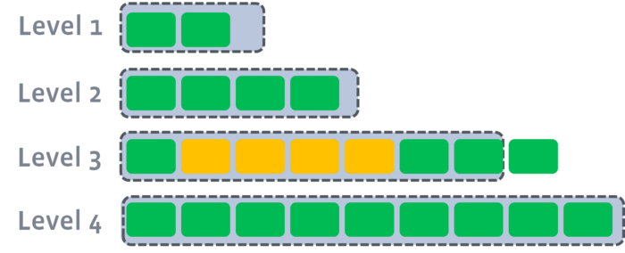
Ln(n>=1) compaction
同样的，合并后可能会触发下一各level的compaction。

Slide 11
agenda
LSM-tree/Compaction
事务
崩溃恢复
性能数据
限制

Slide 12
Transactions
General purpose transaction supports are implemented
  BEGIN; COMMIT; ROLLBACK
    ▪ SAVEPOINT (modifying rows) is not supported
  START TRANSACTION WITH CONSISTENT SNAPSHOT;
  Read Committed and Repeatable Read isolation levels
  SELECT FOR UPDATE and SELECT LOCK IN SHARE MODE
  Non locking reads do not hold read locks
  Controllable durability (2pc with binlog, no 2pc, sync/async per commit)
Gap Lock is not implemented
  Important Limitation: Row Based Binary Logging (RBR) must be used on master

Slide 13
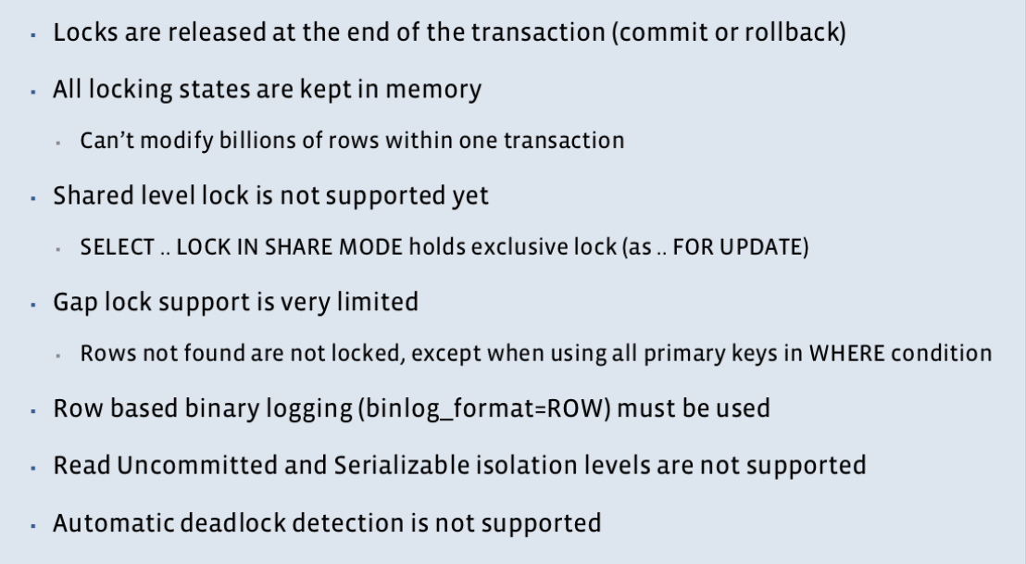
MyRocks Row Locking

Slide 14
Transaction Isolation
MyRocks transaction isolation implementation is close to PostgreSQL’s style – snapshot isolation
  Behavior is very close, though there are some minor differences
There are some behavior differences between InnoDB and PostgreSQL/MyRocks
Locking reads (UPDATE, SELECT FOR UPDATE, etc) read current data in InnoDB, regardless of isolation levels
Locking reads in MyRocks and PostgreSQL read from snapshot
  Read Committed: Snapshot is created at each statement
  Repeatable Read (PostgreSQL): Snapshot is created at the beginning of the transaction
  Repeatable Read (MyRocks): Snapshot is created at the first statement of the transaction

Slide 15
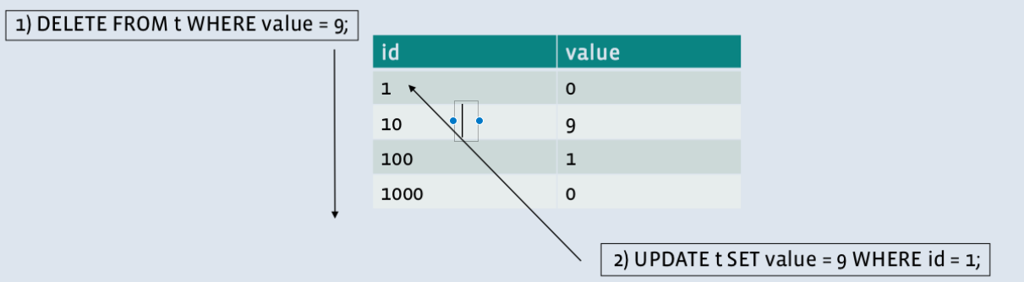
Why lack of Gap Lock support needs RBR
1)Checked id = 1 first, not matched, unlocking if gap lock is not supported
2) Updated value = 9 where id = 1, committed, written to binlog
1) Finished delete statement. id=10 was deleted. Written to binlog
Final Result: id=1 exists, value=9. id=10 was deleted
Binary log:
1. UPDATE t SET value = 9 WHERE user_id=1;
2. DELETE FROM t WHERE status = 9;
=> Both id=1 and 10 are deleted on slaves

Slide 16
Queries relying on Gap Lock – pt-table-checksum
REPLACE INTO percona.checksums SELECT * FROM app_tables WHERE key > X andkey<Y;
Running the same statement on both master and slaves via replication, then comparing results (checksums)
This relies on Gap Lock so it doesn’t work with MyRocks
We’re checking table checksum with different algorithm at Facebook

Slide 17
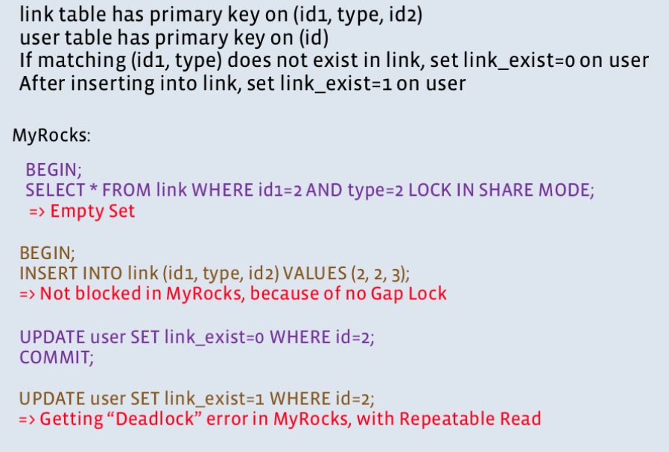
Queries relying on Gap Lock – empty check

Slide 18
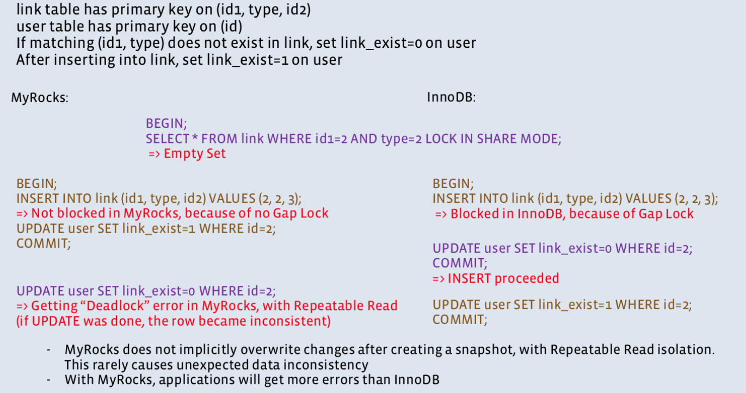
Queries relying on Gap Lock – empty check

Slide 19
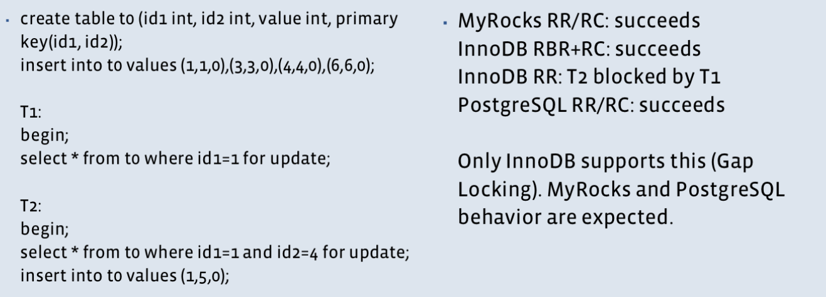
Locking rows that do not exist

Slide 20
agenda
LSM-tree/Compaction
事务
崩溃恢复
性能数据
限制

Slide 21
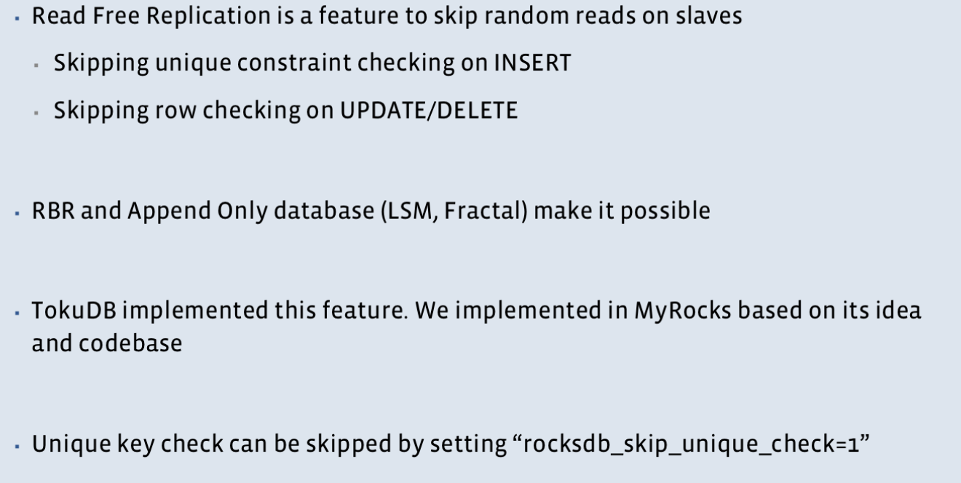
Reed Free replication

Slide 22
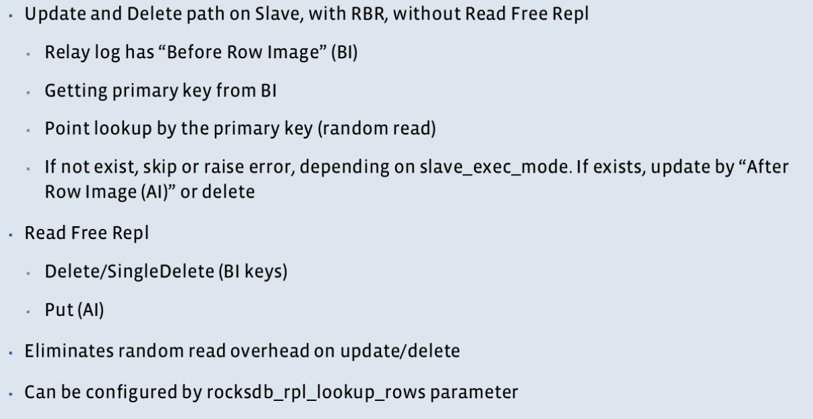
Reed Free replication--Avoid lookup rows

Slide 23
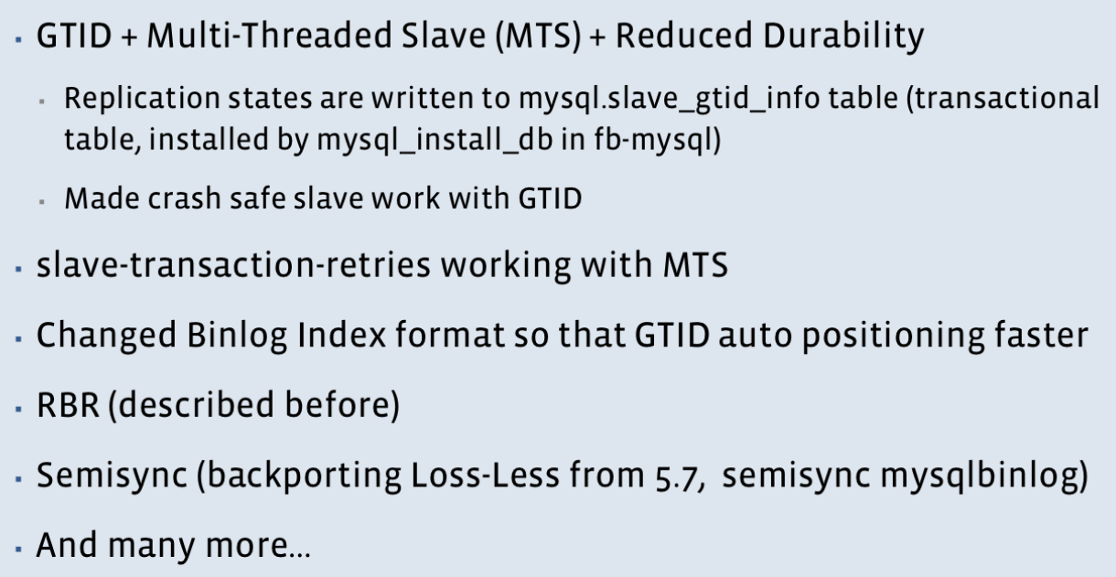
Facebook’s Replication Extentions

Slide 24
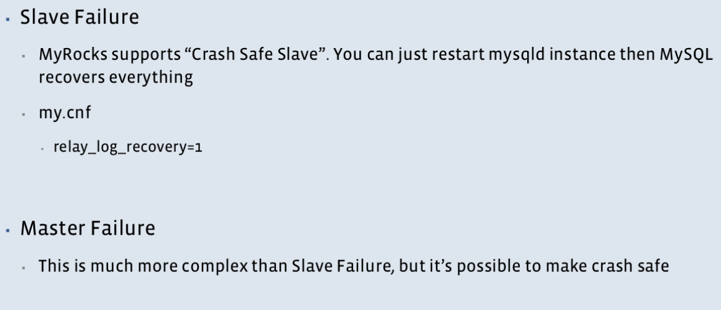
Crash Scenario and how to recover MyRocks

Slide 25
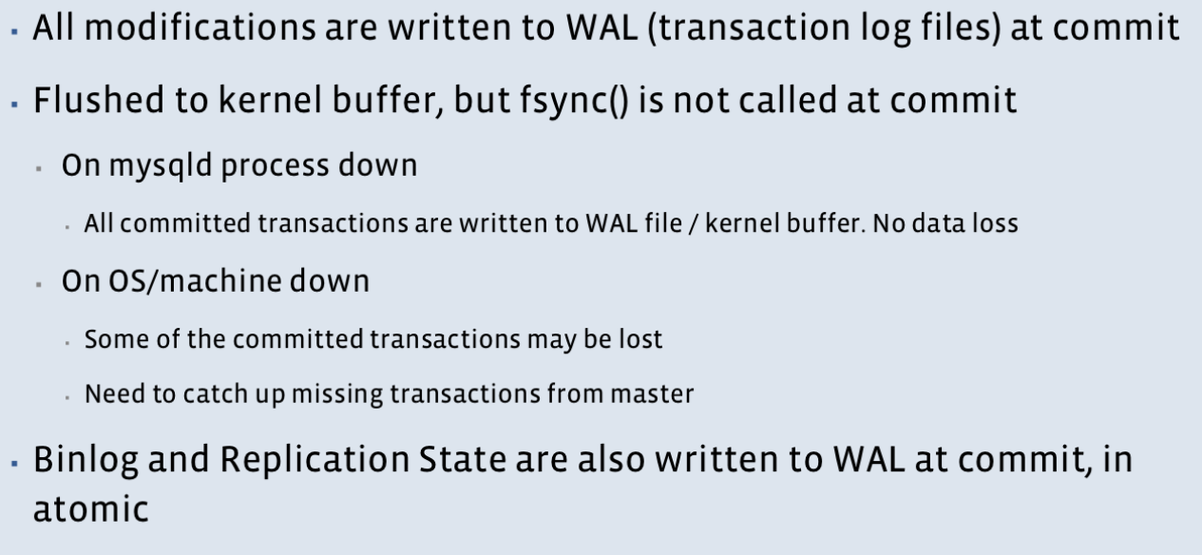
How crash recovery works

Slide 26
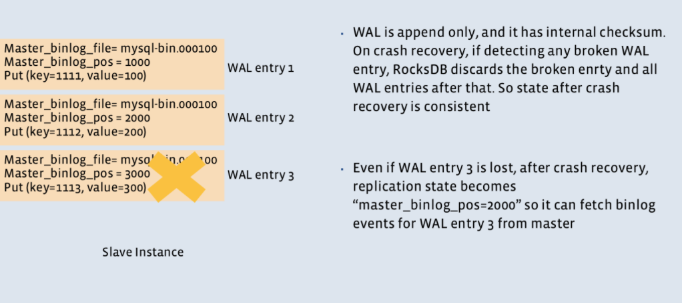
Crash safe MyRocks on slaves

Slide 27
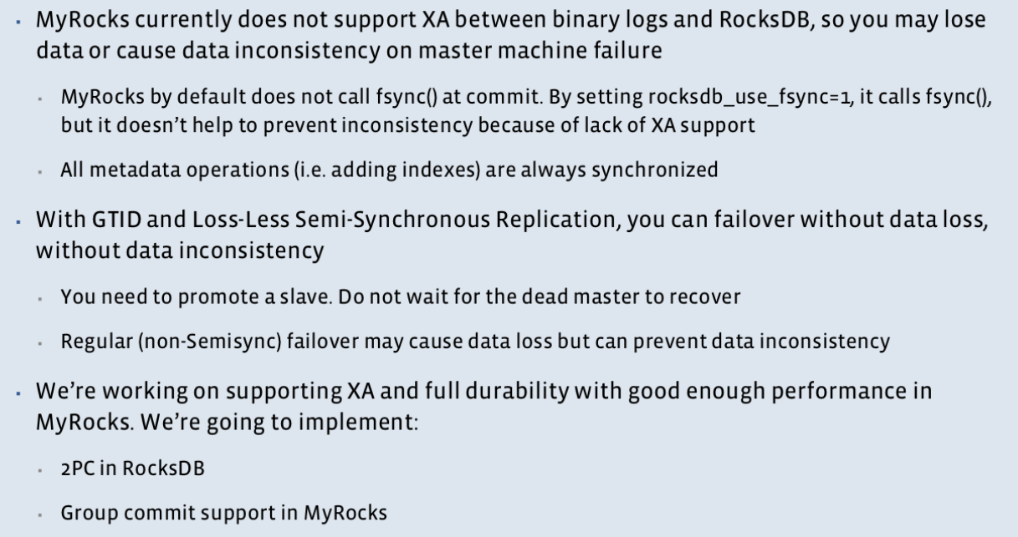
MyRocks limitations around crash safety

Slide 28
agenda
LSM-tree/Compaction
事务
崩溃恢复
性能数据
限制

Slide 29
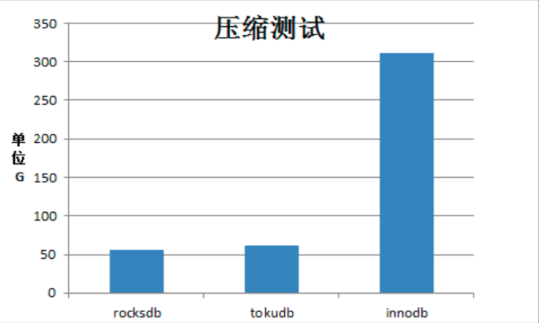
MyRocks特性——压缩

Slide 30
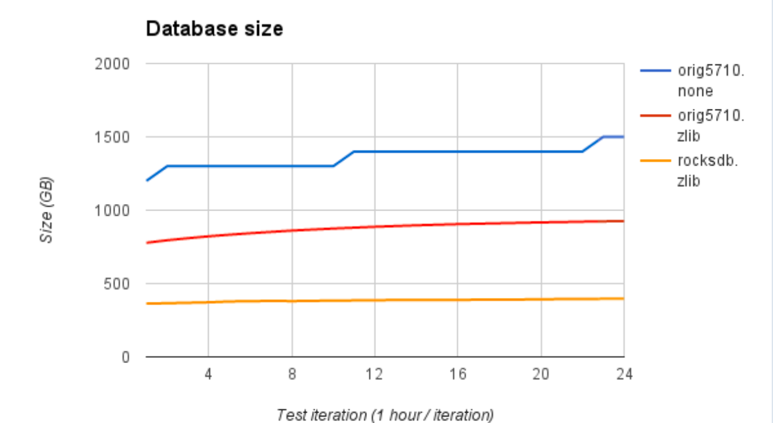
压缩——database size

Slide 31
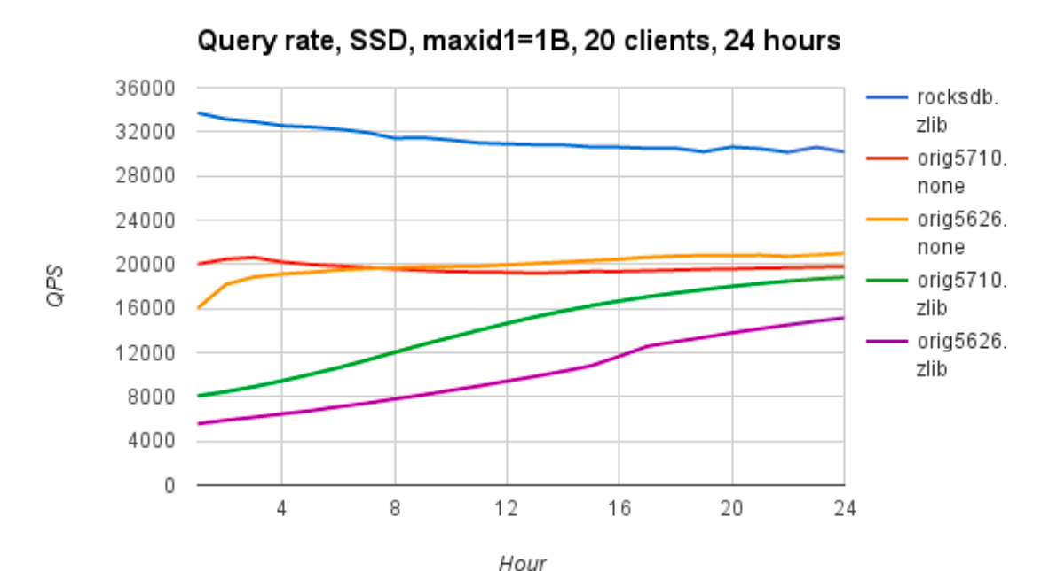
QPS

Slide 32
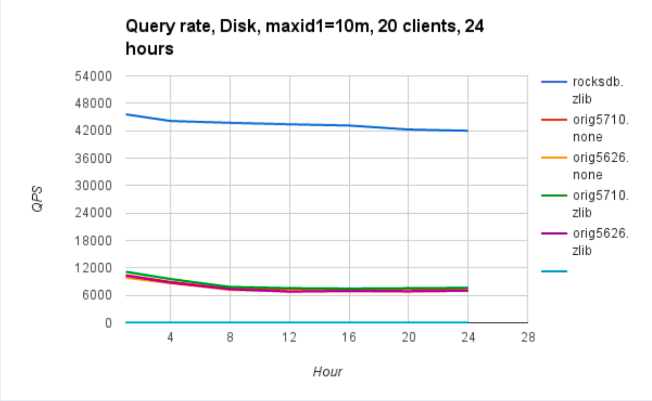
On HDD workloads

Slide 33
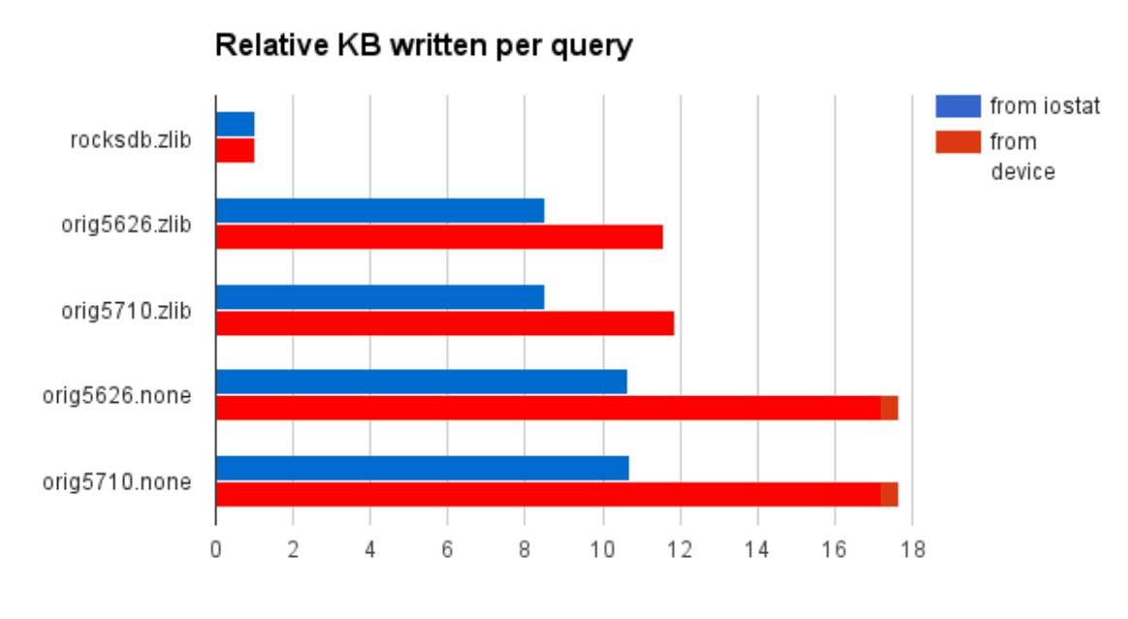
写放大——flush writes per query

Slide 34
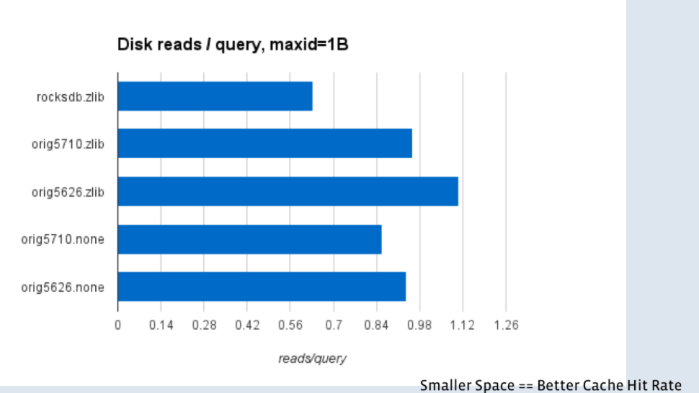
读放大——Flush read per read

Slide 35
TerakDB/MyRocks测试
压缩率：
  压缩效果较好，数据和索引总体可以压缩到原数据的1/4左右。
  Innodb原生压缩只能达到1/2。比tokudb压缩率高30%以上。
读性能：
  随着内存和磁盘数据比值的改变，读性能在各种场景下表现略有不同，
  用百度知道业务流量测试读性能是innodb的1.5倍。
  模拟数据最好情况下读性能比innodb好5倍左右。
  模拟数据最差的情况下（全内存访问），TerarkDB和Innodb接近。
  Range查询，多字段联合索引，group by等一些场景，TerarkDB性能比innodb差。
写性能：
  写性能好于innodb，最好情况下是innodb的2.5倍。
  百度贴吧业务：terarkDB的写性能是innodb的1. 85倍。
  利用模拟数据进行顺序写和随机写，最好情况下terarkDB是innodb写性能的2.5倍。
  使用load方式灌数据的性能比innodb要差，而且在灌入数据量非常大的情况下，compact空间占用也膨胀并导致磁盘占满。

Slide 36
agenda
LSM-tree/Compaction
事务
崩溃恢复
性能数据
限制

Slide 37
限制
The MyRocks storage engine lacks the following features compared to InnoDB:
Online DDL
ALTER TABLE ... EXCHANGE PARTITION
SAVEPOINT
Transportable tablespace
Foreign keys
Spatial indexes
Fulltext indexes
Gap locks
Group Replication
Notes:
https://www.percona.com/doc/percona-server/LATEST/myrocks/limitations.html

Slide 38
Q&A
谢谢！

