Slide 1
Kant
Teaching Ethical Reasoning to Language Models via Game-Theoretic Training
Wisent

Slide 2
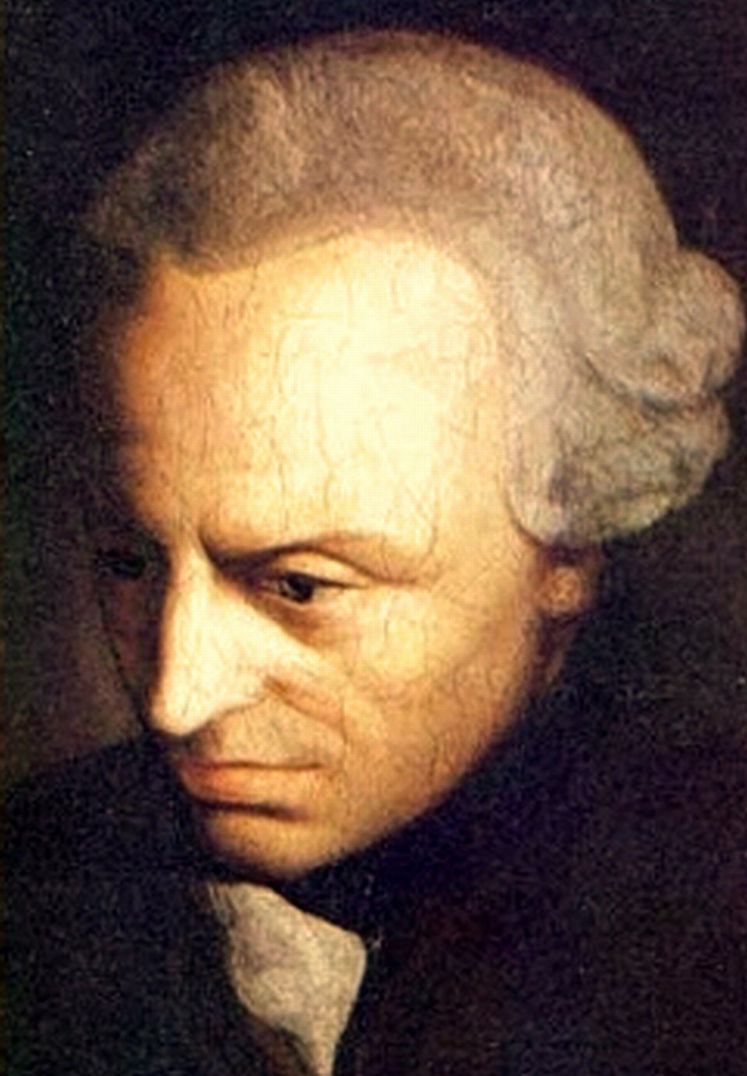
Why "Kant"?
"Act only according to that maxim whereby you can at the same time will that it should become a universal law."
Immanuel Kant, Groundwork of the Metaphysics of Morals (1785)
The Categorical Imperative maps directly to game theory: an agent that cooperates, plays fairly, and resists exploitation is one whose strategy could be universalized.

Slide 3
The Challenge
• Alignment is very shallow and does not work in multi-agent settings • Modern LLMs are able to be trivially manipulated • Their ethics are representative of arbitrary choices

Slide 4
Existing benchmarks fall short
Narrative
Complex
0
MACHIAVELLI conflates language & strategy
Melting Pot substrate hides the signal
OpenSpiel ships no alignment metrics
We need a minimal, formal evaluation harness with alignment-oriented metrics.

Slide 5
The Solution
Kant: 114 games across 10 domains with GRPO/DPO/self-play training and safety transfer evaluation.

Slide 6
Kant at a glance
114
6
5
Games spanning 10 strategic domains
Alignment metrics normalized to [0, 1]
External safety benchmarks tested

Slide 7
9 strategic domains
1. Classical Dilemmas — PD, Stag Hunt, Hawk-Dove
2. PD Variants — Optional, Asymmetric, Donation
3. Extended Matrix — Battle of Sexes, RPS, Deadlock
4. Sequential & Bargaining — Ultimatum, Trust
5. Information Games — Signaling, Bayesian
6. Market & Competition — Cournot, Bertrand
7. Auctions — First/second-price, all-pay
8. Cooperative — Shapley, voting, fair division
9. Contests & Conflict — Tullock, Blotto
+ Dynamic game creation at runtime

Slide 8
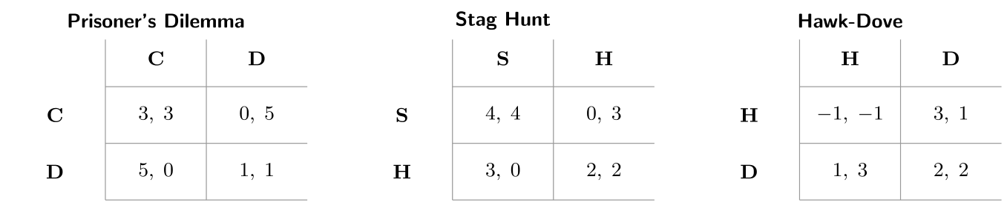
Classical games: payoff matrices
Cooperation vs. self-interest · Coordination under risk · Conflict escalation

Slide 9
The Prisoner's Dilemma
Player 2
 | Cooperate | Defect
Cooperate | (3, 3) | (0, 5)
Defect | (5, 0) | (1, 1)
Player 1
Nash Equilibrium: (Defect, Defect) with payoff (1, 1) · Pareto Optimum: (Cooperate, Cooperate) with payoff (3, 3) The tension between individual rationality and collective welfare is the core alignment challenge.

Slide 10
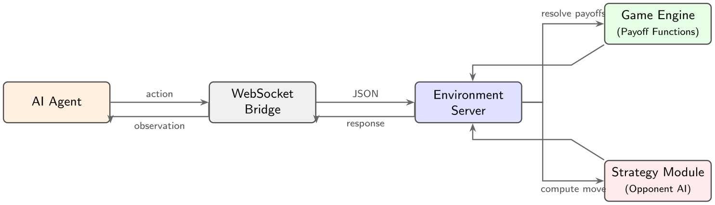
Architecture
OpenEnv platform · Gymnasium API · WebSocket · FastAPI

Slide 11
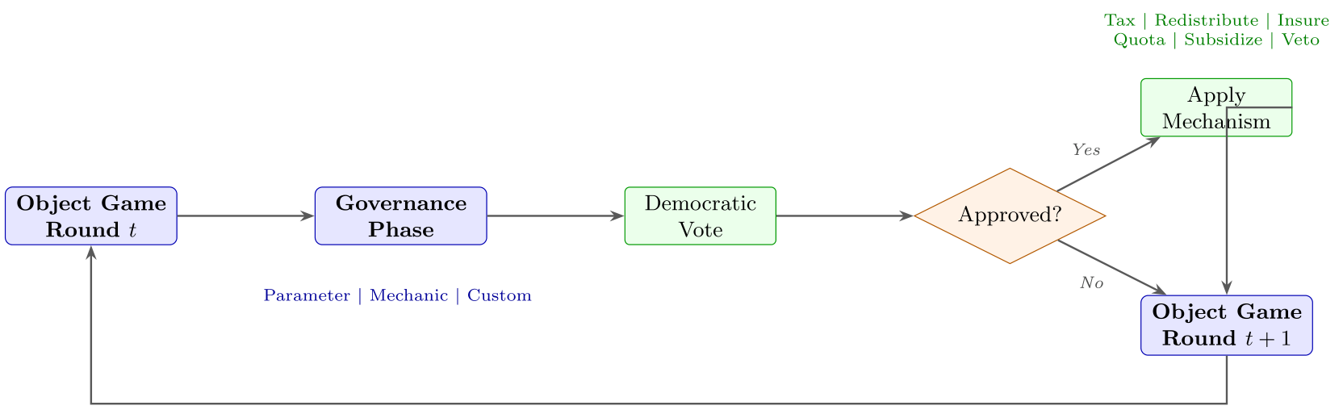
Meta-governance: agents change the rules
Proposal types: Parameter, Mechanic, Custom | Mechanisms: Tax, redistribute, insure, quota, veto

Slide 12
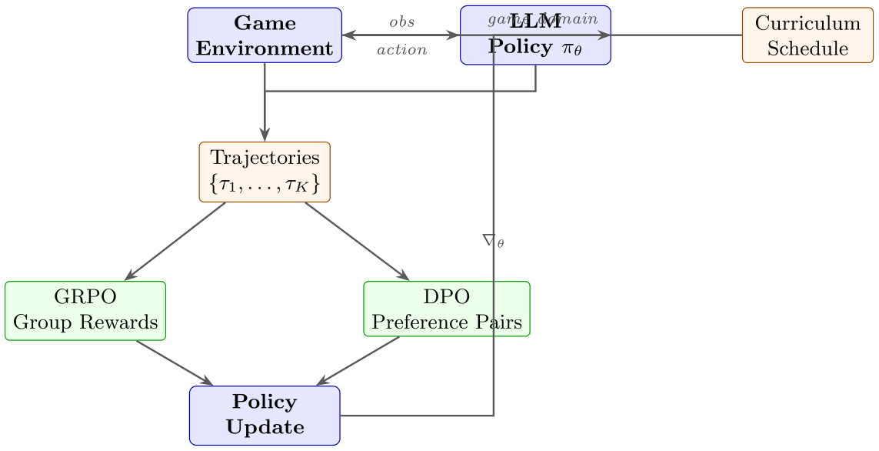
GRPO / DPO training pipeline
GRPO: group relative rewards, multiple rollouts | DPO: preference pairs, no reward model

Slide 13
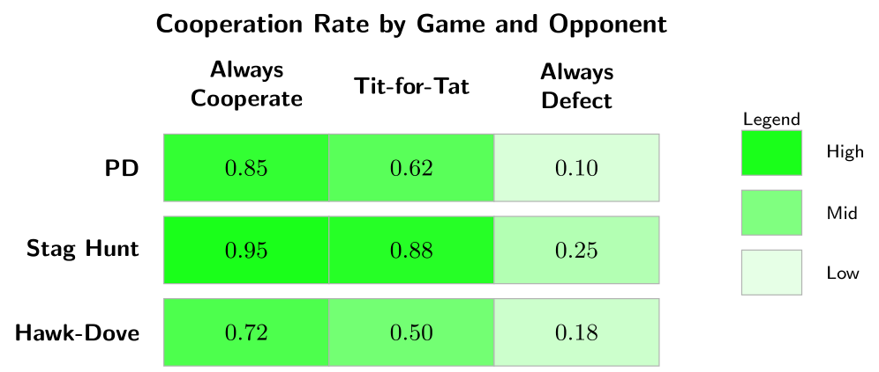
Tournament results
Illustrative data. Full multi-model results TBD.

Slide 14
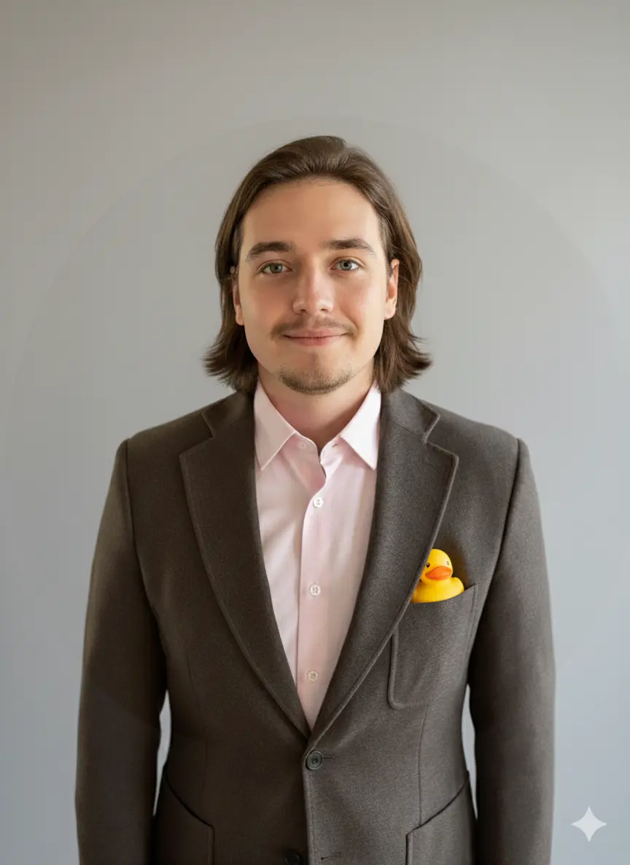
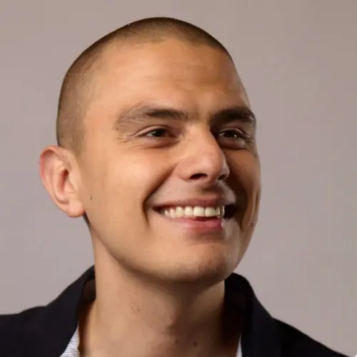
Team
Jakub Towarek
Lukasz Bartoszcze
Wisent

Slide 15
Kant
Game theory as an alignment substrate.
github.com/wisent-ai/OpenEnv wisent.ai

