Slide 1
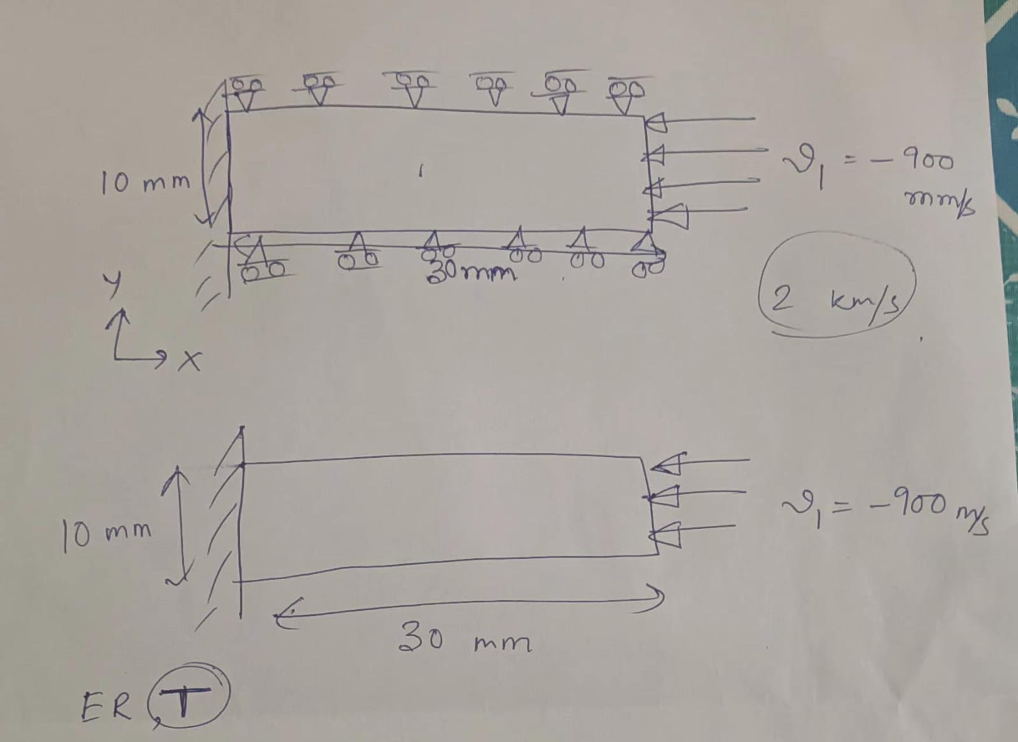
Problem
Statement:
Compression

Slide 2
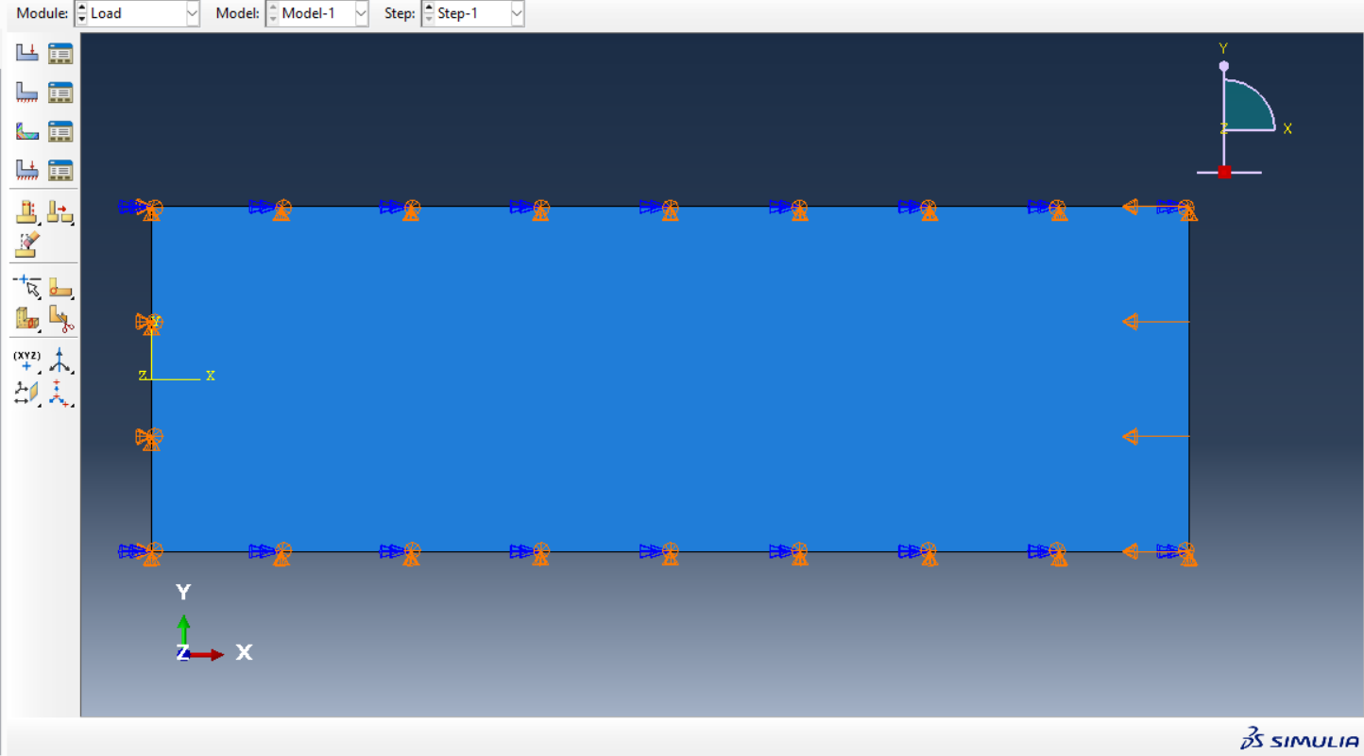

Slide 3
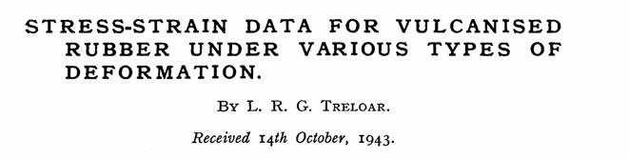
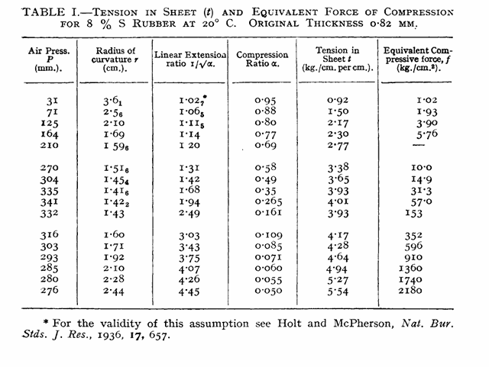
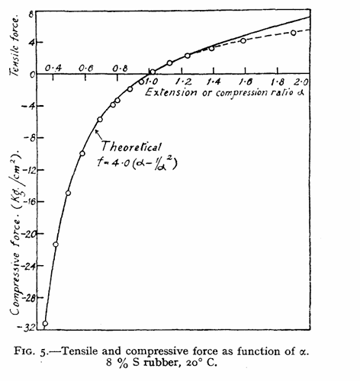
Getting Compression Data
The hyperelastic characterization in this study utilizes the classical 8% sulfur natural rubber dataset from Treloar (1944)
This dataset provides compression derived from a validated 2-dimensional inflation method over a large strain range.
The material behavior closely reflects that of nearly incompressible natural rubber, aligning with the assumptions used in the finite element model.

Slide 4
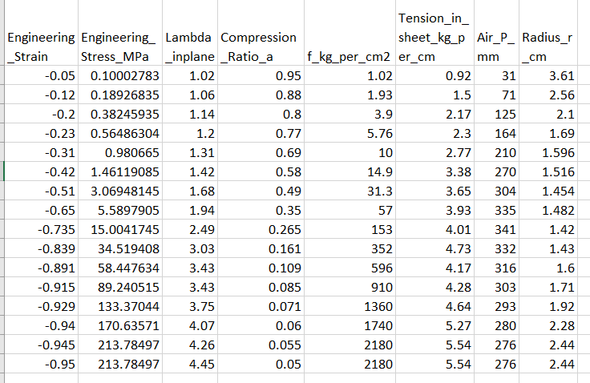
Simulating in ABAQUS for stress-strain graph and strain rate

Slide 5
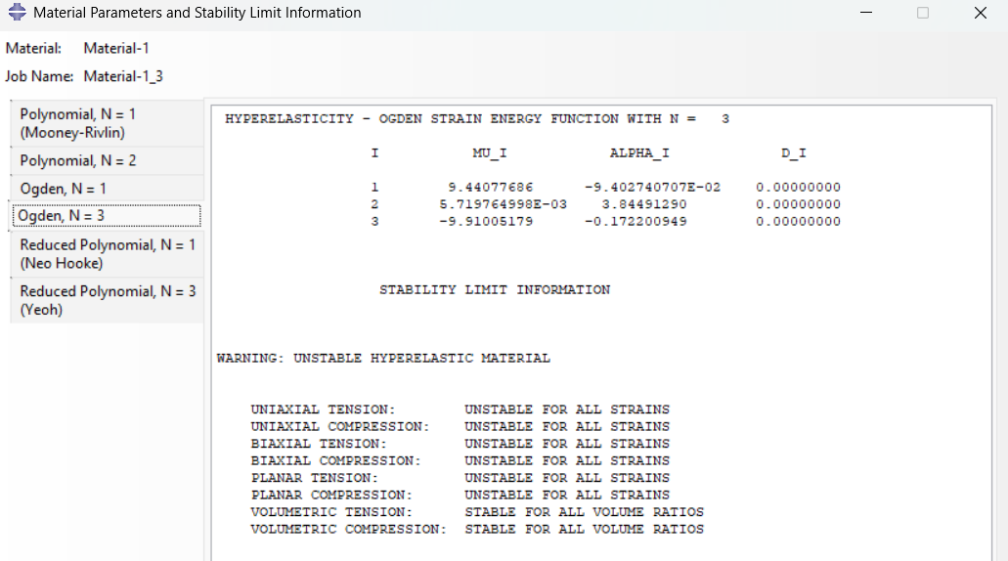
Material Unstable on evaluating on Different Models
Unstable for all these models

Slide 6
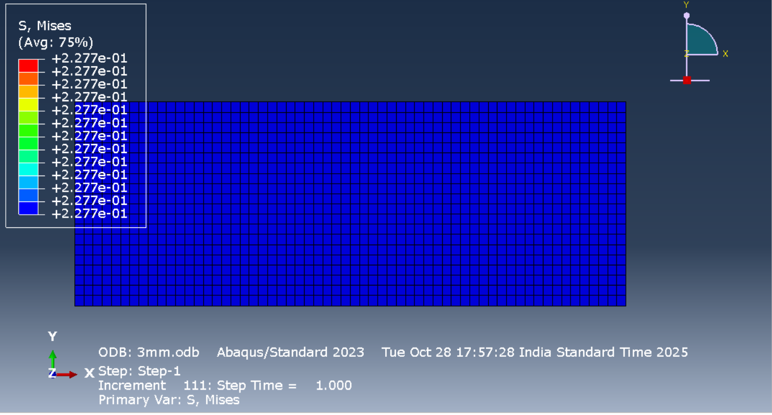
V= 3mm/s

Slide 7
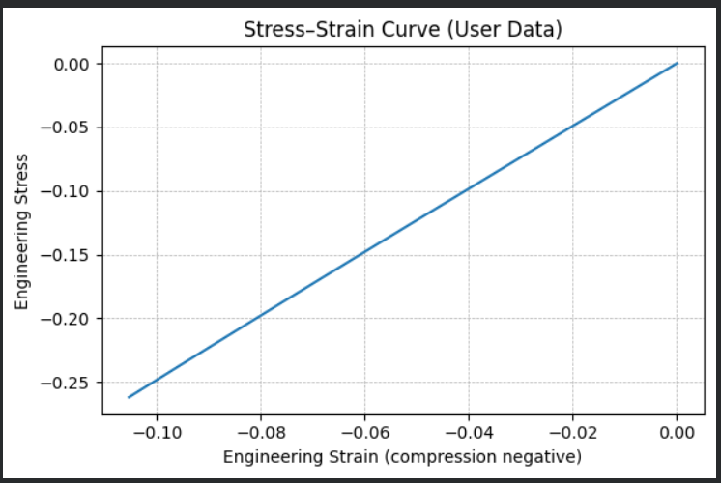
Stress-strain curve

Slide 8
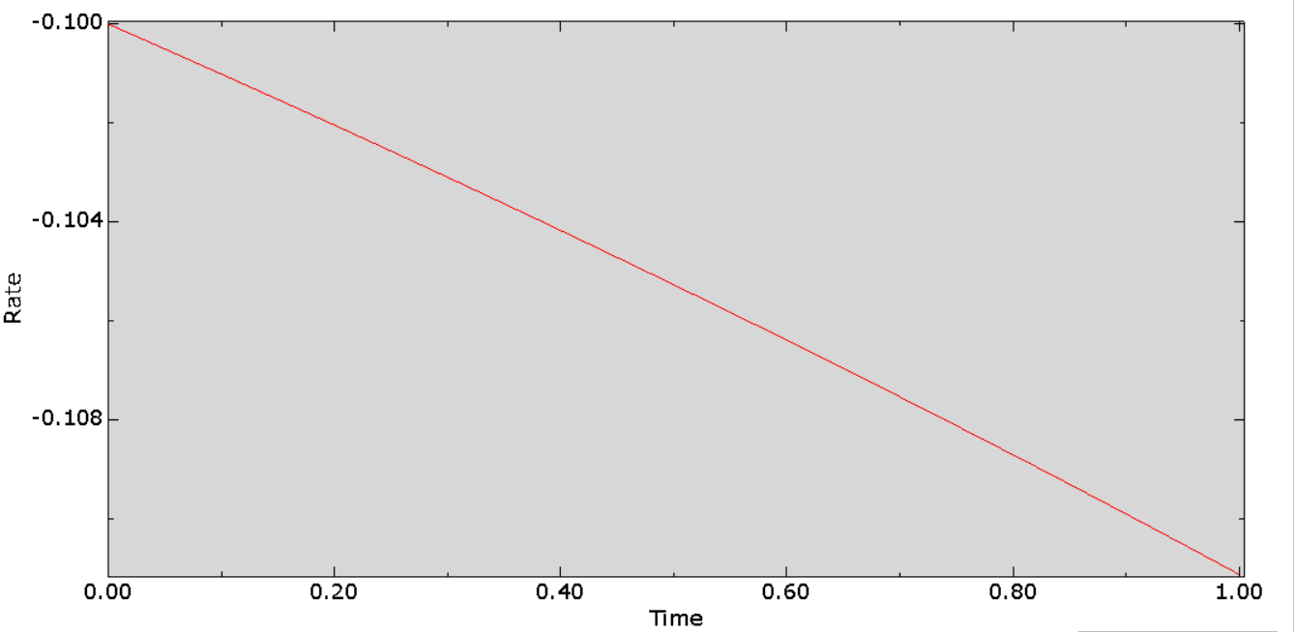
Strain Rate

Slide 9
V= 30mm/s
Simulation didn’t ran; ABAQUS stopped working
V= 150mm/s
V= 900mm/s
Couldn’t run for any higher values of velocity except 3mm/s

Slide 10
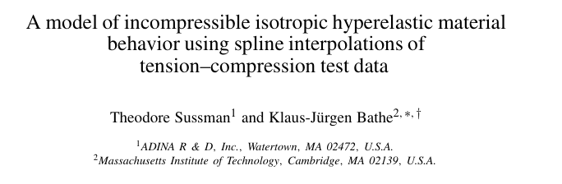
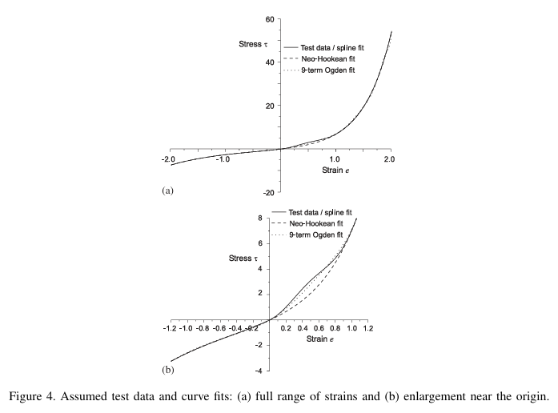
Getting Data – useful papers(but didn’t had data)
Theoretical justification for including compression branch to ensure stability & accuracy
It only illustrates the model with synthetic assumed data (not tied to any physical rubber specimen). These examples cannot be used:
No material identified
No sample geometry
No strain-rate information
No raw numerical values

Slide 11
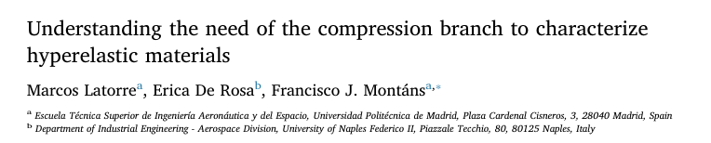
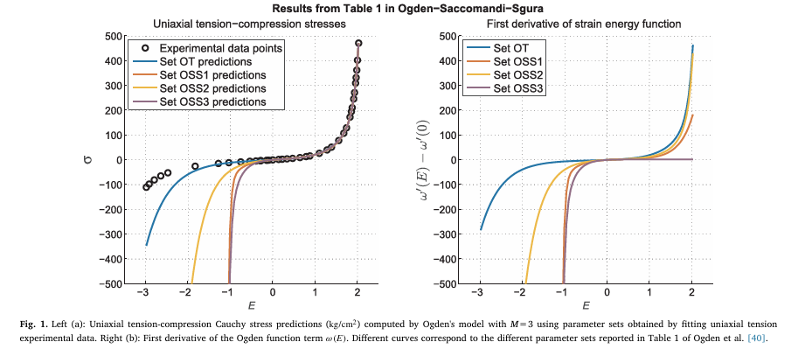
Getting Data
Provides the strongest physical justification for needing compression data
Shows mathematically that tension-only fitting cannot determine energy function uniquely
Demonstrates how missing compression → wrong stress predictions and convergence issues
Explains tension–compression asymmetry as a real material effect
Aligns perfectly with your FE case (rubber under uniaxial compression)

Slide 12
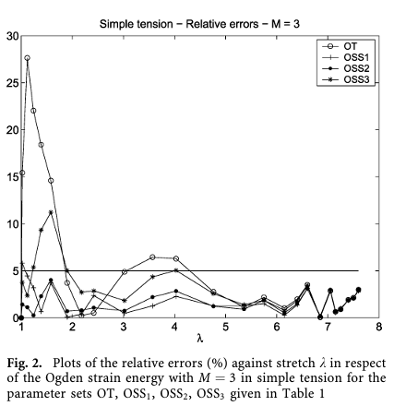
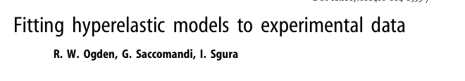
Getting Data
Directly uses Treloar’s experimental dataset, which you are using
Demonstrates best practices for fitting hyperelastic models
Shows real risk of parameter non-uniqueness
Confirms that Ogden N=2 or N=3 is a strong choice for Treloar data
Reason for choosing Ogden model in ABAQUS Simulation

Slide 13
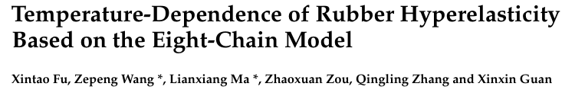
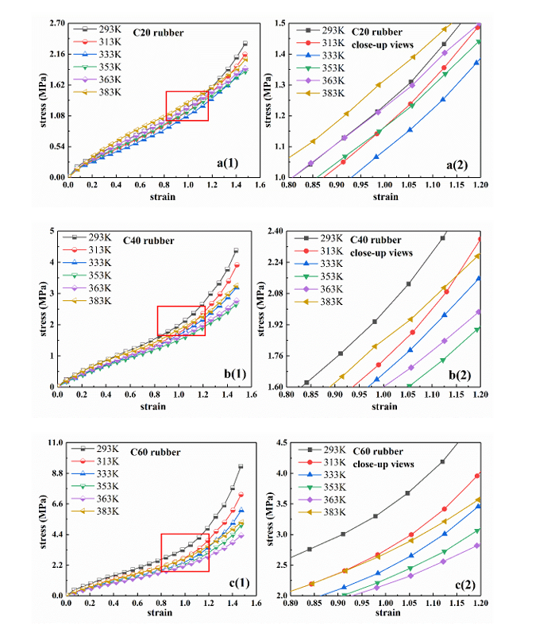
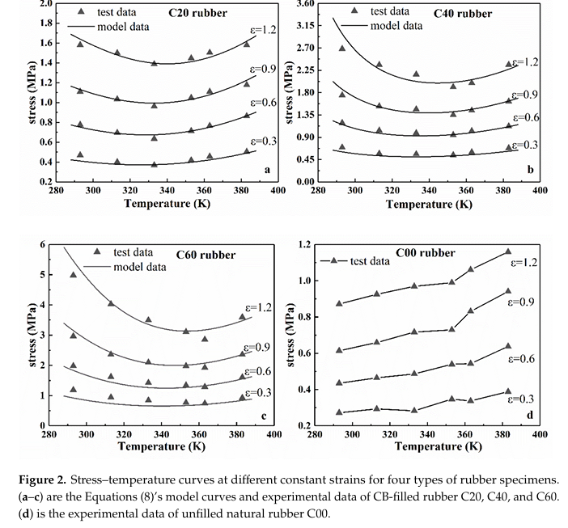
Getting temp-dependent data (couldn’t find for compression)

