Slide 1
SE2042 Operating Systems Lecture 02
Prof.Samantha Rajapaksha
Associate Processor
PhD, M.Sc. B.Sc.(Eng.) Moratuwa

Slide 2
Direct memory access (DMA)
DMA is used to improve the performance of large data transfers.
Use a special-purpose processor (DMA controller).
DMA bypasses CPU to transfer data directly between I/O device and memory.
Concurrently, CPU goes on with other work.
CPU must give command to DMA controller, containing information:
A pointer to the source/address of the data being transferred,
A pointer to the destination/address of the transfer, and
A count of the number of bytes to be transferred.
Handshaking between DMA controller and device controller uses: DMA-request line and DMA-acknowledge line.
Device controller puts a signal on the DMA-request line when a word of data is available for transfer.
Sensing the signal, DMA controller seizes the memory bus, sets the intended address on address bus, and puts a signal on the DMA-acknowledge line.
When the device controller receives the DMA-acknowledge signal, it transfers the data word to memory, and removes the DMA-request signal.
After finishing the entire transfer, DMA controller interrupts the CPU.

Slide 3
DMA (cont.)
Steps:
OS (Device driver) sets DMA controller registers to set source and destination addresses, read/write request, and transfer length.
DMA controller transfers blocks of data from buffer storage directly to main memory without CPU intervention – CPU is free to do other tasks.
DMA controller interrupts CPU after transfer has completed.
Only one interrupt is generated per block rather than one interrupt per byte.
I/O Devices
CPU
Memory
I/O instructions

Slide 4
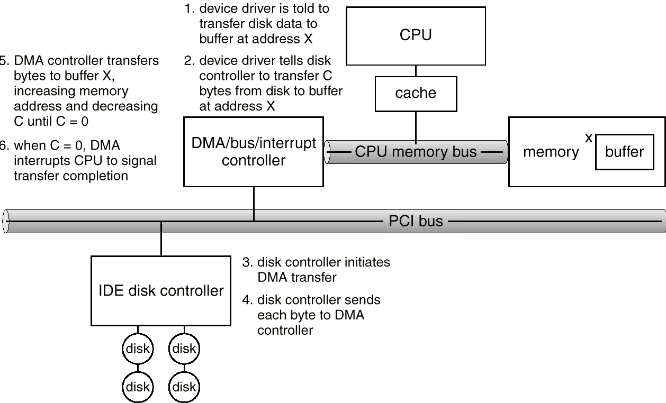
Steps in DMA Transfer Fig. 13.5 (textbook)

Slide 5
Computer-System Architecture
A single-processor system contains only one CPU to execute general purpose instructions
However, it also contains special purpose processors
E.g., disk, keyboard, DMA, graphic controllers
These specialized processors do not run user processes
OS may be able to manage the processors, e.g., task disk controllers to use given scheduling algorithms.
A multiprocessor system contains two or more processors working together
They may share computer bus, system clock, memory, I/O devices
Also called parallel system or multicore system

Slide 6
Multiprocessor (cont. )
Three main advantages of multiprocessor system
Increased throughput: get more work done in less time
The speed up in n processor system is NOT n due to overhead
Economy of scale: I/O devices, memory storage, and power supplies can be shared
Increased reliability: failure of one processor does not make the whole system down
Graceful degradation: the system can perform operations proportional to the level of operations of the surviving parts of the system
Fault-tolerant: the system can continue its function in the event of component failures
Require failure detection, diagnoses, and even correction
May use multiple hardware and software duplicates to execute the same tasks in parallel, and take as output the result from the majority of the duplicates

Slide 7
Multiprocessor (cont.)
Two types of multiprocessor system:
Asymmetric multiprocessing
Symmetric multiprocessing (SMP)
Asymmetric multiprocessing:
Use a master processor to schedule and allocate work to (slave) processors.
Each slave processor waits for instruction from the master or has predefined task
More common in extremely large systems

Slide 8
Multiprocessor Systems (cont. )
SMP – not the master-slave model; a more common system
Each processor runs an identical copy of the OS.
Each processor has its own registers and cache
However, they share the same memory
Many processes can run at once without significant performance deterioration
Need load balancing to improve performance
Symmtric and Asymmetric may be the result of either hardware or software.

Slide 9
Multiprocessor Systems (cont. )
Multicore system is a multiprocessor system but the processors are on a single chip
More efficient because on-chip communication is faster than inter-chip communication
Less power/energy
Note: not all multiprocessors are multicores
Blade servers: multiple processor boards, I/O boards and networking boards are put in the same chassis.
Each processor board boots independently and runs its own OS
Each processor board can be multiprocessors

Slide 10
Clustered Systems
A clustered system consists of multiple CPUs, like multiprocessors
However they are individual systems or nodes
Each node can be a single processor or a multicore
They share storage and communicate via LAN
It offers high-availability service
Beowulf cluster consists of on-the-self hardware, e.g., personal computers, interlinked by LAN
Use open-source software for communication
Typically runs LINUX
Low cost for high performance computing tasks

Slide 11
Multiprogramming
Goal: to increase the CPU utilization
Several jobs are kept in main memory at the same time, and the CPU is multiplexed among them
It needs these OS features:
Job scheduling → OS chooses jobs in the job pool and put them into memory.
Memory management → OS allocates the memory for each job.
CPU scheduling → OS chooses one among the jobs in memory (called processes) that is ready to run.
I/O allocation.
Memory partition
OS
Job 1
Job 2
Job 3

Slide 12
Time-Sharing/Multitasking Systems
Goal: to provide interactive use of computer system at reasonable cost (one computer – several users/jobs).
It is a variant of multiprogramming → but user input is from on-line terminal.
CPU is multiplexed among jobs in memory frequently (≤1 sec?) so that users can interact with their running program.
It needs these OS features:
On-line communication between users and system
When OS finishes the execution of one command, it seeks the next control statement from the user’s keyboard.
On-line file system, for users to access data and code.
Today, most systems provide both batch processing and time sharing.

Slide 13
Real-time Systems
Well-defined fixed-time constraint – the system is functional if it returns the correct result within the time constraint.
Hard real-time system.
Guarantees that critical tasks complete on time.
Often used as a control device in a dedicated application
controlling scientific experiments, medical imaging systems, industrial control systems, and some display systems
Secondary storage is limited or absent
data is stored in short-term memory, or in ROM.
Realtime vs. time-sharing systems?
Soft real-time system
A critical-time task gets priority over others until it completes.
Limited utility in industrial control robotics.
Useful in applications (multimedia) requiring advanced OS features.

Slide 14
Virtualization
Virtualization technology allows an OS to run as applications on other OS
It is a software that includes an emulation that is used when the type of source CPU is different from that of the target CPU
e.g., it allows applications compiled for a IBM power CPU to run on Intel CPU

Slide 15
OS Operation
In multiprogramming, OS must ensure that an incorrect (or malicious) program cannot cause other programs to execute incorrectly.
Many programming errors are detected by the hardware, and the errors are normally handled by the OS.
Dual-mode operation
Hardware provides at least two modes of operations:
User mode – in which user programs run.
Monitor mode, also called Supervisor, System, or privileged mode.
Mode bit is provided by the hardware to indicate the current mode: monitor (0) or user (1).

Slide 16
OS Operation (cont.)
Dual-mode operation (cont.)
Some machine instructions that may cause harm are designated (by hardware) as privileged instructions.
E.g., the MSB of the machine code of the instruction is a bit ‘0’
A privileged instruction can be executed only in monitor mode.
At system boot-time the hardware starts in monitor mode → OS is loaded.
OS starts user processes in user mode; a user process could never gain control of the computer in monitor mode.
When an interrupt or fault occurs hardware switches to monitor mode.
Set user mode
monitor
user
Interrupt/fault

Slide 17
OS Operation (cont.)
I/O
All I/O instructions are privileged instructions.
How does the user program perform I/O ? Use system call.
Usually takes the form of a trap to a specific location in the interrupt vector.
Control passes through the interrupt vector to a service routine in the OS, and the mode bit is set to a monitor mode.
The monitor verifies that the parameters are correct and legal, executes the request, and returns control to the instruction following the system call.

Slide 18
OS Operation (cont.)
Memory
System must provide memory protection at least for the interrupt vector and the Interrupt Service Routine.
Use two registers that determine the range of legal addresses a program may access:
Base register – holds the smallest legal physical memory address.
Limit register – contains the size of the range.
Memory outside the defined range is protected.
The load instructions for the base and limit registers are privileged instructions.
OS has unrestricted access to monitor and user memory.

Slide 19
OS Operation (cont.)
CPU
System must prevent one user program using CPU all the time
Because of getting stuck in an infinite loop, or non-fair users
Use timer interrupt after specified period to ensure OS maintains control
Timer is decremented every clock tick.
When timer reaches value 0, an interrupt occurs.
Timer is commonly used to implement time sharing.
Timer is also used to compute the current time.
Loading timer value is a privileged instruction. Why?

Slide 20
System Calls
A system call is a user interface to the OS services
Available in assembly-language instructions or in high level languages for systems programming (e.g., C)
E.g., fork () is a system call to ask OS to create a new process
Application Program Interface (API): a set of functions available to an application programmer.
An API typically invokes the actual system calls for the application programmers.
Examples of API: Windows API, POSIX API, Java API
API is more portable and simpler to use
Figure 2.5 (Textbook)

Slide 21
System Calls (cont. )
A system call is known by its number
System call interface maintains a vector table which stores pointers to system call routines
System call interface intercepts each API and calls all corresponding system calls to handle the API
System call result/termination.
Normal termination (exit or return).
Terminate current program and return to the command interpreter.
Abnormal termination (trap) ⎯ program error.
How to pass parameters to OS?
In registers
In a block of memory or table – for many parameters
In a stack
Figure 2.6 (Textbook)

Slide 22
System Calls (cont. )
Types of system calls
1) Process control
End, abort (running program); Load, execute; Create, terminate; Signal event, etc.
Examples: fork(), exit(), wait(), etc.
2) File management
Create, delete; Open, close; Read, write, reposition; Get and set file attributes, etc.
Examples: open(), read(), write(), close(), etc.
3) Device management (memory, tape drives etc.)
Request device; Release device; Read, write, reposition, etc.
Examples: ioctl(), read(), write(), etc.
4) Information maintenance
Get or set time or date; Get or set process attributes, etc.
Examples: getpid(), alarm(), sleep(), etc.
5) Communications
Create, delete communication connection; Send and receive messages, etc.
Examples: pipe(), shmget(), mmap(), etc.
6) Protection
Resource access control
Examples: chmod(), umask(), chown(), etc.

Slide 23
System programs or utilities
Provide a convenient environment for program development and execution
Most users’ view of the OS is defined by system programs, not the actual system calls.
Some of them are simple user interface to system calls.
System programs can be divided into:
File manipulation: Create, delete, copy, rename, print, dump, list.
Status information: Date, time, memory, disk space, number of users.
File modification: Text editors to create and modify content of files.
Programming-language support: Compilers, interpreters, assemblers.
Program loading and execution: Absolute, Relocatable, Overlay loaders.
Communication: Programs that provide the mechanism for creating virtual connections among processes, users, and different computer systems.

Slide 24
OS Structures
A system as large and complex as a modern OS must be designed carefully such that it can function properly and be modified easily.
Various structures:
Simple Structure/Monolithic
Layered Approach
Microkernels
Modules

Slide 25
Simple Structure
No well-defined structures.
MS-DOS - written to provide the most functionality in the least space.
It is not divided into modules
Although MS-DOS has some structure, its interfaces and levels of functionality are not well separated
MS-DOS layer structure
Application program
Resident system program
MS-Dos device drivers
ROM BIOS Device drivers

Slide 26
UNIX system structure
(the users)
Shells and commands Compilers and interpreters System libraries
System call interface to the kernel
Signals terminal handling Character I/O system Terminal drivers | File system Swapping block I/O Disk/tape drivers | CPU scheduling Page replacement Demand paging Virtual memory
Kernel interface to the hardware
Terminal controllers Terminals | Device controllers Disks and tapes | Memory controllers Physical memory
The original Unix OS was limited by hardware functionality
it had limited structuring.
The UNIX OS consists of two separable parts:
System programs
Kernel
Kernel consists of everything below the system-call interface and above the physical hardware
It provides the file system, CPU scheduling, memory management, and other operating-system functions;
It contains many functions in one level → difficult to implement and maintain.

Slide 27
Layered approach
The OS is divided into a number of layers (levels), each built on top of lower layers. The bottom layer (layer 0) is the hardware, and the highest (layer N) is the user interface.
With modularity, layers are selected such that each layer uses functions (operations) and services of only lower-level layers.
A layered design was first used in the THE (Technische Hogeschool Eindhoven) operating system.
Advantage: Modularity → easy to debug
Disadvantage: less efficient, hard to define level functionality.
Six layers
Layer 5: User programs
Layer 4: Buffering for input and output devices
Layer 3: Operator-console device driver
Layer 2: Memory management
Layer 1: CPU scheduling
Layer 0: Hardware

Slide 28
Microkernel
Smaller-sized kernel → only provides minimal services such as process and memory management, and communication.
Put non-essential components of kernel as system/user programs
Kernel function: as a communication facility between a client and the OS services using message passing.
Advantages:
Easier to extend OS
More portable
Better security and reliability
Disadvantages:
Using message passing increases system function overhead → reduce performance
Examples: Mach (CMU), Mac OS X kernel (Darwin), Digital Unix,

Slide 29
Modules
Modular kernel - current method
Use Object-oriented programming techniques
Kernel has a set of core components.
Add additional modules (e.g., Scheduling, device drivers, file systems) during boot/run time to kernel.
Like a layered system but more flexible
Any module can call any other module
Like a microkernel but more efficient
Modules do not need message passing
Examples: Solaris, Linux, Mac OS X.

