Slide 1
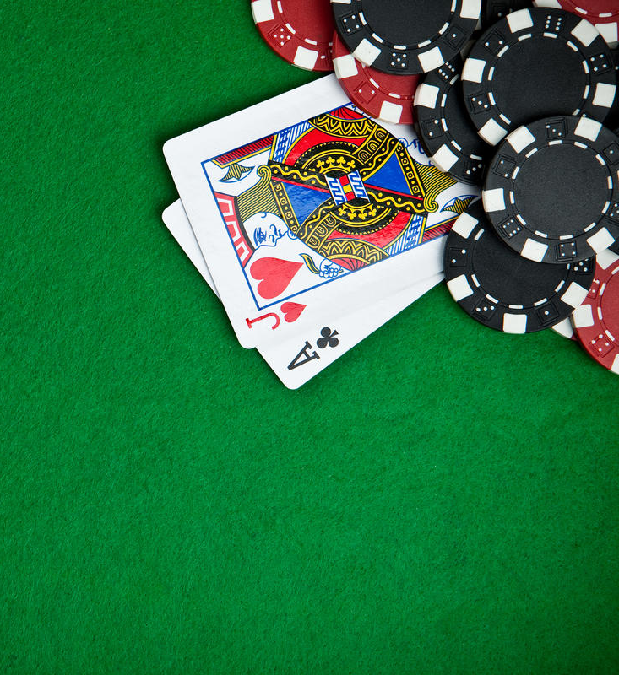
Texas Holdem Sprint 2
Maoan Wang
Yi Yang
Shiqi Jia- Product Owner

Slide 2

Improvements | TaskID | Task | Task Owner
Draft and implement the data model to ensure the data integrity in case user is disconnected from the server. | 1.1 | Server Side | Maoan Wang
 | 1.2 | Cleint Side | Shiqi Jia
Users can choose to fold or check for each round. | 2.1 | Server Side | Yi Yang
 | 2.2 | Clock function | Yi Yang
 | 2.3 | Client Side | Shiqi Jia
 | 2.4 | Data Model | Yi Yang
 | 2.5 | UI update | Maoan Wang
 | 2.6 | Room creation | Maoan Wang
Additional User functions: Game Helper Page and Room Selection | 3.1 | Room Display and Selection | Shiqi Jia
 | 3.3 | Game Helper Page | Yi Yang
Users are able to play games with other users. | 4.1 | Server Side | Maoan Wang
 | 4.2 | Client Side | Shiqi Jia
 | 4.3 | Web Socket | Yi Yang
 | 4.4 | Data Model | Maoan Wang

Slide 4
Sprint3
Call Check Function | User can choose to call or check in game
Chat Room | Users can chat during the game
Ranking Page | Ranking page will show the users with top accumulated chips
Deploy game on AWS | Deploy game on cloud
UI Improvement | Improve UI
Function Improvement | Improve and modify current Functions

