Slide 1
Relational model Checkpoint
Ajmi Wissal

Slide 2
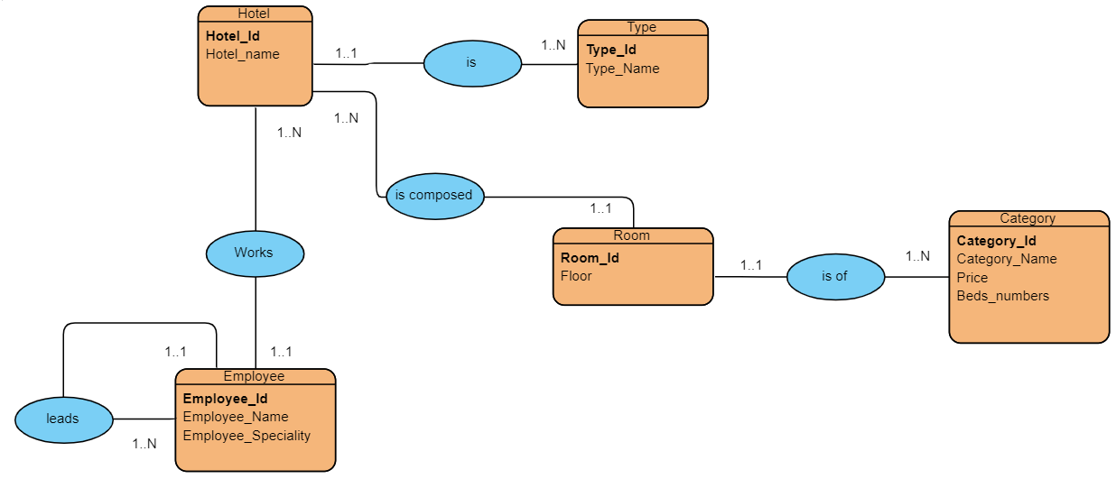

Slide 3
Convert the entity relationship model to a relational diagram
HOTEL(Hotel_id, Hotel_name, #Type)
Type(Type_id, Type_name)
Room(Room_id, Floor, #Hotel, #Category)
Category(Category_id, Category_name, Price, Beds_numbers)
Employee(Employee_id, Employee_name, Employee_speciality, #Hotel, #lead_id)

