Slide 1
Car Pooling
Rona Elias
Jad Daher
Nader Bouhamdan

Slide 2
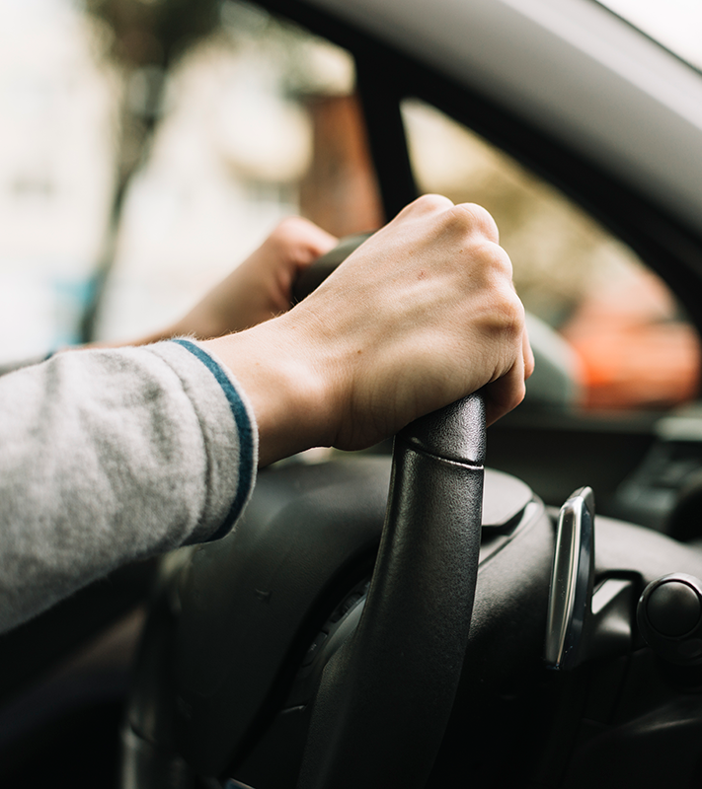
01
Iterator Design Pattern

Slide 3
User Interface
02
Technologies Used:
1
Scene Builder
2
JavaFX

Slide 4
HashMap
03
Data Structure:

Slide 5
Lessons Learned
04
Group Work
User Interface
Database

