Slide 1
Getting creative with autoencoders
Tijmen Tieleman, CEO & CTO at minds.ai
WiSSAP 2019, Trivandrum

Slide 2
Overview
This is a fairly general talk
Application-agnostic
General ideas, rather than recent research
This is a fairly specialized talk
It’s about Deep Learning
More specifically: representation learning
More specifically: unsupervised representation learning
More specifically: autoencoders

Slide 3
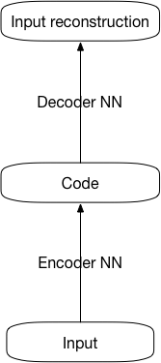
Autoencoders
Training objective: reconstruct the input
Components: encoder and decoder
Usual purpose: representation learning
Generative view: variational autoencoders
Components: encoder and decoder generator
Flexible
Get creative with encoder and/or generator
Interpretable codes can be arranged
Code units are only partially hidden units

Slide 4
Clustering
“k means”
K means as an (odd) autoencoder
Encoder (not NN)
Generator (constant for each cluster)
Implicit assumption
More powerful generator: non-trivial covariance
Different implicit assumption

Slide 5
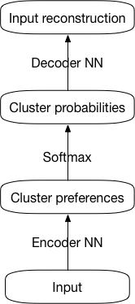
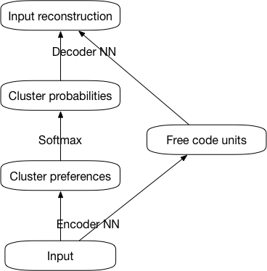
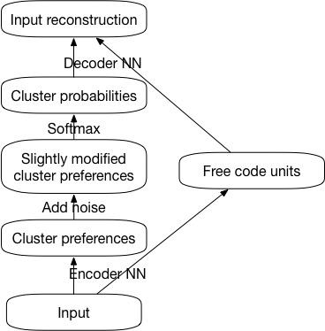
Clustering autoencoder
With free code units and discretization
Naïve
With free code units

Slide 6
Intermission: a few minutes for questions about the past few slides.

Slide 7
Getting creative with autoencoders
Clustering autoencoder
Ignoring autoencoder
Binarizing autoencoder
Biased autoencoder
Computer graphics autoencoder
Independent features autoencoder
Etc
Feel free to combine

Slide 8
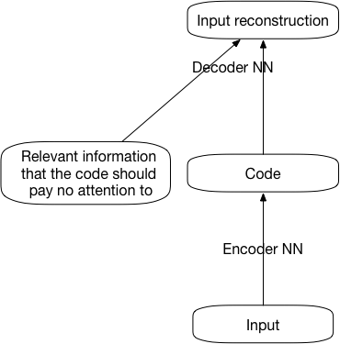
Ignoring autoencoder
Goal: code that ignores some information
E.g. ignoring speaker information
E.g. ignoring the spoken text
Application: focusing on essentials
Application: domain adaptation
Application: anti-discrimination
Application: reconstructing with different information
Method 1: provide that information to the decoder
Method 2: insist that the to-be-hidden information cannot be reconstructed

Slide 9
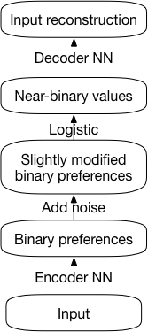
Binarizing autoencoder
Goal: binary code
Application: ”semantic hashing”
Application: extreme compression (lossy)
Method: use discretization noise on a bank of logistic code units

Slide 10
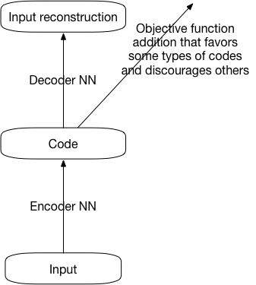
Biased autoencoder
Goal: codes that tend to be of certain kinds
E.g. a softmax with 2 commonly used units and 10 rarely used ones.
E.g. binarizing and preferring sparsity
Method: simply push in the objective

Slide 11
Intermission: a few minutes for questions about the past few slides.

Slide 12
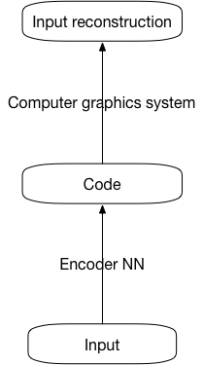
Computer graphics autoencoder
More generally: domain-specific generator
E.g. audio synthesis autoencoder
Goal: highly interpretable codes
Goal: help the encoder understand the nature of images
Application: reverse rendering, for “image parsing” or as preparation for generating image variants
Application: using the better encoder as a good featurizer
Method: replace the generator

Slide 13
Computer graphics as generator
Problem: it has to be differentiable
Solution 1: implement a reduced CG system in TensorFlow
Weakness: “reduced” is unfortunate
Nice: it can contain learnables
Solution 2: learn a second NN to approximate a real CG system; backpropagate through the approximation
Weakness: approximations are a pain
Nice: it has the potential for full CG
The codes still have to be continuous

Slide 14
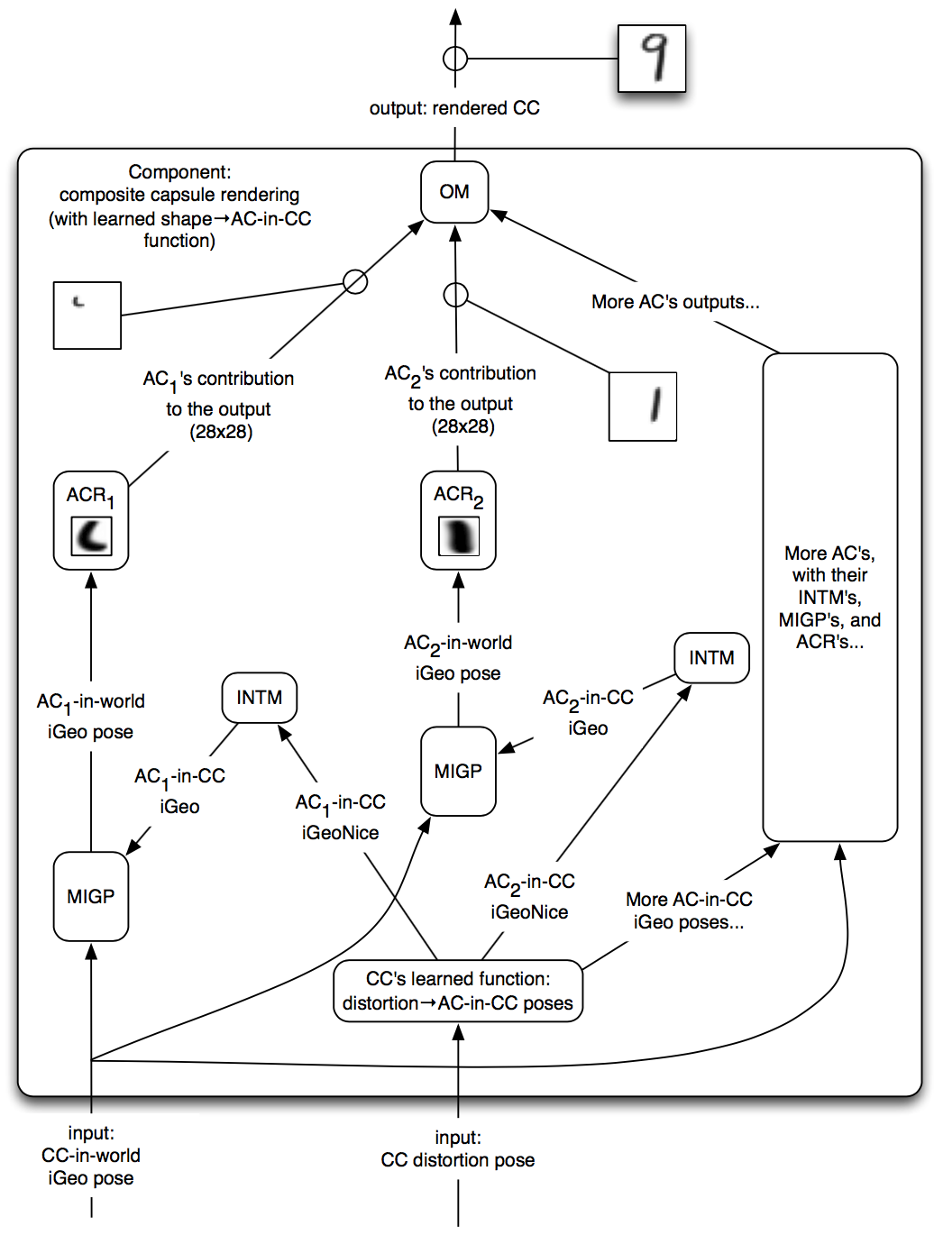
PoC: graphics for MNIST
Uses “capsules”
Learned constant: small image templates
Learned function: free code unit values → affine transformation for the templates
Hard-coded function: apply affine transformations to the templates
Affine transformed templates are added together to create final output

Slide 15
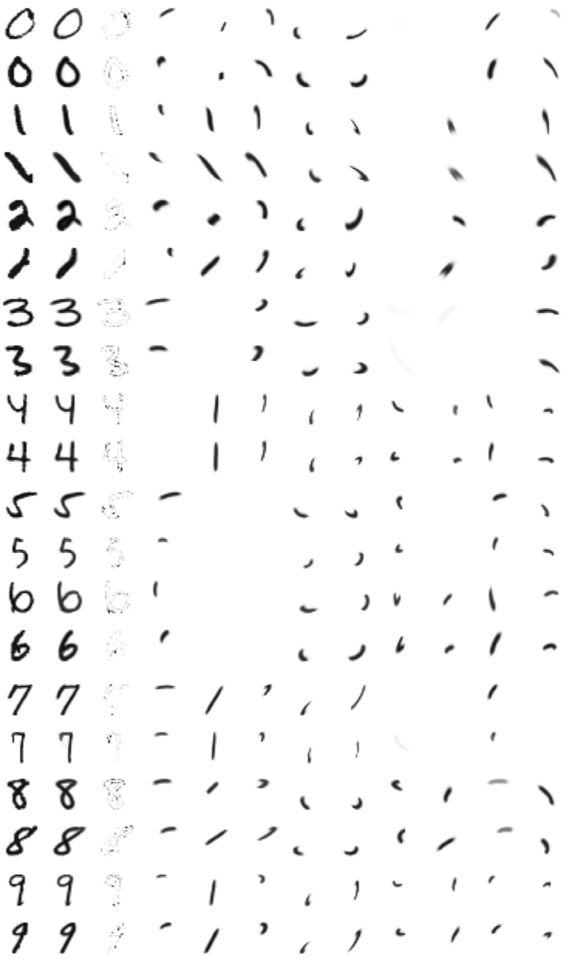
PoC: graphics for MNIST
Uses “capsules”
Learned constant: small image templates
Learned function: free code unit values → affine transformation for the templates
Hard-coded function: apply affine transformations to the templates
Affine transformed templates are added together to create final output

Slide 16
Clustering MNIST
K means clustering wouldn’t work well: the generator is too primitive
We need a more powerful generator
It has to understand that a shifted image is still about the same image
Let’s use this computer graphics generator
Unsupervised clustering into 25 clusters
Good classification accuracy with just 25 labeled cases

Slide 17
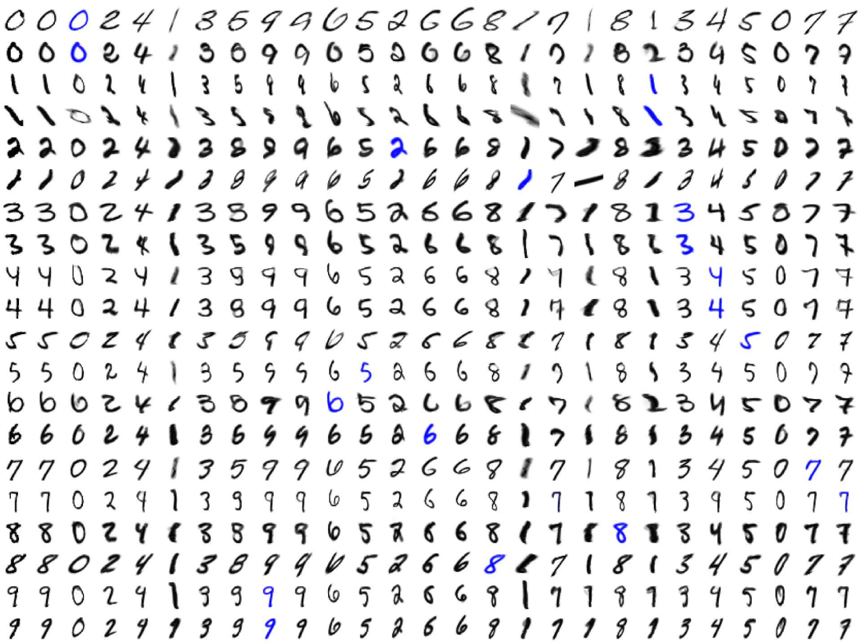

Slide 18
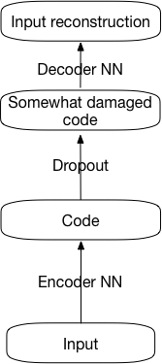
Independent features autoencoder
Goal: code components that are somewhat independently interpretable
Application: identifying the patterns in the data
Application: generating data variants with a higher chance of meaningful results
Method: apply dropout to the code components

Slide 19
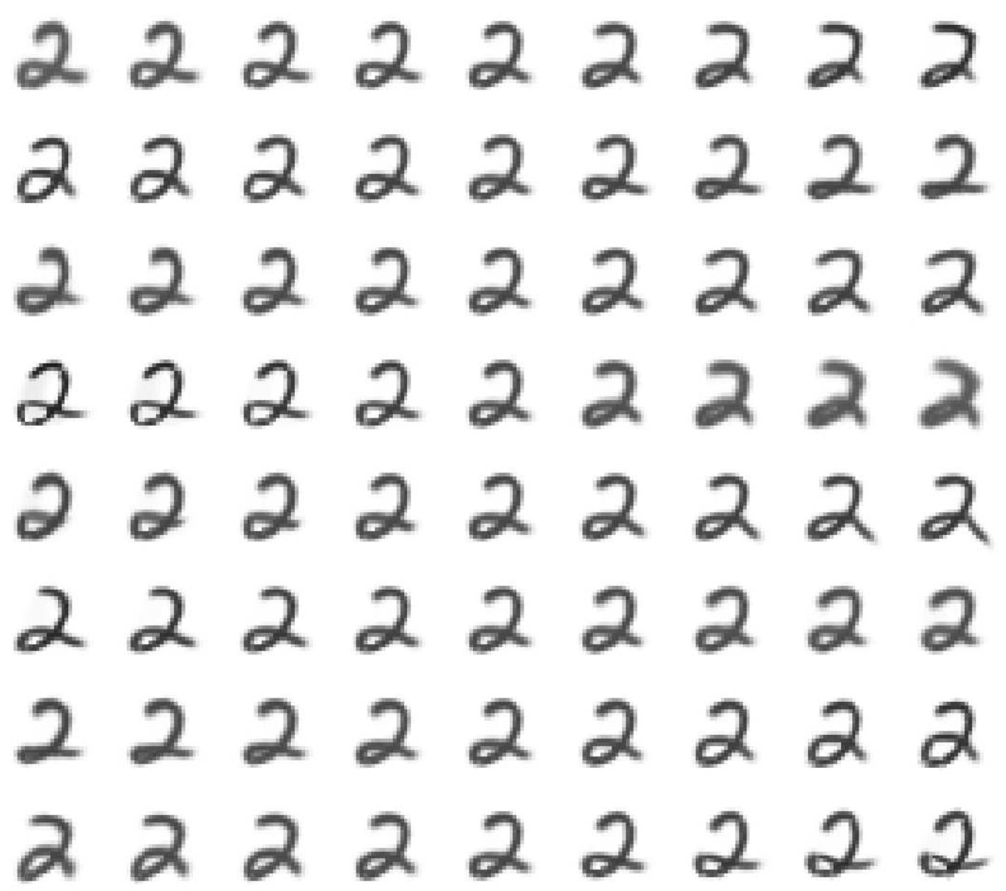
Independent features
← Feature value →
This focuses on one image (see the central column)
This shows data variants by varying one feature at a time
The 8 features are clearly somewhat independent
The variants are meaningful
← Feature index →

Slide 20
Tools for crafting specialized autoencoders
Impose some structure on the code
E.g. clustering autoencoder, computer graphics autoencoder
Apply deterministic editing to the code
E.g. ignoring autoencoder
Apply random editing to the code
E.g. binarizing autoencoder, clustering autoencoder, independent features autoencoder
Apply an objective function addition to the code
E.g. sparse binarizing autoencoder
Hard-code (part of) the generator
E.g. computer graphics autoencoder

Slide 21
Conclusion
Creating custom specialized autoencoders is doable
There is a collection of basic tools for this
This can improve interpretability and learning power
Next stage for DL: combining learnable and hard-coded components
Learnable components provide “intuition”
Hard-coded components provide the power of computation
Either alone is quite limited
AlphaGo has hard-coded as main() and learnable as subroutine
The CG autoencoder has learnable as main() and hard-coded as subroutine

Slide 22
Thank you

