Slide 1
CS Task01 – First Analysis
27.09.13
Ivan Wissler, Patrizia Zehnder, Faton Shabanaj, Sviatlana Sianko, Ranjit Kalarickamakel und Michael Heeb

Slide 2
CS Task01 – First Analysis
1. Target users
Clinical staff → doctors, nurses, health visitors
Receptionists
Medical records staff

Slide 3
CS Task01 – First Analysis
2. Key features
Clinical staff needs to have information about treatments, appointments, prescriptions and medication regarding mental health issues of all patients and need to be able to modify it.
Receptionists need access to appointment-data and should be able to change it.
Medical records staff provides information to health service managers and the hospital management.

Slide 4
CS Task01 – First Analysis
3. Critical success factors
Usability: Include users in software development to make it user – friendly; Different GUI’s for different users
Privacy: Data Protection of personal and medical information
Testing: Regularly testing after changes

Slide 5
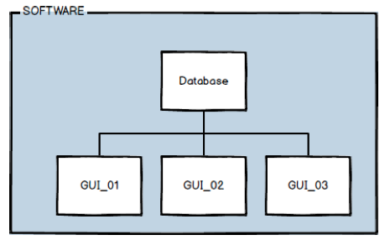
CS Task01 – First Analysis
4. Potential system components and architecture
One software with different user interfaces for every professional group. One database to store all of the information. Specified user rights.

Slide 6
Herzlichen Dank!

