Slide 1
Task 9 & 10
Faton Shabanaj, Swetlana Sianko

Slide 2
Inhalt
Package Diagram
Scrum
Organisation
Product Backlog
Sprint Backlog
Burndown Chart

Slide 3
Package Diagram

Slide 4
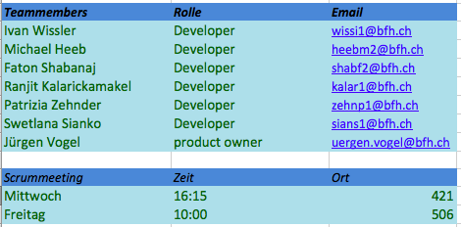
Organisation

Slide 5
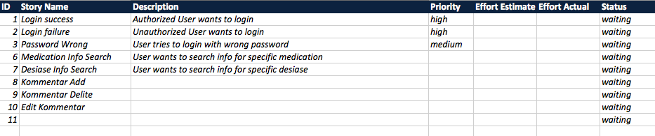
Product Backlog

Slide 6
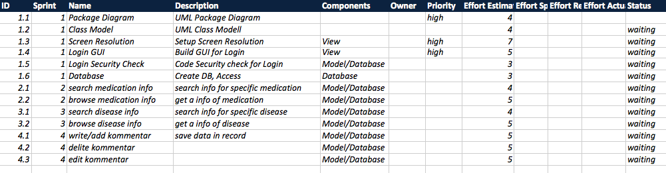
Sprint Backlog

Slide 7
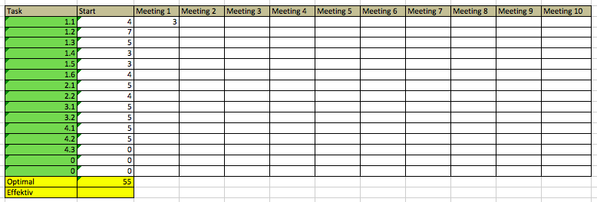
Burndown Chart

Slide 8


