Slide 1
CS Task02 – SE Process
27. Sept. 2013, Team Red
Ivan Wissler, Patrizia Zehnder, Faton Shabanaj, Sviatlana Sianko, Ranjit Kalarickamakel und Michael Heeb

Slide 2
Decide whether your SE Process for implementing the MHC- PMS should be rather plan- driven or agile
Pro agile
Since we have sufficient resources we can get as much feedback as we need
use good tools to support system development
Medium – size software project
The team is small and is able to communicate well and easy

Slide 3
Decide whether your SE Process for implementing the MHC- PMS should be rather plan- driven or agile
Pro plan – driven
The project requires quite detailed specification and design before implementation
The expected system lifetime is long
All team members aren’t highly skilled programmers
Safety requirements
Because of these points we decided to take a combo between plan – driven and agile for our project.

Slide 4
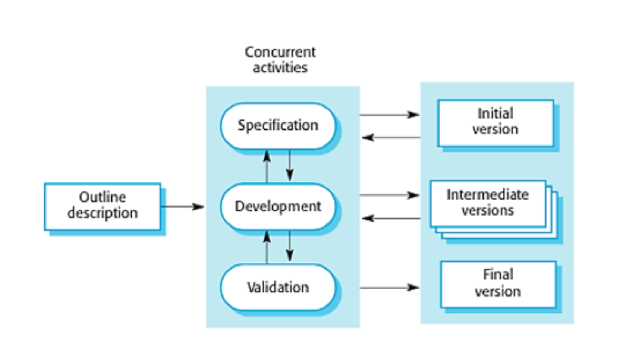
Process model

Slide 5
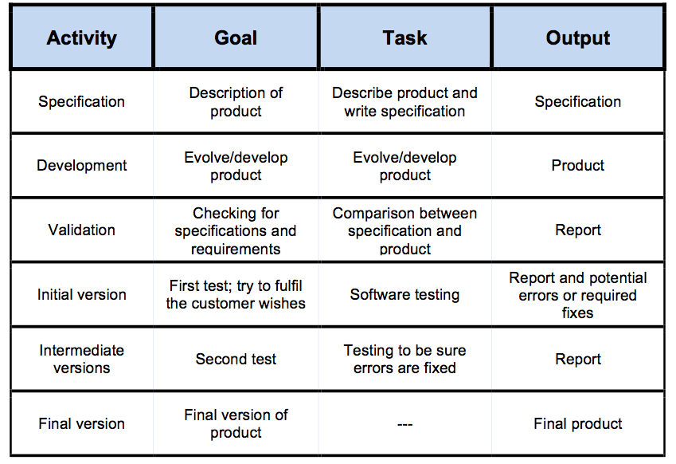
For each activity the goals, tasks and potential output(s)

Slide 6
Relation among outputs of different activities
The requirements of the customer are written down in the specification
This document is required to start developing a product.
After development but still before the first test, Validation takes place. This is to be sure that all the requirements are implemented.
After testing the initial version errors get fixed and missing demands are added.
The final version has to fulfil all the needs of the client.

Slide 7
Involvement of stakeholders
The customer gets involved with the management to give details about the concrete requirements.
The management gets involved with the development team to hand over the wishes and plans of the customer.
The development team is during development involved with the client to talk about his presented challenges and also with the users in the context of testing and feedback.

Slide 8
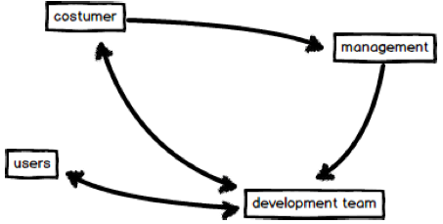
Involvement of stakeholders

Slide 9
Herzlichen Dank!

