Slide 1
Replication, Aggregation, Federation, Sharding?!
Stefan Wiedemann
FIWARE Foundation
October 2021

Slide 2
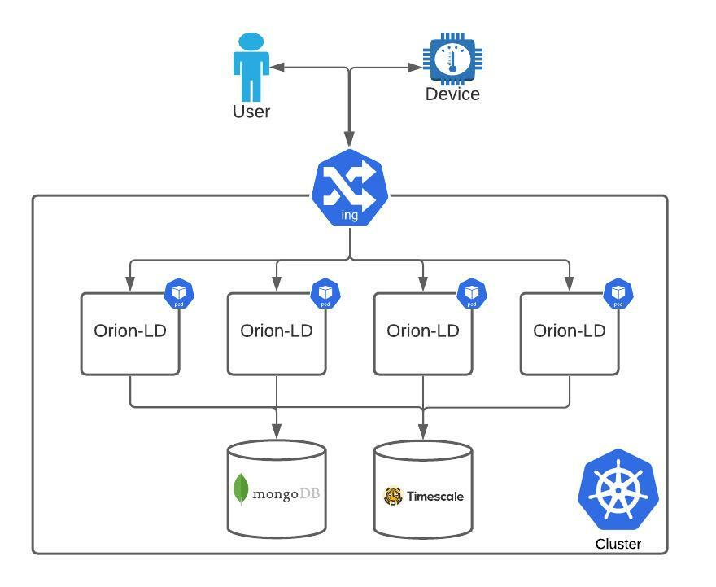
Replication

Slide 3
Replication
Deployment approach that ensures availability and enables horizontal scaling
Multiple instances of the Orion-LD Broker are deployed in parallel, talking to the same database-instances(mongoDB and timescaleDB)
Load-balancer distributes traffic (usually) equally through the instances
In kubernetes:
  Orion-LD is deployed as a replica-set with multiple pods
  Connected through the internal networking to the DBs(often also running inside the same cluster)
  External traffic through the ingress-controller, distributed to the pods

Slide 4
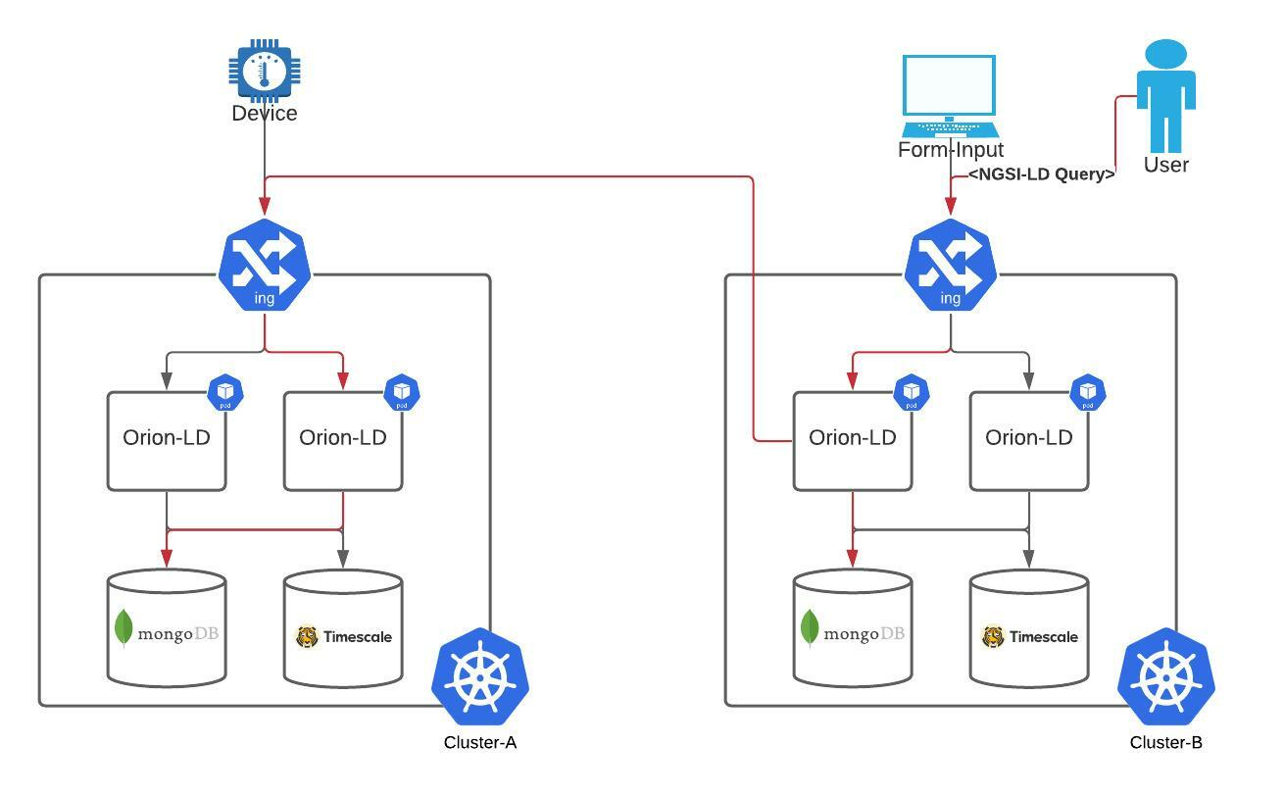
Federation

Slide 5
Federation
Multiple brokers are deployed to (potentially) multiple clusters
The individual brokers can be deployed in any potential mode(replication, sharding, single instance etc.), can be different between them
Each broker talks to its own database
The brokers receive different data, store them in their individual databases
Retrieval/Query requests are handled by each broker by:
  Retrieving the requested data from its own database
  Requesting the other broker, retrieving the data stored there
  Responding with the data from both brokers

Slide 6
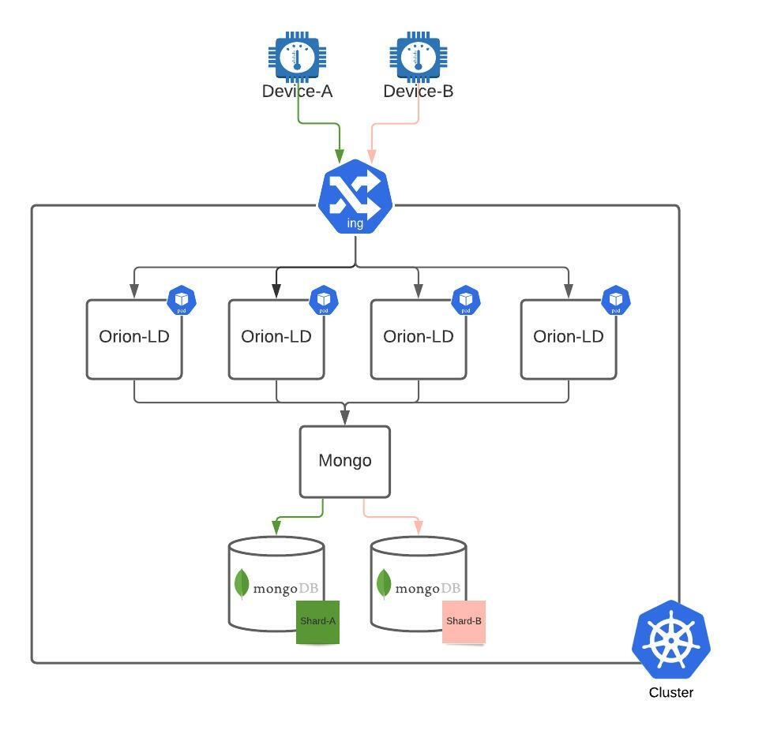
Sharding

Slide 7
Sharding
Deployment method for databases, focused on load-distribution
A single logical dataset is splitted through multiple database instances
Data-sharding:
  Data insertion through the same Orion-LD(usually replicated)
  Mongo-Daemon receives the data, splits them on a predefined “sharding-key”(f.e. deviceId)
  Mongo-Daemon forwards data to the individual database instances(“shards”)
Requests distributed by the sharding key to the individual shards
“Cross-shard” requests are handled by the daemon and the results are combined there, more expensive than single-shard requests

Slide 8
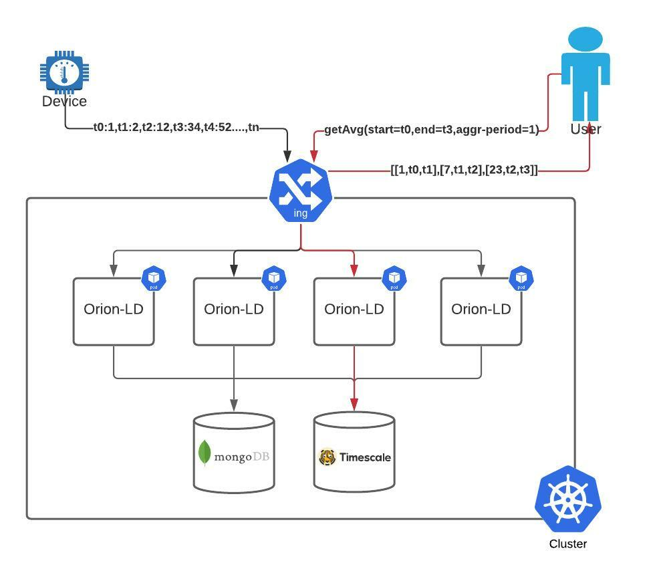
Aggregation

Slide 9
Aggregation
Feature of the NGSI-LD temporal operations, defined in spec >=1.4(see chapter 4.5.19)
Requested data is aggregated in defined time-buckets
Example:
  A device sends raw data with number values
  Aggregation “avg” is requested between t1-t10, aggregation period is requested to be 5 min
  Broker will respond with the average number for every 5 min bucket inside that hour(e.g. 24 entries if the delta between t1 and t10 is 2 h)

